Slide 1

Evaluation/Performance Metrics
Rayid Ghani and Kit Rodolfa

Slide 2
Reminders
Coming up next week:
Monday: Project Update 2
Tuesday: Weekly Feedback Form
Wednesday: Deep Dive Session on Modeling and Validation Plans

Slide 3
Project Update 1 Review
Formulation – first of every month?
Base rate – definition and keeping parallel with label
Commonsense Baselines – what makes sense here?

Slide 4
Discussion Question
What validation strategy is your group using for the Donors Choose project?

Slide 5
Scope
Data
Exploration
Modeling
Get Data
Store Data
Link Data
Rows
Features
Labels
Model Selection
Train-Test Splits
Performance Metrics
Model Interpretation
Entities
temporal
Spatial
…
Models
Dealing with Bias and Fairness
Field Trial Design
Deployment
Monitoring
Goals, Actions, Data, Analysis, Ethics

Slide 6
How to solve a prediction problem
Define and Create Rows (unit of prediction)
Define and Create Label (outcome/target variable – what event and when?)
Define and Create Features (features/predictors)
Create Training and Validation/Test Sets
Train model(s) on Training Set(s)
Validate model(s) on Validation/Test Set(s)
Select “best” model

Slide 7
What is the goal of model selection?

Slide 8
What is the goal of model selection?
You’ve run a large number of different types of models varying …
You need to understand what types of models are effective under what circumstances, and
You need to decide which one(s) to use in the future

Slide 9
What do we need our selected model to do?

Slide 10
What do we need our selected model to do?
Perform well
What metric?
Compared to what?
Generalize
To what?

Slide 11
Performance Metrics

Slide 12
Score Distribution on the Test Set
# of people
Score

Slide 13
Evaluation - Metrics
Predictions are often scores between 0 and 1
We need to first turn them into 0 or 1 by selecting a threshold
Predicted Class
 | Yes | No
Yes | True Positives (TP) | False Negatives (FN)
No | False Positives (FP) | True Negatives (TN)
Actual Class
Notes:
Not comparable, not probabilities

Slide 14
Evaluation – Metrics (at a threshold k)
Accuracy = (TP + TN) / (TP + TN + FP + FN)
Precision (aka PPV: Positive Predictive Value) = TP / (TP + FP)
Recall (aka Sensitivity, TPR) = TP / (TP + FN)
Specificity = TNR
Predicted
 | Yes | No
Yes | True Positives (TP) | False Negatives (FN)
No | False Positives (FP) | True Negatives (TN)
Actual

Slide 15
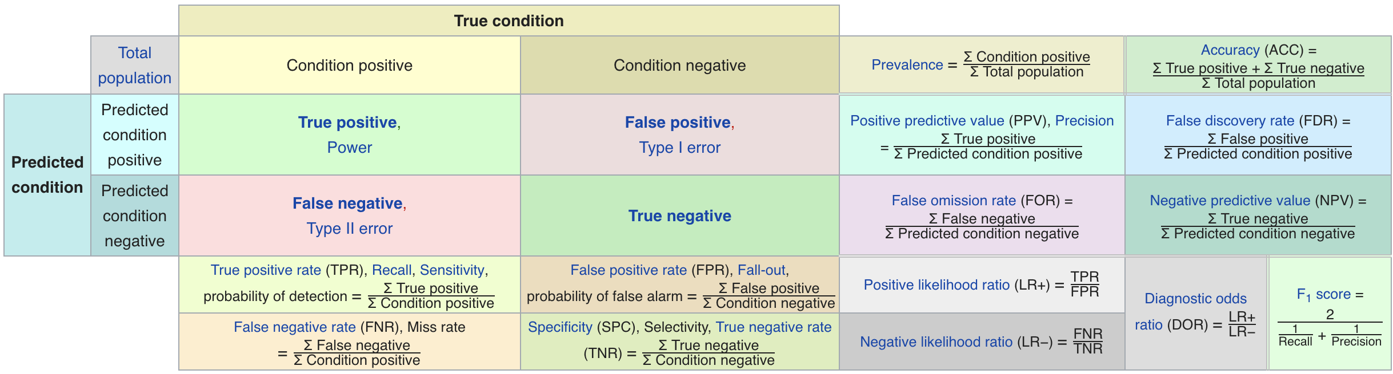
Confusion Matrix-based Metrics Cheatsheet
Source: https://en.wikipedia.org/wiki/Sensitivity_and_specificity

Slide 16
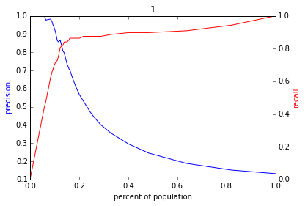
Varying the Threshold
Score
1 .9 .8 .7 .6 .5 .4 .3. .2 .1
| | | | | | | | | |
Baseline

Slide 17
ROC Curve
Receiver Operator Characteristic Curve

Slide 18
AUC (Area Under Curve)
Overall measure of performance
1 if all 1s are ranked above all 0s
0 if all 0s are above all 1s

Slide 20
AUC – Area Under Curve
If you care about the entire space

Slide 21
Evaluation - Baselines
Random according to the base rate/class prior
What they do today
What they could easily do today (without much if any ML)

Slide 22
Discussion Question
What would be some potential strategies for integrating considerations around fairness in the process of model evaluation and selection?

Slide 23
Reminders
Coming up next week:
Monday: Project Update 2
Tuesday: Weekly Feedback Form
Wednesday: Deep Dive Session on Modeling and Validation Plans

