Slide 1

Machine Learning in Practice
Rayid Ghani and Kit Rodolfa

Slide 2
What do you want/expect to learn from this class?

Slide 3
Why does this class exist?

Slide 4
What we want you to learn from this class
How to responsibly and effectively solve real-world problems using ML
Understand the *entire* Machine Learning process (and get hands-on experience doing most of it)
Build (and use) reusable ML pipelines
Learn how to formulate ML problems, use, understand, evaluate, and communicate ML methods (that you have covered in earlier classes) in the context of a real problem

Slide 5
How is this course different than typical ML classes you’ve taken before?
We’ll assume everyone knows
Methods/algorithms/models
Assumptions behind them
How to implement them
And focus on everything else that comes before the matrix and after the models are built (99% of the work done in a real-world project)

Slide 6
Grading
Pass/Fail
We want the focus to be on learning and not on the grade.
Levels of learning
Exposed to information covered in this course
Applying the information (correctly) covered to the class project
Generalizing to the next ML problem you tackle

Slide 7
Pre-requisites
Machine Learning (methods and overall process)
Python (pandas, sklearn, tensorflow, matplotlib)
Ideally: experience with SQL, command line (bash), git(hub), working on remote servers

Slide 8
Skills needed to solve real-world problems (with ML)
Computer Science &
Programming
Statistics
Classes
Social Sciences

Slide 9
Skills needed to solve real-world problems (with ML)
Computer Science &
Programming
Problem
Formulation
Statistics
Communication
REAL
WORLD
Social Sciences
Ethics &
Legal Issues
Experimental
Design
Notes:
For ML students, previous iterations of this class probably involved some readings and assignments in each of these areas. This semester, we’re taking a more hands-on project-focused approach.

Slide 10
Scope
Data
Exploration
Modeling
Get Data
Store Data
Link Data
Rows
Features
Labels
Model Selection
Train-Test Splits
Performance Metrics
Model Interpretation
Entities
temporal
Spatial
…
Models
Dealing with Bias and Fairness
Field Trial Design
Deployment
Monitoring
Goals, Actions, Data, Analysis, Ethics

Slide 11
Structure of the class
Module 1: End-to-end ML Pipeline
Formulation, Modeling Setup, Features, Models, Model Selection
Module 2: Model Interpretability
Module 3: Fairness

Slide 12
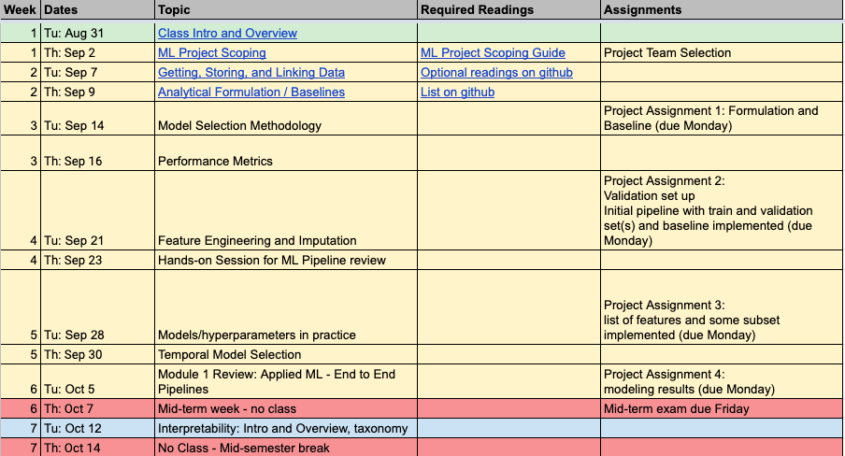
Class Schedule

Slide 13
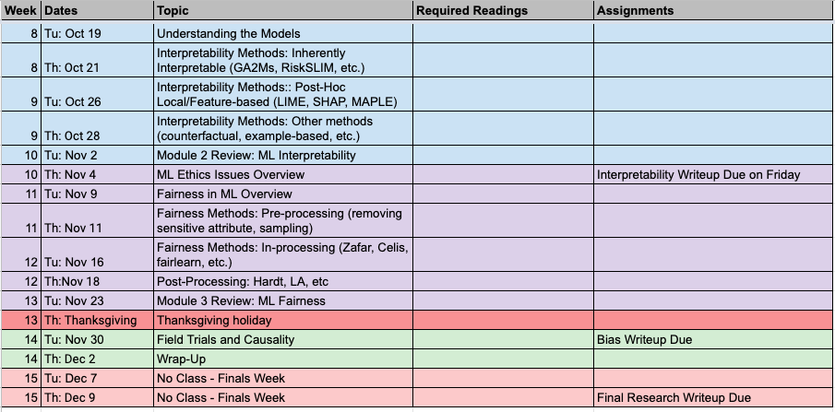
Class Schedule

Slide 14
Logistics
Attendance (is not optional)
Platforms:
Latest content will be on github
Canvas (for assignment submissions)
Slack (and email) for communications and project and teamwork
Wednesday sessions
Office hours
TAs: to help manage and help access AWS infrastructure

Slide 15
Project Teams
Make sure to fill out the survey: We need your github username and public SSH key
You should create 5-person teams by the end of this week (and fill out the spreadsheet to let us know)
Notes:
If you think you’re likely to drop, please let us know sooner rather than later so we can balance teams

Slide 16


Project

Slide 17
Tech Setup Options
Get set up on github for your project
Compute Infrastructure
Use your own laptop/machine for running things locally
Or use AWS resources we have set up to run larger jobs
Data Infrastructure
Use CSVs on your own laptop/machine
Or use Postgres database we have set up with data loaded
If you use AWS, make sure you have the following things set up:
ssh (to connect to the server) server.mlinpractice.dssg.io
dbeaver and psql (to connect to the database) server.mlinpractice.dssg.io
Nice to have: get familiar with
Postgresql (to analyze and query data)
*nix command line
Remote server workflow

Slide 18
Prep for next class
Reading
Project Scoping guide
Assignments
Survey (if you haven’t already): link from email
Project Team Selections: link in canvas
No Wednesday Session This Week
Notes:
We’ll be creating accounts on Wednesday and send around instructions about connecting to the course infrastructure once they’re ready for you to log on

