Slide 1
M&A Prediction from
Pre-Announcement New
J.P.Morgan Industry Project | Week 2 Results | June 2026
Dexin Fu, Ronald Liu

Slide 2
Dataset Overview
SPGlobal M&A Database — US Acquisitions
16,915
2025.6–2026.6
1.2%
14,772
Total M&A Events
Date Range
Target Ticker Coverage
Completed Deals
Variable
Coverage
Note
target_name
99.8%
Company name — used for news search
target_ticker
1.2%
Stock ticker — very limited
acquirer_ticker
10.4%
Slightly better acquirer coverage
deal_value_usd
22.9%
Deal size known for ~1 in 4 deals
primary_industry
85%+
Sector classification available
M&A Prediction | JPMorgan Industry Project | June 2026

Slide 3
Pipeline Overview
End-to-End M&A Prediction Workflow
SPGlobal M&A Events
News Scraping
VADER Sentiment
Feature Engineering
ML Models
Evaluation
→
→
→
→
→
16,915 US deals 2025–2026
GDELT + SEC EDGAR + Google News
Headline NLP Compound score
9 features per event-window
Logistic Reg. Random Forest
ROC-AUC PR-AUC
News Sources
GDELT
SEC EDGAR
Google News RSS
Global Database of Events, Language, and Tone
Date-filtered
English
SEC filings: 8-K, SC-TO, 13D, 13G, DEFM14A
Covers private M&A targets
Full-text search by company name
Broad keyword news
Recent articles only (no date filter)
Used as supplementary source
M&A Prediction | JPMorgan Industry Project | June 2026

Slide 4
Data Coverage
Scraping Results — 50 Events Sampled
50
23
702
637 / 65
Events Sampled
Events with News (46%)
Total Articles Collected
GDELT / SEC EDGAR Articles
Coverage Analysis
• 54% of sampled events returned 0 articles — mostly private/small companies with minimal media presence
• GDELT coverage: strong for large public companies; drops off sharply for smaller or private targets
• SEC EDGAR: captures M&A filings (13D, SC-TO, 8-K) — valuable supplement for private company M&A
• Coverage correlates strongly with deal size: >$1B deals likely have much higher news coverage
Response Plans
Plan A: Coverage-Stratified Analysis
Plan B: Larger-Deal Filter
Train/evaluate only on the 23 covered events Removes noise from zero-coverage events Reduced sample → model accuracy limited
Filter: target_ticker exists OR deal_value ≥ $10M Expected coverage: substantially higher Trade-off: smaller but more informative universe
M&A Prediction | JPMorgan Industry Project | June 2026

Slide 5
Sentiment Analysis
VADER Headline Scoring — 702 Articles
VADER (Valence Aware Dictionary and sEntiment Reasoner)
• Rule-based NLP tuned for short financial/news text
• Returns compound score ∈ [−1, +1]
Window
Company Coverage
Date Coverage
Pre-M&A (label=1)
MA Event related companies
90 days to 7 days before announcement date
Baseline (label=0)
Same
180 days to 90 days before announcement date
✦ 7-day blackout before announcement — avoids leakage from deal rumor news
✦ 180-day shift for negative — creates true 'quiet period' baseline for same company
✦ Same company as control — eliminates company-size and industry confounders
Window
Avg Compound
Pos Score
Neg Score
M&A Keywords
Pre-M&A (label=1)
+0.0655
0.0822
0.0520
1.46%
Baseline (label=0)
+0.1085
0.0953
0.0384
2.79%
Difference
−0.0430
−0.0131
+0.0136
−1.33%
Surprising Finding: Baseline articles are more positive and have more M&A keywords than pre-announcement articles. This is counter-intuitive — the 180-day shift may land in an earlier period of high M&A sector activity.
M&A Prediction | JPMorgan Industry Project | June 2026

Slide 6
Feature Engineering
9 News-Derived Features per Event-Window
Feature
Description
Economic Interpretation
news_count
Total articles in window
Volume signal
avg_sentiment
Mean VADER compound score
Overall tone
std_sentiment
Sentiment volatility (std dev)
Uncertainty / activist attention
pos_ratio
Fraction of articles with compound > 0.05
Proportion of bullish coverage
neg_ratio
Fraction of articles with compound < −0.05
Proportion of negative coverage
ma_keyword_count
# articles mentioning: merger, acquire, bid, offer…
Raw M&A keyword frequency
ma_keyword_ratio
Fraction of articles with M&A keywords
Proportional keyword signal
max_sentiment
Peak positive sentiment score
Best headline tone
min_sentiment
Peak negative sentiment score
Worst headline tone
M&A Prediction | JPMorgan Industry Project | June 2026

Slide 7
Feature Comparison
Pre-M&A vs Baseline — Mean Values
Feature Means by Class (all 100 rows including zero-coverage events)
Feature
Baseline (label=0)
Pre-M&A (label=1)
Difference
Direction
Note
news_count
7.18
6.86
−0.32
↓ pre-M&A
Less coverage before deal?
avg_sentiment
0.041
0.047
+0.006
↑ pre-M&A
Slightly more positive before deal
std_sentiment
0.074
0.082
+0.008
↑ pre-M&A
More volatile sentiment before deal
pos_ratio
0.125
0.121
−0.004
↓ pre-M&A
Slightly less positive coverage
neg_ratio
0.033
0.036
+0.003
↑ pre-M&A
Marginally more negative
ma_keyword_ratio
0.007
0.003
−0.004
↓ pre-M&A
Counter-intuitive
Key Observation: Differences are very small between pre-M&A and baseline windows and no feature reaches statistical significance (all p > 0.40). With only 50 events and 54% zero-coverage rate, signal-to-noise is too low for significance.
M&A Prediction | JPMorgan Industry Project | June 2026

Slide 8
Model Training
Binary Classification — Plan A (Covered Events Only)
Training Setup
Dataset Filter
Train / Test Split
Cross-Validation
Covered events only (≥1 article in either window)
23 events → 46 rows (23 pos / 23 neg)
Zero-news events excluded — no discriminative signal
Time-based split (realistic deployment simulation)
80% train: ≤ Dec 2025 → 38 rows
20% test: > Dec 2025 → 8 rows
50% positive class in both splits
5-fold Stratified KFold on training set
Maintains class balance across folds
Primary metric: ROC-AUC
Models Evaluated
Logistic Regression
Random Forest
Features Used
C=0.5 (light regularization)
Features standardized (StandardScaler)
Provides interpretable coefficients
Linear decision boundary
300 trees, max_depth=5
min_samples_leaf=5 (regularized for small data)
class_weight='balanced'
Provides feature importance
9 sentiment features + industry encoding
news_count, avg_sentiment, std_sentiment, pos/neg ratio, MA keyword count/ratio, max/min sentiment, industry_enc
M&A Prediction | JPMorgan Industry Project | June 2026

Slide 9
Model Results
Performance Metrics — Test Set (8 samples)
Performance Summary
Model
5-Fold CV ROC-AUC (Train)
Test ROC-AUC
Test PR-AUC
Logistic Regression
0.379
0.250
0.433
Random Forest
0.404
0.063
0.378
Random Baseline
—
0.500
0.500
Both models perform BELOW random chance on the test set (ROC-AUC < 0.5). Random Forest test AUC = 0.063 — effectively predicting the wrong class systematically. This is a data limitation problem, not a modeling problem.
Root Cause Analysis
1. Tiny test set (8 samples) — any random variation dominates AUC calculations
2. 54% zero-coverage — most events have identical feature vectors (all zeros)
3. No real signal detected — Mann-Whitney U confirmed no significant feature differences
4. Time-based split in 50-event sample is statistically fragile — test set too small for reliable AUC
M&A Prediction | JPMorgan Industry Project | June 2026

Slide 10
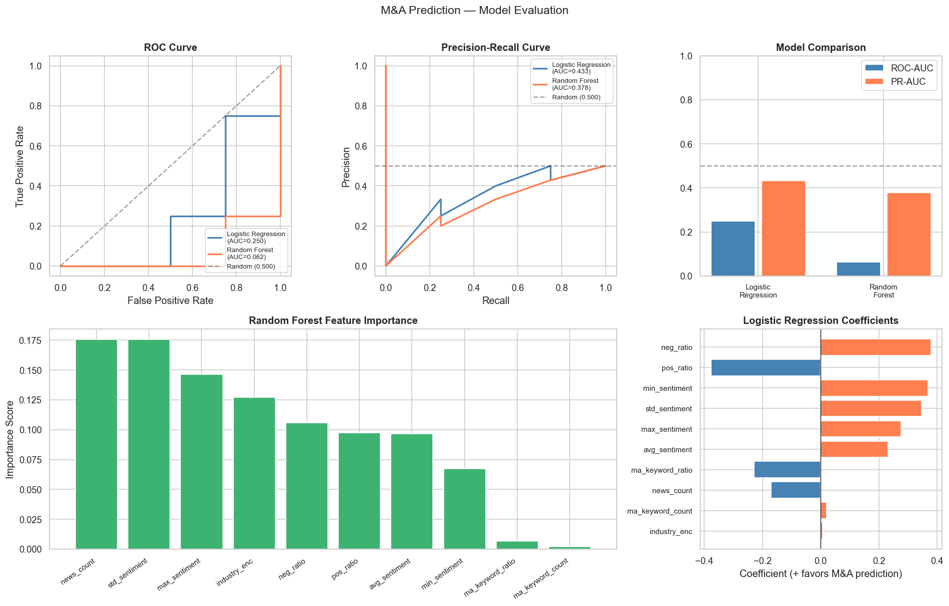
Feature Importance
What the Models Actually Learned
M&A Prediction | JPMorgan Industry Project | June 2026

Slide 11
Limitations
Why Results Are Not Yet Meaningful — And How to Fix Them
Sample Size
Coverage Gap
Shallow NLP
Problem: 50 events → 23 covered → 8 test samples
Problem: 54% of events return 0 news articles
Problem: VADER is bag-of-words, misses context
Fix: Need 500–2,000+ covered events for stable AUC Scale overnight scrape to full dataset
Fix: Apply Plan B filter: ticker OR deal_value≥$10M Expected coverage: 60–80% on larger deals
Fix: Replace with FinBERT (financial BERT) Captures 'rejected bid' vs 'accepted offer’
Build the LLM Agent Models
7-Day Blackout
No Macro Features
Data Recency
Problem: May still leak deal rumor news
Problem: M&A activity is cyclical (rates, credit)
Problem: Dataset covers 2025–2026 (future dates)
Fix: Test 14-day and 30-day blackout windows Compare AUC to validate leakage control
Fix: Add sector M&A wave indicator, Fed rate Interest rate environment strongly affects M&A
Fix: Verify data integrity, rerun on 5-year basis Check for look-ahead bias in features
M&A Prediction | JPMorgan Industry Project | June 2026

Slide 12
Thanks
JPMorgan Industry Project | June 2026

