Slide 1

Predicting M&A from Free News
Classic NLP vs a Large Language Model
J.P. Morgan Industry Project | Group 2 | MFE 27, Term 2 | July 2026
Dexin Fu · Ronald Liu

Slide 2
The Question
1 · BACKGROUND
Can free news flag a company as a takeover target before the deal is public?
WHAT WE WANT
WHY IT IS HARD
Spot likely $1B+ takeover targets 3 to 6 months early, using only free public data.
When a deal is announced, the target's stock usually jumps 20 to 30% overnight. Ranking companies by takeover odds before that jump is worth real money for event-driven and merger-arb desks.
We stick to free data on purpose. No paid rumor feeds. That keeps the work easy to repeat, and it asks a sharper question: is the signal even in the public record?
Takeovers are rare. About 250 US deals this size a year, against 7,600 listed companies. A base rate near 3%.
The talks are secret. Negotiations sit under NDAs, and leaking is a legal problem. Quiet press before a deal may just be the system working as intended.
It is easy to fool yourself. Old news already holds the answer. An honest test has to show it is not peeking at the future. For an LLM, also that it is not recalling the deal from training.
The test, stated plainly: given 90 days of a company's free news ending a week before a deal, can we tell it apart from a quiet 90-day stretch for the same company months earlier?
Predicting M&A from Free News | MFE 27 Term 2 | J.P. Morgan Industry Project | Group 2 | July 2026
1

Slide 3
How We Set It Up
2 · METHOD
Each company is compared against itself, so size and popularity cannot explain the result
DEAL ANNOUNCED
day 0
QUIET WINDOW (label 0)
90 days, 180 days earlier
RUN-UP WINDOW (label 1)
90 days before the deal
SKIP
7 days
-277d
-97d
-7d
0
SAME COMPANY, BOTH SIDES
WHY SKIP THE LAST WEEK
WHAT THE MODEL NEVER SEES
Each deal gives one run-up window and one quiet window for the same firm.
So a model cannot win just by spotting big, well-covered companies. Size, sector and press coverage stay fixed.
Leaks and 'sources say' stories bunch up in the final days before a deal.
Keeping them gives a high score that is useless in practice, since the stock has already moved. Dropping them keeps this real prediction.
· the announcement date
· which window is which
· the answer (the label)
· any news after the window ends
It sees only headlines, tagged with a day offset and the month.
Both methods run on these same windows, the same companies, and the same time split. The only thing that changes is how the news becomes numbers.
Predicting M&A from Free News | MFE 27 Term 2 | J.P. Morgan Industry Project | Group 2 | July 2026
2

Slide 4
The Data
3 · DATA
2,673 large US deals and about 40,000 free news items and filings
2,673
~40k
1,156
2,002
400
>
>
>
>
US deals
$1B+, 2016-2026
news + filings
collected free
companies with
enough news
windows
(run-up + quiet)
held back to
test on
WHERE THE REST WENT
WHY ONLY $1B AND UP
About a third of the deals had no free news at all. That is not a scraping bug. Looking through them, they are:
· asset and carve-out sales (a portfolio of buildings, a business unit)
· blank-cheque shells and SPACs
· private or foreign targets the US press never covered
On purpose, not for convenience. Big targets are almost always public, well-known companies. That is the only place free news coverage exists at all.
Below $1B the news mostly is not there, so the question would be unanswerable rather than answered.
Cost of the whole evidence base: $0 for news and filings, $2.10 for 4,450 LLM calls.
Predicting M&A from Free News | MFE 27 Term 2 | J.P. Morgan Industry Project | Group 2 | July 2026
3

Slide 5
Two Ways to Read the Same News
2 · METHOD
Classic NLP and an LLM, over one shared set of headlines
SHARED INPUT
1,156 companies
x 2 windows
= 2,002 rows
cleaned headlines
A. Classic NLP
hand-built word statistics
B. The LLM
one call per window (openai/gpt-4o-mini)
>
VADER + FinBERT tone · M&A keyword counts · distinctive terms · topics · volume · filing mix
ten takeover warning signs (0 to 10) · an overall takeover score (0 to 100) · short evidence quotes
C. Both sets together
IDENTICAL AFTER THAT
WHY THIS IS A FAIR TEST
· top 16 features, picked on the training data only
· same three models (logistic regression, random forest, gradient boosting)
· same time split, 400 rows held back
· same bootstrap confidence intervals
Everything after the features is the same.
So any gap in the scores comes from how the news was read, not from the data, the split, or the tuning. That is what makes the comparison mean something.
Predicting M&A from Free News | MFE 27 Term 2 | J.P. Morgan Industry Project | Group 2 | July 2026
4

Slide 6
Pipeline A: Classic NLP in Detail
2 · METHOD
The established baseline from weeks 2 to 4: four layers of hand-built text features
NEWS
GDELT + SEC EDGAR
>
NLP LAYERS
VADER · FinBERT
log-odds · NMF
>
FEATURES
28 per window
>
SAME MODELS
LR · RF · GB
VOLUME & TONE
FINBERT
DISTINCTIVE TERMS
TOPICS & STRUCTURE
- article counts, articles per day
- VADER tone: average, spread, extremes
- positive / negative ratio
- M&A keyword hits
- finance-tuned sentiment model
- P(positive) / P(negative)
- net finance tone per window
- reads 'rejected bid' vs 'agreed deal'
- TF-IDF over the headlines
- log-odds against the quiet windows
- company names masked out first
- terms that separate the two windows
- NMF topic model, 8 topics
- topic weights per window
- price momentum joins
- the mix of SEC filing types
Twenty-eight features per window in all. They feed the exact same models and split as the LLM, so the two pipelines are judged on equal footing.
Predicting M&A from Free News | MFE 27 Term 2 | J.P. Morgan Industry Project | Group 2 | July 2026
5

Slide 7
Pipeline B: The LLM Call
2 · METHOD
One call per window: fixed instructions, plus that window's headlines
The model sees the headlines and nothing else. Not the date, not which window it is, not the outcome.
WHAT GOES IN · rules + this window's headlines
WHAT COMES BACK · fixed-format JSON
Company: ANSYS
Period: ~90 days ending 2024-01
SEC filings during the period: 8-K x3
Headlines (40 of 40 kept after spam filtering, chronological;
[d72] S & P 500 Gains and Losses Today : Nike Warns of Soft Sa
[d72] Stocks meander into Christmas after cool PCE - Newsquawk
[d72] Ansys Shares Climb 17 % After Reports of Possible Sale (
[d72] Why AAR Shares Are Trading Lower By 7 %? Here Are Other
[d73] Tech Giants In Talks : Synopsys Reportedly Aims For Bloc
[d73] Synopsys To Acquire Engineering Software Firm Ansys (bus
[d73] Synopsys and Ansys in talks to merge : report (biztoc.co
[d73] Synopsys Submits Offer to Acquire Ansys (marketscreener.
[d73] Ansys explores sale amid takeover interest - sources (ke
{
"ma_rumor_intensity": 10,
"strategic_alternatives_review": 0,
"activist_pressure": 0,
"management_instability": 0,
"financial_distress": 0,
"acquisition_likelihood": 90,
"dominant_theme": "ma_speculation",
"recognized_company": true,
"recognized_deal": true,
"evidence_quotes": [
"Ansys Shares Climb 17 % After Reports of Possibl...",
"Synopsys Reportedly in Advanced Talks to Acquire..."
],
"rationale": "The coverage primarily discusses potential ac
}
The format is enforced, so all 4,450 calls return the same 17 fields in the same shape. No parsing guesswork, no missing values to patch.
Predicting M&A from Free News | MFE 27 Term 2 | J.P. Morgan Industry Project | Group 2 | July 2026
6

Slide 8
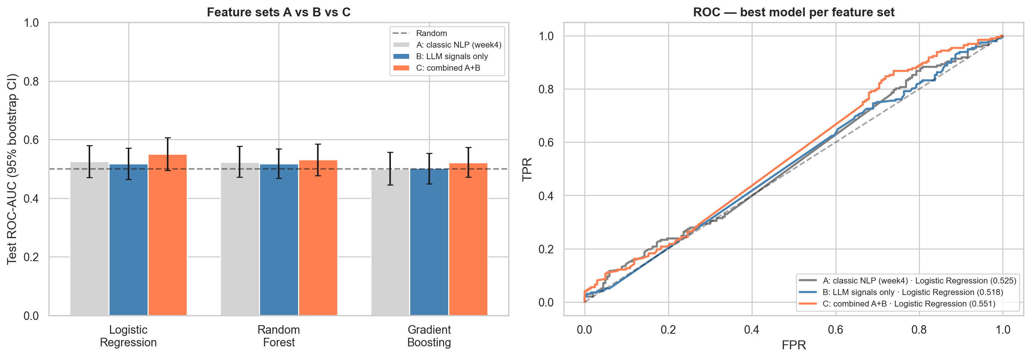
Result: Head to Head
4 · RESULTS
Best model for each method, same rows and split (2,002 windows, 400 test rows)
Method
Best model
Test AUC
95% range
vs chance
A. Classic NLP
Logistic Regression
0.525
0.470 to 0.580
+0.025
B. LLM
Logistic Regression
0.518
0.465 to 0.571
+0.018
C. Both together
Logistic Regression
0.551
0.495 to 0.606
+0.051
Random guess
-
0.500
-
0.000
Combining classic NLP with the LLM has the highest AUC (0.551), a small edge over either alone (NLP 0.525, LLM 0.518). The ranges still include 0.50, so this is promising rather than proven, but the two methods look complementary.
Predicting M&A from Free News | MFE 27 Term 2 | J.P. Morgan Industry Project | Group 2 | July 2026
7

Slide 9
Where the News Actually Shows Up
4 · RESULTS
We counted coverage day by day around each deal
~12
0.35
0.25
articles on the
announcement day
articles per day in
the week after
articles per day in
the 90-day run-up
THE COVERAGE IS THERE, JUST LATE
WHY THIS SETTLES IT
News about these deals lands on the day they are announced, not before.
The run-up window sees about a quarter of an article a day, the same trickle as any random quiet period. On day zero it jumps to a dozen. That is dozens of times heavier.
There are two ways to fail at this task.
· the method is too weak, which better features could fix
· the information is not there, which nothing can fix
The day-zero spike proves the tools do pick up deal news when it exists. So the near-chance result is about the data, not the method.
Predicting M&A from Free News | MFE 27 Term 2 | J.P. Morgan Industry Project | Group 2 | July 2026
8

Slide 10
The Same Tools Do Work, One Week Later
4 · RESULTS
Point the exact same pipeline at the announcement week instead of the run-up
Different question: given one week of a company's news, did a deal just happen? This is spotting, not predicting, and we say so plainly.
Model
CV AUC (train)
Test ROC-AUC
Test PR-AUC
THE GAP IS THE POINT
Gradient Boosting
0.818
0.793
0.741
Spotting a deal: 0.79 AUC
Predicting one early: 0.55 AUC
Same features, same models, same filters. The only change is which week we look at.
So the tools work fine. The early news simply is not there to read.
Random Forest
0.814
0.773
0.733
Logistic Regression
0.807
0.773
0.737
Random baseline
-
0.500
0.500
400 weeks in the test: 200 announcement weeks and 200 quiet weeks for the same companies.
What drives it
Announcement wk
Quiet wk
Articles per day
1.80
0.12
M&A keyword count
1.02
0.23
There is a usable tool here today: spotting deals as they are announced, from free news alone, at 0.79.
Predicting M&A from Free News | MFE 27 Term 2 | J.P. Morgan Industry Project | Group 2 | July 2026
9

Slide 11
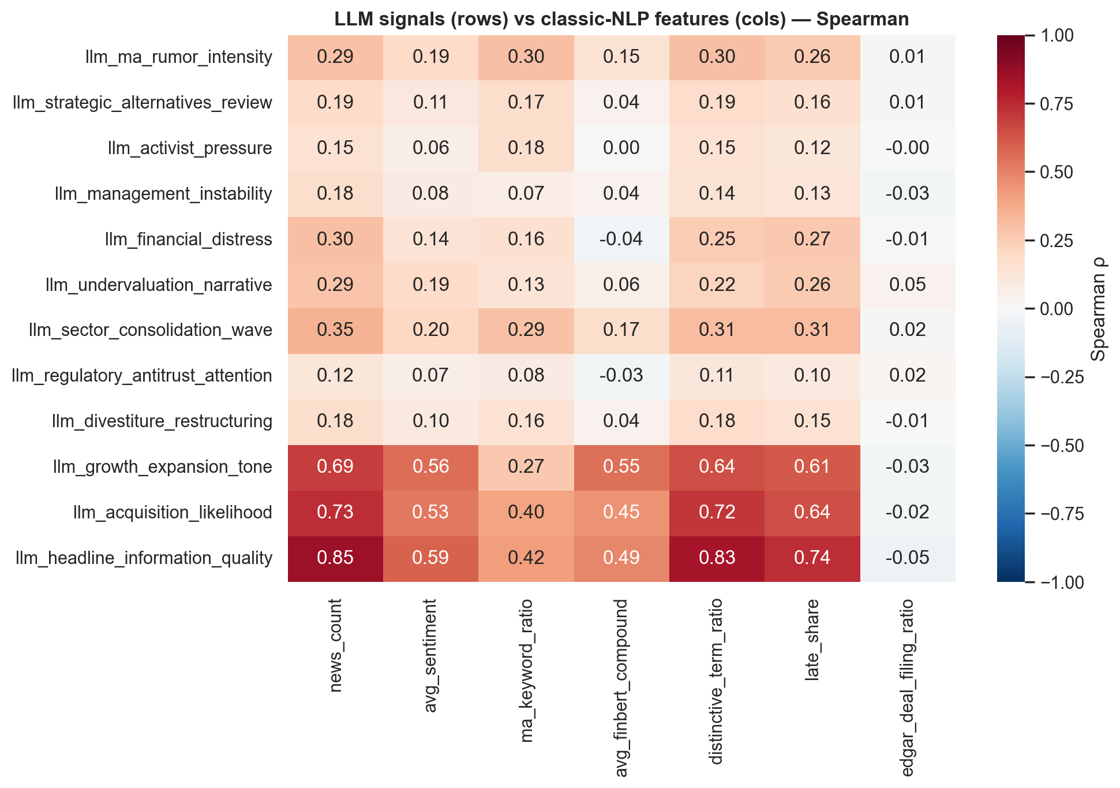
Are the LLM Signals New Information?
4 · RESULTS
How much the LLM scores overlap with the classic ones
A DIFFERENT, COMPLEMENTARY SIGNAL
Each square asks whether the two scores rank companies the same way.
The colours are mostly pale, so the LLM's takeover signals are largely separate from the word-count and tone features.
That is why the two help most together. Because they read different things, the combined set edges ahead of either one alone.
Predicting M&A from Free News | MFE 27 Term 2 | J.P. Morgan Industry Project | Group 2 | July 2026
10

Slide 12
Can We Trust the LLM Score?
5 · VALIDITY
Three checks, because the model might already know how these deals ended
The worry: openai/gpt-4o-mini was trained up to 2023-10-01, before most of our deals. If it scores a window high because it remembers the deal, we have measured memory, not prediction.
50%
+0.017
0.90
guessing deals with no
news shown (coin flip = 50%)
score change when we
hide company names
agreement when we
score twice
IT IS NOT REMEMBERING
IT IS READING THE NEWS
THE SCORES ARE STABLE
Asked to guess deals with no news at all, it scored 50.4%, a coin flip.
It did no better on older deals it might have seen in training (51%) than on newer ones (50%).
Hide the company name and the score barely moves, 0.518 to 0.501.
So it is going off the words in the headlines, not off recognising a famous name.
Score the same window twice and the two runs line up at 0.90 out of 1.
The overall takeover number moves about 1.6 points out of 100. Not random noise.
It also quotes the exact headline behind each score, and every quote checked out against the real text.
All three checks came back clean. The small edge we found is a real reading of the news, and the method carries over to deals the model has never seen.
Predicting M&A from Free News | MFE 27 Term 2 | J.P. Morgan Industry Project | Group 2 | July 2026
11

Slide 13
Every LLM Score Cites Its Source
5 · VALIDITY
The model quotes the headline behind each score, and we check it
Across 8 test events, 22 of 22 quoted headlines matched the real text word for word. None were made up.
Company · signal
Score
Quoted headline
Source
Clearwater Analytics · ma_rumor_intensity
8
Warburg Pincus, Permira said to be in talks to buy Clearwater Analytics
[d61] seekingalpha.com
Clearwater Analytics · acquisition_likelihood
80
Buyout firm Thoma Bravo has offered to buy Clearwater Analytics, sources say
[d63] marketscreener.com
ANSYS · ma_rumor_intensity
8
Ansys explores sale amid takeover interest - sources
[d73] kelo.com
ANSYS · acquisition_likelihood
80
Synopsys Reportedly in Advanced Talks to Acquire Ansys
[d86] marketscreener.com
Instructure · ma_rumor_intensity
8
Thoma Bravo explores sale of Instructure, sources say
[d28] marketscreener.com
Instructure · acquisition_likelihood
85
KKR Emerges as Front-Runner for Instructure Buyout
[d91] themiddlemarket.com
A number an analyst can click through to a real headline is worth more than a number on its own. The checking is automatic.
Predicting M&A from Free News | MFE 27 Term 2 | J.P. Morgan Industry Project | Group 2 | July 2026
12

Slide 14
What We Found
6 · CONCLUSION
The take-aways, with the numbers behind them
1
Free news does not predict these deals early.
Best AUC 0.551 across 2,002 windows, and the range still includes a coin flip. A small edge at best.
2
The limit is the data, not the method.
The same setup spots deals the week they land at 0.79. Coverage barely exists before the announcement, so there is little to find.
3
The LLM and classic NLP work best together.
Classic NLP 0.525, LLM 0.518, both together 0.551 (the highest). They read different things, so combining them helps, though the edge is small.
4
The LLM is honest.
It reads rather than remembers, its scores hold up when we hide names and when we re-run, and every score cites a real headline.
5
One thing works today.
Spotting deals as they are announced, from free news, at 0.79 for about $2 of compute.
Predicting M&A from Free News | MFE 27 Term 2 | J.P. Morgan Industry Project | Group 2 | July 2026
13

Slide 15
What We Would Do Next
6 · CONCLUSION
Ordered by what would move the needle most
CHANGE THE INPUT
TWO SMALLER STEPS
The biggest gain is a different input, not a fancier model.
Go upstream of the news. Company financials (debt, cash, a cheap valuation, activist investors building a stake) are where the older research finds its signal. News is a late, downstream symptom.
Read filings, not just headlines. Annual reports and earnings calls often hint at a sale months earlier. The extractor already takes long text.
Price the free-data limit. Run one paid news feed once, and measure how much the free-only rule costs us. That number is a result in itself.
Get a bigger test set. More deals would tighten the range and settle whether the small edge is real or not.
Keep classic NLP as the cheap baseline. It matched the LLM here, at a fraction of the cost.
Every diagnostic points at the same thing: the news is a late signal. The next step is to look where the early signal actually lives.
Predicting M&A from Free News | MFE 27 Term 2 | J.P. Morgan Industry Project | Group 2 | July 2026
14

Slide 16
Thank You
Predicting M&A from Free News · Classic NLP vs an LLM
Dexin Fu · Ronald Liu
Full write-up, notebooks and code in the project repository

Slide 17
Appendix
Backup detail for questions

Slide 18
Where This Fits in the Literature
APPENDIX
TAKEOVER PREDICTION
TEXT AS A SIGNAL
LLMs IN FINANCE
Palepu (1986) set the template: predict targets from company fundamentals.
Later work (Ambrose & Megginson 1992, Powell 2001) finds the same thing: a little better than chance, and the edge fades after trading costs.
Takeaway: an AUC of 0.55 to 0.70 is the realistic ceiling, not 0.90.
Tetlock (2007) showed news tone moves prices.
Loughran & McDonald (2011) showed generic word lists misread financial text, so we use finance-specific tools like FinBERT (Araci 2019).
Lopez-Lira & Tang (2023) found ChatGPT headline scores predict next-day returns, but the memory-vs-reasoning question was left open.
Our angle: run classic NLP and an LLM on the exact same news, then test hard whether the LLM is reading or remembering.
Predicting M&A from Free News | MFE 27 Term 2 | J.P. Morgan Industry Project | Group 2 | July 2026
15

Slide 19
Cleaning the News First
APPENDIX
Three ways the raw text was misleading, and the fix for each
FILING STUBS READ AS NEWS
COMPANY NAMES AS SIGNAL
BOT-WRITTEN ARTICLES
Problem: auto-generated filing lines ('COMPANY filed an 8-K on...') were about 40% of the text, and the tone models scored them like real articles.
Fix: use news for tone; turn filings into plain counts instead.
Problem: both windows are the same company, so the most 'distinctive' words were just its name, which does not generalise.
Fix: blank out each company's own name before counting words.
Problem: about 17% of items were templated bot posts (holdings updates, rating bots) that show up for any public company.
Fix: filter them by pattern and domain, the same way on both windows.
Every filter is applied the same way to both windows. A filter that treated the two sides differently would invent a signal that is not really there.
Predicting M&A from Free News | MFE 27 Term 2 | J.P. Morgan Industry Project | Group 2 | July 2026
16

Slide 20
Contributions
APPENDIX
Who did what
Area
Dexin Fu
Ronald Liu
Scoping and background reading
Lead
Support
Deal cleaning and labels
Lead
News and filing scrapers
Lead
Support
Classic NLP (VADER, FinBERT, topics)
Lead
Data-quality fixes and diagnostics
Lead
LLM extraction pipeline
Lead
Trust checks (memory, name, repeat)
Lead
Full-data run and head-to-head
Support
Lead
Slide decks and write-up
Weeks 2-4
Week 7, final
Both of us reviewed every result together and agreed the pass or fail marks before running any model.
Predicting M&A from Free News | MFE 27 Term 2 | J.P. Morgan Industry Project | Group 2 | July 2026
17

