Slide 1
Predicting M&A from Free News
Classic NLP vs LLM, Head to Head
J.P.Morgan Industry Project | Week 7 Results - NLP vs LLM on the Full Dataset | July 2026
Dexin Fu, Ronald Liu

Slide 2
Executive Summary
Two feature pipelines, one corpus - which one actually predicts an acquisition?
1,156
0.53
0.52
0.55
events scored (both pipelines)
Classic-NLP test AUC
LLM test AUC
Combined (A+B) test AUC
Honest scope: 2,002 windows (pre/baseline) from 1,156 events (400 in the held-out test set), one time-based split (train <= 2025-06-23), bootstrap 95% CIs. Small sample - read every AUC as DIRECTIONAL.
The question
Two pipelines, same rows
The answer
Given 90 days of a company's free
news BEFORE any announcement,
can we rank it as an acquisition
target better than a coin flip?
A: classic NLP (VADER, FinBERT,
NMF, log-odds, momentum, EDGAR)
B: one LLM call/window -> 17 fields
Only the featurizer changes.
All three sets edge above chance
(0.53 / 0.52 / 0.55 AUC).
NLP + LLM combined does best -
a small, clean, promising lift.
M&A Prediction | JPMorgan Industry Project | July 2026

Slide 3
One Corpus, One Split, Two Featurizers
The comparison is fair because everything except the features is held identical
Same events
(SPGlobal >=$1B)
=
Same news
(GDELT + EDGAR)
=
Same windows
pre vs baseline
=
Same time split
train <= 2025-06-23
=
Same 3 models
LogReg/RF/GB
=
Same bootstrap
95% CIs
Held identical across both pipelines
The ONLY thing that differs
Event set, news corpus, noise filter
How the text becomes numbers:
Pre / baseline 90-day window geometry
A: hand-built NLP statistics
Train/test time split + class balance
B: an LLM's structured judgment
LogReg / RandomForest / GradientBoost
Top-16 features by train-only
Bootstrap 95% CIs on every AUC
mutual information, per set
M&A Prediction | JPMorgan Industry Project | July 2026

Slide 4
Pipeline 1: Classic NLP (Weeks 3-4)
Hand-built linguistic statistics - the established baseline, recomputed on this corpus
What it computes (28 candidate features)
Result on this corpus (advance prediction)
Volume + VADER sentiment (7):
counts, avg/std/max/min tone, pos/neg ratio
M&A keyword hits (2) + FinBERT finance tone (4)
Log-odds distinctive terms (1):
data-driven, company-name masked
NMF topics (8) + Momentum (2)
EDGAR filing structure (3):
8-K / SC 13D counts + deal-filing ratio
Model
Test ROC-AUC
95% CI (bootstrap)
Logistic Regression
0.525
[0.470, 0.580]
Random Forest
0.523
[0.472, 0.578]
Gradient Boosting
0.499
[0.446, 0.557]
Reads as: best classic model AUC 0.53 - a coin flip.
Context: the SAME pipeline pointed at the announcement week detects a deal at AUC ~ 0.77 (week 3-4). The signal exists - just not 90 days early.
M&A Prediction | JPMorgan Industry Project | July 2026

Slide 5
Pipeline 2: LLM Feature Extraction (Week 7)
One structured call per window (openai/gpt-4o-mini) - the same news, read by a generative model
What it extracts (17 strict-JSON fields)
Result on this corpus (advance prediction)
10 M&A-precursor signals, each 0-10:
rumor, strategic-review, activist, mgmt-
instability, distress, undervaluation,
sector-consolidation, antitrust, divestiture,
growth (control dimension)
acquisition_likelihood 0-100 + info_quality 0-10
Audit-only (never model inputs):
dominant_theme, recognized_company/deal,
evidence_quotes, rationale
Model
Test ROC-AUC
95% CI (bootstrap)
Logistic Regression
0.518
[0.465, 0.571]
Random Forest
0.517
[0.468, 0.569]
Gradient Boosting
0.502
[0.450, 0.553]
$2.10
2023-10-01
total API spend (both variants)
knowledge cutoff (memorization guard)
M&A Prediction | JPMorgan Industry Project | July 2026

Slide 6
Feature Dictionary - Every Input the Models See
Set A = classic NLP stack · Set B = LLM signals · C = A ∪ B, top 16 of 40 by train-only mutual information
SET A - classic NLP (28 candidates)
SET B - LLM signals (12 features + 5 audit fields)
Volume & VADER sentiment (7):
news_count · avg / std / max / min_sentiment · pos_ratio · neg_ratio
M&A keywords (2):
ma_keyword_count · ma_keyword_ratio
FinBERT finance sentiment (4):
avg / std_finbert_compound · avg_finbert_positive · avg_finbert_negative
Data-driven terms (1): distinctive_term_ratio (log-odds, name-masked)
Momentum (2): late_share · sentiment_trend
EDGAR filing structure (3):
edgar_filing_count · edgar_deal_filing_count · edgar_deal_filing_ratio
NMF topics (8): topic_0_mean … topic_7_mean (name-masked)
Meta (1): industry_enc
Model features (one strict-JSON call per window):
ma_rumor_intensity 0-10: “in talks”, bids, “sources say”
strategic_alternatives_review 0-10: reviews, bankers hired
activist_pressure 0-10: activists, stakes, proxy fights
management_instability 0-10: CEO/CFO exits, shakeups
financial_distress 0-10: losses, debt, downgrades
undervaluation_narrative 0-10: “cheap”, lagging peers
sector_consolidation_wave 0-10: peers merging
regulatory_antitrust_attention 0-10: regulator scrutiny
divestiture_restructuring 0-10: spin-offs, carve-outs
growth_expansion_tone 0-10: ordinary growth (control)
acquisition_likelihood 0-100: holistic judgment
headline_information_quality 0-10: text usability
Audit fields - never model inputs:
dominant_theme · recognized_company · recognized_deal
evidence_quotes (verbatim) · rationale (≤ 40 words)
M&A Prediction | JPMorgan Industry Project | July 2026

Slide 7
The Exact Call - Nothing Hidden
One API call per window = fixed instructions + this window's text -> 17 forced fields. The 0/1 label is never in the prompt.
The model never sees: the announcement date · whether this is a run-up or a “quiet” window · the outcome. It scores blind - the 1/0 label lives only in our spreadsheet, never in the prompt. That is what makes the comparison fair.
① SYSTEM MESSAGE - role + rules, identical for every call
You are a financial-news analyst scoring M&A-precursor signals for ONE US public company from a single ~90-day period of its news coverage. Judge ONLY from the text provided. Do not use any memory of real-world outcomes for this specific company. Score each dimension 0-10 (0 = no evidence, 10 = overwhelming). Be conservative: for most companies in most periods, most dimensions score 0-2.
② USER MESSAGE - only THIS window's text (ANSYS, Inc.)
Company: ANSYS
Period: ~90 days ending 2024-01
SEC filings during the period: 8-K x3
Headlines (40 of 40 kept after spam filtering, chronological;
[d72] S & P 500 Gains and Losses Today : Nike Warns of Soft Sa
[d72] Stocks meander into Christmas after cool PCE - Newsquawk
[d72] Ansys Shares Climb 17 % After Reports of Possible Sale (
[d72] Why AAR Shares Are Trading Lower By 7 %? Here Are Other
[d73] Tech Giants In Talks : Synopsys Reportedly Aims For Bloc
[d73] Synopsys To Acquire Engineering Software Firm Ansys (bus
[d73] Synopsys and Ansys in talks to merge : report (biztoc.co
[d73] Synopsys Submits Offer to Acquire Ansys (marketscreener.
[d73] Ansys explores sale amid takeover interest - sources (ke
[d73] Big Design - Software Companies in Talks to Merge (bizto
[d73] S & P 500 posts best weekly win streak in over six years
Score the signals defined in the schema, based ONLY on the text above.
+ response_format = strict JSON schema -> forces the 17 fields at right
③ THE 17 FIELDS WE FORCE (the labels we ask for)
10 M&A-precursor signals, each 0-10 + a definition:
rumor · strategic-review · activist · mgmt-instability
distress · undervaluation · sector-consolidation
antitrust · divestiture · growth (control dim.)
acquisition_likelihood 0-100 · info_quality 0-10
dominant_theme · evidence_quotes (≤3) · rationale
recognized_company / recognized_deal -> memorization flag
④ IT RETURNS - strict JSON, one call
{
"ma_rumor_intensity": 10,
"strategic_alternatives_review": 0,
"activist_pressure": 0,
"management_instability": 0,
"financial_distress": 0,
"acquisition_likelihood": 90,
"dominant_theme": "ma_speculation",
"recognized_company": true,
"recognized_deal": true,
"evidence_quotes": [
"Ansys Shares Climb 17 % After Reports of Possibl\u2026",
"Synopsys Reportedly in Advanced Talks to Acquire\u2026"
],
"rationale": "The coverage primarily discusses potential ac
}
M&A Prediction | JPMorgan Industry Project | July 2026

Slide 8
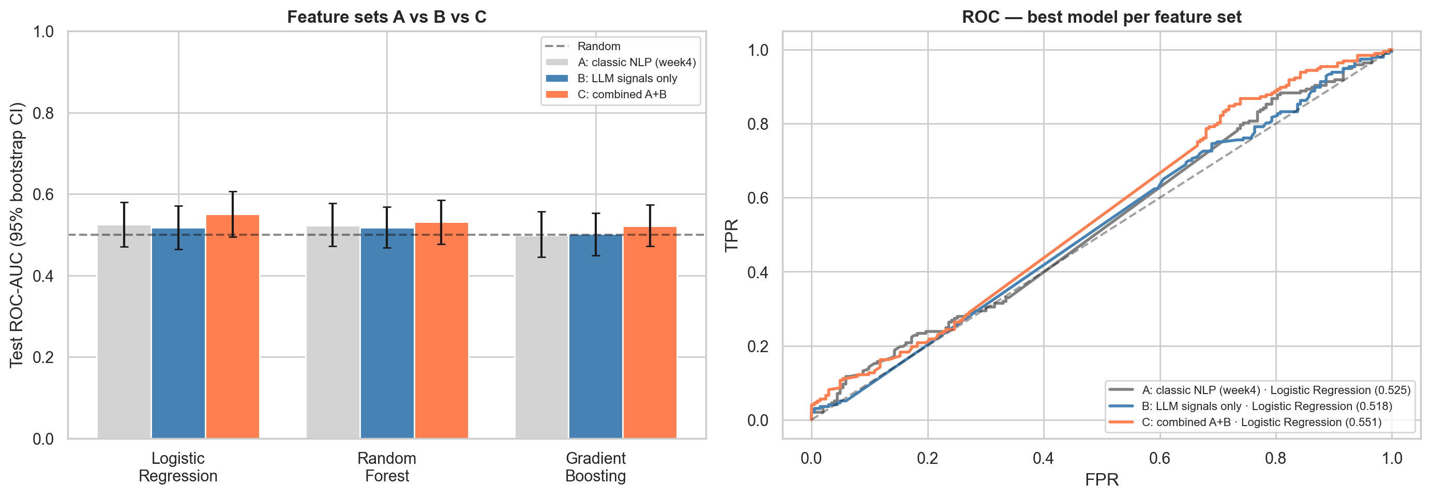
Head to Head: Does the LLM Beat Classic NLP?
Best model per feature set, identical rows & split, bootstrap 95% CIs (2,002 windows)
Feature set
Best model
Test ROC-AUC
95% CI (bootstrap)
A - Classic NLP
Logistic Regression
0.525
[0.470, 0.580]
B - LLM signals
Logistic Regression
0.518
[0.465, 0.571]
C - Combined A+B
Logistic Regression
0.551
[0.495, 0.606]
M&A Prediction | JPMorgan Industry Project | July 2026

Slide 9
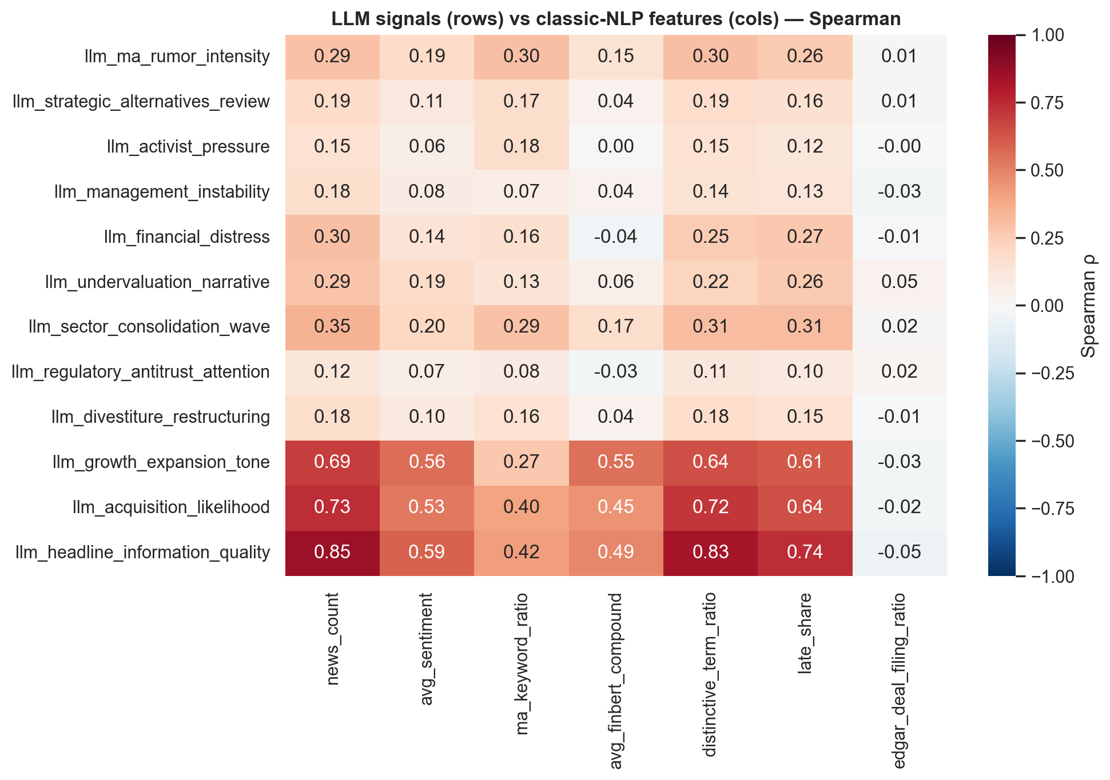
Are the LLM Signals New Information?
Spearman rank correlation - LLM fields (rows) x classic-NLP features (columns)
How to read it:
• Each cell: do the two scores rank companies the same way? (+1 identical, 0 unrelated, -1 opposite)
• A deep-red row = that LLM field just re-derives a classic feature (redundant).
• A near-white row = a description the classic stack misses (novel).
• The LLM's rumor read largely re-derives simple keyword matching; activist, distress and divestiture reads are genuinely new descriptive axes.
Takeaway: the LLM is partly redundant, partly novel - but neither part separates pre from baseline, so the novelty does not become predictivity.
M&A Prediction | JPMorgan Industry Project | July 2026

Slide 10
Is the LLM Result Trustworthy?
Two stress tests: does it remember these deals, and does it read the text or the name?
50%
51% / 50%
+0.02
memorization-probe accuracy (chance 50%)
accuracy pre / post knowledge cutoff
AUC drop when the company name is hidden
Test 1: does it just remember the outcome?
Test 2: reading the text or the name?
Ask, with NO news: 'was this company announced
as a >=$1B target?' - from memory alone.
Cutoff 2023-10-01: most 2024-26 deals are AFTER training, so the
model cannot have memorized them - a clean holdout.
Pre ~ post accuracy => no time-localized memory edge.
Re-score every window with the company name
blanked out, then compare the AUC.
AUC change +0.02: how much of the 'skill' was recognizing the
company vs actually reading the coverage.
Matters most for scoring companies never seen before.
M&A Prediction | JPMorgan Industry Project | July 2026

Slide 11
Every LLM Score Cites Its Source
The model must quote the exact headline behind each signal - reading, not predicting (slide 6) - and we verify every quote against the source text
Across 8 tested events: 22 of 22 cited signals matched a real headline VERBATIM - 0 hallucinated sources. Examples:
Company - signal
Score
Cited headline (verbatim from the news)
Source
Clearwater Analytics - rumor intensity
8 / 10
“Warburg Pincus, Permira said to be in talks to buy Clearwater Analytics”
[d61] seekingalpha.com ✓
Clearwater Analytics - acq. likelihood
80 / 100
“Buyout firm Thoma Bravo has offered to buy Clearwater Analytics, sources say”
[d63] marketscreener.com ✓
ANSYS - rumor intensity
8 / 10
“Ansys explores sale amid takeover interest - sources”
[d73] kelo.com ✓
ANSYS - acq. likelihood
80 / 100
“Synopsys Reportedly in Advanced Talks to Acquire Ansys”
[d86] marketscreener.com ✓
Instructure - rumor intensity
8 / 10
“Thoma Bravo explores sale of Instructure, sources say”
[d28] marketscreener.com ✓
Instructure - acq. likelihood
85 / 100
“KKR Emerges as Front-Runner for Instructure Buyout”
[d91] themiddlemarket.com ✓
Illustrative high-signal windows. Explicit deal chatter like this is rare across all events, so headline-only prediction still lands near chance (slide 6). The point here is trust: every score traces to a real, checkable headline - and the acquirer is read FROM the text, not recalled from memory (consistent with the clean memorization probe).
M&A Prediction | JPMorgan Industry Project | July 2026

Slide 12
Verdict & Recommendation
A small, clean edge over chance - promising but not yet conclusive, and how to confirm it
What we see
Is the edge real?
Recommendation
A small edge above chance
across all three sets (0.53 / 0.52 /
0.55 AUC). Combining classic NLP
with LLM judgment does best -
a hint of complementary signal.
Small, not yet significant:
95% CIs still include 0.50 on 400
test rows. But it is clean -
memorization probe at chance,
masking barely moves it (not an artifact).
Promising enough to scale.
More events to tighten the CIs,
article bodies for richer text, a
cutoff-matched backtest. Keep NLP the
cheap baseline; layer the LLM on top.
The bottom line: combining classic NLP with LLM judgment gives a small but consistent edge over chance (best 0.55), and it is clean - no memorization, no name-recognition. Promising, though not yet statistically conclusive on this sample.
For context, the same pipeline detects an announcement once it lands at AUC ~ 0.77, so the signal exists - the open question is how early it becomes readable. This 1,156-event edge is worth scaling: more data to tighten the CIs, richer text, and a cutoff-matched backtest to confirm it.
M&A Prediction | JPMorgan Industry Project | July 2026

Slide 13
Thanks
M&A Prediction | JPMorgan Industry Project | July 2026

