Slide 1
Can an LLM Read M&A Intent
from Free News?
J.P.Morgan Industry Project | Week 6 Results - GenAI Feature Extraction | July 2026
Dexin Fu, Ronald Liu

Slide 2
Executive Summary
One structured LLM call per event-window - scored, stress-tested, priced
250
$0.36
0.45 vs 0.44
52%
LLM calls scored OK
total API spend (budget $100)
test AUC: LLM-combined vs classic
memorization-probe accuracy (chance 50%)
Honest scope: 65 windows from 37 LLM-scored events (13 in test). Small sample - read every AUC as DIRECTIONAL (bootstrap 95% CIs), not settled.
⚠ LLM scaling currently paused on an OpenAI API credit issue we're resolving - the pipeline is built and runs; only the paid LLM step is gated (~$0.39 spent, 37 of 126 scraped events scored).
1 · Built
2 · Measured
3 · Stress-tested
• extract_llm_features.py - parallel,
resumable, $-capped scorer
• 17 strict-JSON fields per window
(rumor, strategic review, activist,
distress, likelihood 0-100, …)
• gpt-5-mini everywhere + gpt-5 subset
• A (classic NLP) vs B (LLM) vs C (both)
on identical rows, split & models
• Bootstrap 95% CI on every AUC
• Per-company pre-vs-baseline check
on each field
• Detection (day-0) replication
• Memorization probe (no news shown)
• Company-name masking A/B
• Re-run consistency (are scores stable?)
• Post-training-cutoff holdout
(2025-26 deals the model can't know)
NULL RESULT, CONSISTENT WITH WEEK 4: even a generative LLM reading the same free-news corpus cannot separate pre-announcement windows from quiet periods. This strengthens the week-4 conclusion - the information is absent
M&A Prediction | JPMorgan Industry Project | July 2026

Slide 3
Approach: One Structured Call per Event-Window
Same corpus, same windows, same models as week 3-4 - only the featurizer changes
Cached headlines
(GDELT + EDGAR)
→
Spam filter
(same as week4)
→
1 LLM call / window
strict JSON schema
→
17 fields parsed
+ clamped
→
Feature sets
A / B / C
→
Same 3 models
+ bootstrap CIs
Signal fields (0-10 each)
Judgment fields
ma_rumor_intensity · strategic_alternatives_review
acquisition_likelihood (0-100)
activist_pressure · management_instability
headline_information_quality (0-10)
financial_distress · undervaluation_narrative
dominant_theme (8-way enum)
sector_consolidation_wave · regulatory_antitrust
recognized_company / recognized_deal
divestiture_restructuring · growth_expansion_tone
evidence_quotes (verbatim) + rationale
Leakage rules: announcement date never sent · window described only by end-month · pre/baseline identity never revealed · resumable cache, hard $ cap per run.
M&A Prediction | JPMorgan Industry Project | July 2026

Slide 4
Feature Dictionary - Every Input the Models See
Set A = week-4 classic stack recomputed on this corpus · Set B = LLM signals · C = A ∪ B
SET A - classic NLP (28 candidates)
SET B - LLM signals (12 features + 5 audit fields)
Volume & VADER sentiment (7):
news_count · avg / std / max / min_sentiment · pos_ratio · neg_ratio
M&A keywords (2):
ma_keyword_count · ma_keyword_ratio
FinBERT finance sentiment (4):
avg / std_finbert_compound · avg_finbert_positive · avg_finbert_negative
Data-driven terms (1): distinctive_term_ratio (log-odds, name-masked)
Momentum (2): late_share · sentiment_trend
EDGAR filing structure (3):
edgar_filing_count · edgar_deal_filing_count · edgar_deal_filing_ratio
NMF topics (8): topic_0_mean … topic_7_mean (name-masked)
Meta (1): industry_enc
Model features (one strict-JSON call per window):
ma_rumor_intensity 0-10: “in talks”, bids, “sources say”
strategic_alternatives_review 0-10: reviews, bankers hired
activist_pressure 0-10: activists, stakes, proxy fights
management_instability 0-10: CEO/CFO exits, shakeups
financial_distress 0-10: losses, debt, downgrades
undervaluation_narrative 0-10: “cheap”, lagging peers
sector_consolidation_wave 0-10: peers merging
regulatory_antitrust_attention 0-10: regulator scrutiny
divestiture_restructuring 0-10: spin-offs, carve-outs
growth_expansion_tone 0-10: ordinary growth (control)
acquisition_likelihood 0-100: holistic judgment
headline_information_quality 0-10: text usability
Audit fields - never model inputs:
dominant_theme · recognized_company · recognized_deal
evidence_quotes (verbatim) · rationale (≤ 40 words)
A and B are computed from the IDENTICAL noise-filtered corpus. C = A ∪ B (40 candidates → top 16 by train-only mutual information).
M&A Prediction | JPMorgan Industry Project | July 2026

Slide 5
The Exact Call - Nothing Hidden
One API call per window = fixed instructions + this window's text → 17 forced fields. The 0/1 label is never in the prompt.
The model never sees: the announcement date · whether this is a run-up or a “quiet” window · the outcome. It scores blind - the 1/0 label lives only in our spreadsheet, never in the prompt. That is what makes the comparison fair.
① SYSTEM MESSAGE - role + rules, identical for every call
You are a financial-news analyst scoring M&A-precursor signals for ONE US public company from a single ~90-day period of its news coverage. Judge ONLY from the text provided. Do not use any memory of real-world outcomes for this specific company. Score each dimension 0-10 (0 = no evidence, 10 = overwhelming). Be conservative: for most companies in most periods, most dimensions score 0-2.
② USER MESSAGE - only THIS window's text (Clearwater Analytics Holdings, Inc.*)
Company: Clearwater Analytics
Period: ~90 days ending 2025-12
SEC filings during the period: 8-K x2, DEFM14A x1
Headlines (28 of 28 kept after spam filtering, chronological;
[d57] Clearwater launches CWAN GenAI for investment AI (idahob
[d58] Stocks making the biggest premarket moves : AMD , CWAN ,
[d58] Clearwater Analytics : CWAN Report : Insurance Industry
[d58] Soars 10 % on Bargain - Hunting After 52 - Week Low (biz
[d58] Clearwater ( CWAN ) Soars 10 % on Bargain - Hunting Afte
[d58] CWAN Report : Insurance Industry $2 . 7 Trillion Shift t
[d59] US close : Dow hits another high , but tech stocks still
[d59] Stocks mixed ahead of House vote on government shutdown
[d61] Warburg Pincus , Permira said to be in talks to buy Clea
[d61] Clearwater Analytics Stock Surges 19 % After - Hours On
[d61] Clearwater Analytics Surges 19 % After - Hours On Friday
Score the signals defined in the schema, based ONLY on the text above.
＋ response_format = strict JSON schema → forces the 17 fields at right
③ THE 17 FIELDS WE FORCE (the labels we ask for)
10 M&A-precursor signals, each 0-10 + a definition:
rumor · strategic-review · activist · mgmt-instability
distress · undervaluation · sector-consolidation
antitrust · divestiture · growth (control dim.)
acquisition_likelihood 0-100 · info_quality 0-10
dominant_theme · evidence_quotes (≤3) · rationale
recognized_company / recognized_deal → memorization flag
④ IT RETURNS - strict JSON, one call
{
"ma_rumor_intensity": 8,
"strategic_alternatives_review": 2,
"activist_pressure": 0,
"management_instability": 1,
"financial_distress": 1,
"acquisition_likelihood": 55,
"dominant_theme": "ma_speculation",
"recognized_company": true,
"recognized_deal": false,
"evidence_quotes": [
"Warburg Pincus , Permira said to be in talks to \u2026",
"Buyout firm Thoma Bravo has offered to buy Clear\u2026"
],
"rationale": "Multiple headlines report private-equity firm
}
M&A Prediction | JPMorgan Industry Project | July 2026

Slide 6
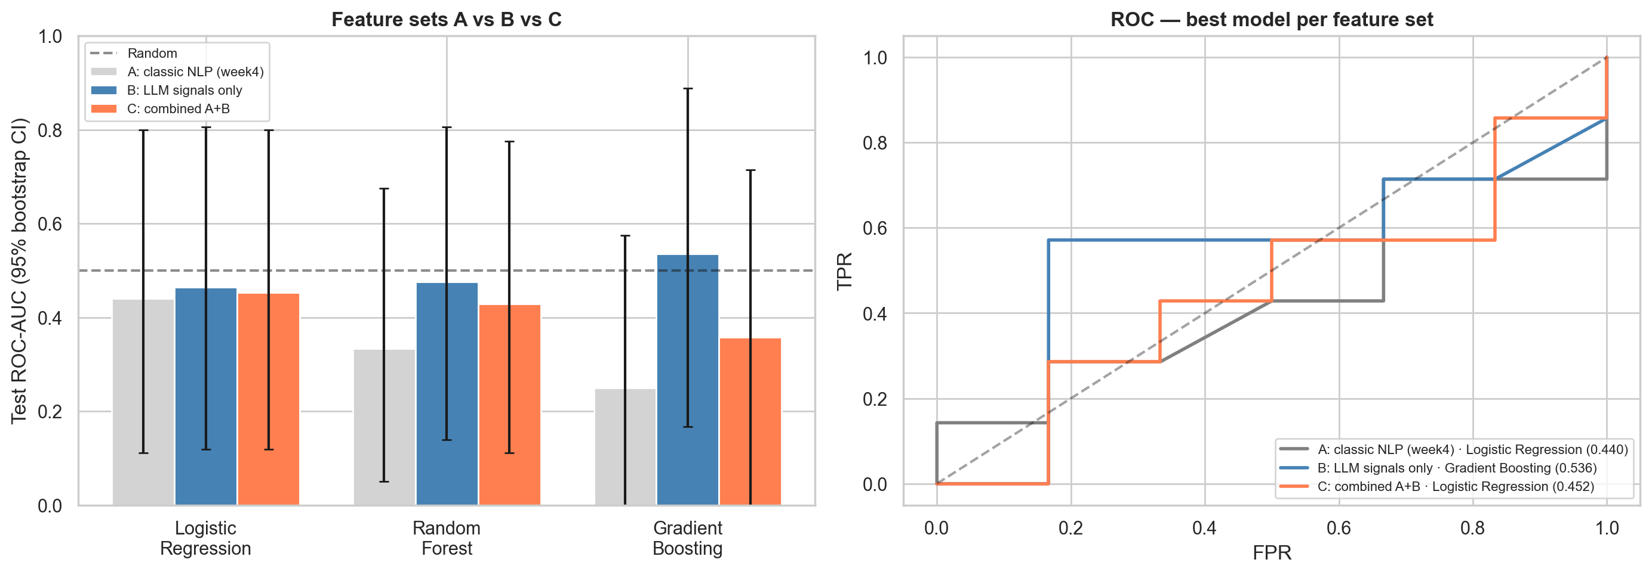
Results: Classic NLP vs LLM vs Combined
65 windows, identical rows & time split (train ≤ 2023-06-12), bootstrap 95% CIs
Feature set
Best model
Test ROC-AUC
95% CI (bootstrap)
A: classic NLP (week4)
Logistic Regression
0.440
[0.111, 0.800]
B: LLM signals only
Gradient Boosting
0.536
[0.167, 0.889]
C: combined A+B
Logistic Regression
0.452
[0.119, 0.800]
CIs overlap (Δ = +0.012): the LLM does not clearly beat the classic stack on pre-announcement prediction - consistent with week 3-4's null.
M&A Prediction | JPMorgan Industry Project | July 2026

Slide 7
Why the AUC Is Flat - In Plain English
AUC ≈ 0.5 = shown a run-up window and a quiet window, the model can't tell which is which
The bet: deal chatter should appear MORE in the 90 days before an announcement than in an earlier “quiet” period. When that holds, the model ranks the run-up higher and AUC climbs toward 1.0.
What actually happens: it holds for some companies (left) - but for just as many, the chatter surfaces in the “quiet” window instead (right), because deal talk leaks on its own schedule, not on our calendar. The two cancel out, so the model does no better than a coin flip → AUC ≈ 0.5.
✓ READS CORRECTLY - chatter in the run-up (what we hoped for)
✗ READS BACKWARDS - chatter in the “quiet” window
Clearwater Analytics Holdings, Inc.*
LLM's acquisition_likelihood (0-100): quiet 5 → run-up 55
what it read in the run-up window:
“Warburg Pincus , Permira said to be in talks to buy Clearwater Analytics ( CWAN : NYSE )”
what it read in the quiet window:
“Clearwater Analytics Promotes Key Executives to Accelerate Growth and Operational Excellence”
Commercial Renewables business
LLM's acquisition_likelihood (0-100): quiet 60 → run-up 5
what it read in the run-up window:
“Duke Energy delivers sustainable value as it responsibly navigates clean energy transition , CEO tells shareholders”
what it read in the quiet window:
“Duke Energy hopes renewable biz sale makes stock more attractive”
Across 28 paired companies: 6 scored higher in the run-up · 8 lower · 14 tied - the ups and downs roughly balance, and a balanced split is exactly what AUC ≈ 0.5 looks like.
M&A Prediction | JPMorgan Industry Project | July 2026

Slide 8
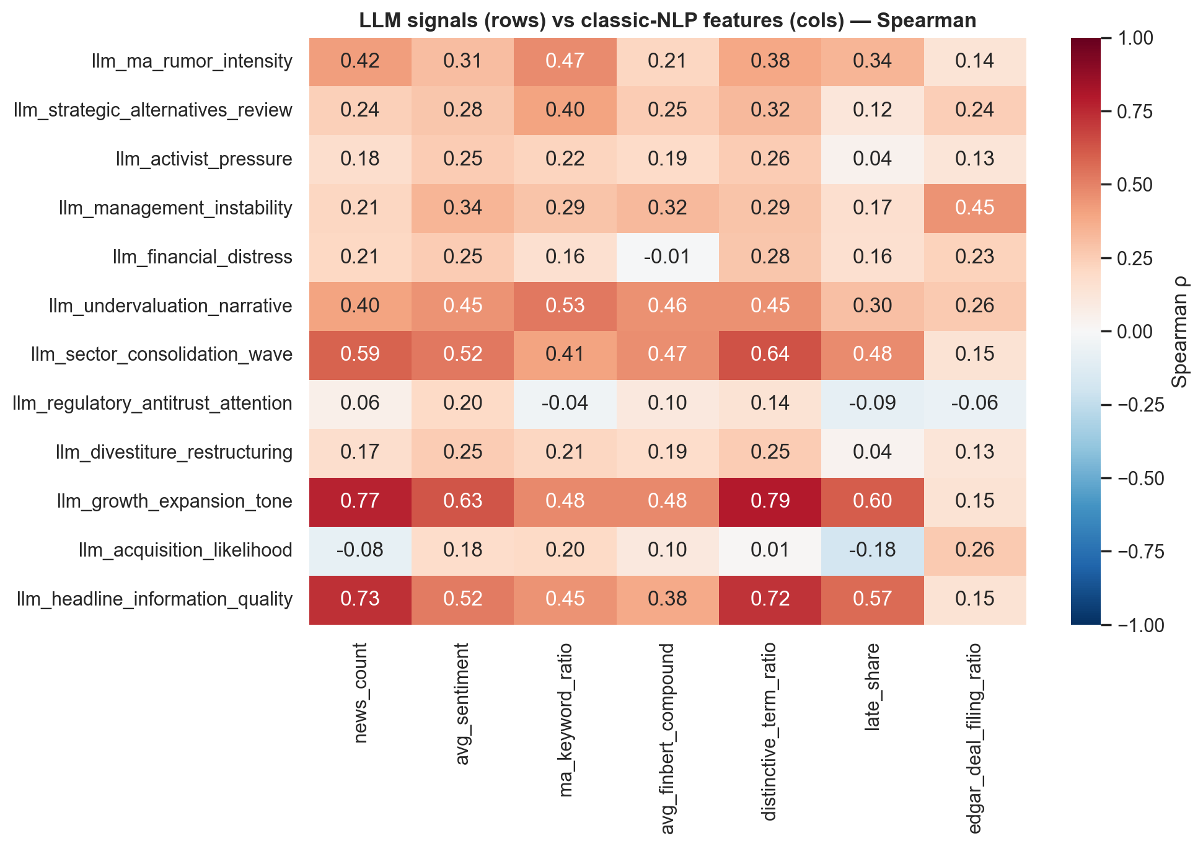
Are the LLM Signals New Information?
Spearman rank correlation - LLM fields (rows) × classic-NLP features (columns), same windows
How to read it:
• Each cell: across the same windows, do the two scores rank companies the same way? (+1 identical ranking · 0 unrelated · −1 opposite)
• A deep-red row = that LLM field re-derives a classic feature - redundant.
• A near-white row = information the classic stack does not capture - novel.
• Hottest cell: growth_expansion_tone × distinctive_term_ratio (ρ = +0.79) - the LLM's rumor read largely re-derives simple keyword matching.
• Mid/low rows (activist, distress, divestiture…) are genuinely new descriptive axes the keyword stack misses.
Takeaway: partly redundant, partly novel - but §6 shows neither the redundant nor the novel parts separate pre from baseline on this corpus.
Novelty without predictivity: the LLM adds new ways to DESCRIBE the news - not new ability to PREDICT from it.
M&A Prediction | JPMorgan Industry Project | July 2026

Slide 9
Does the Model Already Know These Deals?
Memorization probe: zero news shown - answer from training memory alone
Design (balanced, chance = 50%):
• “As of <date>: was <company> announced as a
≥$1B acquisition target within 120 days?”
• Asked at announcement−7d (truth = YES)
• Asked at announcement−187d (truth = NO)
• Same companies as the modeling sample
52%
71%
probe accuracy (50% = clean)
acquirer named correctly (17 recall claims)
52%
50%
accuracy PRE-cutoff (< 2024-06-01, memorizable)
accuracy POST-cutoff (unseen deals)
Why this matters:
If the model recalls outcomes without any news, every
pre-cutoff “prediction” is potentially an act of memory,
not inference. The pre- vs post-cutoff gap isolates it.
Is the 71% a memorization problem?
No - real memory, but not time-localized:
71% acquirer recall = entity memory, only on the 17 windows it self-flags (knows who bought whom).
52% yes/no ≈ chance = but it can't place a deal in time (a fact has no timeline).
52% pre ≈ 50% post-cutoff = deals it could have memorized score no higher than ones it never saw, so no edge.
Memorization is real but NOT time-localized: 71% acquirer recall, yet the yes/no probe is at chance and pre- ≈ post-cutoff - so it does not inflate the results.
M&A Prediction | JPMorgan Industry Project | July 2026

Slide 10
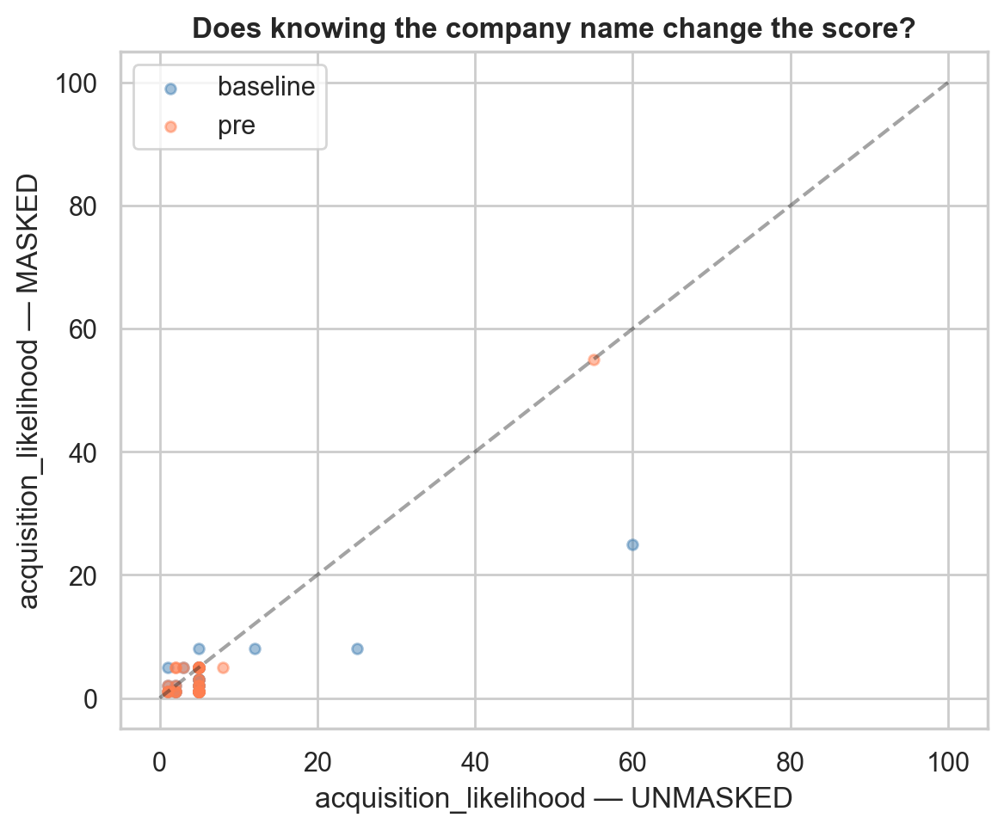
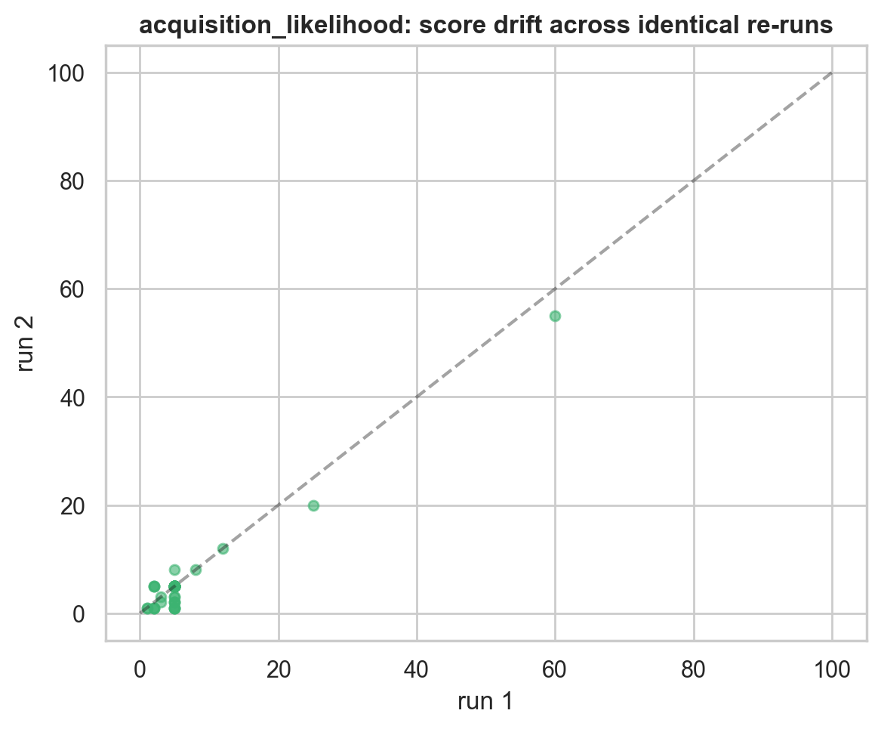
Masking & Repeatability
Do the scores hold up? Testing recognition-vs-reading and run-to-run stability
Left chart: does the name do the work?
Right chart: are the numbers stable?
Each dot is one company: score with the name vs with it hidden.
Dots BELOW the dashed line = hiding the name LOWERED the score.
ΔAUC = +0.06: part of the 'signal' is recognizing the company, not reading the news, so it may not carry to unknown companies.
Same window scored twice: run 1 vs run 2.
Dots sit ON the line = the re-run gives almost the same number.
Spearman 0.80, drift ~1.2 pts on 0-100: the scores are reproducible, not arbitrary, so they carry real information even if imperfect.
Read together: the scores are stable and not random (good), but some of the apparent skill is recognizing the company rather than reading the text, the caveat for scoring companies the model has never seen.
M&A Prediction | JPMorgan Industry Project | July 2026

Slide 11
Model Sensitivity & What $100 Buys
gpt-5 vs gpt-5-mini on 65 shared windows - does ~10x price buy a different read?
0.662
0.54 / 0.55
4.3x
$0.36
score agreement (mean Spearman)
subset AUC: mini / gpt-5
cost ratio per window
actual total spend this week
Run
Model
Approx. cost
Score ~1,400 windows (700 events × 2)
gpt-5-mini
≈ $2.50
Same, company names masked
gpt-5-mini
≈ $2.50
Memorization probe (2 calls/event)
gpt-5-mini
≈ $0.60
100-event sensitivity subset ×2 variants
gpt-5
≈ $4.00
Everything above at gpt-5 prices
gpt-5
≈ $45 - still inside $100
Cost is NOT the constraint - validity is. The binding limit is look-ahead bias and score stability, not the API bill.
M&A Prediction | JPMorgan Industry Project | July 2026

Slide 12
Honest Read & The Right Fix
The bottom-line finding, three honest caveats, and the fix that makes it trustworthy
Look-ahead bias
Arbitrary numbers
Thin data + API gate
LLM trained on news about these deals.
Fix: OpenRouter - pin models whose
training cutoff predates the eval window;
makes look-ahead structurally impossible.
'activist_pressure = 7' is a judgment.
Fix: average repeat scores, calibrate
against realized frequencies, keep
evidence quotes mandatory (auditable).
Only 37 events LLM-scored - an OpenAI
credit issue paused scaling (resolving now);
small test sets swing AUC ±0.05+.
Fix: fund credits (full run ≈ a few $),
scale scrape, add article bodies.
The verdict: the best model across all three feature sets scores AUC 0.54, a coin flip.
Even a frontier LLM reading the same free news cannot reliably separate a pre-announcement window from a quiet one. The LLM set's small edge over classic NLP sits inside the noise of a 13-window test set, and part of it is name recognition (masking drops AUC 0.06), so it is not trustworthy evidence. This is the same null result as week 4, now confirmed with a generative LLM.
Week 7 fix: a cutoff-matched backtest via OpenRouter on the full event set, the only version of this result an investor should trust.
M&A Prediction | JPMorgan Industry Project | July 2026

Slide 13
Thanks
M&A Prediction | JPMorgan Industry Project | July 2026

