Slide 1
M&A Prediction
J.P. Morgan – Industry Project
Proposal| Jun 10, 2026
Ronald Liu Dexin Fu

Slide 2
Project Goal
Build a forecasting system for S&P 500 returns using Google's TimesFM foundation model, leading toward a trading agent.
01
02
Forecasting
Direction
Predict returns across 1-21 day horizons using TimesFM 2.5 200M
Classify up/down moves with calibrated probability estimates

Slide 3
Project Timeline
1
Week 1
Baseline
Zero-shot TimesFM on close prices and returns
2
Week 2
Metrics Expansion
Added MAE, direction, quantile coverage; rolling backtest
3
Week 3
Standardization
Single holdout vs rolling design
4
Week 4
LoRA Fine-Tuning
Adapter-based fine-tuning, 1.23M trainable params (0.53%)
5
Week 5
Peer Mixer
Cross-attention with self-aux/peers + DirectionHead
6
Week 6
Validation Split
Time-ordered validation, best-checkpoint, class-balanced BCE

Slide 4
Data & Setup
Dataset
Forecast Setup
Source
Databento OHLCV (adjusted)
Model
TimesFM 2.5 200M
Universe
502 S&P 500 stocks
Horizons
1, 5, 10, 21 days
Date Range
May 2018 - May 2026
Context
512 days
Trading Days
2,013 days
Backtest
Rolling, stride = 5
Total Rows
960,723 post-adjustment
Target Universe
10 stocks (MSFT, AAPL...)

Slide 5
Architecture Evolution
Weeks 1-3
Week 4
Weeks 5-6
v1: Zero-Shot
v2: LoRA Fine-Tuned
v3: Peer Mixer + Validation
• Pretrained TimesFM 2.5
• Adapters on qkv_proj + out
• Cross-attention on top
• No fine-tuning
• 1.23M trainable params
• Self-aux + DirectionHead
• Univariate input only
• Smooth L1 loss
• Validation + best checkpoint
• 20-30% MAE improvement
• 20-36% MAE improvement
• ~65% MAE improvement

Slide 6
Fine-Tuning
Low-Rank Adaptation
Structure
Advantage
LoRA, or Low-Rank Adaptation, freezes the original pretrained TimesFM weights and adds small trainable adapter matrices inside selected model layers. During training, only these adapter parameters are updated.
The goal is to make TimesFM better aligned with our dataset, including:
S&P 500 daily stock prices
Simple returns
Log returns
Forecast horizons of 1, 5, 10, and 21 trading days
Full fine-tuning would update all TimesFM parameters, which is expensive and can easily overfit because TimesFM 2.5 has more than 200M parameters.
LoRA trains only about 1.23M parameters, which is around 0.53% of the model.
Much cheaper than full fine-tuning
Less memory pressure than full fine-tuning
More stable for limited financial data
Less likely to destroy the pretrained knowledge already inside TimesFM

Slide 7
Fine-Tuning
LoRA Training Configuration
LoRA rank | 8
LoRA alpha | 16
LoRA dropout | 0.05
Epochs | 2
Batch size | 8
Learning rate | 0.0001
Weight decay | 0.0001
Loss function | Smooth L1 loss
Structure
The LoRA fine-tuning is inserted into the TimesFM transformer attention layers.
model.stacked_xf[*].attn.qkv_proj
model.stacked_xf[*].attn.out
These are the input & output attention projection layers inside each TimesFM transformer block. The pretrained TimesFM weights remain frozen. The model keeps its original learned time-series representation, while the LoRA adapters learn small task-specific adjustments for financial data.
Target | Training Samples | Epoch 1 Loss | Epoch 2 Loss | Loss Drop
Close price | 2,004 | 5.414857 | 4.750981 | 12.26%
Returns | 4,008 | 0.000247 | 0.000218 | 11.87%
The LoRA adapters successfully learned some financial-domain adjustment without modifying the full TimesFM backbone.

Slide 8
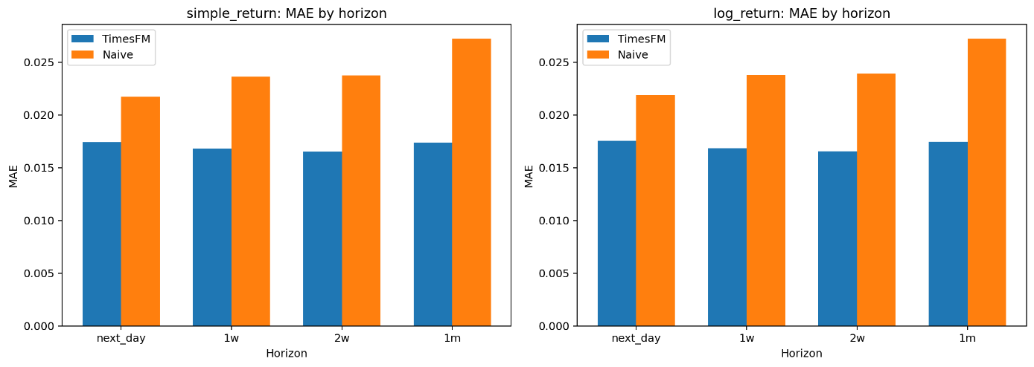
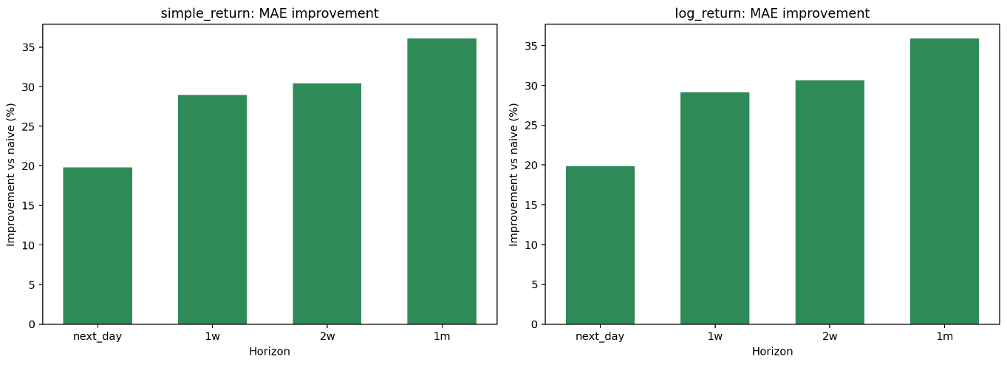
LoRA Fine-Tuning
Return Forecasting Result
Target | Horizon | TimesFM MAE | Naive MAE | Improvement vs Naive
Simple return | Next day | 0.017341 | 0.021734 | 20.21%
Simple return | 1 week | 0.016759 | 0.023633 | 29.09%
Simple return | 2 weeks | 0.016499 | 0.023764 | 30.57%
Simple return | 1 month | 0.017383 | 0.027227 | 36.16%
Log return | Next day | 0.017426 | 0.021868 | 20.31%
Log return | 1 week | 0.016811 | 0.023767 | 29.27%
Log return | 2 weeks | 0.016543 | 0.023895 | 30.77%
Log return | 1 month | 0.017438 | 0.027226 | 35.95%

Slide 9
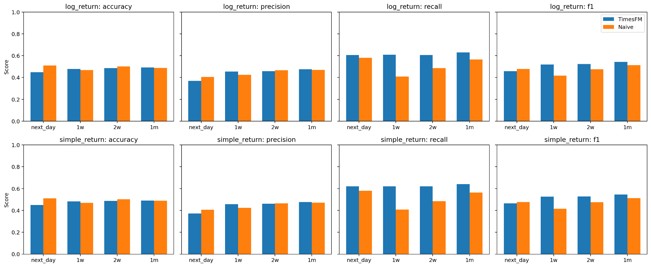
LoRA Fine-Tuning
Direction Classification Result
Return Type | Horizon | TimesFM Accuracy | Naive Accuracy | TimesFM F1 | Naive F1
Simple return | Next day | 0.4680 | 0.5100 | 0.4784 | 0.4776
Simple return | 1 week | 0.4860 | 0.4688 | 0.5257 | 0.4160
Simple return | 2 weeks | 0.4912 | 0.5024 | 0.5322 | 0.4751
Simple return | 1 month | 0.4983 | 0.4879 | 0.5520 | 0.5133
Log return | Next day | 0.4660 | 0.5100 | 0.4713 | 0.4776
Log return | 1 week | 0.4892 | 0.4688 | 0.5258 | 0.4160
Log return | 2 weeks | 0.4914 | 0.5024 | 0.5286 | 0.4751
Log return | 1 month | 0.4986 | 0.4879 | 0.5475 | 0.5133

Slide 10
Peer Mixer
Cross-attention architecture
- Use extra market context for better prediction results. Series from self features or other stocks return/features are assume to help for prediction.
TimesFM output projection
Target log returns
TimesFM tokenizer
Target tokens Query
return forecast
Cross-attention mixer + gated residual
Frozen TimesFM transformer layers (stacked_xf)
Final hidden state
Self-aux or peer series
TimesFM tokenizer
Companion tokens Key / Value
DirectionHead MLP
up/down probability
Trainable
Cross-attention weights
Gate parameter
DirectionHead MLP
Frozen
TimesFM tokenizer
TimesFM transformer layers
TimesFM output projection
Objective
Regression Head: Smooth L1 on cumulative return
Direction Head: classifier on final hidden state using BCE

Slide 11
Peer Mixer
Cross-attention architecture
Self-Aux Mode
Peers Mode
Auxiliary channels from the target stock itself: Momentum: 1d, 5d, 10d, 21d, 60d returns Volume: 1d, 5d, 10d, 21d, 60d volume changes 10 auxiliary channels total.
Self-aux features use clipped pct_change in [-3, 3]. Target tokens = Query Self-aux tokens = Key + Value
Close prices from hand-picked sector peers: NVDA: AMD, AVGO, AMAT, LRCX, KLAC JPM: BAC, C, GS, MS, WFC, PNC XOM: CVX, COP, EOG, SLB, HAL Target tokens = Query Peer stock tokens = Key + Value
Both modes: TimesFM backbone is frozen. Trainable components are cross-attention adapters and optional DirectionHead. Loss is smooth L1 on cumulative returns and cross-entropy on direction.

Slide 12
Peer Mixer
Experiment matrix and feature design
Four comparable runs separate the input source question from the horizon specialization question.
Run | Aux input | Horizons | What it tests
h10_self | Self-Aux | 10d | Own momentum/volume, single-horizon specialization
h10_peers | Peers | 10d | Sector peer stock context at 10d
h51021_self | Self-Aux | 5 / 10 / 21d | Own features across multiple horizons
h51021_peers | Peers | 5 / 10 / 21d | Peer context across multiple horizons
Training setup
10 target stocks
Context = 512 trading days
10 epochs, lr = 5e-5, 4 attention heads
Evaluation setup
640 rolling windows per horizon
Cumulative log-return regression
DirectionHead classification metrics
Reporting principle
Use MAE improvement for magnitude
Use balanced accuracy, MCC, ROC-AUC for direction

Slide 13
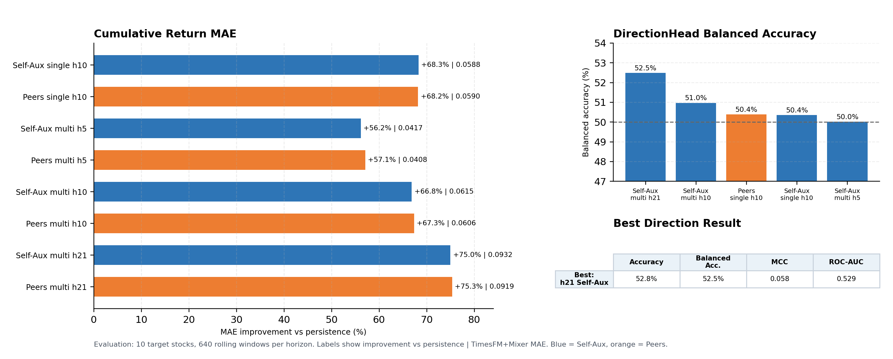
Peer Mixer
Performance comparison
Readout: h10 self-aux is best for magnitude; h21 multi-horizon self-aux is best for DirectionHead. Peers slightly help multi-horizon MAE, but not direction.

Slide 14
Validation Split Inside Training Prefix
Previous
all prefix samples used for optimization
New
train
validation
backtest
Key idea
Validation is still inside the training prefix.
Split is chronological, not random.
Default validation fraction is 0.20.
No leakage into rolling backtest windows.

Slide 15
Validation Logging + Best Checkpoint
Logged each epoch
Best checkpoint logic
val/peer_mixer/epoch_loss
val/peer_mixer/epoch_cumulative_loss
val/peer_mixer/epoch_direction_accuracy
val/peer_mixer/epoch_direction_balanced_accuracy
val/peer_mixer/epoch_direction_mcc
After each epoch: run validation.
Compare selected validation metric.
Keep best state_dict in memory.
After training: restore best state_dict.
DirectionHead run uses val_direction_balanced_accuracy.

Slide 16
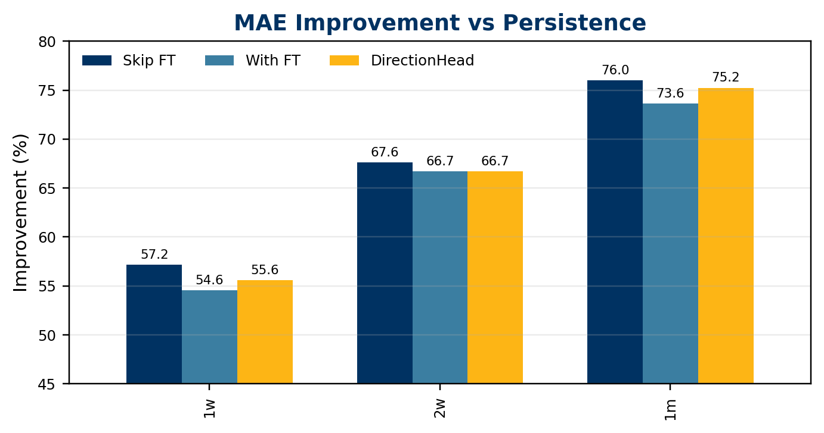
Regression Result: Cumulative Log Return MAE
Run | Avg MAE | Naive MAE | MAE Imp.
Skip FT | 0.0630 | 0.2158 | 66.9%
With FT | 0.0673 | 0.2158 | 65.0%
DirectionHead | 0.0650 | 0.2158 | 65.8%
Run | 1w | 2w | 1m
Skip FT | 57.2% | 67.6% | 76.0%
With FT | 54.6% | 66.7% | 73.6%
DirectionHead | 55.6% | 66.7% | 75.2%
All runs beat persistence by about 65% average MAE improvement. Skip FT is best on MAE in these outputs.

Slide 17
DirectionHead Improvements
Week 6 upgrade: class-balanced loss + expanded direction metrics
Loss Function
Before:
BCEWithLogitsLoss(logit, label)
After:
BCEWithLogitsLoss(pos_weight = N_down / N_up)
Class-balanced to fight bullish bias
Metrics Added
Before:
Accuracy, F1
After:
Balanced Accuracy, MCC, Precision, Recall, Specificity, Confusion Matrix
Avoid majority-class shortcuts

Slide 18
Final Experiment Comparison
Skip FT vs With FT vs DirectionHead -> same targets, horizons, rolling windows
Skip FT
Best on MAE; DirectionHead helps balanced accuracy and MCC; strongly up-biased
Peer mixer only, no LoRA
With FT
LoRA didn't help MAE here, but reduced extreme up-bias; less biased direction
LoRA + peer mixer
DirectionHead Run
Balanced metrics improve, but prediction shifts toward down (over-correction)
Balanced BCE + val checkpoint

Slide 19
Direction Classification: Best Result
h=21 Self-Aux DirectionHead with class-balanced BCE
Interpreting the numbers
52.5%
Raw accuracy is inflated by bullish bias. Model predicts 'up' ~75% of the time when market is up only ~54%. Class-balanced BCE reduces this but can over-correct toward 'down'. MCC of 0.058 = small but real positive signal (0 is random, 1 is perfect).
balanced accuracy
MCC
0.058
ROC-AUC
0.529
Raw Accuracy
52.8%

Slide 20
Key Insights
1
Peer Mixer is the strongest architecture
Cross-attention on top of frozen TimesFM gives ~65% MAE improvement, outperforming both zero-shot and pure LoRA fine-tuning.
2
Fine-tuning trades MAE for less bias
LoRA didn't improve MAE in our setup, but it reduced extreme up-bias in direction predictions. There's a tradeoff between magnitude accuracy and direction calibration.
3
Validation is essential for picking checkpoints
Training loss alone is misleading. Chronological validation split with best-checkpoint selection is the core upgrade that makes results reliable.
4
Direction signal is real but needs careful control
MCC of 0.058 confirms positive signal. Class-balanced BCE helps but can over-correct. Threshold calibration and trading-aware metrics are the next levers.

Slide 21
Thank You
Dexin Fu · Yihan Lin · Yimei Cheng · Al Bensaid
Questions?

