Slide 1
FUNdamentals of Biostatistics (Lectures 1-4)
BIOSTAT 201A Fall 2025
Discussion 2 – October X, 2025
Cindy J. Pang

Slide 2
Outline
Lecture 1: Biostatistics, Inference, and Data
Population vs. Sample, Parameter vs. Statistic
Types of Data
Lecture 2: Parameters vs. Statistics, Summary Statistics, and Data Visualization (See Problem 1)
Measures of Location
Measures of Spread
Describing a Distribution
Data Visualization - Boxplots
Lecture 3: Probability, Conditioning, and Independence (see Problems 2 and 3)
Lecture 4: Random Variables, Sampling, and The Central Limit Theorem
Discrete Random Variables
Properties of the Normal Distribution
Central Limit Theorem

Slide 3
Outline
Lecture 1: Biostatistics, Inference, and Data
Population vs. Sample, Parameter vs. Statistic
Types of Data
Lecture 2: Parameters vs. Statistics, Summary Statistics, and Data Visualization (See Problem 1)
Measures of Location
Measures of Spread
Describing a Distribution
Data Visualization - Boxplots
Lecture 3: Probability, Conditioning, and Independence (see Problems 2 and 3)
Lecture 4: Random Variables, Sampling, and The Central Limit Theorem
Discrete Random Variables
Properties of the Normal Distribution
Central Limit Theorem

Slide 4
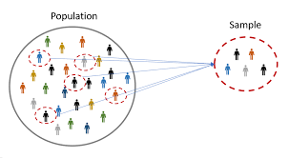
1.1 Population vs. Sample, Parameter vs. Statistic

Slide 5
1.2 Types of Data
Quantitative (“Quantifiable”) – discrete or continuous response of measurable magnitude
Continuous – can take on an uncountable set of values
Discrete – can take on a limited, and often fixed number of possible values
(2) Qualitative – no corresponding set of numbers
Can you produce some examples of each type of data?

Slide 6
1.2 Types of Data
Stevens’ Scale of Data Classification
 | Categorical | Order | Equal Spacing | True Zero | Examples
Nominal – categorical data without any sensible ordering of values | X
Ordinal – categorical or discrete data with a natural ranking/ordering relationship | X | X
Interval – has a notion of distance, defined by measurement units of equal size | X | X | X
Ratio – has a notion of magnitudes or “x times greater” | X | X | X | X

Slide 7
Outline
Lecture 1: Biostatistics, Inference, and Data
Population vs. Sample, Parameter vs. Statistic
Types of Data
Lecture 2: Parameters vs. Statistics, Summary Statistics, and Data Visualization (See Problem 1)
Measures of Location
Measures of Spread
Describing a Distribution
Data Visualization - Boxplots
Lecture 3: Probability, Conditioning, and Independence (see Problems 2 and 3)
Lecture 4: Random Variables, Sampling, and The Central Limit Theorem
Discrete Random Variables
Properties of the Normal Distribution
Central Limit Theorem

Slide 8
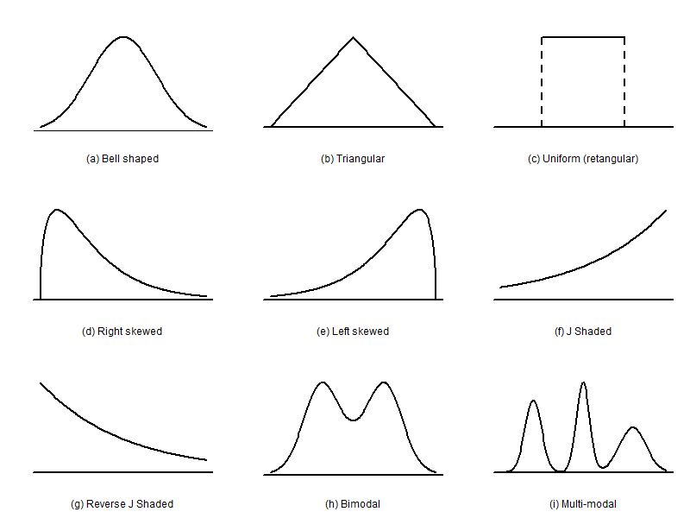
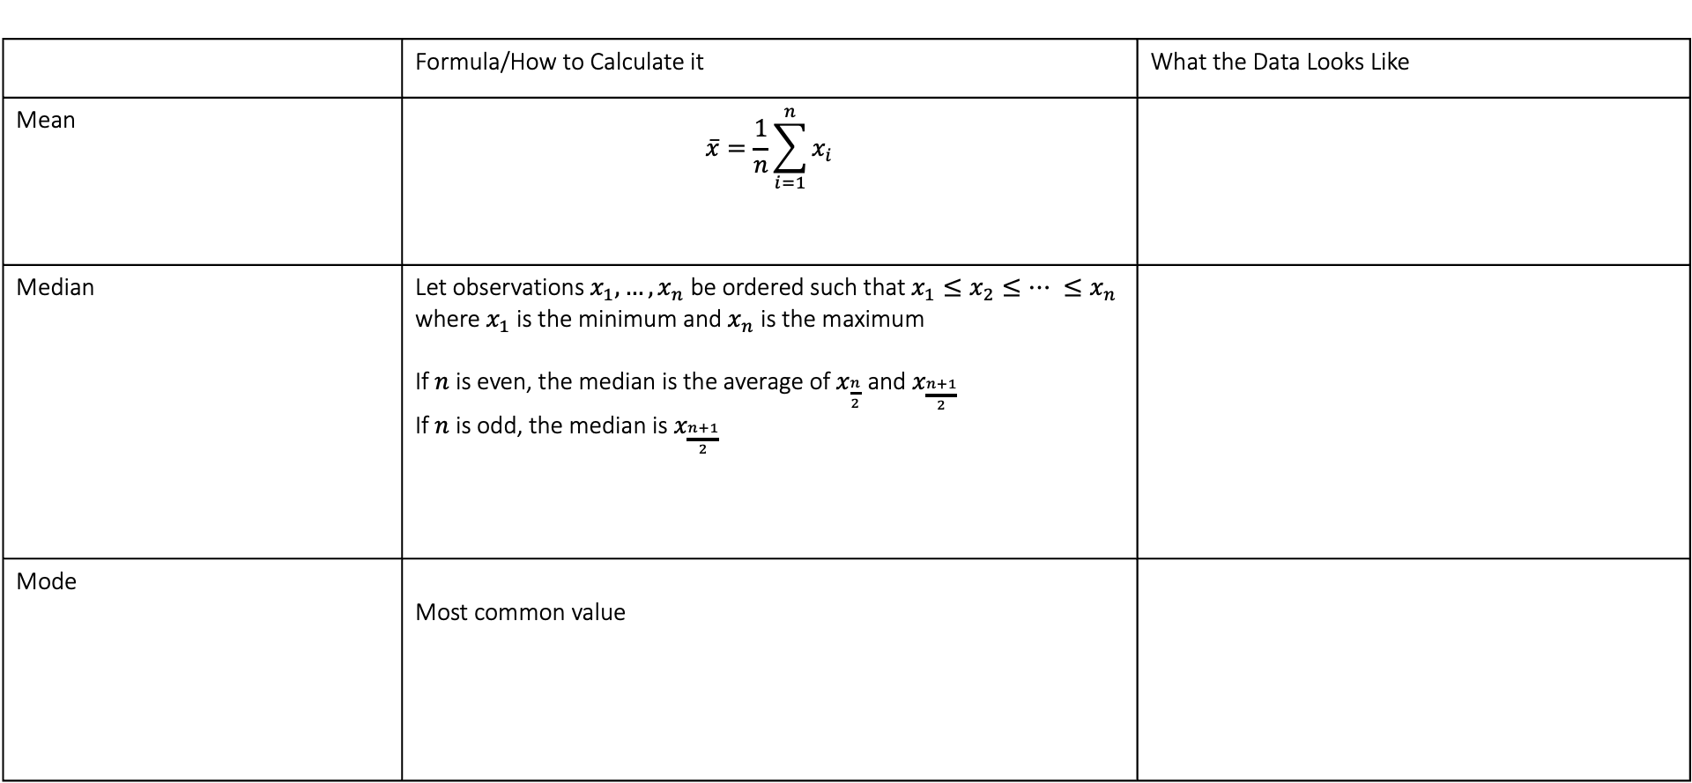
2.1 Measures of Location
 | Formula/How to Calculate it | What the Data Looks Like
Mean | $$\overline{x}=\frac{1}{n}\sum_{i=1}^{n}{x_{i}}$$
Median | Let observations $x_{1},…, x_{n}$ be ordered such that $x_{1}≤x_{2}≤… ≤x_{n}$ where $x_{1}$ is the minimum and $x_{n}$ is the maximum If $n$ is even, the median is the average of $x_{\frac{n}{2}}$and $x_{\frac{n+1}{2}}$ If $n$ is odd, the median is $x_{\frac{n+1}{2}}$
Mode | Most common value

Slide 9
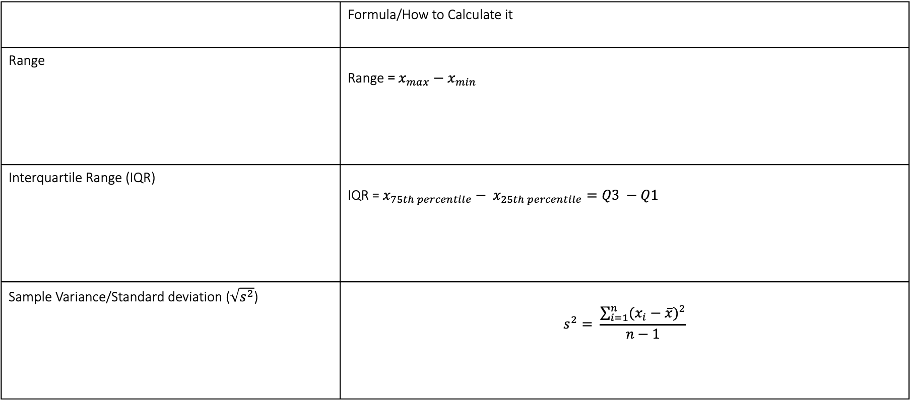
2.2 Measures of Spread
 | Formula/How to Calculate it
Range | Range = $x_{max}−x_{min}$
Interquartile Range (IQR) | IQR = $x_{75th percentile}− x_{25th percentile}=Q3 −Q1$
Sample Variance/Standard deviation ($\sqrt{s^{2}}$) | $$s^{2}= \frac{\sum_{i=1}^{n}{{(x_{i}−\overline{x})}^{2}}}{n−1}$$

Slide 10
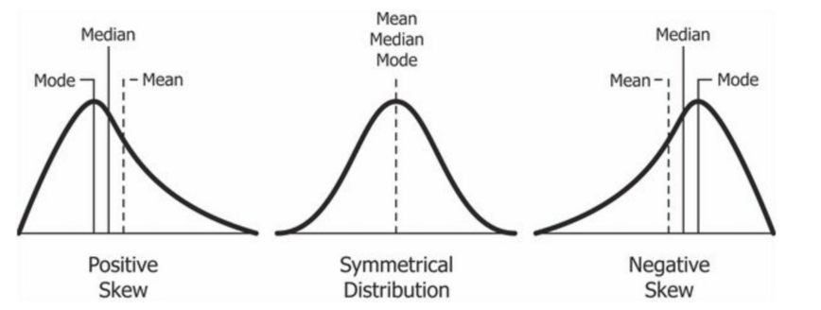
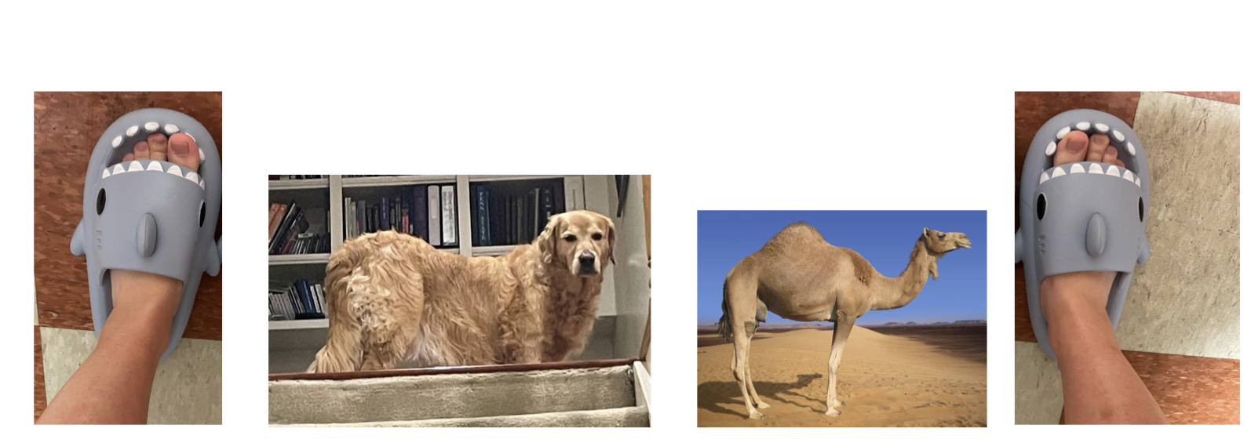
2.3 Describing a Distribution

Slide 11
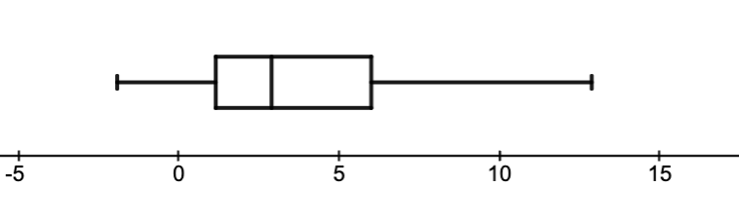
2.4 Data Visualization - Boxplots

Slide 12
2.4 Data Visualization – Stem and Leaf
15, 16, 21, 23, 23, 31, 35, 39, 40, 41, 46, 55, 56

Slide 13
Outline
Lecture 1: Biostatistics, Inference, and Data
Population vs. Sample, Parameter vs. Statistic
Types of Data
Lecture 2: Parameters vs. Statistics, Summary Statistics, and Data Visualization (See Problem 1)
Measures of Location
Measures of Spread
Describing a Distribution
Data Visualization - Boxplots
Lecture 3: Probability, Conditioning, and Independence (see Problems 2 and 3)
Lecture 4: Random Variables, Sampling, and The Central Limit Theorem
Discrete Random Variables
Properties of the Normal Distribution
Central Limit Theorem

Slide 14
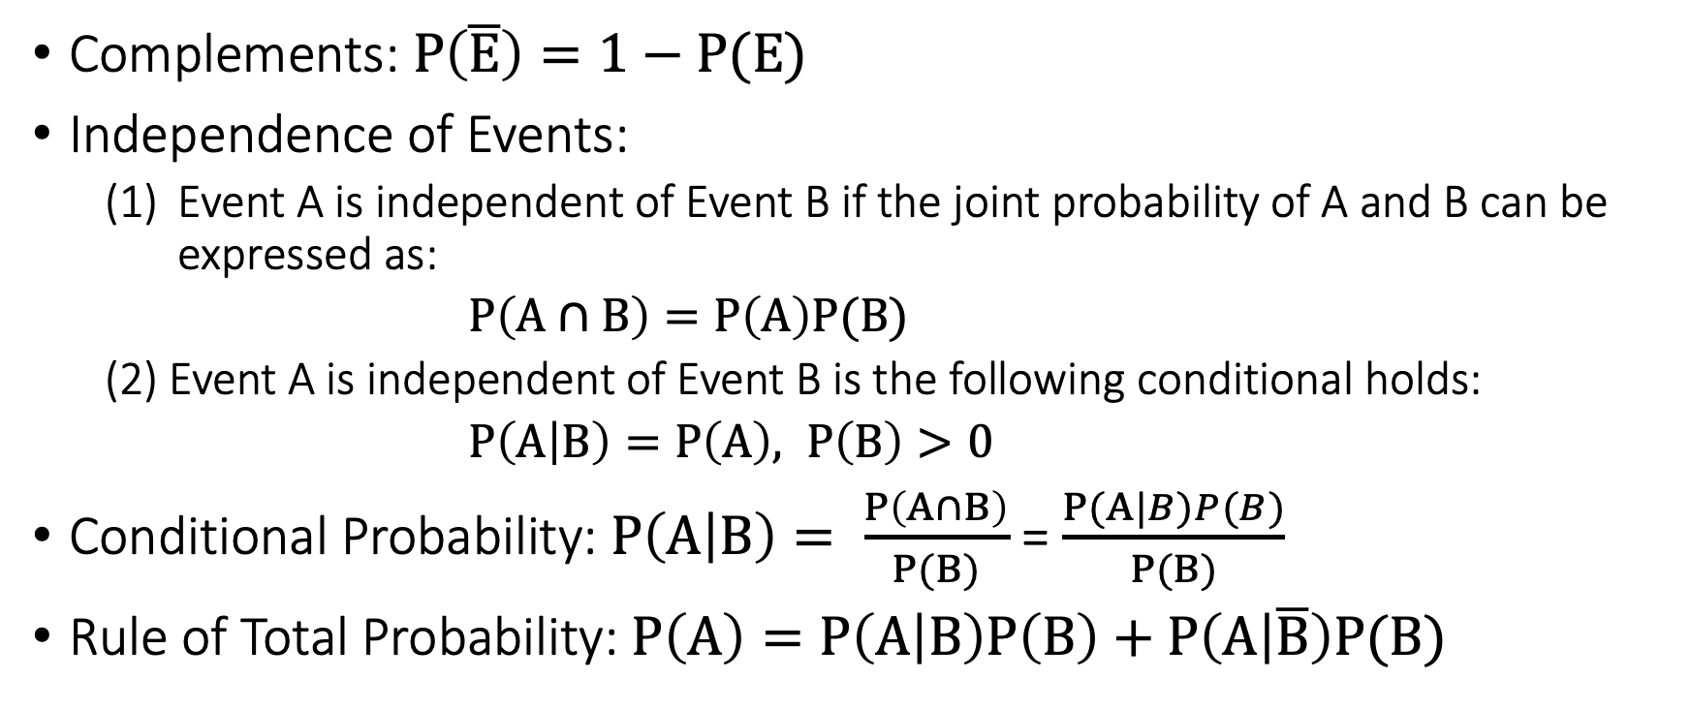
Some general probability rules
Complements: $P\left(\overline{E}\right)=1−P(E)$
Independence of Events:
Event A is independent of Event B if the joint probability of A and B can be expressed as:
$P\left(A∩B\right)=P\left(A\right)P(B)$
(2) Event A is independent of Event B is the following conditional holds:
$P\left(A | B\right)=P\left(A\right), P\left(B\right)>0$
Conditional Probability: $P\left(A | B\right)= \frac{P\left(A∩B\right)}{P(B)}$ = $\frac{P(A|B)P(B)}{P(B)}$
Rule of Total Probability: $P\left(A\right)=P\left(A | B\right)P\left(B\right)+P\left(A | \overline{B}\right)P(B)$

Slide 15
Outline
Lecture 1: Biostatistics, Inference, and Data
Population vs. Sample, Parameter vs. Statistic
Types of Data
Lecture 2: Parameters vs. Statistics, Summary Statistics, and Data Visualization (See Problem 1)
Measures of Location
Measures of Spread
Describing a Distribution
Data Visualization - Boxplots
Lecture 3: Probability, Conditioning, and Independence (see Problems 2 and 3)
Lecture 4: Random Variables, Sampling, and The Central Limit Theorem
Discrete Random Variables
Properties of the Normal Distribution
Central Limit Theorem

Slide 16
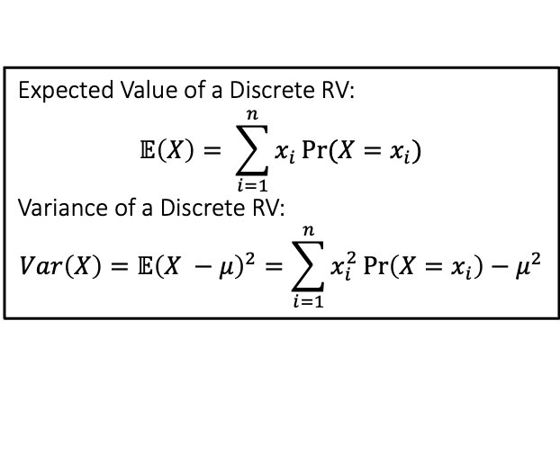
4.1 Discrete Random Variables - Example
Expected Value of a Discrete RV:
$$𝔼\left(X\right)= \sum_{i=1}^{n}{x_{i}}Pr⁡(X=x_{i})$$
Variance of a Discrete RV:
$$Var\left(X\right)=𝔼{\left(X −μ\right)}^{2}=\sum_{i=1}^{n}{x_{i}^{2}}\operatorname{Pr}\left(X=x_{i}\right)−μ^{2}$$
Probability Mass Function (PMF) – probability distribution for a discrete variable
Value | 1 | 2 | 4 | 6
Probability | 0.2 | 0.1 | 0.4 | 0.3
Exercise. Compute
(a) Expected Value of X:
(b) Variance of X:
(c ) Construct the cumulative distribution function (cdf)

Slide 17
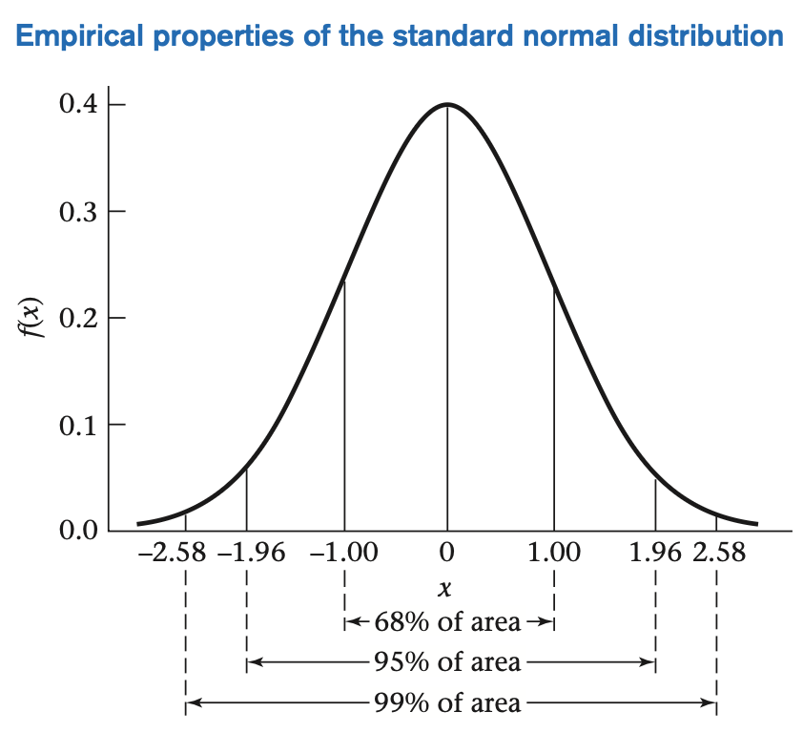
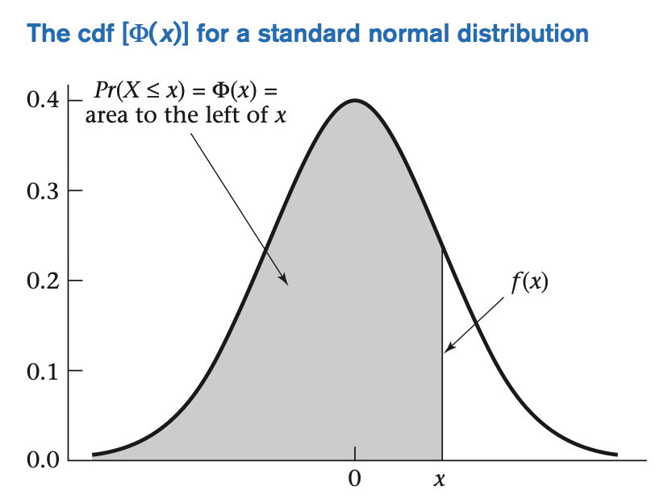
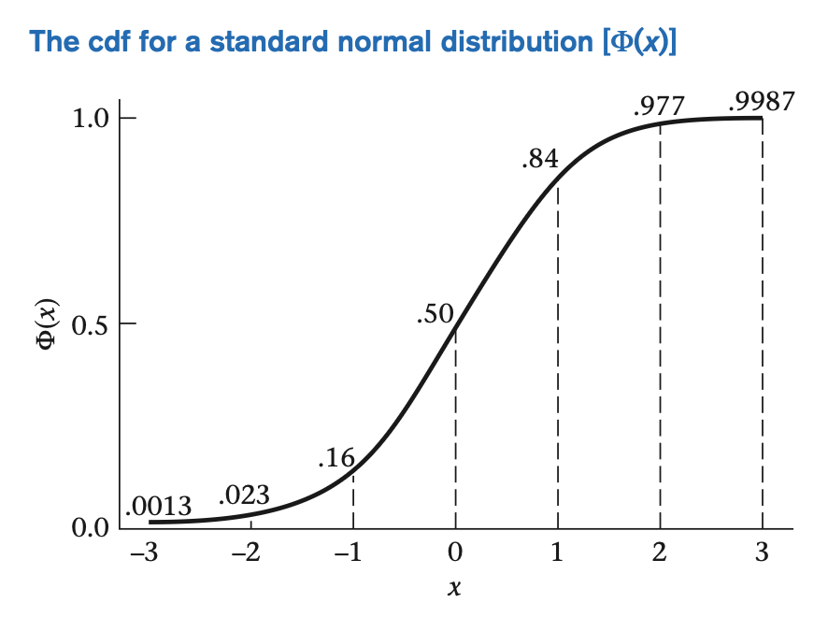
4.2 Properties of the Normal Distribution – The Empirical Rule and CDF

Slide 18
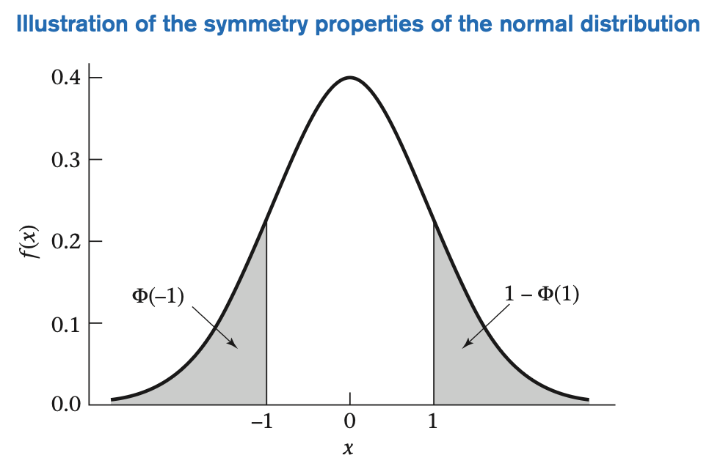
4.2 Properties of the Normal Distribution - Symmetry
$$Φ\left(−x\right)=1−\operatorname{Pr}\left(X≤x\right)=1−Φ(x)$$

Slide 19
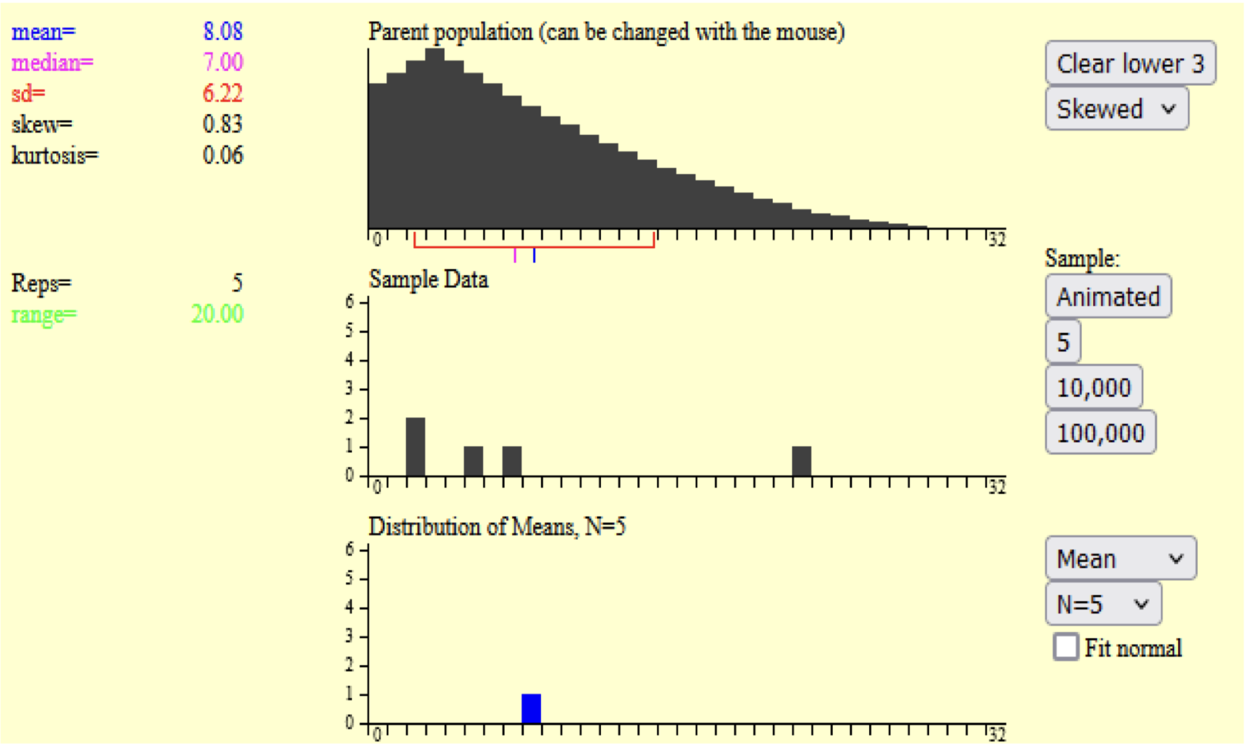
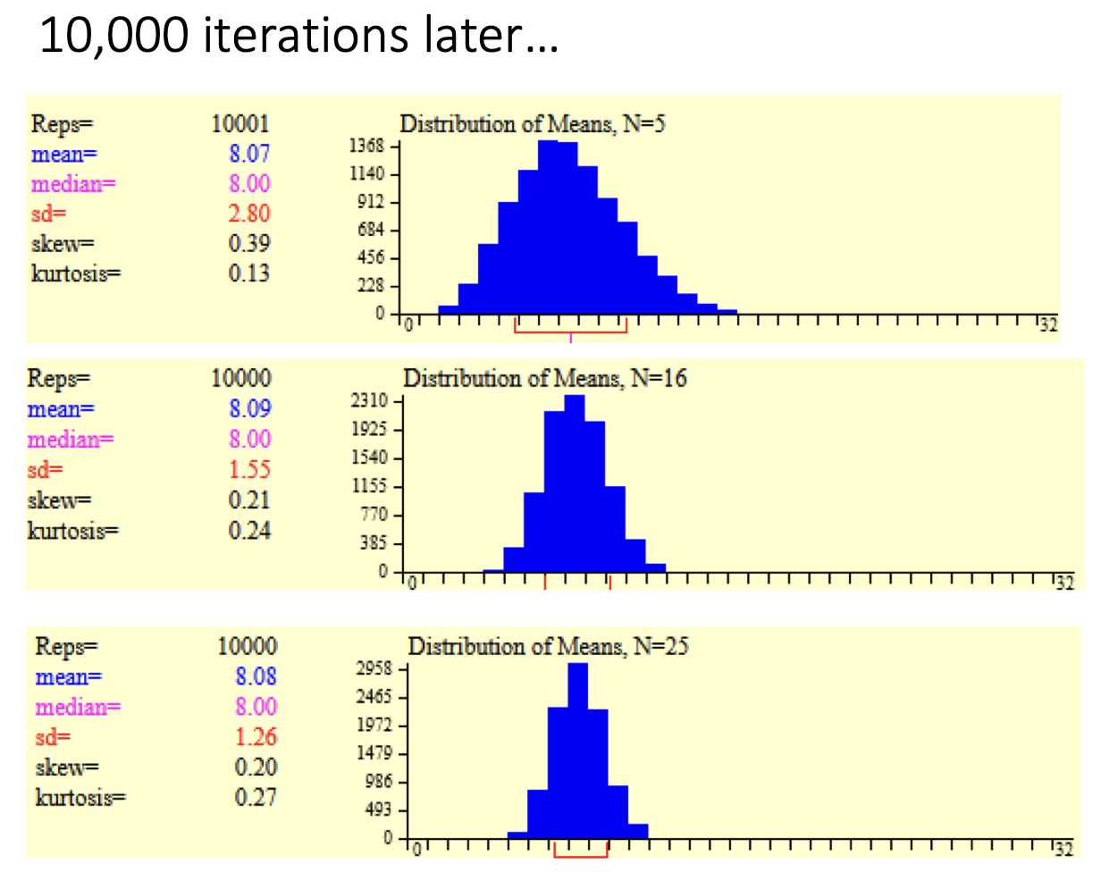
4.3 Central Limit Theorem - Illustration
What do you notice?
About the Shape?
What happens as we increase the sample size?
Simulation Link: https://onlinestatbook.com/stat_sim/sampling_dist/
Notes:
Notice that the distribution of means looks like a normal distribution and as the sample size increases, the standard deviation shrinks, as does the the shape of the normal distribution

