Slide 1
One-Sample Inference (Lectures 4 & 5)
BIOSTAT 201A Fall 2025
Discussion 3 – October 17, 2025
Cindy J. Pang

Slide 2
Outline
Lecture 4. Point and Confidence Interval Estimation for Population Mean
Sampling Distribution of the Mean
Confidence Intervals for Means
Lecture 5. Point and Confidence Interval Estimation for Population Proportion
Binomial Distribution
Normal Approximation to the Binomial Distribution

Slide 3
Outline
Lecture 4. Point and Confidence Interval Estimation for Population Mean
Sampling Distribution of the Mean
Confidence Intervals for Means
Lecture 5. Point and Confidence Interval Estimation for Population Proportion
Binomial Distribution
Normal Approximation to the Binomial Distribution

Slide 4
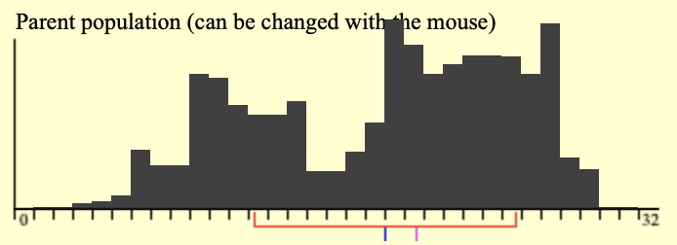
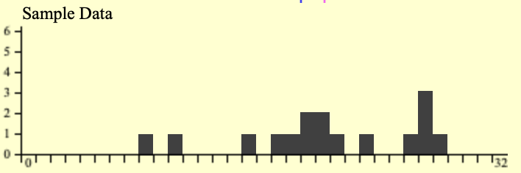
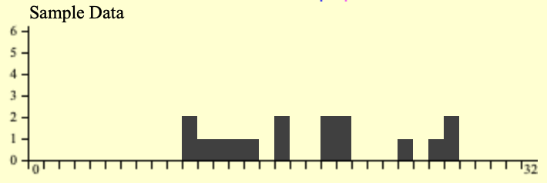
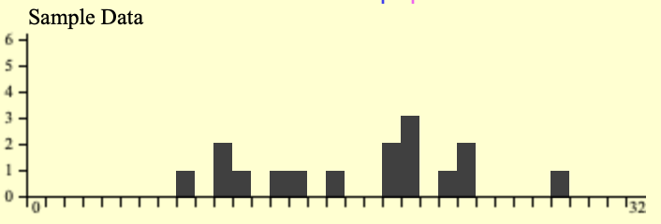

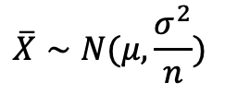


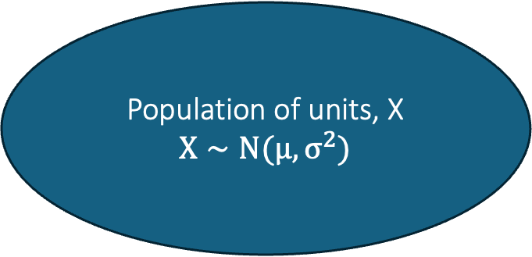



1.1 Sampling Distribution of the Mean
Population of units, X
$$X∼N(μ, σ^{2})$$
Sample #k of size n
Sample #1 of size n
Sample #2 of size n
…
$$\overline{x_{k}}$$
$$\overline{X}∼N(μ, \frac{σ^{2}}{n})$$
Sample Means:
$$\overline{x_{1}}$$
$$\overline{x_{2}}$$
Sample Variances:
$$s_{1}^{2}$$
$$s_{2}^{2}$$
$$s_{k}^{2}$$

Slide 5
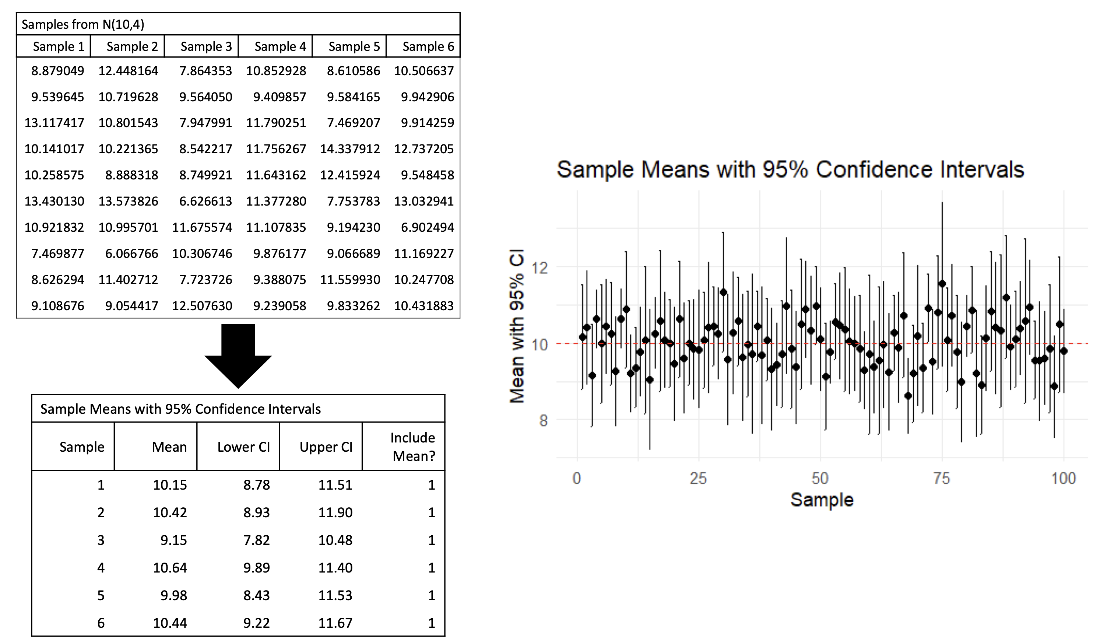
1.2 Confidence Intervals for Mean (Intuition)

Slide 6
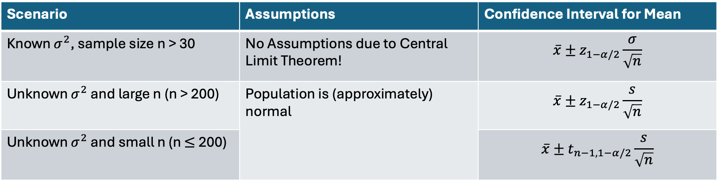
1.2 Confidence Intervals for Mean
Scenario | Assumptions | Confidence Interval for Mean
Known $σ^{2}$, sample size n > 30 | No Assumptions due to Central Limit Theorem! | $$\overline{x}±z_{1−α/2}\frac{σ}{\sqrt{n}}$$
Unknown $σ^{2}$ and large n (n > 200) | Population is (approximately) normal | $$\overline{x}±z_{1−α/2}\frac{s}{\sqrt{n}}$$
Unknown $σ^{2}$ and small n (n $≤$ 200) |  | $$\overline{x}±t_{n−1, 1−α/2}\frac{s}{\sqrt{n}}$$

Slide 7
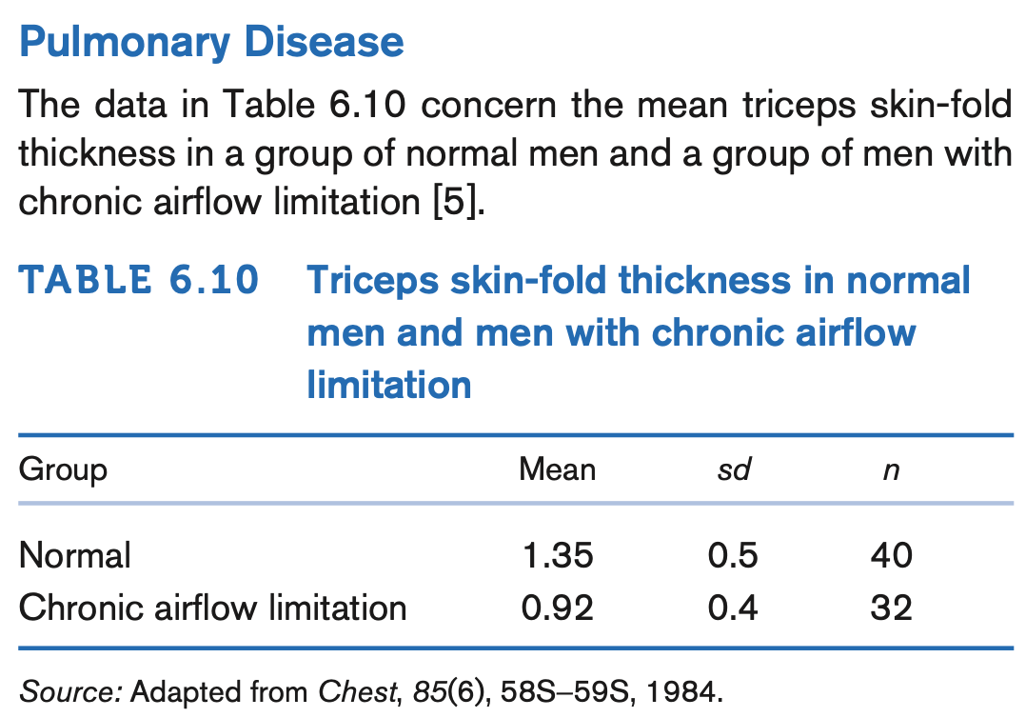
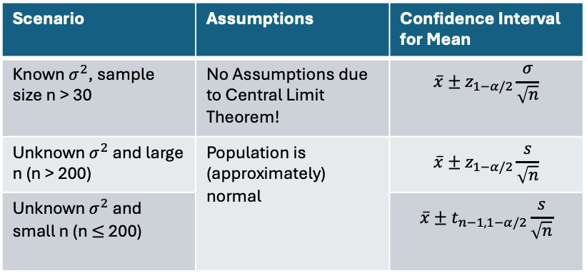
Exercise.
Compute the Standard Error of the Mean for the Normal Group
What is an Unbiased Estimator of the Population Mean?
What is an Unbiased Estimator of the Population Variance?
Compute a 95% Confidence Interval for the Mean of the Normal Group
Compute a 90% Confidence Interval for the Mean of the Normal Group
Compare the 90% vs. 95% Confidence Intervals. Which one is larger, and what does that tell you about the precision of the estimate?
Scenario | Assumptions | Confidence Interval for Mean
Known $σ^{2}$, sample size n > 30 | No Assumptions due to Central Limit Theorem! | $$\overline{x}±z_{1−α/2}\frac{σ}{\sqrt{n}}$$
Unknown $σ^{2}$ and large n (n > 200) | Population is (approximately) normal | $$\overline{x}±z_{1−α/2}\frac{s}{\sqrt{n}}$$
Unknown $σ^{2}$ and small n (n $≤$ 200) |  | $$\overline{x}±t_{n−1, 1−α/2}\frac{s}{\sqrt{n}}$$

Slide 8
Outline
Lecture 4. Point and Confidence Interval Estimation for Population Mean
Sampling Distribution of the Mean
Confidence Intervals for Means
Lecture 5. Point and Confidence Interval Estimation for Population Proportion
Binomial Distribution
Normal Approximation to the Binomial Distribution

Slide 9
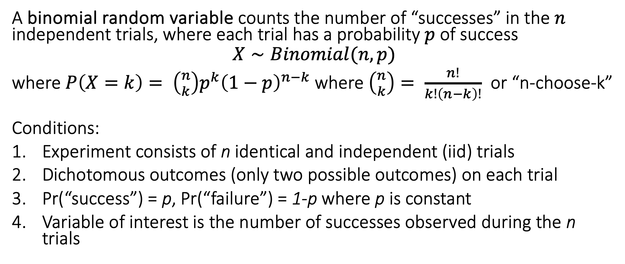
2.1 The Binomial Distribution
A binomial random variable counts the number of “successes” in the $n$ independent trials, where each trial has a probability $p$ of success
$$X∼Binomial(n, p)$$
where $P\left(X=k\right)= \left({n \atop k}\right)p^{k}{\left(1−p\right)}^{n−k}$ where $\left({n \atop k}\right)= \frac{n!}{k!\left(n−k\right)!}$ or “n-choose-k”
Conditions:
Experiment consists of n identical and independent (iid) trials
Dichotomous outcomes (only two possible outcomes) on each trial
Pr(“success”) = p, Pr(“failure”) = 1-p where p is constant
Variable of interest is the number of successes observed during the n trials

Slide 10
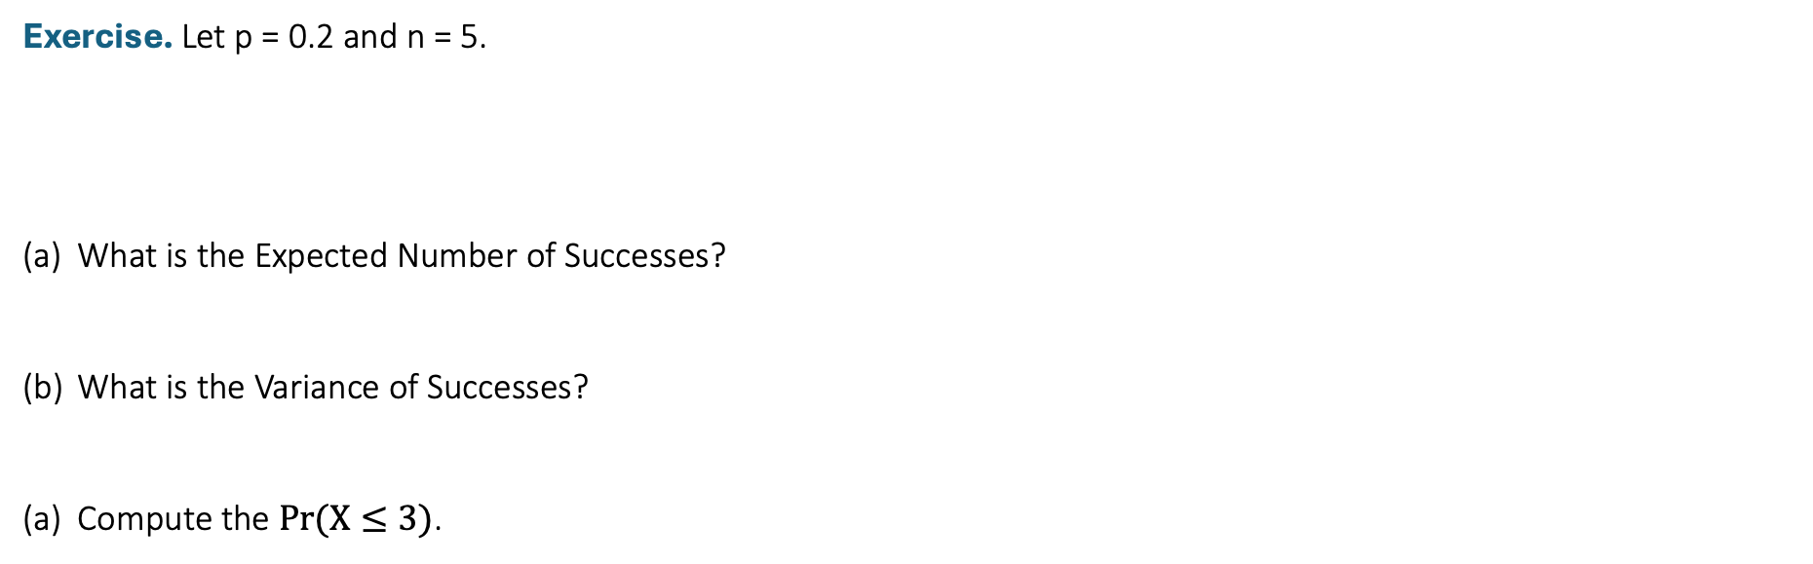
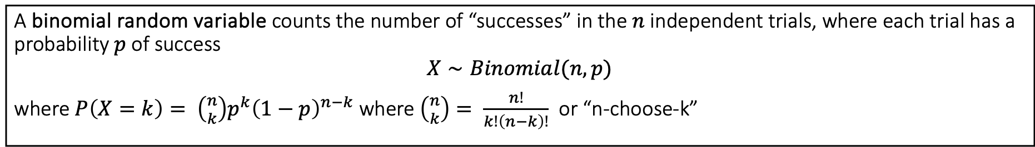
2.1 The Binomial Distribution
A binomial random variable counts the number of “successes” in the $n$ independent trials, where each trial has a probability $p$ of success
$$X∼Binomial(n, p)$$
where $P\left(X=k\right)= \left({n \atop k}\right)p^{k}{\left(1−p\right)}^{n−k}$ where $\left({n \atop k}\right)= \frac{n!}{k!\left(n−k\right)!}$ or “n-choose-k”
Exercise. Let p = 0.2 and n = 5.
What is the Expected Number of Successes?
What is the Variance of Successes?
Compute the $Pr⁡(X≤3)$.

Slide 11
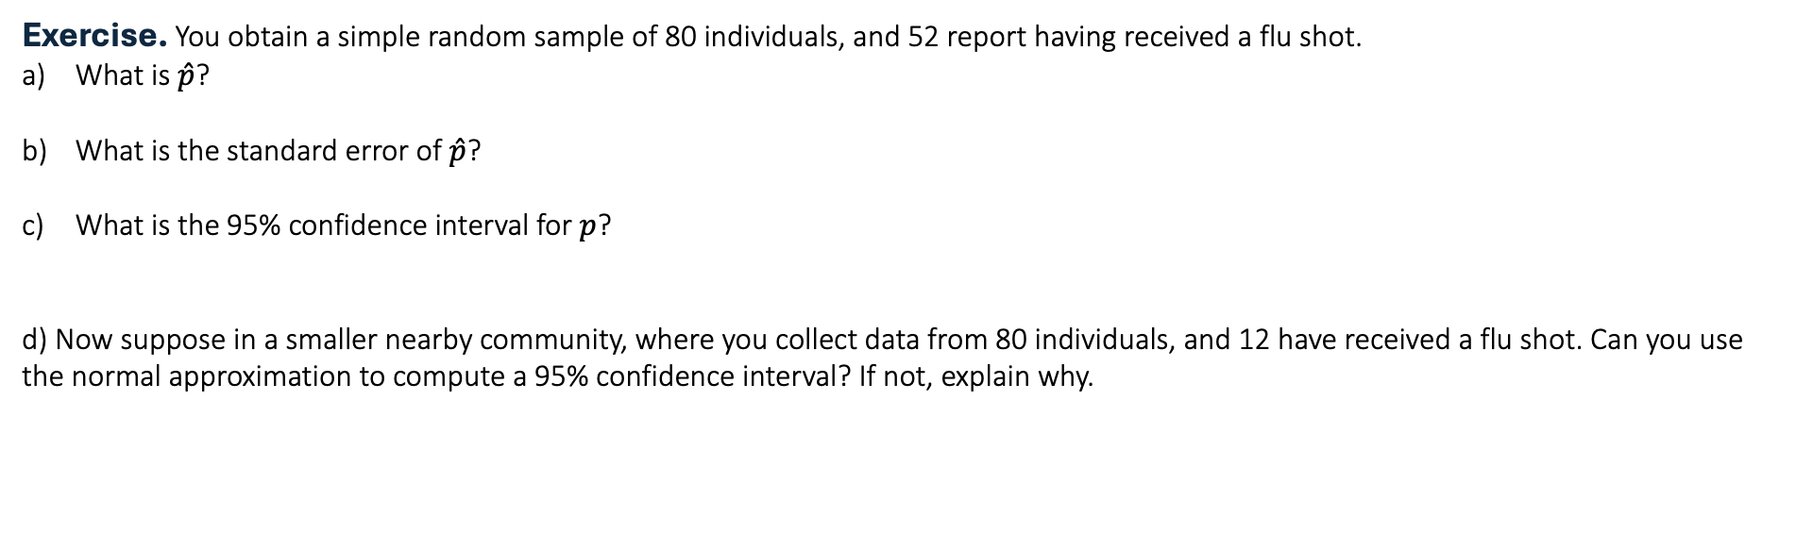
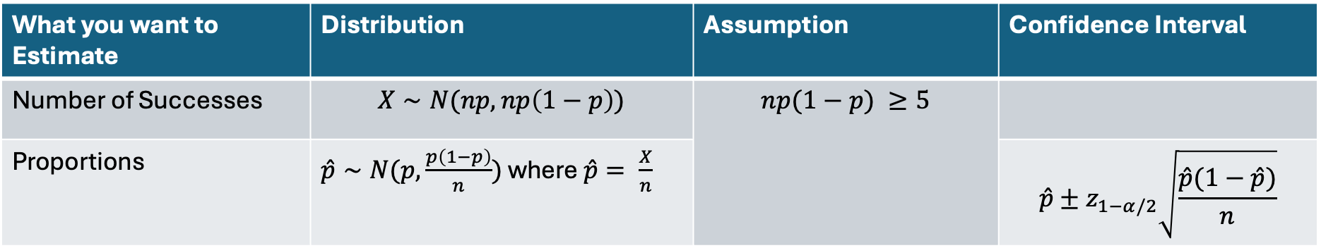
2.2 Normal Approximation to the Binomial Distribution
What you want to Estimate | Distribution | Assumption | Confidence Interval
Number of Successes | $$X∼N(np, np\left(1−p\right))$$ | $$np(1−p) ≥5$$
Proportions | $\hat{p}∼N(p, \frac{p\left(1−p\right)}{n})$ where $\hat{p}= \frac{X}{n}$ |  | $$\hat{p}±z_{1−α/2}\sqrt{\frac{\hat{p}(1−\hat{p})}{n}}$$
Exercise. You obtain a simple random sample of 80 individuals, and 52 report having received a flu shot.
What is $\hat{p}$?
What is the standard error of $\hat{p}$?
What is the 95% confidence interval for $p$?
d) Now suppose in a smaller nearby community, where you collect data from 80 individuals, and 12 have received a flu shot. Can you use the normal approximation to compute a 95% confidence interval? If not, explain why.

