Slide 1
2-Sample Categorical Data Fisher’s Exact Test, McNemar’s Test
BIOSTAT 201A Fall 2025
Discussion 8 – November 21, 2025
Cindy J. Pang

Slide 2
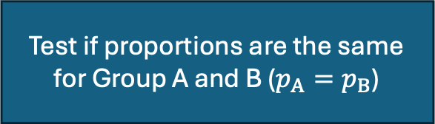
2-Sample Categorical Data
Test if proportions are the same for Group A and B ($p_{A}=p_{B}$)
Test if Groups A and B are Independent
Test if Groups A and B are equally effective for matched pairs data
McNemar’s Test
Two Sample Test for Difference in Proportions
Pearson’s Chi-Square Test
(use Fisher’s Exact test if expected counts are less than 5)
Today’s Discussion

Slide 3
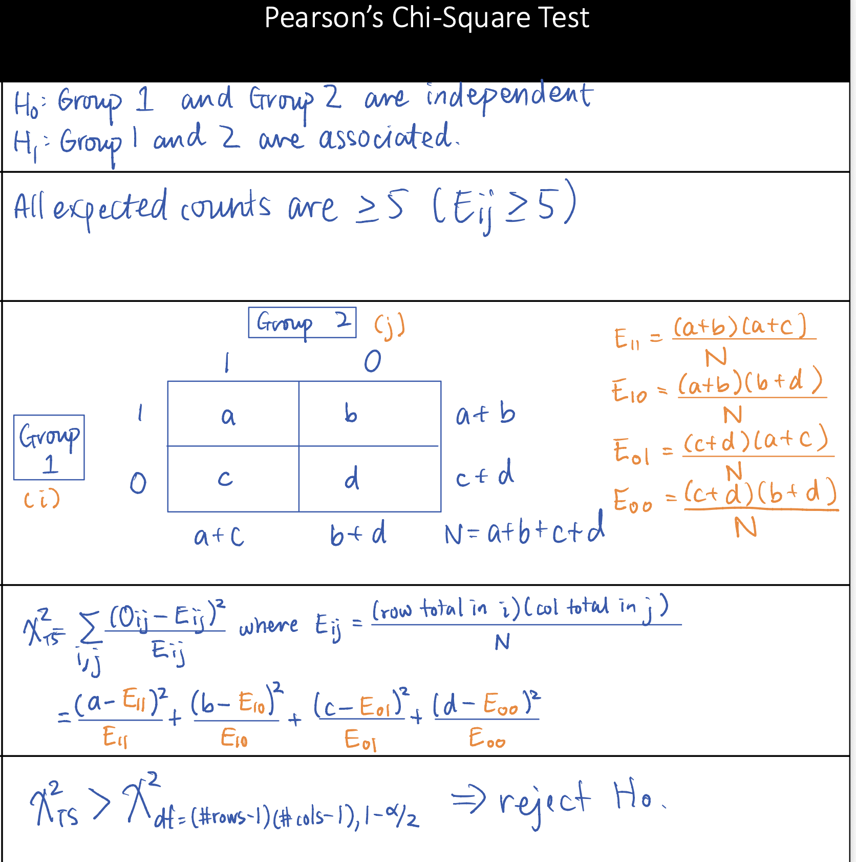
Recall from Last Class…
But now this assumption is violated such that at least one of the cells has an expected count less than 5
Use Fisher’s Exact Test!

Slide 4
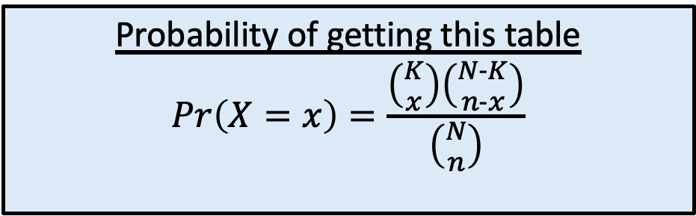
Fisher’s Exact Test - Hypergeometric Distribution
Suppose you have and urn with K white balls and N-K black balls and you draw n balls without replacement
Let x be the number of white balls in the sample, then X ~ Hypergeometric(N, K, n)
 | White | Black
Sampled | x | n-x | n
Not Sampled |  |  | N-n
 | K | N-K | N
Probability of getting this table
$$Pr\left(X=x\right)=\frac{\left({K \atop x}\right)\left({N-K \atop n-x}\right)}{\left({N \atop n}\right)}$$

Slide 5
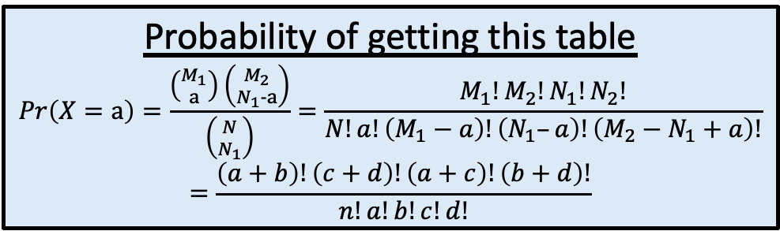
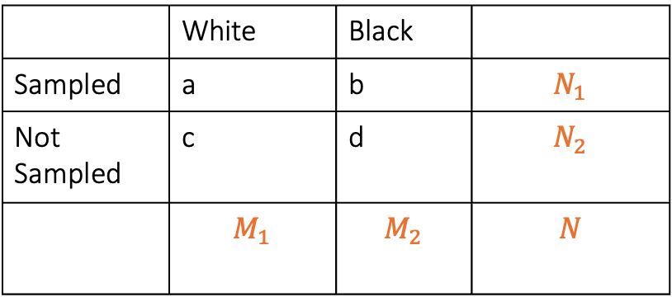
Fisher’s Exact Test - Hypergeometric Distribution (Rosner’s Version)
Suppose you have and urn with K white balls and N-K black balls and you draw n balls without replacement
Let x be the number of white balls in the sample, then X ~ Hypergeometric(N, K, n)
 | White | Black
Sampled | a | b | $$N_{1}$$
Not Sampled | c | d | $$N_{2}$$
 | $$M_{1}$$ | $$M_{2}$$ | $$N$$
Probability of getting this table
$$Pr\left(X=a\right)=\frac{\left({M_{1} \atop a}\right)\left({M_{2} \atop N_{1}-a}\right)}{\left({N \atop N_{1}}\right)}=\frac{M_{1}!M_{2}!N_{1}!N_{2}!}{N!a!\left(M_{1}−a\right)!\left(N_{1}–a\right)!\left(M_{2}−N_{1}+a\right)!}$$
$$=\frac{\left(a+b\right)!\left(c+d\right)!\left(a+c\right)!\left(b+d\right)!}{n!a!b!c!d!}$$
where $N_{1}≤N_{2}$ and $M_{1}≤M_{2}$

Slide 6
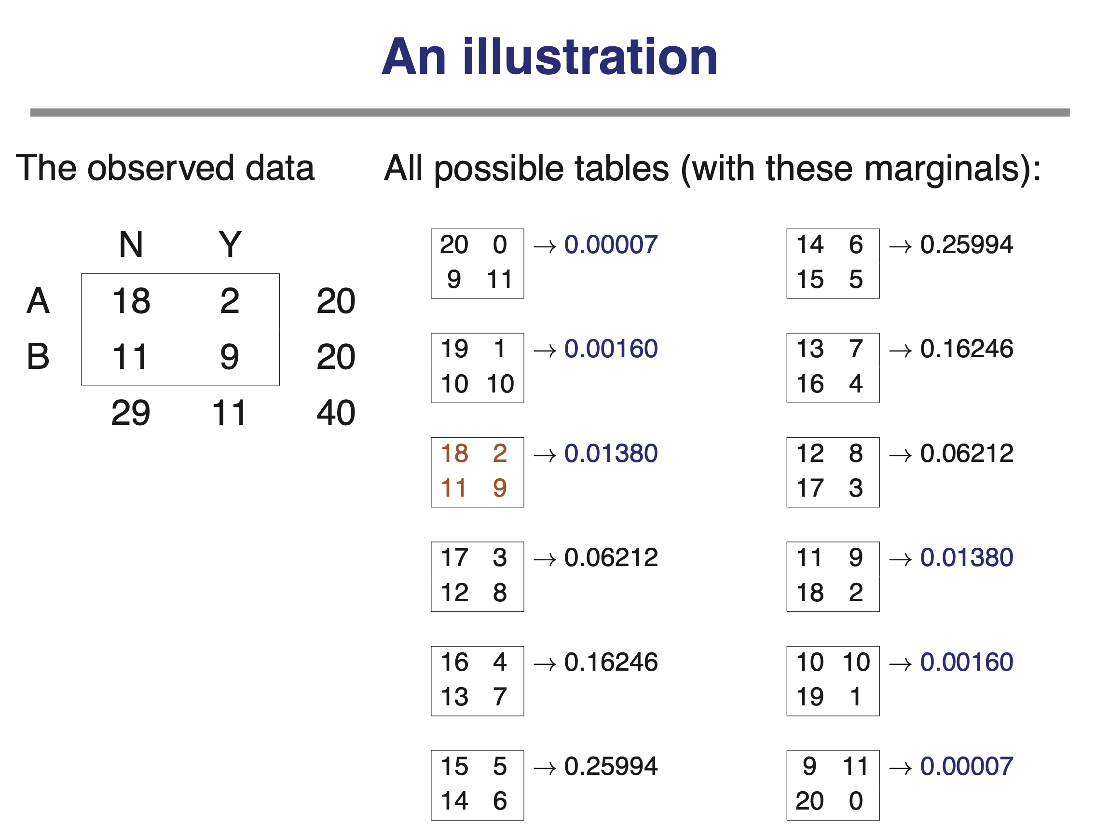
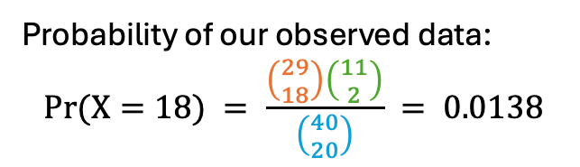
Computing p-Values
We want to know what the probability of getting a table more “extreme” or “as extreme” as our current table
Probability of our observed data:
$$Pr(X=18) = \frac{\left({29 \atop 18}\right)\left({11 \atop 2}\right)}{\left({40 \atop 20}\right)} = 0.0138$$

Slide 7
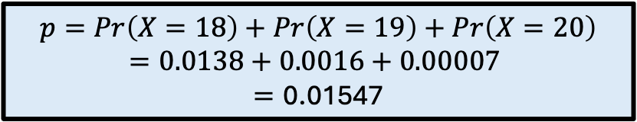
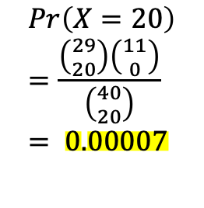
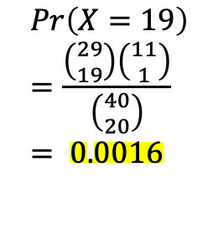

Computing p-Values
We want to know what the probability of getting a table more “extreme” or “as extreme” as our current table
Starting from your table, create the more “extreme” tables by dropping the lowest cell value by 1
$$p=Pr\left(X=18\right)+Pr\left(X=19\right)+Pr\left(X=20\right)$$
$$=0.0138+0.0016+0.00007$$
$$=\text{0.01547}$$
$$Pr(X=18) =0.0138$$
$$Pr\left(X=19\right)=\frac{\left({29 \atop 19}\right)\left({11 \atop 1}\right)}{\left({40 \atop 20}\right)} = 0.0016$$
$$Pr\left(X=20\right)=\frac{\left({29 \atop 20}\right)\left({11 \atop 0}\right)}{\left({40 \atop 20}\right)} = 0.00007$$

Slide 8
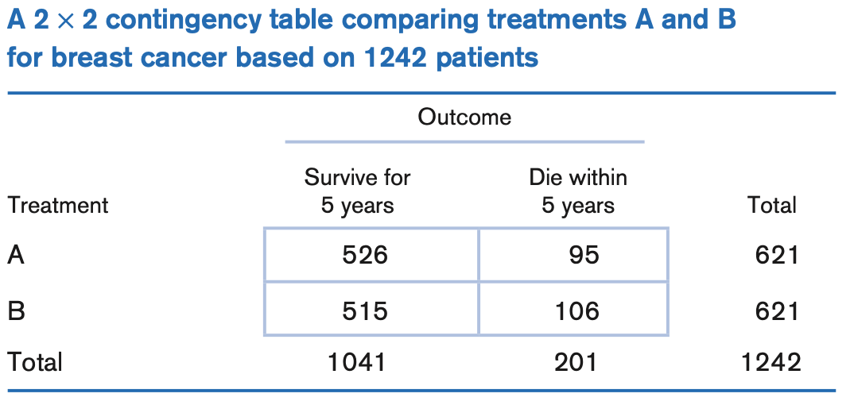
Matched-Pairs Experimental Design
Treatment A
Treatment B
5 years
A survives B survives
1
2
621
A survives B dies
A dies
B survives

Slide 9
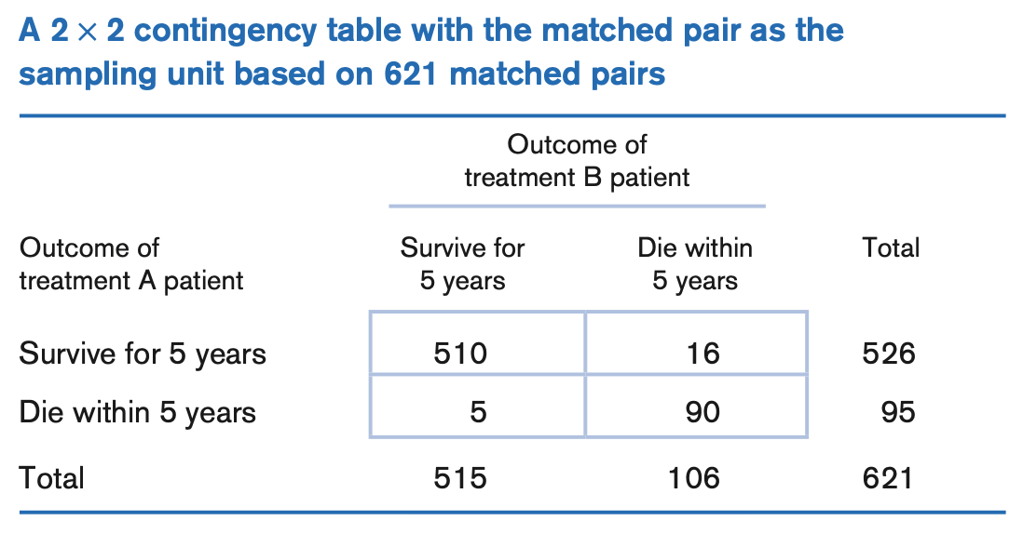
Matched-Pairs Experimental Design
Treatment A
Treatment B
5 years
A survives B survives
Concordant pair
1
2
621
A survives B dies
Type A Discordant Pair
Discordant pair
A dies
B survives
Type B Discordant Pair

Slide 10
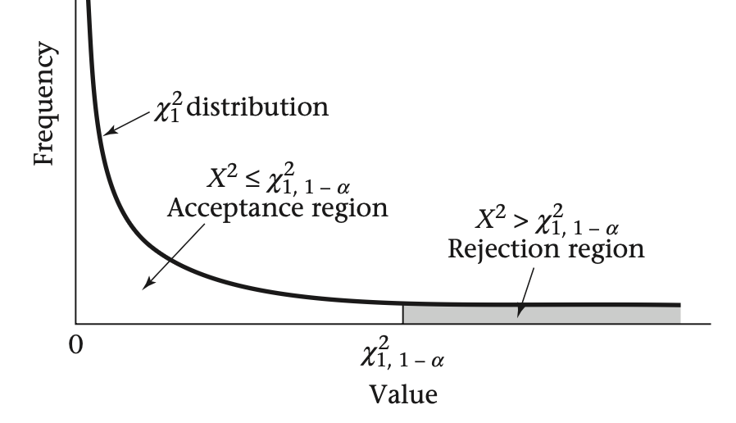
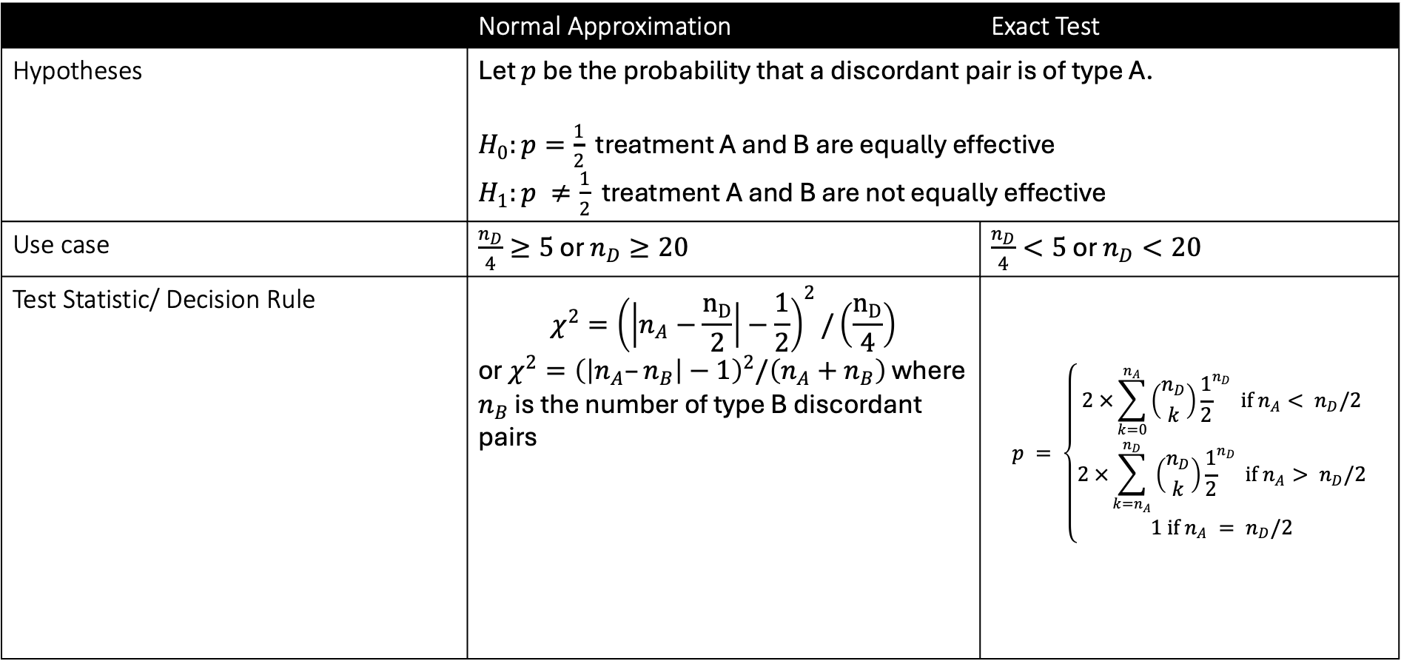
McNemar’s Test
 | Normal Approximation | Exact Test
Hypotheses | Let $p$ be the probability that a discordant pair is of type A. $H_{0}:p=\frac{1}{2}$ treatment A and B are equally effective $H_{1}:p ≠\frac{1}{2}$ treatment A and B are not equally effective
Use case | $\frac{n_{D}}{4}≥5$ or $n_{D}≥20$ | $\frac{n_{D}}{4}<5$ or $n_{D}<20$
Test Statistic/ Decision Rule | $$χ^{2}={\left(\left|n_{A}−\frac{n_{D}}{2}\right|−\frac{1}{2}\right)}^{2}/\left(\frac{n_{D}}{4}\right)$$ or $χ^{2}={\left(\left|n_{A}–n_{B}\right|−1\right)}^{2}/\left(n_{A}+n_{B}\right)$ where $n_{B}$ is the number of type B discordant pairs | $$p = \left\{\begin{aligned}2 ×\sum_{k=0}^{n_{A}}{\left({n_{D} \atop k}\right){\frac{1}{2}}^{n_{D}} if n_{A}< n_{D}/2} \\ 2 ×\sum_{k=n_{A}}^{n_{D}}{\left({n_{D} \atop k}\right){\frac{1}{2}}^{n_{D}} if n_{A}> n_{D}/2} \\ 1 if n_{A} = n_{D}/2\end{aligned}\right.$$

