Slide 1
Two-Sample Inference (Lectures 8-10)
BIOSTAT 201A Fall 2025
Discussion 5 – October 31, 2025
Cindy J. Pang

Slide 2
Outline
Motivation for Two Sample Inference Problems
Two Sample Inference for Paired Data (Lecture 8)
Two Sample Inference for Independent Samples (Lecture 9 & 10)

Slide 3
Two Sample Problems
Goal of Two Sample Problems:
(1)
(2)
Types
1.
2.
Unpaired is more likely to reject but why should we still use a paired test?
Situations where we do matched-pairs in clinical research:
1.
2.

Slide 4
Two-Sample Problems | Dependent Groups (Paired Data)
Hypotheses
Data
Assumptions
Test Statistic
Decision Rule
Confidence Interval

Slide 5
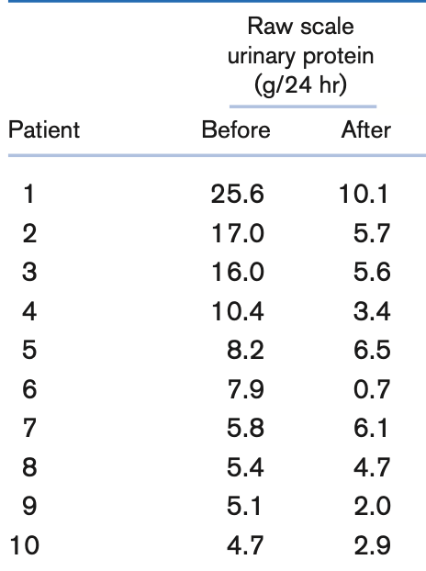
Renal Disease. We are interested to see if the raw scale of urinary protein changes after 8 weeks.
Identify the appropriate statistical procedure to do this. Explain.
Did urinary protein change after 8 weeks? Use a hypothesis test to determine this.
Compute a 95% confidence interval for the differences in urinary protein change. How does your created confidence interval support your conclusions in part (b)?

Slide 6
Two-Sample Problems | Independent Groups
 | Equal Variances | Unequal Variances | Test for Equality of Variances
Hypotheses
Data
Assumptions
Test Statistic
Decision Rule
Confidence Interval

Slide 7
Nutrition. The mean ±1 sd of ln [calcium intake (mg)] among 25 females, 12 to 14 years of age, below the poverty level is 6.56 ± 0.64. Similarly, the mean ± 1 sd of ln [calcium intake (mg)] among 40 females, 12 to 14 years of age, above the poverty level is 6.80 ± 0.76.
Test for a significant difference between the variances of the two groups.
Test for whether there is a significant difference in means between the two groups.
Create a 95% Confidence Interval for the difference in means between the two groups.

