Slide 1
Lab 6 Confidence Intervals and T-Tests
Cindy J. Pang
BIOSTAT 100A Summer Session C 2024
August 29, 2024

Slide 2
Normal Distribution and CLT
Central Limit Theorem:
When is a sample “sufficiently large”?
When do we assume normality?
Inference: (1) Estimation vs. (2) Hypothesis Testing

Slide 3

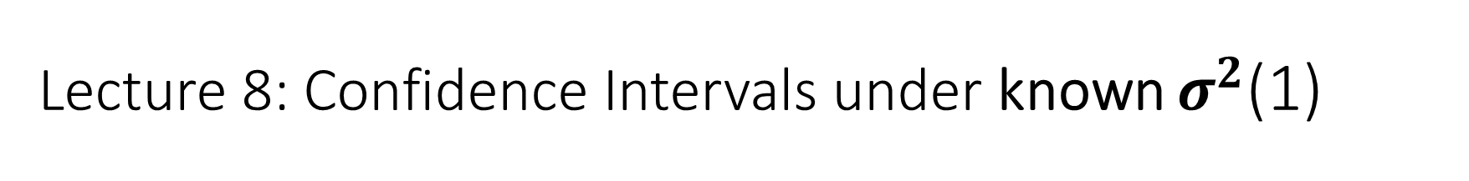
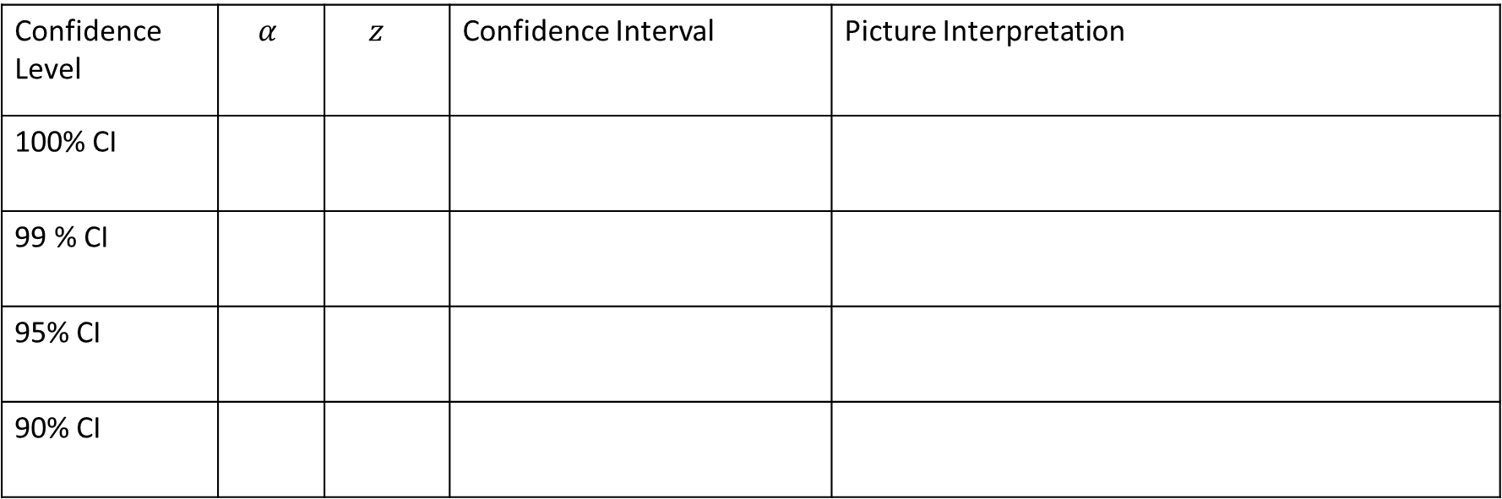
Lecture 8: Confidence Intervals under known $σ^{2}$(1)
Interpretation of a Confidence Interval
Math:
In words:
Common Confidence Intervals for $μ$:
Confidence Level | $$α$$ | $$z_{}$$ | Confidence Interval | Picture Interpretation
100% CI
99 % CI
95% CI
90% CI

Slide 4
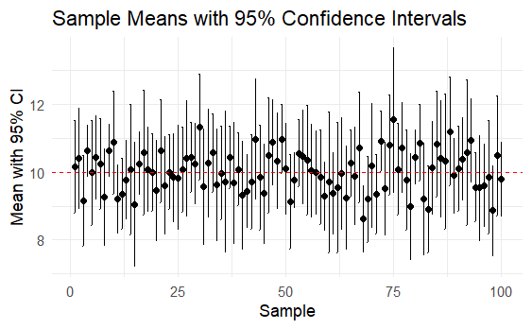
Samples from N(10,4)
Sample 1 | Sample 2 | Sample 3 | Sample 4 | Sample 5 | Sample 6
8.879049 | 12.448164 | 7.864353 | 10.852928 | 8.610586 | 10.506637
9.539645 | 10.719628 | 9.564050 | 9.409857 | 9.584165 | 9.942906
13.117417 | 10.801543 | 7.947991 | 11.790251 | 7.469207 | 9.914259
10.141017 | 10.221365 | 8.542217 | 11.756267 | 14.337912 | 12.737205
10.258575 | 8.888318 | 8.749921 | 11.643162 | 12.415924 | 9.548458
13.430130 | 13.573826 | 6.626613 | 11.377280 | 7.753783 | 13.032941
10.921832 | 10.995701 | 11.675574 | 11.107835 | 9.194230 | 6.902494
7.469877 | 6.066766 | 10.306746 | 9.876177 | 9.066689 | 11.169227
8.626294 | 11.402712 | 7.723726 | 9.388075 | 11.559930 | 10.247708
9.108676 | 9.054417 | 12.507630 | 9.239058 | 9.833262 | 10.431883
Sample Means with 95% Confidence Intervals
Sample | Mean | Lower CI | Upper CI | Include Mean?
1 | 10.15 | 8.78 | 11.51 | 1
2 | 10.42 | 8.93 | 11.90 | 1
3 | 9.15 | 7.82 | 10.48 | 1
4 | 10.64 | 9.89 | 11.40 | 1
5 | 9.98 | 8.43 | 11.53 | 1
6 | 10.44 | 9.22 | 11.67 | 1

Slide 5
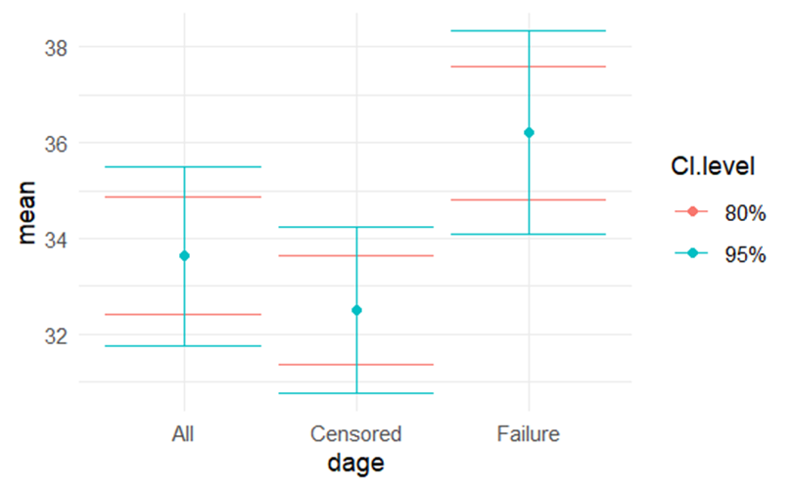
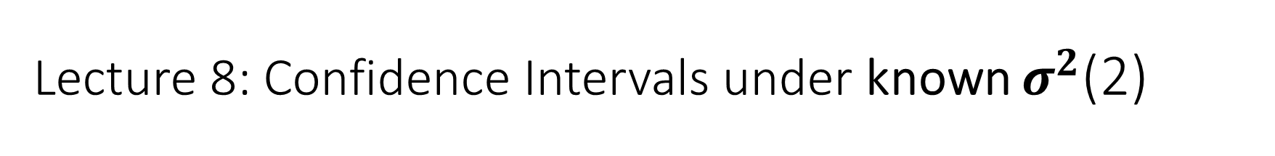
Lecture 8: Confidence Intervals under known $σ^{2}$(2)
Accuracy vs. Precision
Accuracy =
Precision =
What is the relationship between accuracy ( ) and precision ( )?

Slide 6
What are the Assumptions to create these Confidence Intervals?
Interpret your Confidence Interval for 95%

Slide 7

Confidence Intervals when $σ^{2}$ unknown
Why use a t-distribution?
T-distribution vs. z-distribution

Slide 8
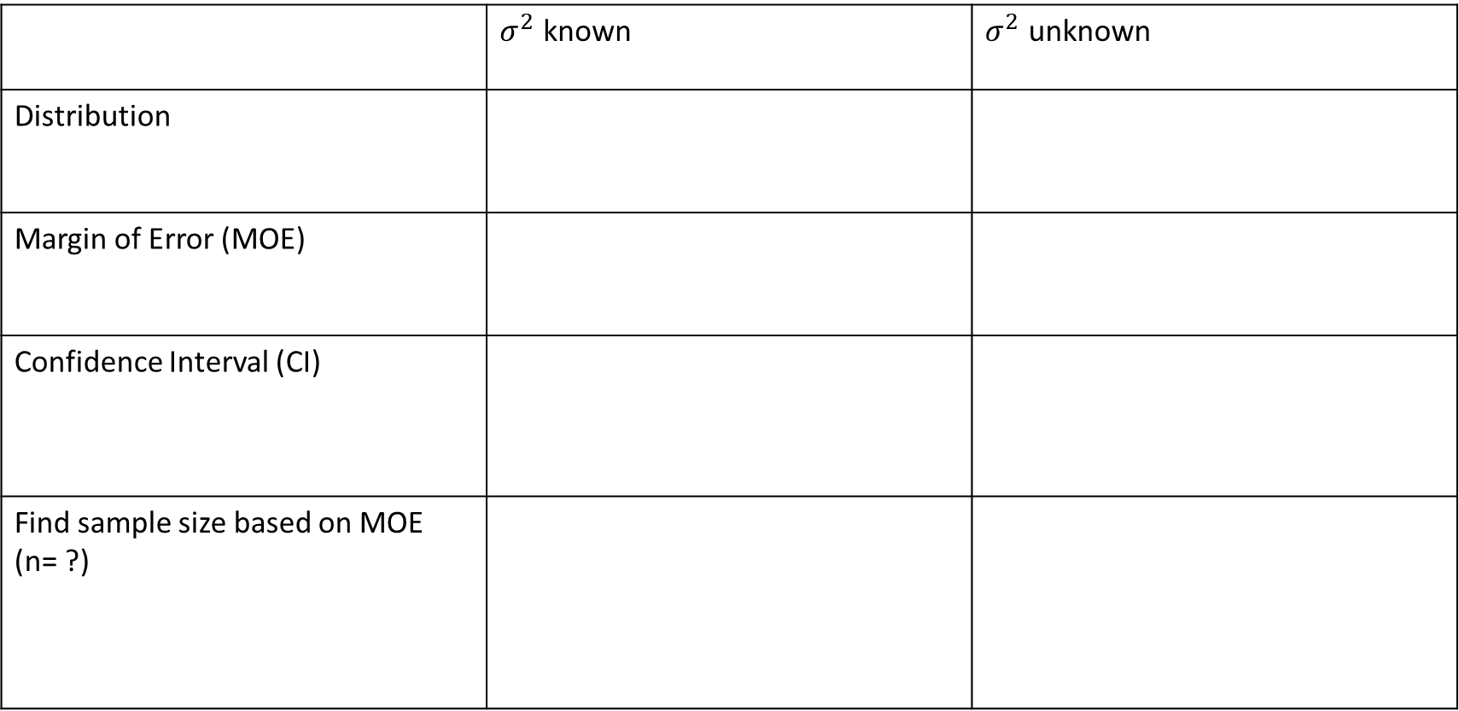
Confidence Intervals Summary
 | $σ^{2}$ known | $σ^{2}$ unknown
Distribution
Margin of Error (MOE)
Confidence Interval (CI)
Find sample size based on MOE (n= ?)

Slide 9

Hypothesis Testing for $μ$
Interpretation of the p-value:
Hypothesis Testing Steps on Next Slide – practice these problems!

Slide 10
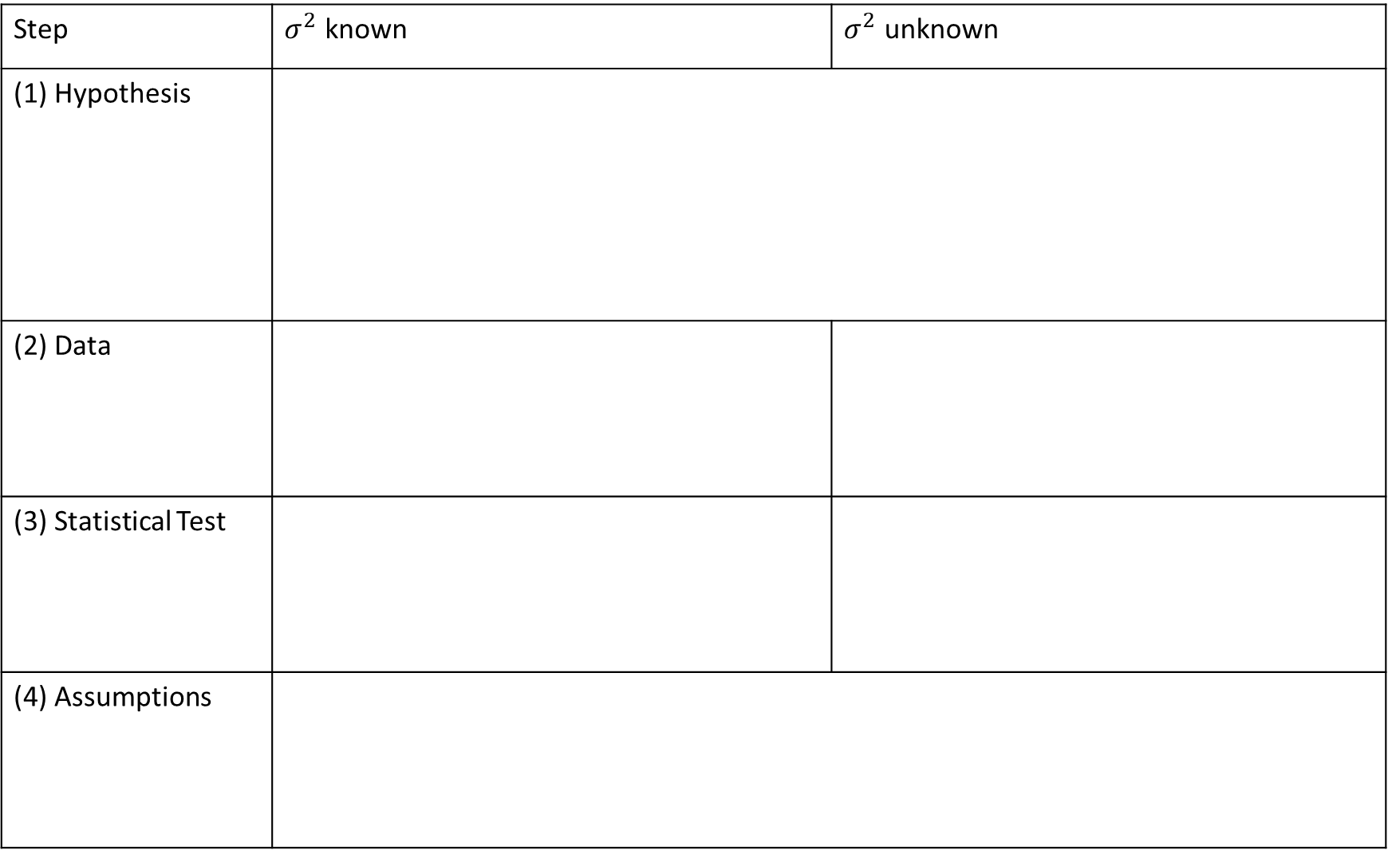
Step | $σ^{2}$ known | $σ^{2}$ unknown
(1) Hypothesis
(2) Data
(3) Statistical Test
(4) Assumptions

Slide 11
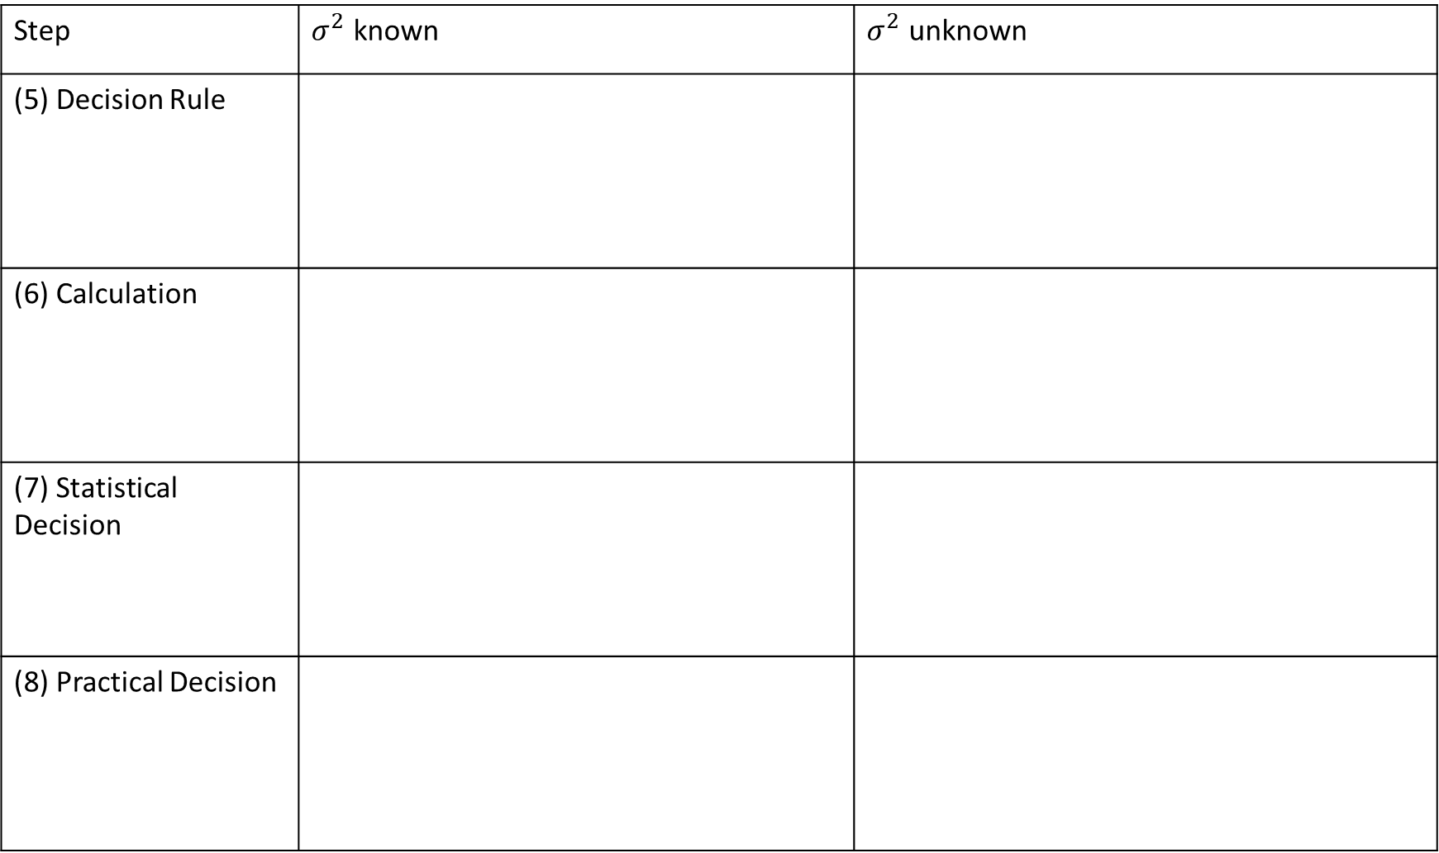
Step | $σ^{2}$ known | $σ^{2}$ unknown
(5) Decision Rule
(6) Calculation
(7) Statistical Decision
(8) Practical Decision

Slide 12
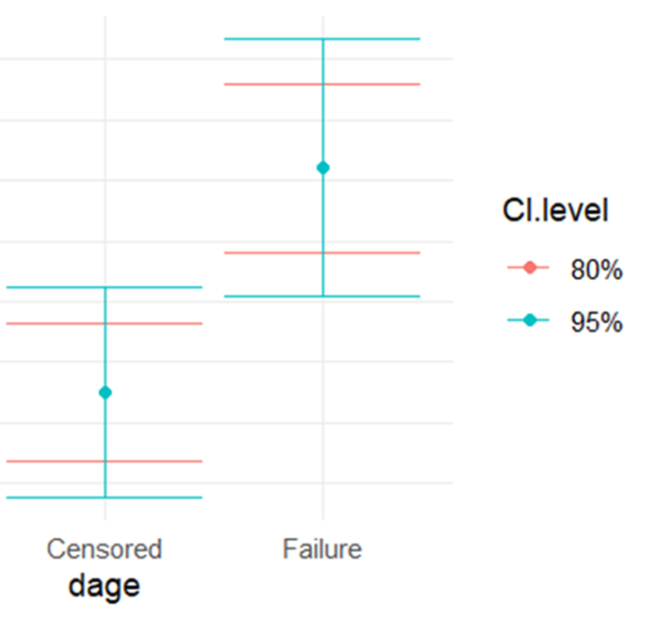
Confidence Interval Method of Hypothesis Testing:
Test Ho: µ_{private} = µ_{university} versus Ha: not so, at α=0.05
How would we do this? Hint: what would have to change in the graph below?

