Slide 1
Lab 4
Cindy J. Pang
BIOSTAT 100A Summer Session C 2024
August 19, 2024

Slide 2
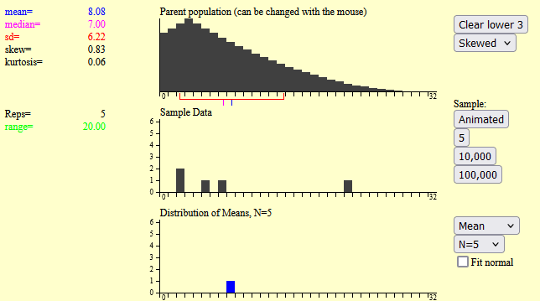
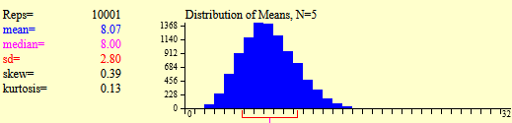
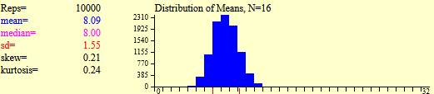
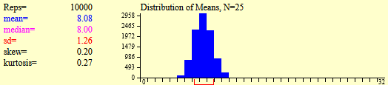
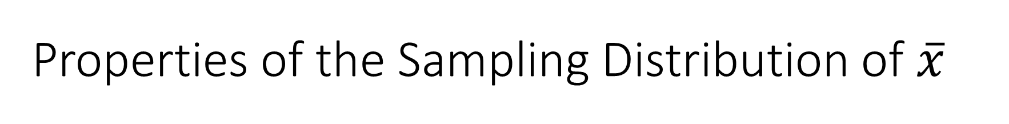
Properties of the Sampling Distribution of $\overline{x}$
What is a Sampling Distribution?
10,000 iterations later…
What do you notice?
About the Shape?
What happens as we increase the sample size?

Slide 3
Properties of the Sampling Distribution of $\overline{x}$
(1)
(2)
(3)

Slide 4
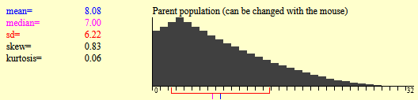
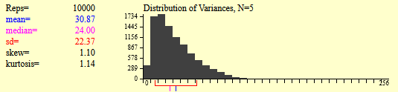
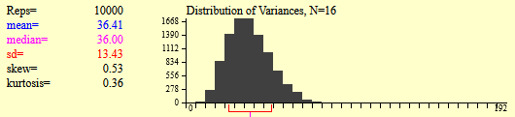
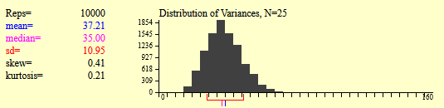
Let’s do the same thing for the variances…
What do you notice?
About the Shape?
What happens as we increase the sample size?

Slide 5
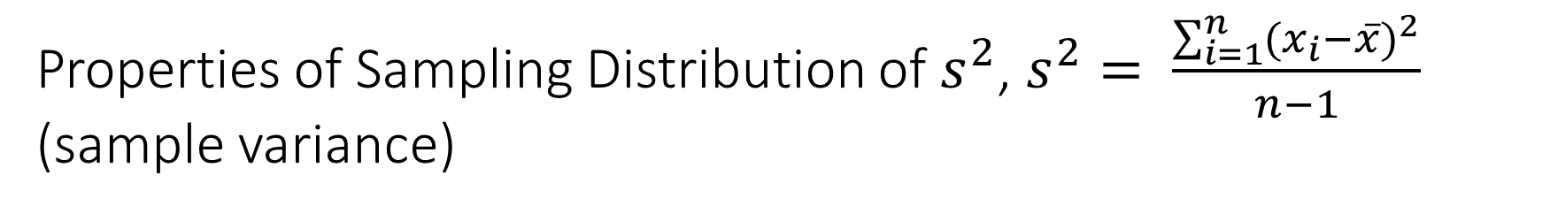
Properties of Sampling Distribution of $s^{2}$, $s^{2}= \frac{\sum_{i=1}^{n}{{(x_{i}−\overline{x})}^{2}}}{n−1}$ (sample variance)

Slide 6
Competency Assessment
In a family of 3 children, what is the probability of 2 boys and 1 girl?

Slide 7
Binomial Distribution

