Slide 1
Project 1 - Team 2
Stroke Dataset
Notes:
15 seg

Slide 2
The problem
Problem statement
Strokes
Context
What are the key factors that affect the likeness of having a stroke?
Occurs when something blocks blood supply to part of the brain or when a blood vessel in the brain bursts.
According to the World Health Organization (WHO) stroke is the 2nd leading cause of death globally, responsible for approximately 11% of total deaths.
Notes:
30 seg
For this project, our group decided to investigate the the key factors that affect the likeness of stroke…

Slide 3
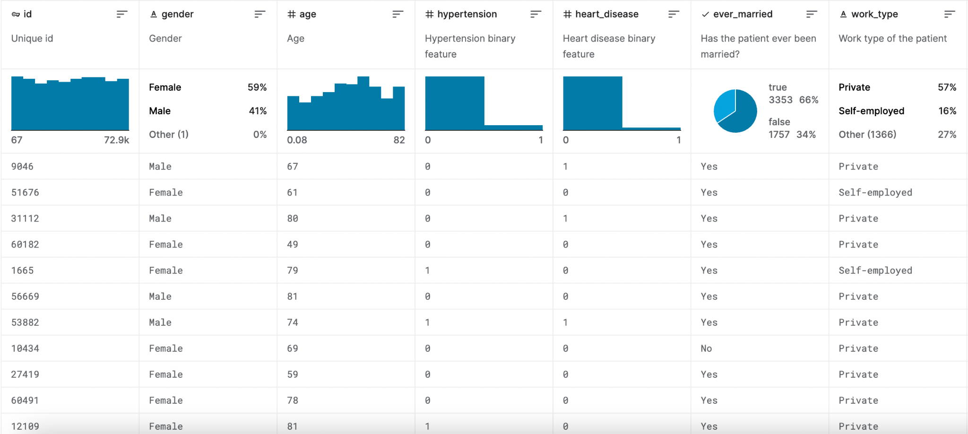
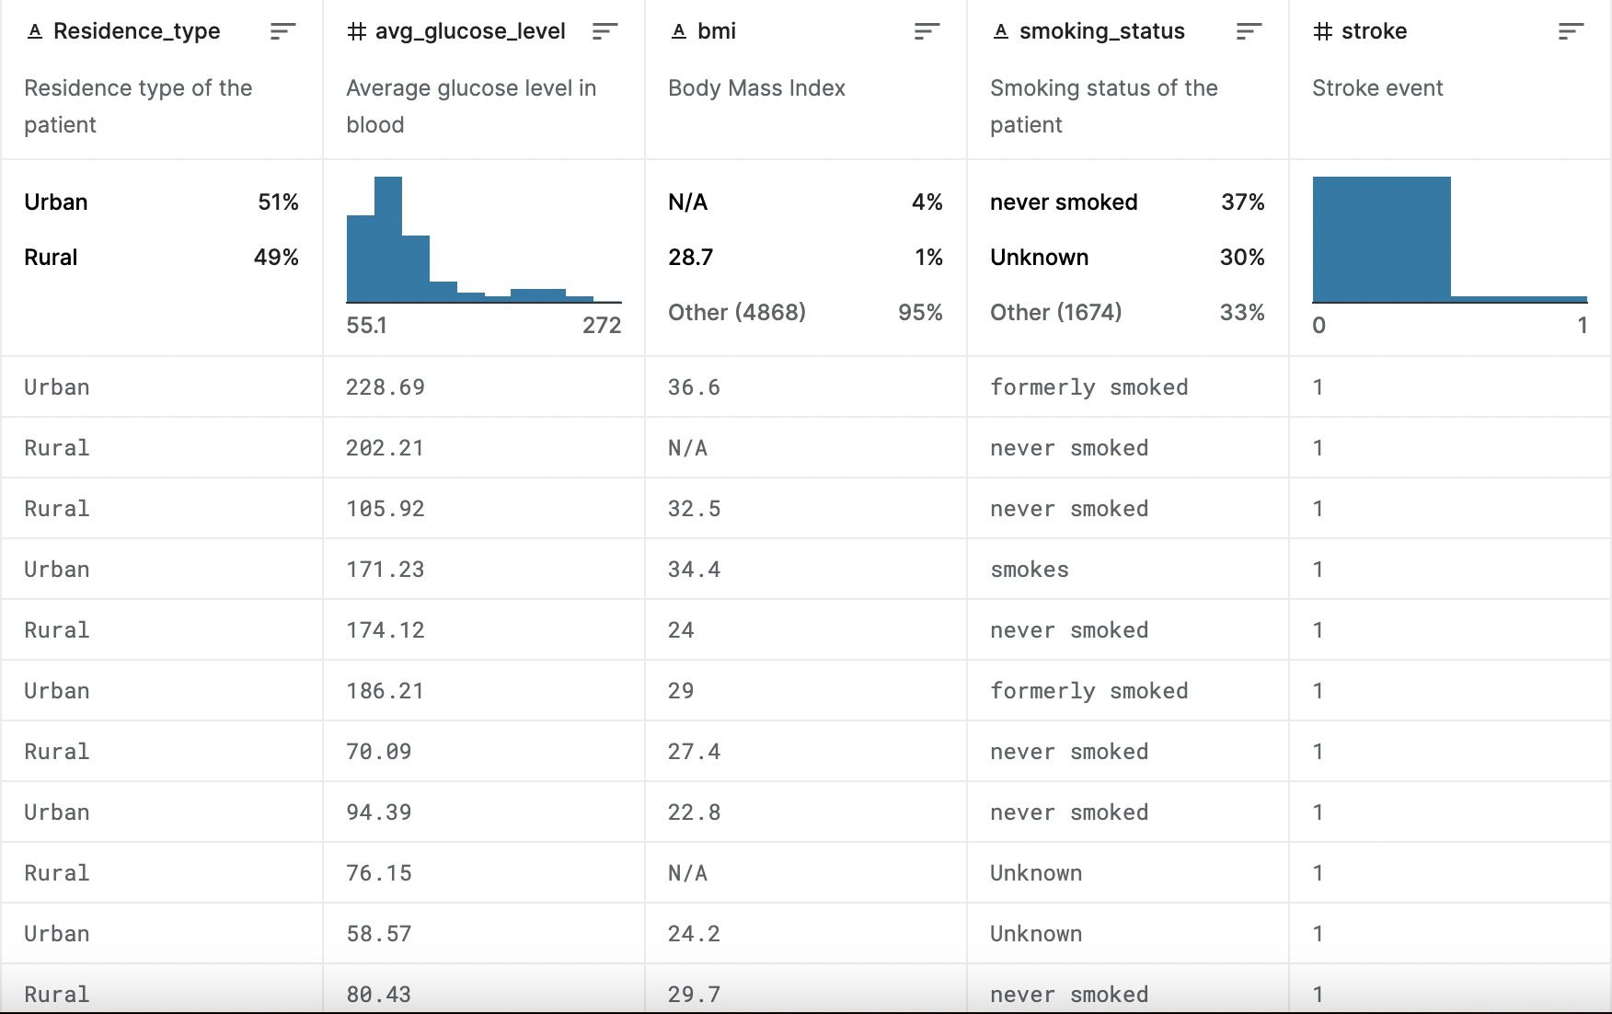
The Stroke Prediction Dataset:
https://www.kaggle.com/datasets/fedesoriano/stroke-prediction-dataset
Notes:
30 seg
Here is the original dataset we found from kaggle, it has 12 columns from…

Slide 4
Questions we found interesting
Cindy: What are the impacts of Hypertension, Heart Disease, Glucose Level, and BMI value on Stroke?
• Hypertension VS Stroke: Are people with hypertension more likely to have stroke?
• Heart Disease VS Stroke: Does having a heart disease increase the likelihood of having a stroke?
• Glucose Level VS Stroke: How does the average glucose level differ between stroke and non-stroke patients?
• BMI VS Stroke: Is there a relationship between BMI (Body Mass Index) and the occurrence of strokes?
Notes:
15 seg

Slide 5
Questions we found interesting
KAGNA:
• Marital Status VS Stroke: How does marital status relate to the occurrence of strokes?
• Work Type VS Stroke: Which work type has a higher prevalence of strokes?
Notes:
15 seg

Slide 6
Questions we found interesting
NESTOR:
How does age affect strokes probability?
What Interesting information we can find?
Notes:
15 seg

Slide 7
Questions we found interesting
ELLIS:
• Area VS Disease: Does living in rural or urban areas affect the risk of heart disease?
• Area VS Stroke: Does living in rural or urban areas affect the risk of stroke?
Notes:
15 seg

Slide 8
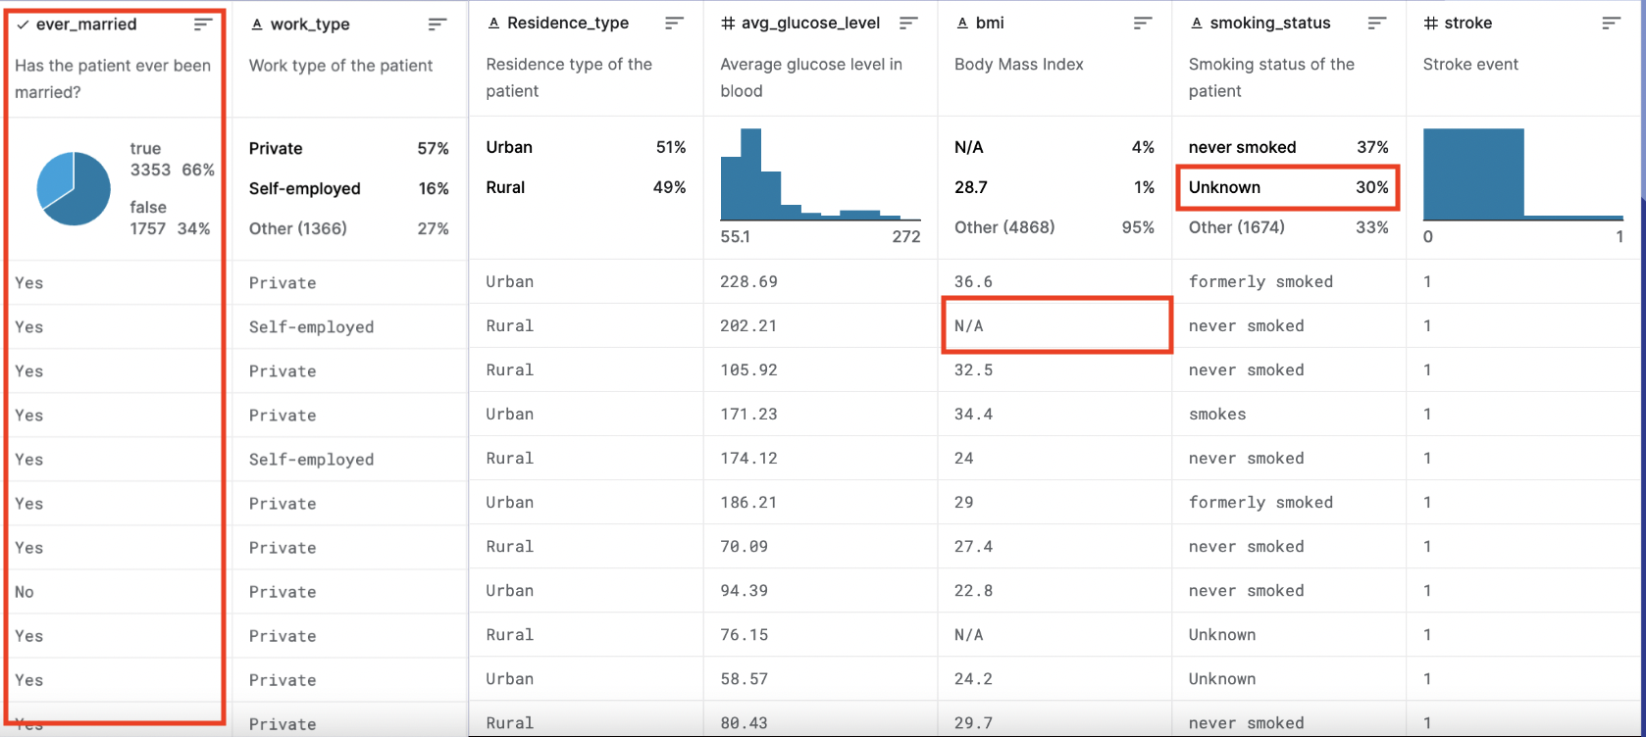
Data Cleanup
Looking at the data
Identifying cleanups
Cleaning
Notes:
30 seg
Looking at the data, there are 3 major cleanups we decided to do. First, looking at the ever_married column, to make our dataset more homogenous and easier to analyze, we decided to transform all “Yes” to 1, and “No”s to 0. Second, looking at the bmi column, we realized there are several (about 500) N/As, this is only about 4% of out entire dataset, so we decided to use linear regression to approximate a value for the missing BMI based on

Slide 9
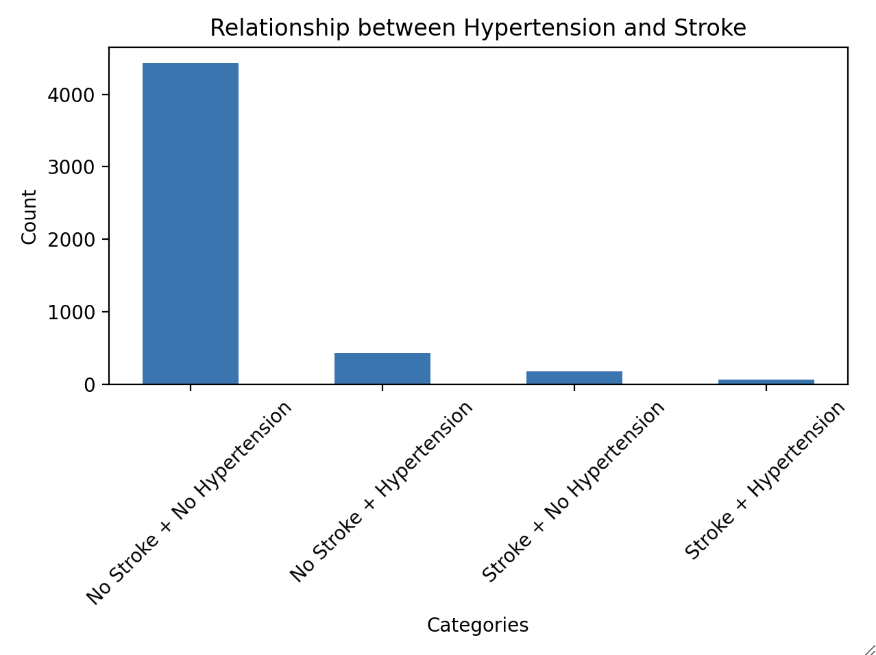
Hypertension VS Stroke:
Are people with hypertension more likely to have stroke?
Approach 1 - COUNT of people with stroke by hypertension
Bad: significantly more data points for people without stroke, not accurate representation of the problem
Notes:
1.5 min

Slide 10
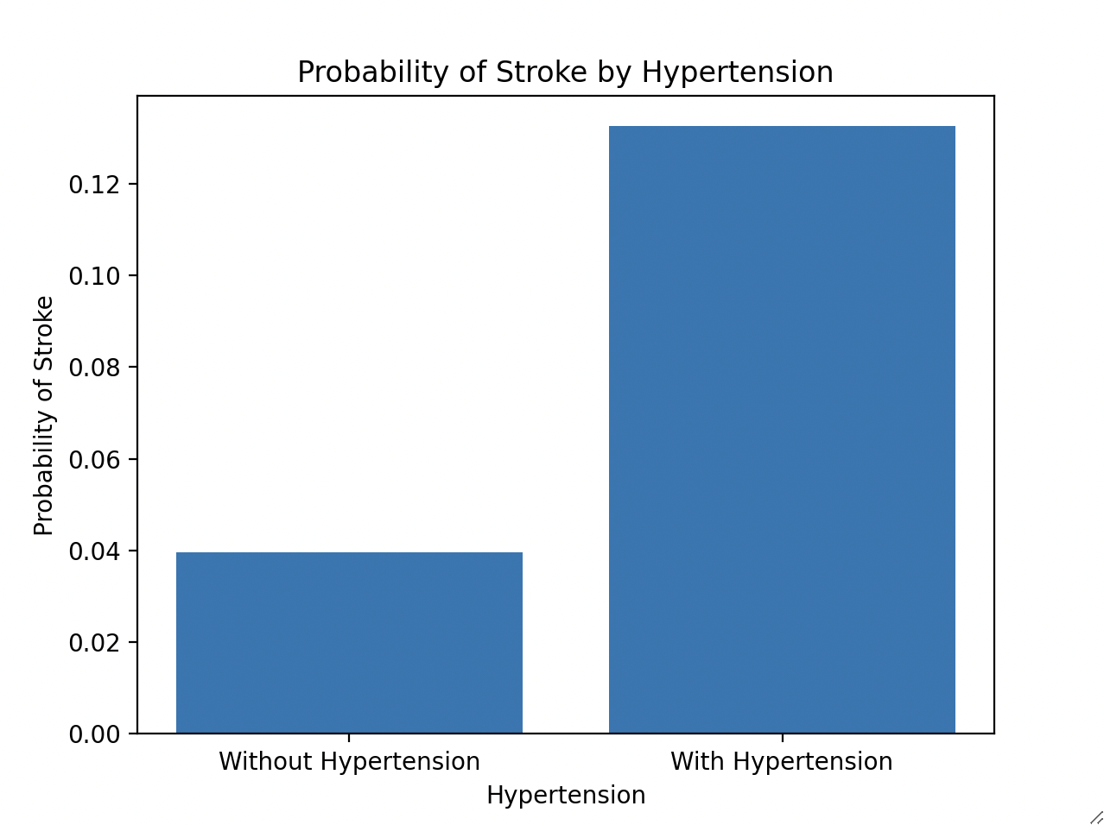
Hypertension VS Stroke:
Are people with hypertension more likely to have stroke?
Approach 2 - PROBABILITY of stroke by hypertension
Probability calculated by finding mean (0 is no stroke, 1 is stroke) after grouping by hypertension.
BETTER: This more accurately answers the question
Chi-squared test: p-value = 1.66e-19
Probability of stroke is greater in an individual with hypertension than one without

Slide 11
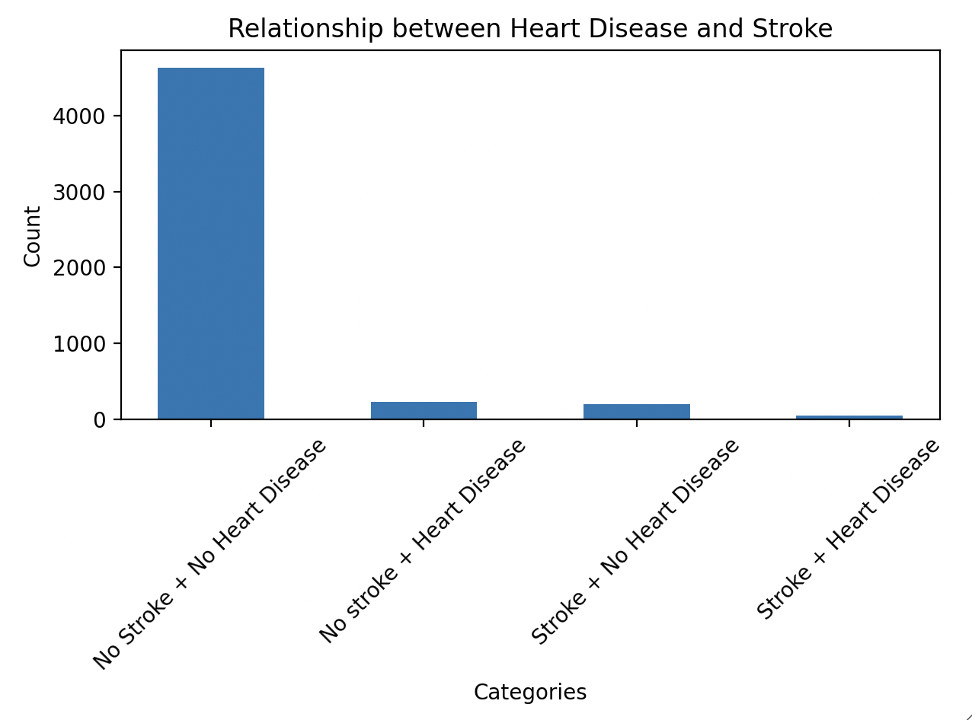
Heart Disease VS Stroke:
Does having a heart disease increase the likelihood of having a stroke?
Approach 1 - COUNT of people with stroke by heart disease
Bad: significantly more data points for people without stroke, not accurate representation of the problem

Slide 12
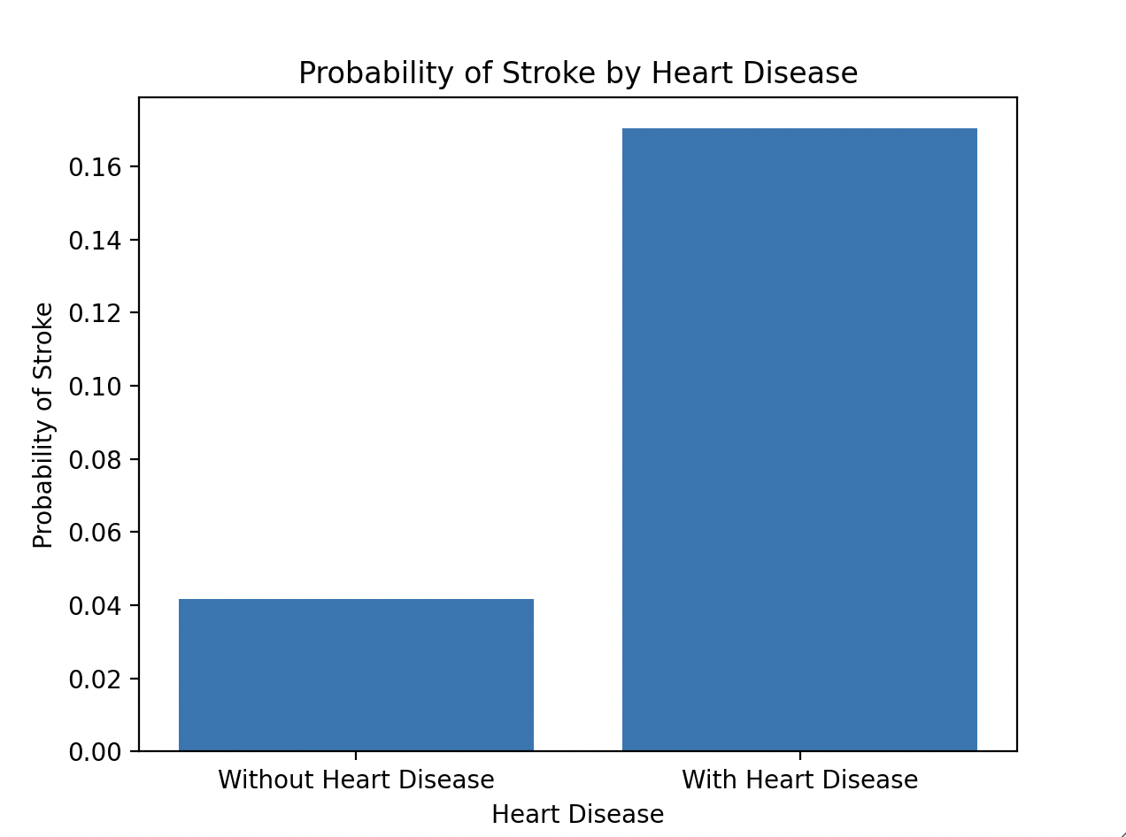
Heart Disease VS Stroke:
Does having a heart disease increase the likelihood of having a stroke?
Approach 2 - PROBABILITY of stroke by heart disease
Probability calculated by finding mean (0 is no stroke, 1 is stroke) after grouping by heart disease.
BETTER: This more accurately answers the question by
p-value = 2.09e-21
Probability of stroke is significantly greater in an individual with heart disease than one without

Slide 13
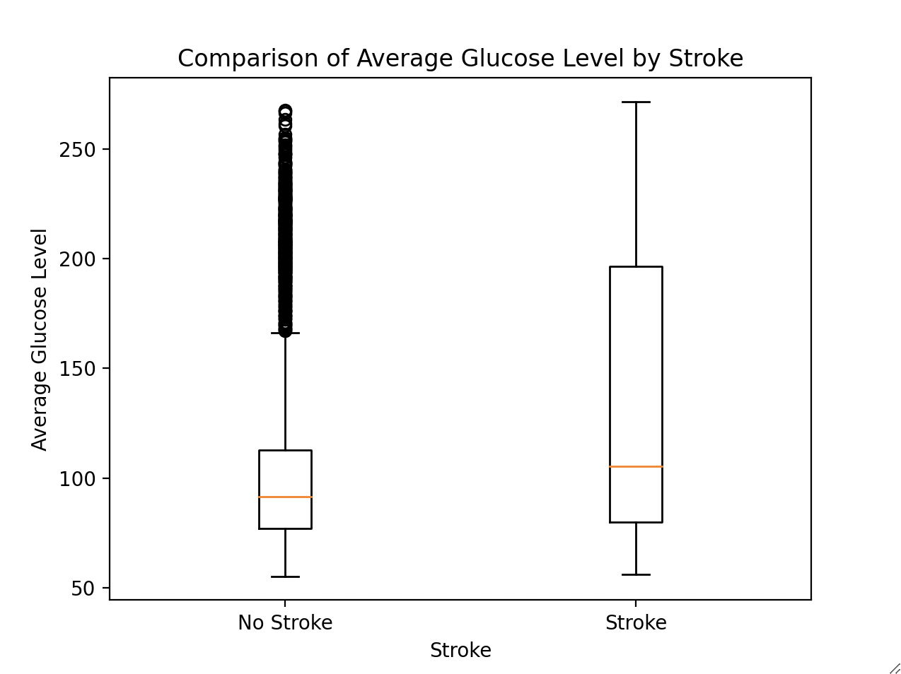
Average Glucose Level VS Stroke:
How does the average glucose level differ between stroke and non-stroke patients?
p-value = 2.77e-21
Median of the average glucose level in stroke patients significantly higher than non-stroke patients
Average glucose level in stroke patients is right skewed, indicating more people with stroke have the lower values of the interquartile range
Many outliers in non-stroke patients

Slide 14
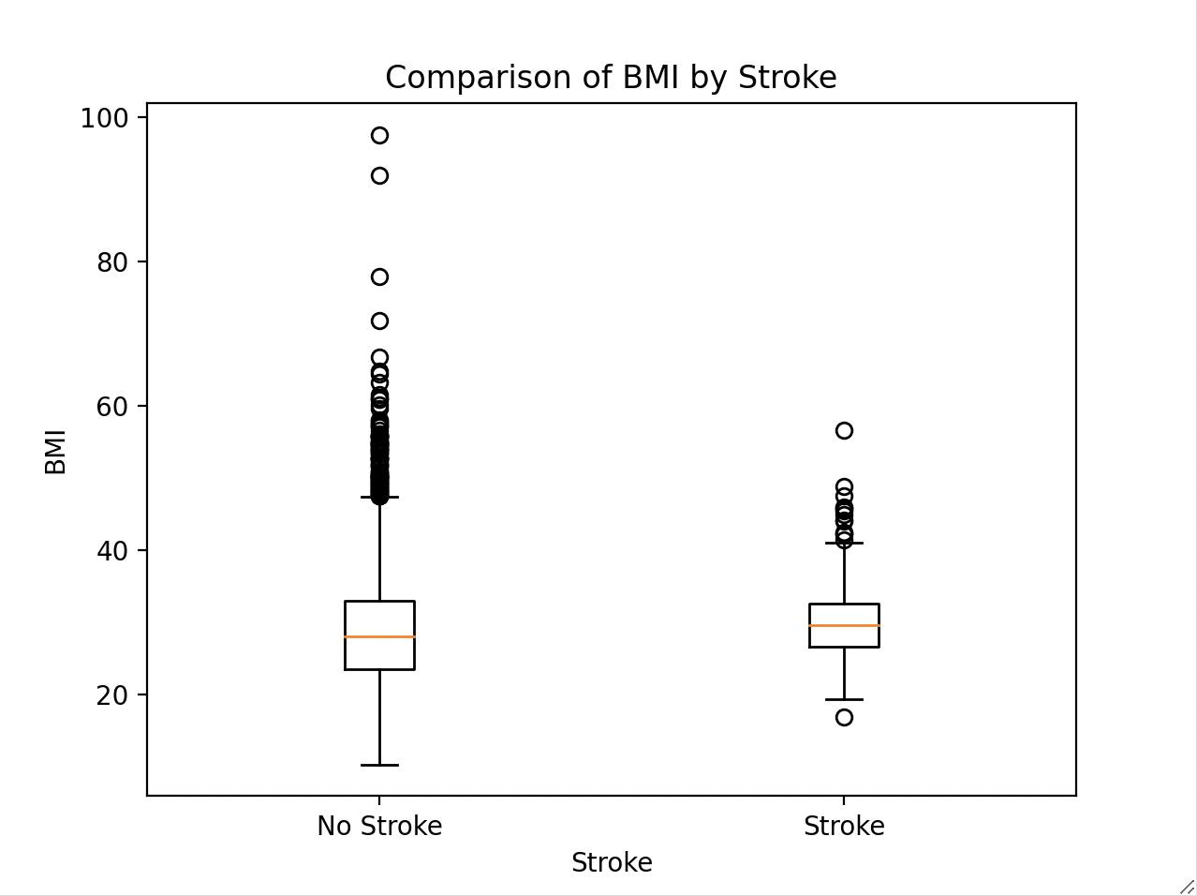
BMI VS Stroke:
Is there a relationship between BMI (Body Mass Index) and the occurrence of strokes?
p-value = 0.006
Median of the BMI in stroke patients significantly higher than non-stroke patients
Relatively normally distributed around the median in both groups
Many outliers in non-stroke patients, and some in stroke patients

Slide 15
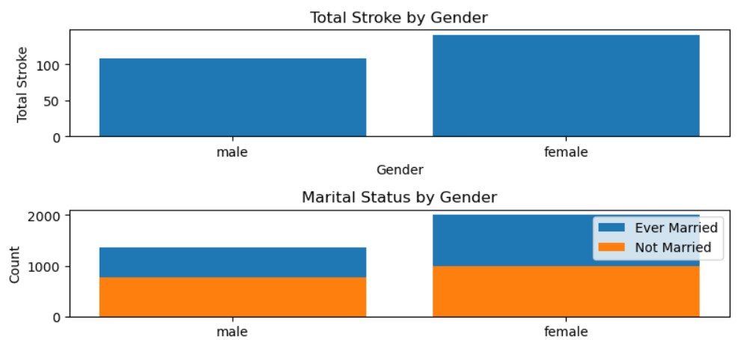
MARITAL STATUS vs HEART STROKE
Is Married Status really affect Heart Stroke ?
Married and unmarried ratio for Female is almost the equal
-Unmarried Male is likely to have more Heart stroke compared to Married Male

Slide 16
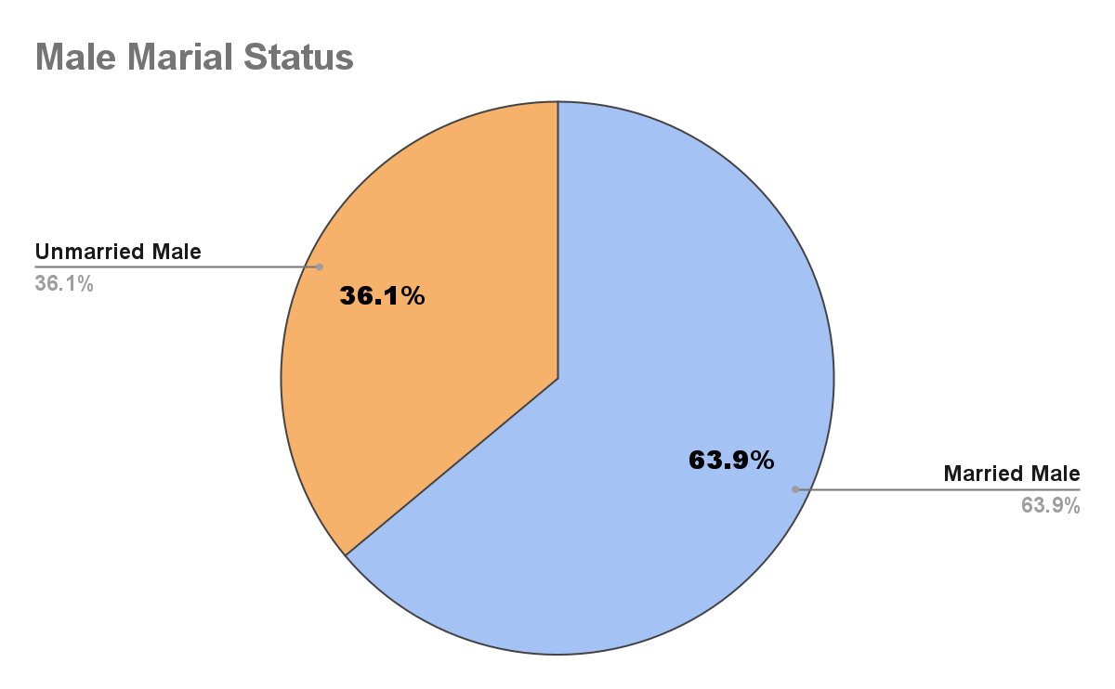
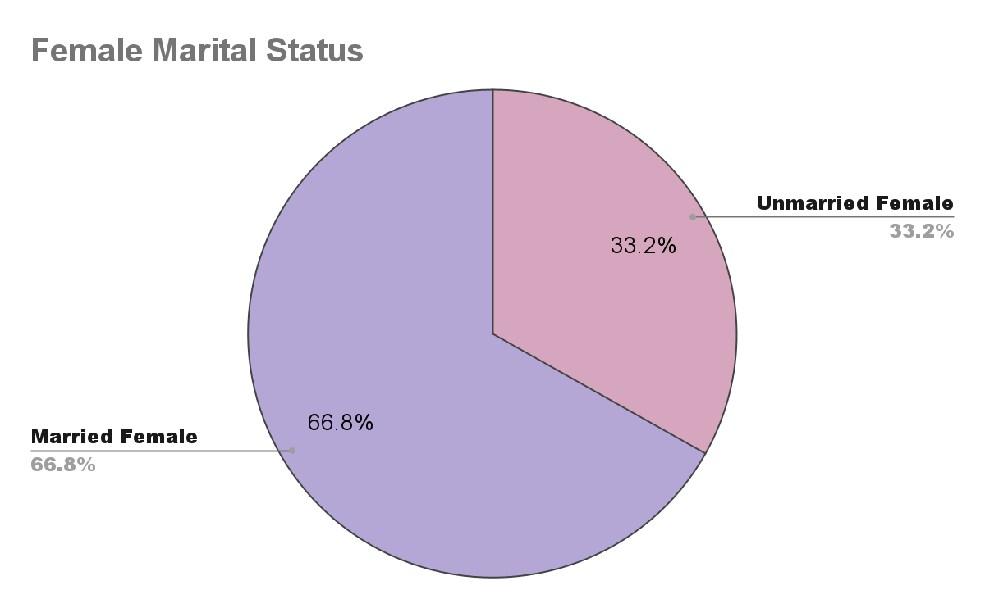
Male vs Female Marital Status

Slide 17
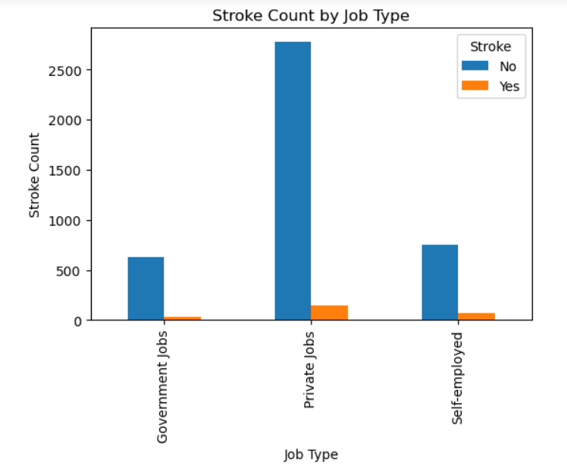
WORK TYPE vs HEART STROKE
Analysis:-From the analysis,it is clear that more people are working in Private companies.
But people who are self-employed are likely to have more heart stroke

Slide 18
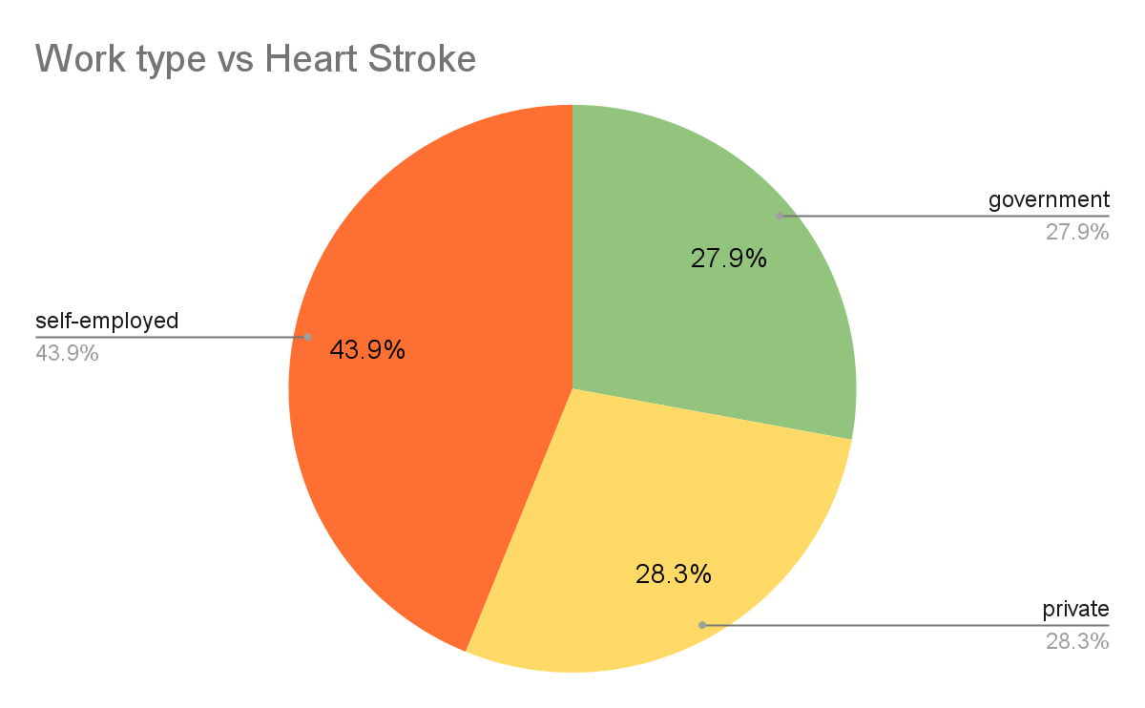
Does work-type really affect Health
People working in Government firm are likely to have less stroke as 27.9%
People who are Self-employed are likely to have more strokes as 43.9% in compared to Private and Government firms.

Slide 19
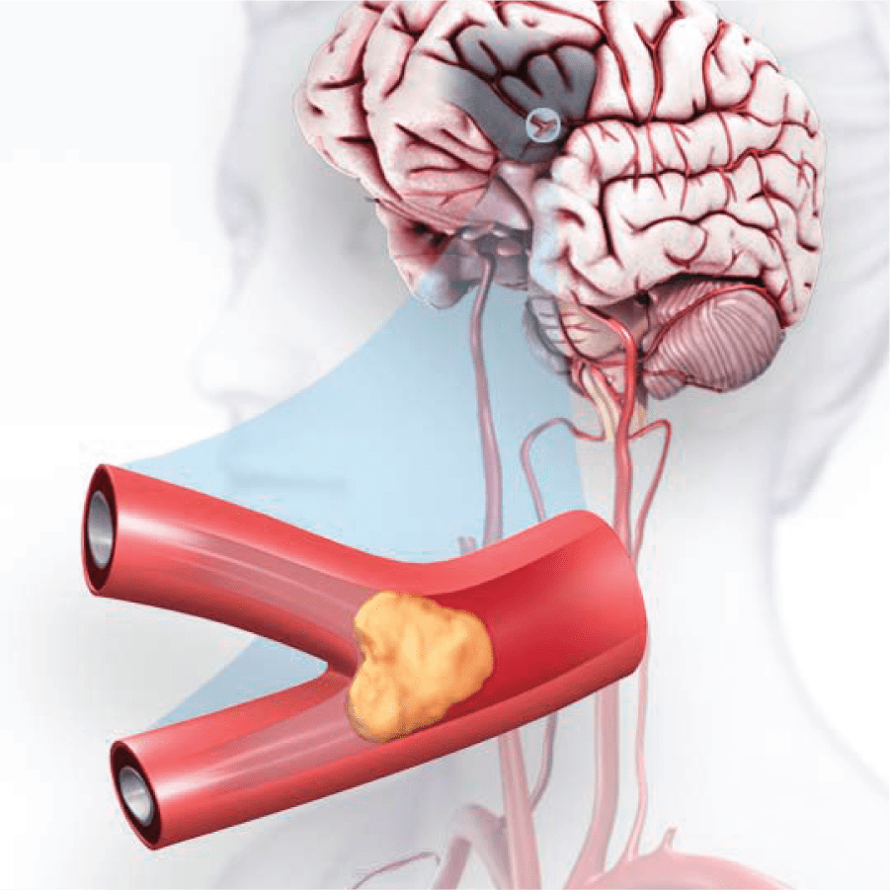
Age vs Stroke (Nestor)
As we age, our blood vessels tend to become stiffer and narrower, making them more susceptible to blockages. Additionally, the walls of the blood vessels may weaken, making them more prone to rupture. (The Stroke Association - 2015 )

Slide 20
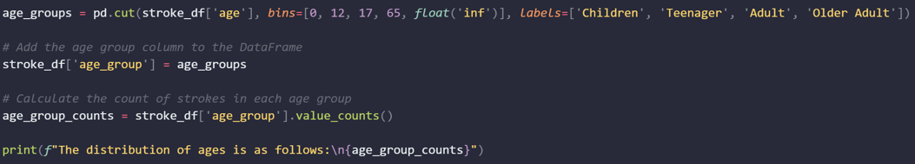
Age Groups
According to the “National Institutes of Health” We can set age group as follow:
12 and younger is a children
17 and younger is a teenager
65 and younger is an adult
65 and older is an Older Adult

Slide 21
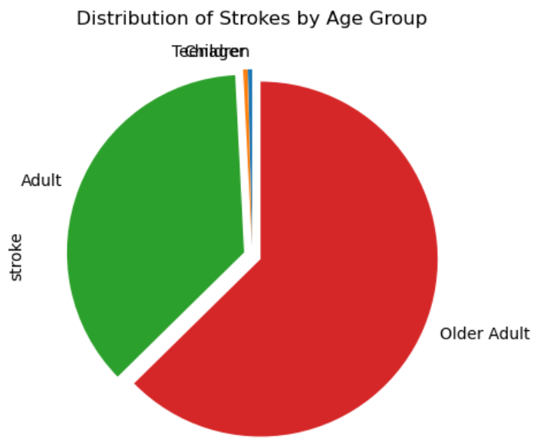
Age vs Strokes
The distribution of ages in the Dataset is as follows:
Adult 3289
Older Adult 965
Children 588
Teenager 268
91
156
Notes:
1.5 min

Slide 22
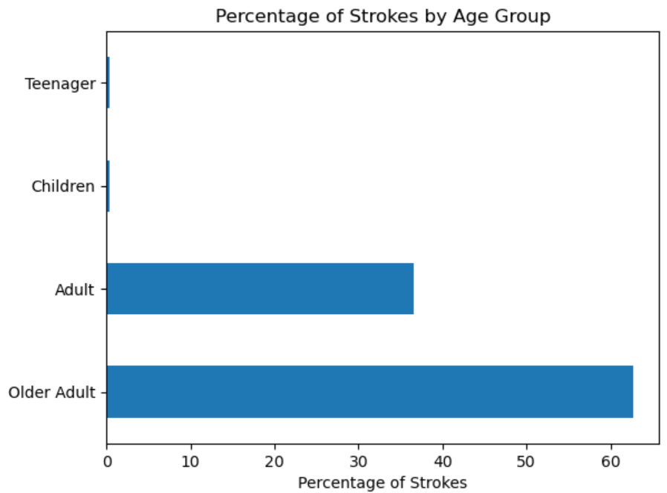
The increase probability to have a stroke as we get older is: 26.10%
Notes:
NESTOR

Slide 23
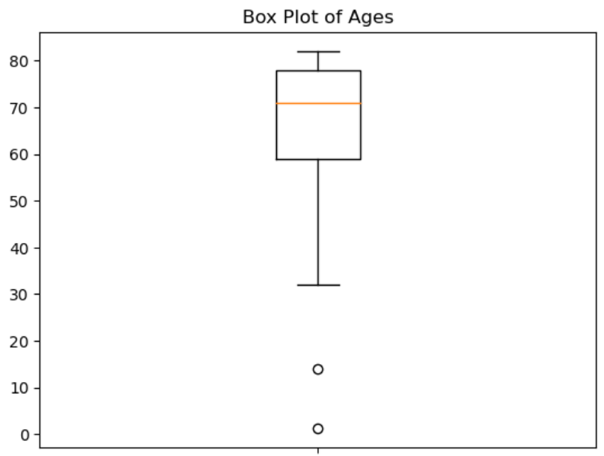

Box plot age groups
Analysis: It's a rarity and outlier to have a stroke as a child or as a teen
Final statistical analysis without outliers:
Teen
Child
Notes:
NESTOR

Slide 24
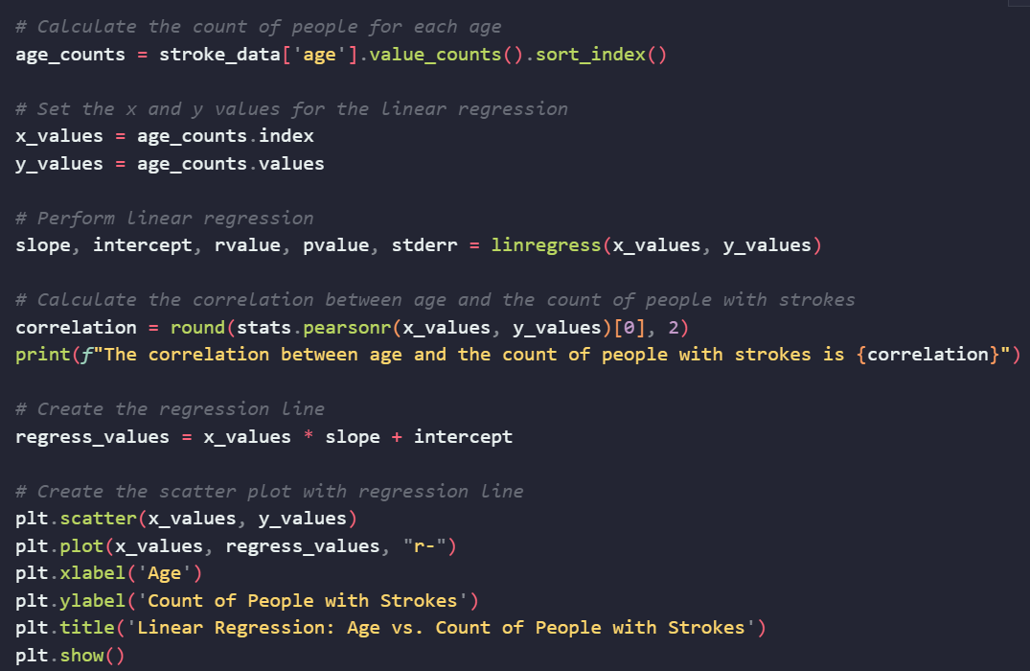
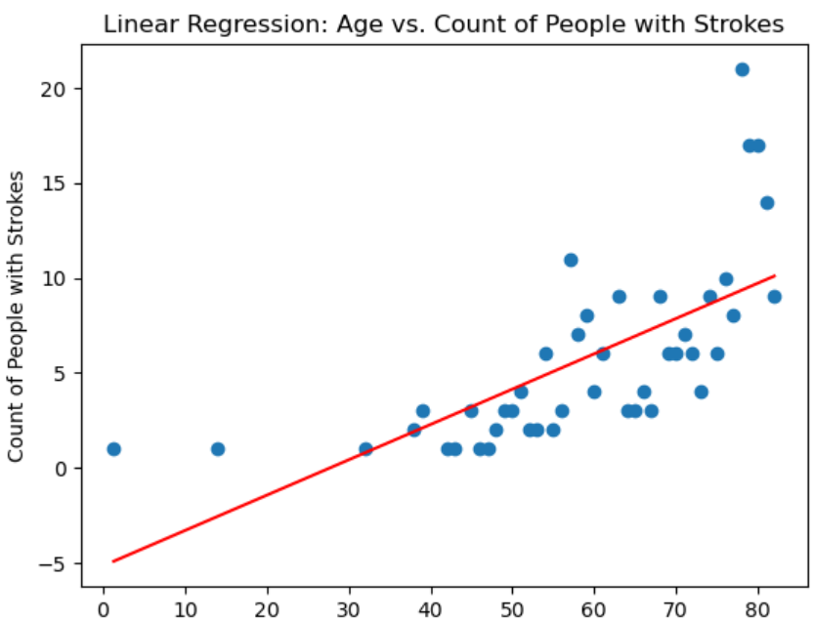
Linear Correlation (y = mx + b) (R = 0.68)
Notes:
NESTOR

Slide 25
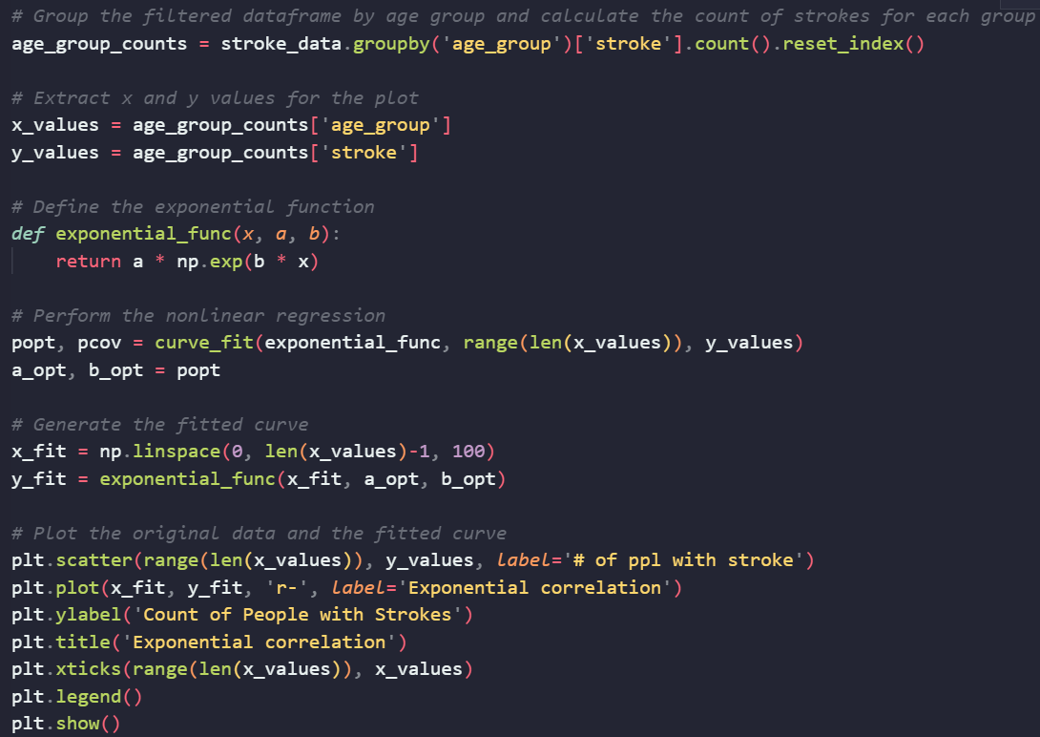
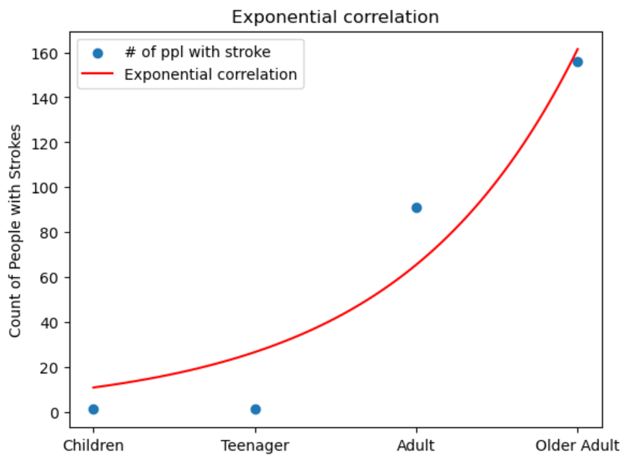
Exponential Correlation (y = ab^x)
Notes:
NESTOR

Slide 26
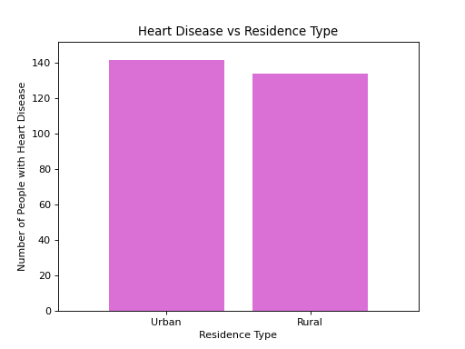
Residence Type vs Heart Disease:
Does living in an urban or rural area have an effect on Heart Disease?
Of the 276 people in the data set who have heart disease- 142 people live in an urban setting and 134 live in a rural setting
There is a slight increase in risk of having heart disease living in an urban setting vs rural

Slide 27
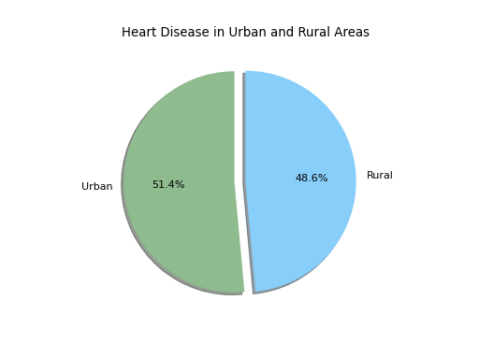
Residence vs Heart Disease Continued:
The percentage for heart disease cases in an urban area is slightly higher at 51.4%
The percentage for heart disease in a rural area is 48.6%
The pie chart is a helpful visual to display that the difference in case numbers isn’t substantial enough to say whether residence type has any significant impact (2.8%)
*Note: Population density is typically higher in urban settings, which could be the reason for the reason we see more cases of heart disease in the urban residence type.

Slide 28
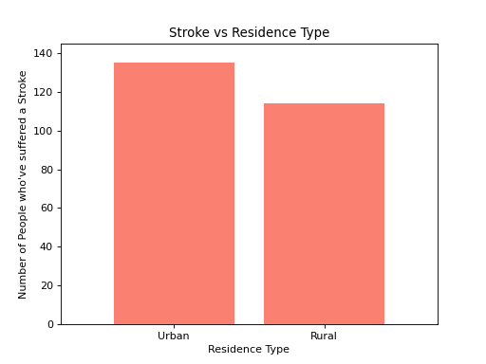
Residence Type vs Stroke:
Does residence type have an effect on the risk of stroke?
Of the 248 people who have had a stroke in the data set- 134 live in an urban setting and 114 live in a rural setting
There is a greater difference in the number of people who have had a stroke when comparing urban and rural settings than heart disease

Slide 29
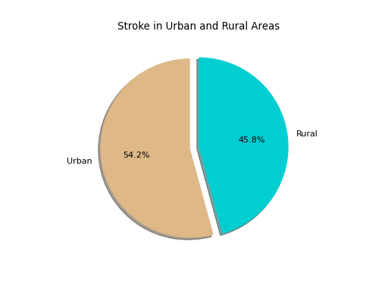
Residence vs Stroke Continued
Of the people who have had strokes in the dataset, 54.2% live in an urban setting and 45.8% live in a rural setting
The pie chart shows a larger difference in the number of cases of stroke between the two residence types (8.4%)
While there is definitely a higher rate of strokes in urban settings I don’t think we can account the residence type as the only factor contributing to one’s risk of stroke

Slide 30
General Conclusion
Cardiovascular health is incredibly important and chances are we all know someone who has been impacted by heart disease and stroke in one way or another. While there are definitely correlations between one’s risk of heart disease or stroke and many of the variables we have touched on today (age, bmi, smoking) it is important to note that we aren’t always in control of all of the variables.
Notes:
30 seg

Slide 31
Thank you!
Questions?
Questions: 3 min
Notes:
15 seg

