Slide 1

Note: The data and information in this document is reflective of a hypothetical situation and client. This document is to be used for KPMG Virtual Internship purposes only.
Sprocket Central Pty Ltd
Data analytics approach
[Division Name] - [Engagement Manager], [Senior Consultant], [Junior Consultant]

Slide 2
Note: The data and information in this document is reflective of a hypothetical situation and client. This document is to be used for KPMG Virtual Internship purposes only.
Agenda
Introduction
Data Exploration
Model Development
Interpretation

Slide 3
Note: The data and information in this document is reflective of a hypothetical situation and client. This document is to be used for KPMG Virtual Internship purposes only.
Introduction
The objective is to explain the variation in the number of bike purchases in 3 year. In other words, we will answer the question “Why is the number of bike purchases in 3 year different in 1000 new customers”, then identify which of the 1000 customers Sprocket Central Pty Ltd should target.
Variables
Age
Gender
Job industry category
Wealth segments
Whether owning car
State

Slide 4
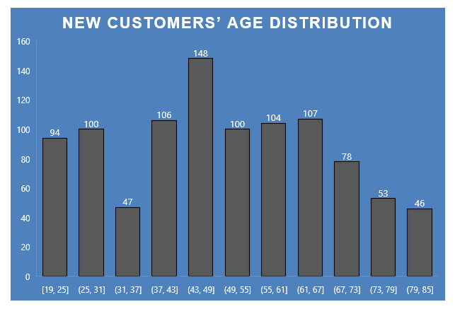
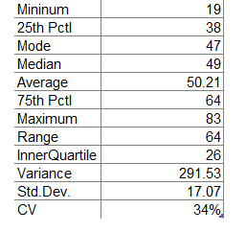
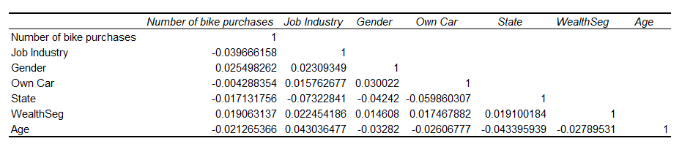
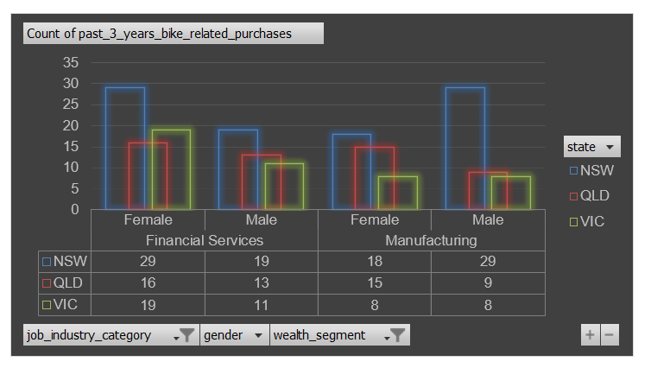
Note: The data and information in this document is reflective of a hypothetical situation and client. This document is to be used for KPMG Virtual Internship purposes only.
Data Exploration
Statistical summary
Matrix Correlation
Pivot chart snap shot
Snap conclusion
The most frequency for range 43-49 years old.
The Financial Services industry sector leads first (21%) followed by Manufacturing (20%).
Mass Customers tend to purchase more (48.38% in total with 26.68% in Financial Services, 21.70% in Manufacturing), followed by High Net Customers.
NWS ranks first (50.76%) in the number of bike purchases, followed by QLD.

Slide 5
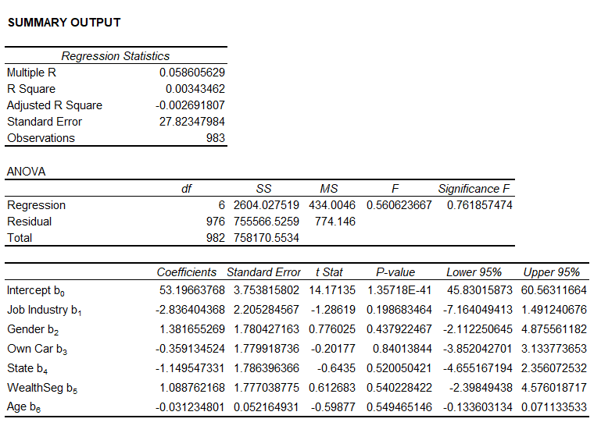
Note: The data and information in this document is reflective of a hypothetical situation and client. This document is to be used for KPMG Virtual Internship purposes only.
Model Development
Linear Regression Model
Number of bike purchases = f(job industry, gender, own car, state, wealth segment, age)
Number of bike purchases = b₀ + b₁(job industry) +b₂(gender) + b₃(own car) + b₄(state) + (wealth segment) + (age)
ESTIMATION MODEL
Number of bike number purchases = 53.2 b0 -2.84(job industry) + 1.38(gender) -0.36(own car)
– 1.15(state) + 1.09(wealth segment) – 0.03(age)

Slide 6
Note: The data and information in this document is reflective of a hypothetical situation and client. This document is to be used for KPMG Virtual Internship purposes only.
Interpretation
Summary interpretation
The results of the estimated regression line include the estimated coefficients, the standard error of the coefficients, the calculated t-statistic, the corresponding p-value, and the bounds of the 95% confidence interval.
The independent variables that statistically significant in explaining the variation in the number of bike purchases are the job industry, gender, own car, state, wealth segment, age, as indicated by (1) calculated t-statistics that exceed the critical values, and (2) the calculated p-values that are less than the significance level of 5%.
The multiple correlation coefficient is 0.057269614
The coefficient of determination, R² = 0.3% (supper weak)
b₀ makes sense in terms of magnitude and sign and are statistically valid
This model shows that independent variables do not add not significantly in explaining the variation in the number of bike purchases <> data exploration.
=> Re-specify the regression model, removing or restating the independent variables such that there is less correlation among them.
Regression Assumptions
There is a population regression line that joins the mean of the dependent variables.
This implies that the mean of the error is 0.
The variance of the dependent variable is constant for all values of the explanatory variables (Homoscedasticity).
The dependent variable is normally distributed for any value of the explanatory variables.
The error terms are probabilistically independent.

Slide 7
Note: The data and information in this document is reflective of a hypothetical situation and client. This document is to be used for KPMG Virtual Internship purposes only.
Appendix

Slide 8
Note: The data and information in this document is reflective of a hypothetical situation and client. This document is to be used for KPMG Virtual Internship purposes only.
Appendix

