Slide 1

Project 3: Gun Death Dataset
Group Members:
Arun Kuinkel
Avigail Spira
Cindy Juan
Dean Loeafoe

Slide 2

Workflow:
Introduction
Research Approach
Statement of Problem
Data Preparation
Data Visualization & Preliminary Conclusion
Bar Plots, Box Plots, Histograms, Correlation Table and Chart
4. Feature Engineering
K-Best Feature Selection
Chi-Square Feature Selection
6. Logistic Regression Model
From Original Data
From K-Best Selected Features
From Chi-Square Selected Feature
From Features with High Correlation
Decision Tree Regression Model
Random Forest Model Built From Original Data
Random Forest Model Built From Selected Features
Ensemble Model
7. Conclusion

Slide 3
Introduction
According to pewresearch.org, suicides account for 54% of gun related deaths in 2020. Gun ownership has been a tumultuous issue in America for decades.
It could be possible to use a predictive model to identify contributing factors that would lead one to commit suicide by shooting. We will use gun death data from 2012 to 2014 to create such a model.
This data was originally taken from the Centers for Disease Control and Prevention's "Multiple Cause of Death database", which is derived from death certificates from all 50 states and the District of Columbia. This data set does not include the gun related deaths of non-U.S. residents which was about 50 per year at the time.

Slide 4
Approach
Statement of Problem
Is it possible to create a classification model that accurately identify factors that contributes to one committing suicide through shooting?
We will attempt to create various classification models that will attempt to classify a gun death as a suicide or not. Once we pick the model with the best performance metrics, we will then look at the attributes that contributed the most to that model's success.
K-Best Feature Selection Technique
Chi-Square Feature Selection Technique
This will be accomplished by creating multiple logistic models created from different features selected with varying methods, decision tree regression and an ensemble model built from the previously created logit models
Logistic Regression Model from Original Data, K-Best Selected Feature & Chi-Square Selected Feature
Logistic Regression Model from Features with High Correlation
Decision Tree Regression Model
Random Forest Model Built From Original Data & Selected Features
Ensemble Model

Slide 5
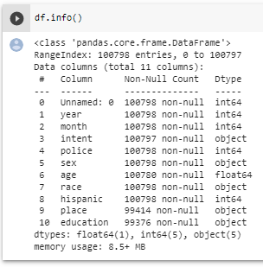
Attributes
This dataset has 100,798 rows and 11 columns. Following are each features with short description:
Year
Month
Intent - intention of incident, which are Suicide, Accidental, Homicide, Undetermined, or Unknown
Police - police involved shooting
Gender
Age
Race - race or ethnicity of the victim
Heritage - Hispanic between 199-996 excluding, White 01, Black 02, Asia/Pacific Islander, Native American/Native Alaskan between 4 - 78 inclusive
Place - location of incident
Education - educational status of the victim, which is categorized as Less than High School (HS), HS/GED, Some college, BA+,

Slide 6
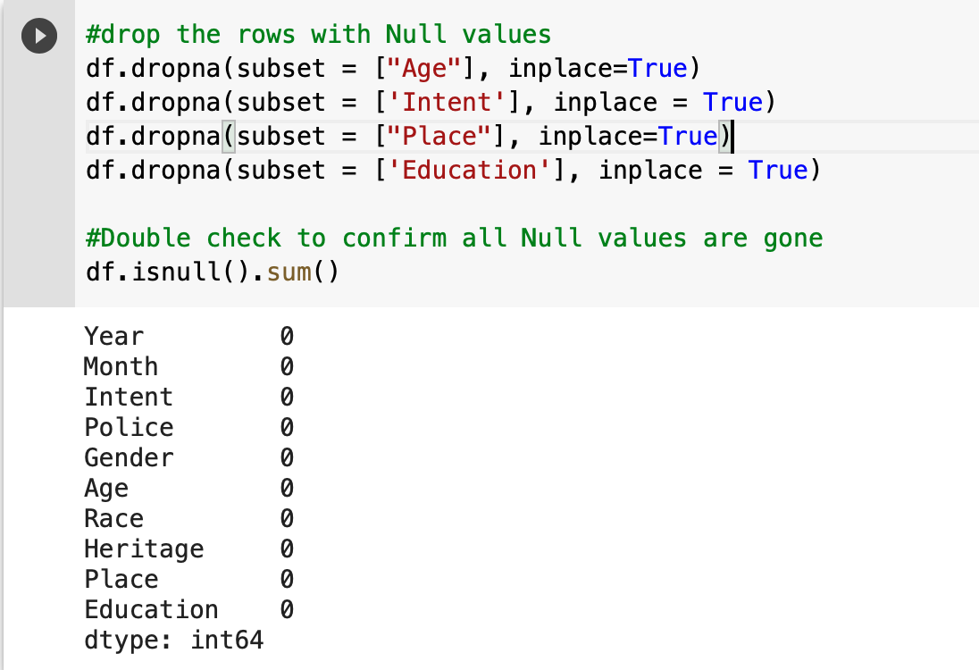
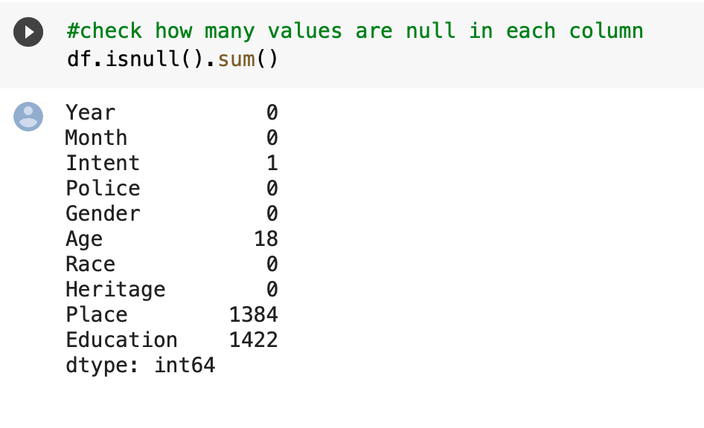
Data Prep
Dropped rows that had null values since there were minimal amounts of null relative to the size of the dataset

Slide 7
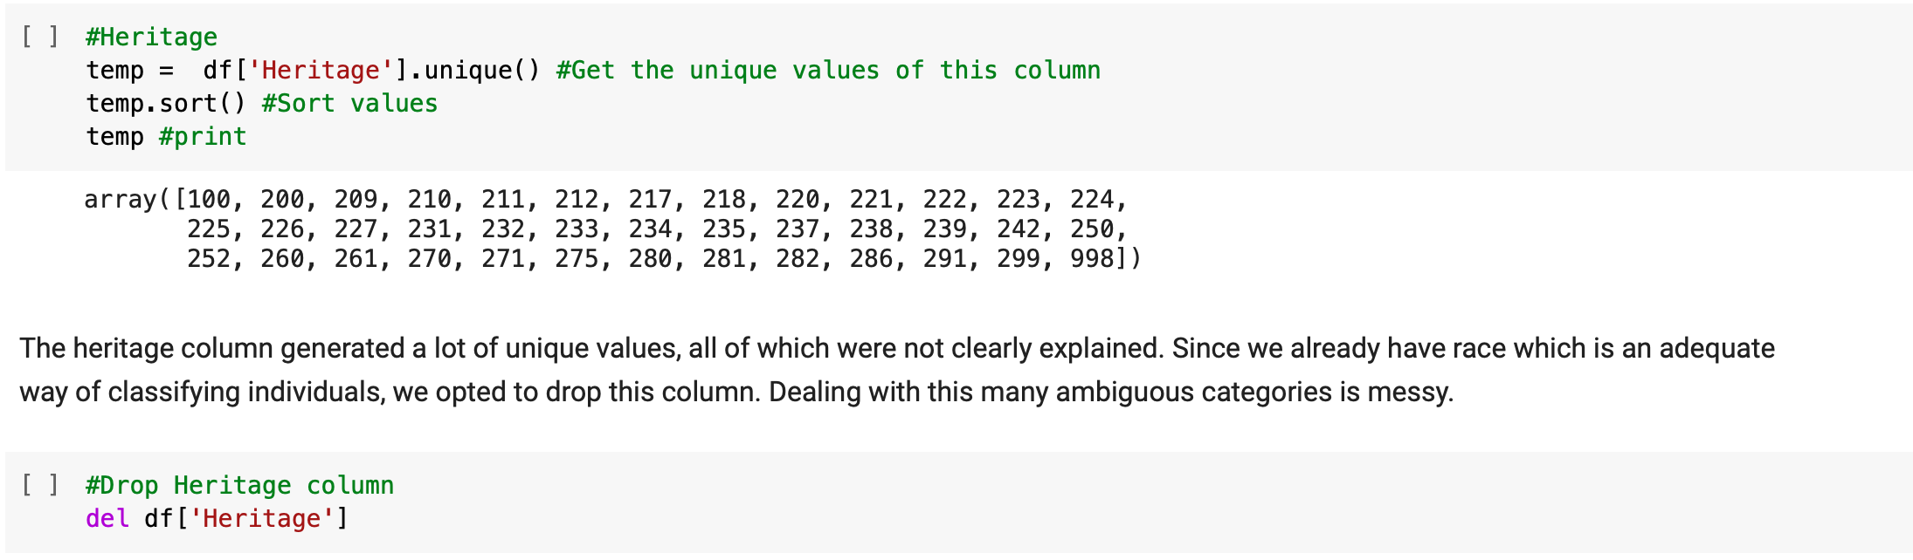
Data Prep
Checked the unique values for each attribute to make sure everything seems OK.
Dropped heritage attribute because its values were ambiguous.

Slide 8
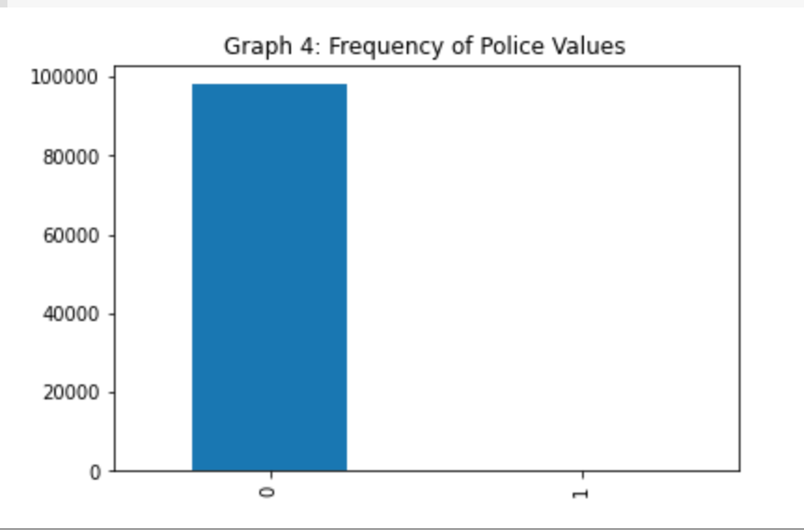
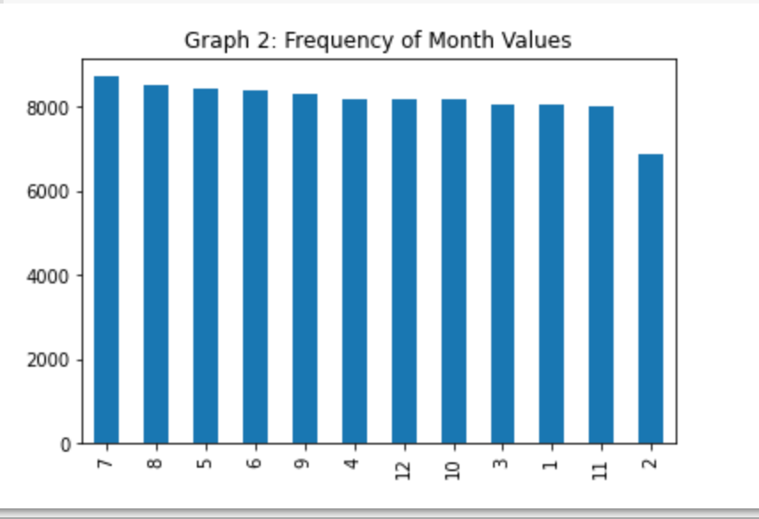
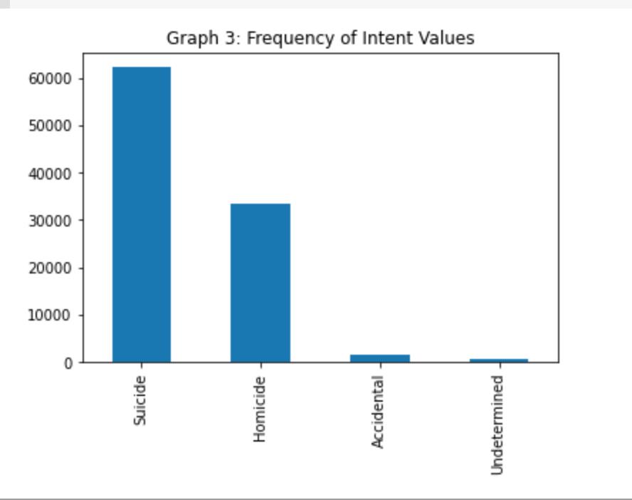
Data Visualization

Slide 9
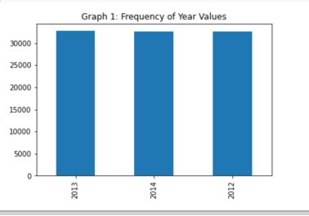
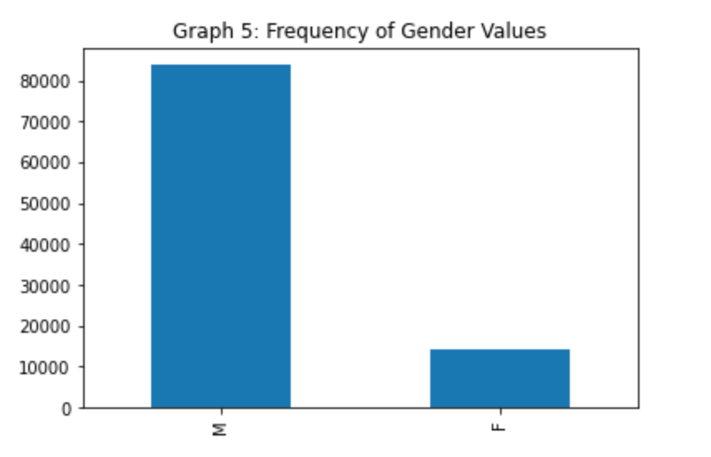
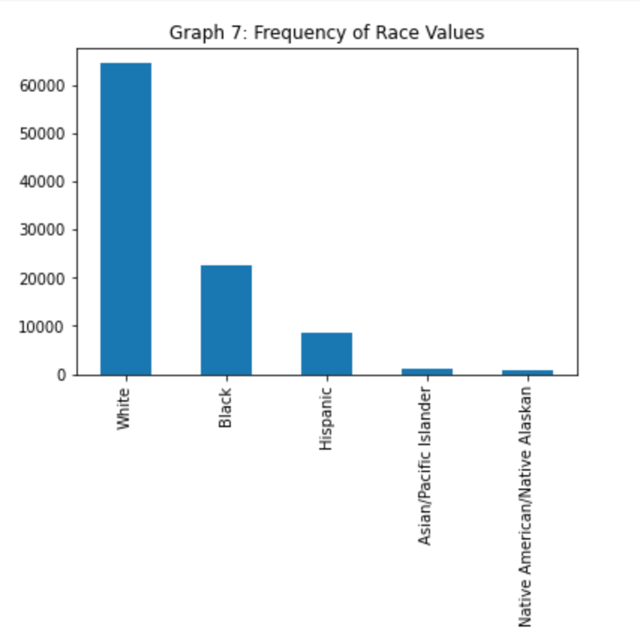
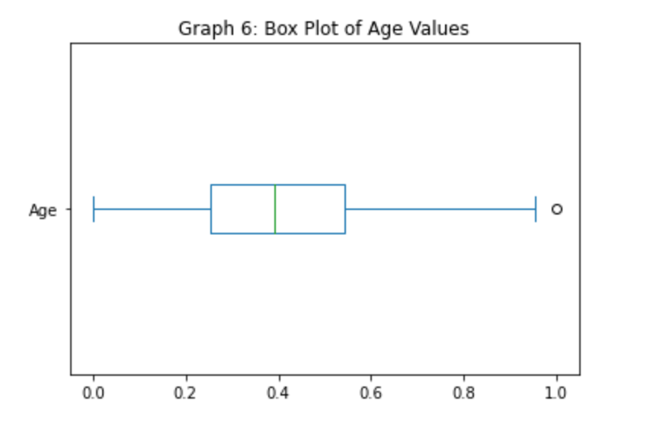
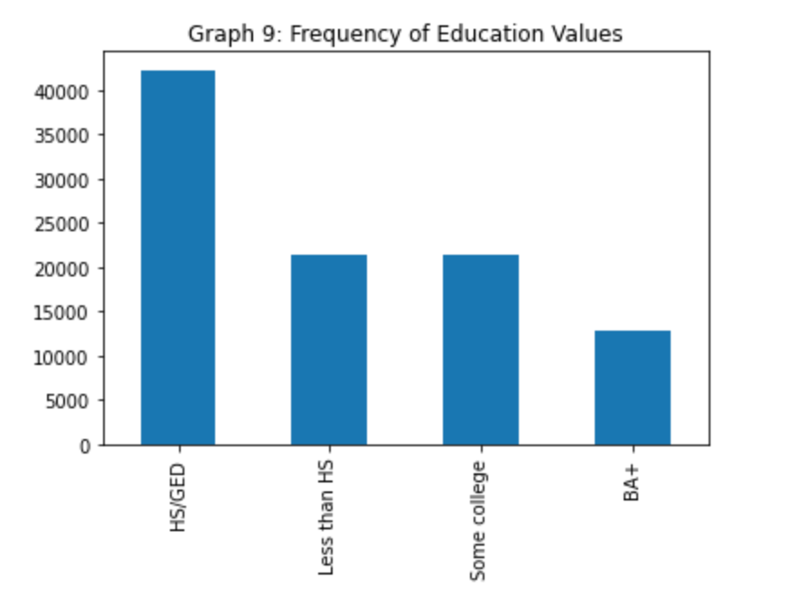

Slide 10
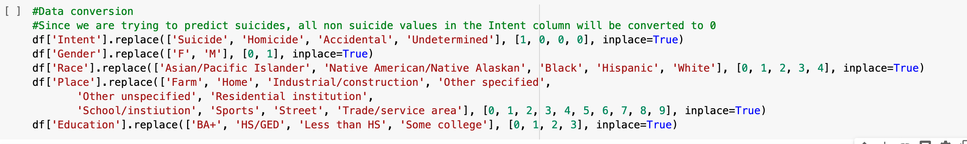
Data Conversion- to Numeric

Slide 11
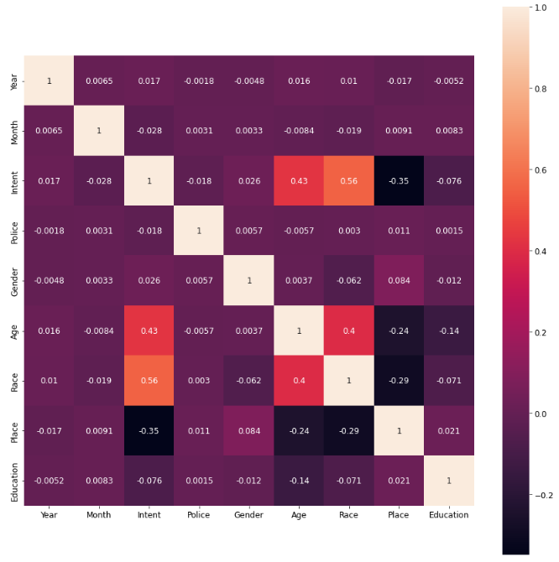
Heatmap

Slide 12
Preliminary Conclusions
- We expect most of the attributes to contribute unique data to our models.
- Age and Race are highly correlated with intent. This is expected since certain demographics are more likely to be involved in gun culture, exposure and violence. Age and race share a decent level of correlation with each other as well.
We can expect that either age or race will not show up as a selected attribute during feature selection since they contribute similar data to any created model.
- One odd observation is the negative correlation between Intent and Place. One would expect a higher amount of correlation between these 2 attributes since we know the majority of gun related deaths takes place in the victim's home.
- We don't expect year to come up as a selected feature since gun violence happens regularly throughout the documented 3 years.
- There was 1 correlation value that defied expectations. This was the Place attribute. Certain demographic groups tend to congregate in different places in society. This is a real world link between location, age and race. Surprisingly, the heat map disagrees.

Slide 13
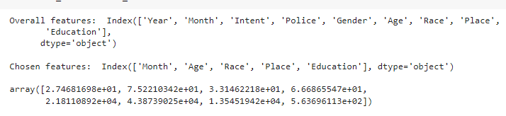
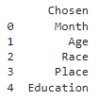
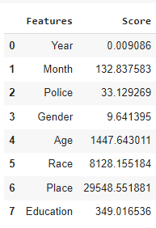
Feature Selection
- once again we utilized the K-best with f regression and Chi-Square methods for feature selections
- we see that the features selected are the same for both methods
- Month, Age, Race, Place, and Education were all chosen

Slide 14


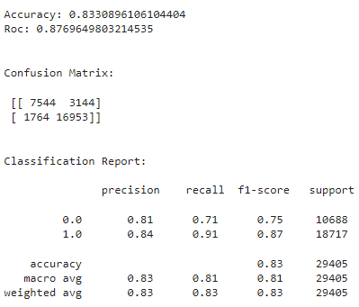
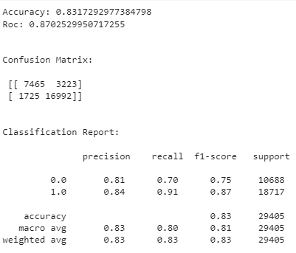
Logistic Regression Model
Original data
Selected Features

Slide 15
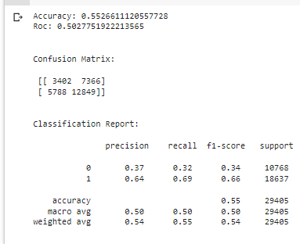

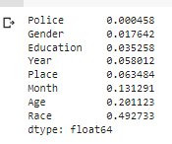
Decision Tree Regression Model
It is interesting to point out that this model placed a heavier numerical weight on a similar set of attributes to the ones selected by K-Best and the Chi Square test. Both form of feature selection picked Month, Age, Race, Place and Education. The Tree Regressor placed heavy weights on Race, Age, Month, Place and Year. Education followed as a near 6th place.

Slide 16


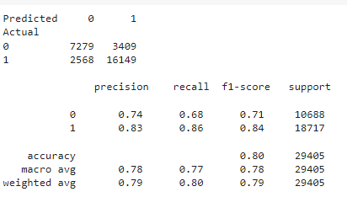
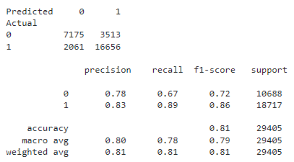
Random Forest model
Original Dataset
Selected Features

Slide 17
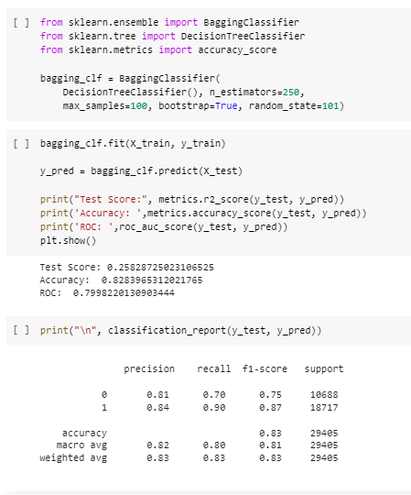
Ensemble Model

Slide 18
Detailed Conclusion
The model that outperformed the others by a slight margin was model number 1, the Logistic Regression model that used all of the attributes. This model has an accuracy of 0.8330896106104404 and Roc of 0.8769649803214535. Model 2 was a close 2nd place. Each of the models performed accurately in some regard. What this report focused on was the idea that a more accurate classification model can be built by selecting the attributes that contribute the most unique data to the models. The results are somewhat inconclusive.
Month, Age, Race, Place and Education was selected by both feature selection method. When these five attributed were fed into a logistic regression model, the performance metrics went down slightly when compared to the model that used all the attributes. The opposite is true for the Random Forest models. When the five selected attributes were used to create a Random Forest, the performance metrics slightly increased when compared to using all the attributes. It is unknown why this happened.
One other observation is that the decision tree placed heavier emphasis on Year, Place, Month, Age and Race. This list has four of the five attributes that were selected by K-Best and the Chi Square test. This is somewhat notable. Although the theory did not pan out as we expected, some knowledge can still be gleamed from the data and selected features. Clearly age and race play a major factor in gun violence since certain demographic have a higher degree of exposure and indulgence in gun use, whether it is for recreational or criminal use. Timing is also important. According to the data, people tend to be more isolated during the non-holiday months. This might lead individuals to be more violent.
The place in which the crime takes place matters as well. Most people are shot in their homes. This aligns nicely with the fact that most shootings and murders are committed by a friend or family member. As for education, it would be easy to say that people of with a Highschool diploma are more likely to be involved in gun violence, but it is more likely that this observation is simply a consequence of how education is distributed among the American population. The one attribute that defied expectation is Gender. We expected this to show up since males were more likely to be the victim of a gun related death unfortunately. It is unclear as to why this is the case.

Slide 19
Thank You !!!

Slide 20
References
https://fivethirtyeight.com/features/gun-deaths/
https://github.com/fivethirtyeight
https://www.pewresearch.org/fact-tank/2022/02/03/what-the-data-says-about-gun-deaths-in-the-u-s/
https://datatofish.com/random-forest-python/

