Slide 1

Project 2: Titanic Data Set
Group Members:
Arun Kuinkel
Avigail Spira
Cindy Juan
Dean Loeafoe

Slide 2

Workflow:
Introduction
Data Summary
Data Preparation
Data Visualization & Preliminary Conclusion
Bar Plots, Box Plots, Histograms, Correlation Table and Chart
5. Feature Engineering
K-Best Feature Selection
Chi-Square Feature Selection
6. Logistic Regression Model
From Original Data
From K-Best Selected Features
From Chi-Square Selected Feature
From Features with High Correlation
7. Conclusion

Slide 3
Introduction
This incident is probably well-known to most of us here
But we were unaware that this topic was equally well-known topics for Data Analytics purpose
The RMS Titanic, a luxury steamship sank in the early hour of April 15, 1912
Out of 2,240 passengers and crew members, 1500 lost their lives
We have information regarding 1311 of those passengers

Slide 4
Our aim is to;
We will examine which of the attributes contributed the most to each passenger's survival using following methods:
K-Best Feature Selection Technique
Chi-Square Feature Selection Technique
We will also attempt to create regression models that predict those passengers' survival based on all the attributes chosen by the above two feature selection algorithms and two others:
Logistic Regression Model from Original Data
Logistic Regression Model from K-Best Selected Feature
Logistic Regression Model from Chi-Square Selected Feature
Logistic Regression Model from Features with High Correlation

Slide 5
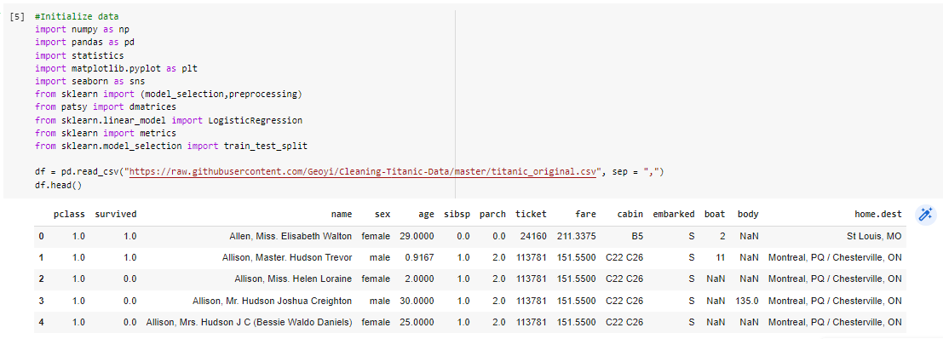
Data Initialization
For this group project we uploaded the data in the GitHub repository and used the GitHub raw link to upload that to pandas

Slide 6
After uploading data:
Because this dataset comes with some meaningful column names, it is not necessary to pick column names
Same goes for the data subsets, if our raw data had a lot attributes, we would probably select the subset of attributes that we believe are best for our study.
Since this data does not require any such things, we can move on to gather some preliminary information this data provides.

Slide 7
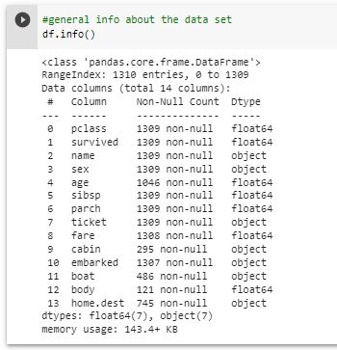
General Information on Data Set
We can see that this data set has 1310 rows (used cases) with 14 different attributes.
There is a mix of categorical and numerical data in this data set
Just by looking at this information we can tell that there are some attributes that have a lot of Null Values, such as age, cabin, boat, body and home.dest

Slide 8
Attributes:
Following are the attributes with brief description:
pclass - Passenger Class (1 = 1st Class; 2 = 2nd Class; 3 = 3rd Class)
survived - Did this passenger survive (0 = No; 1 = Yes)
name - The name of each passenger
sex - The biological sex of each passenger
age - The age of each passenger
sibsp - The number of siblings and spouses this passenger has aboard the ship
parch - The number of parents and children aboard the ship
ticket - Ticket number
fare - The price the passenger paid for their ticket
cabin - The number of the cabin in which the passenger stayed
embarked - Port of Embarkation (C = Cherbourg; Q = Queenstown; S = Southampton)
boat - If the passenger survived, did they make it to a lifeboat?
body - The id number given to the recovered bodies of the dead passengers
We will examine the data set with the help of algorithms in the later sections, however based on our domain knowledge and the end goal to know the probability of someone surviving the crash. We can say that the attributes such as name, body, home-destination won't matter much.

Slide 9
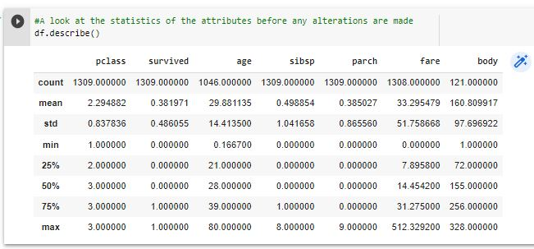
General Stat (data summary)
This function (df.describe()) gives us the general statistics of numerical variables in the original data frame
The general stat gives us the initial statistics of the data set before we make any alterations in the data set
We have mean value of each attributes, standard deviation, minimum value of each attributes,
25% (percentile) shows us that 25% of the data points lies below that value and 75% of data points lies above that value
50% is the median,
75% (percentile) shows us that 75% of data points lies below that value and 25% of the data points lies above that value
Standard deviation means the dispersion of data relative to its mean: Larger the std, more spread out the data points are
Larger gap between mean and std means the normal distribution curve is wider

Slide 10
General Stat cont...
Fare and body has a very high std, which means that that data is highly dispersed, this does not necessarily mean these attributes have outliers but it’s a good indicator to pay more attention on them when we do data cleaning and data preparation
Passenger class (pclass), survived, number of siblings and spouses (sibsp) attributes all have good standard deviation (std)
The minimum value for fare is $0, we must investigate those zero values , because normally everyone pays fare unless someone got them for free. But because there are only 2 such values, we can simply ignore them without impacting much of the data set

Slide 11
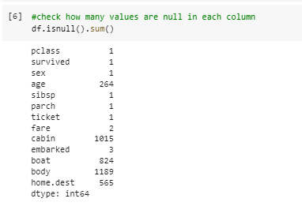
Data Preparation
From the snapshot of the code and output, we can see that there are a lot of null values in the attributes age, cabin, boat, body, and home.dest

Slide 12
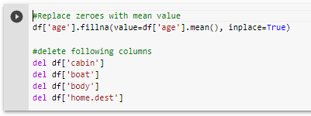
Handling Null Values
The cabin, boat, body and home.dest attributes have too many null values to handle properly.
These columns will be dropped to prevent the model from being swayed by potentially erroneous data.
Since the age attribute has a relatively small number of Null values, they will be replaced with the mean

Slide 13
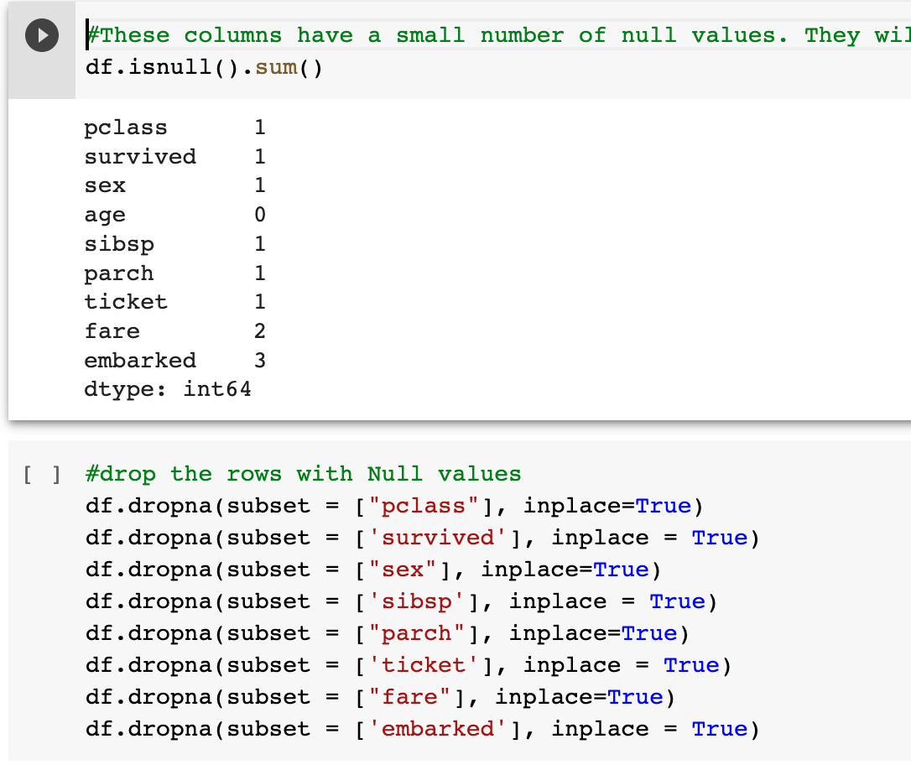
Remaining null Values
Now there is minimal amount of null values left in the dataset.
Those rows with nulls can be dropped without majorly effecting the dataset.

Slide 14
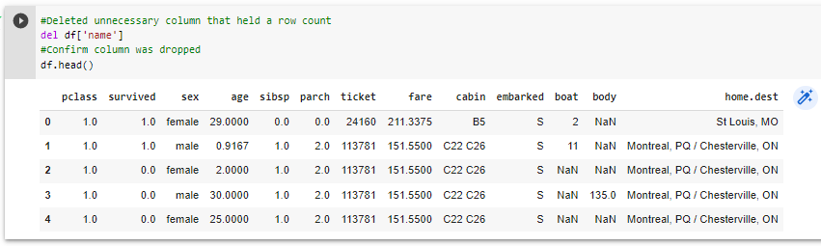
Dropping Name column
The name of each passenger will likely not be a major determining factor in their survival.
Additionally, the name attribute will create an individual category for each uniquely named passenger. This is messy.
To avoid these complications, the name column will be dropped.

Slide 15
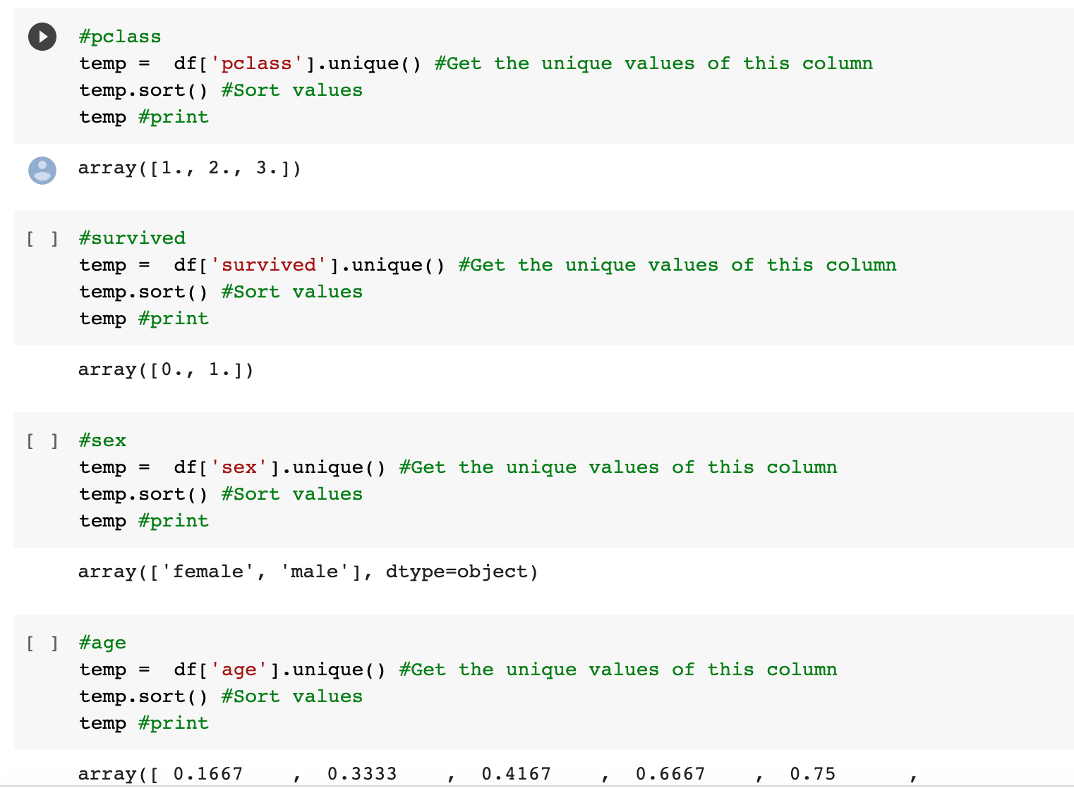
More data prep: Checking unique values
We checked the unique values just to ensure that nothing seems out of the ordinary and that there are no null values in the form of a ? Or negative numbers.

Slide 16
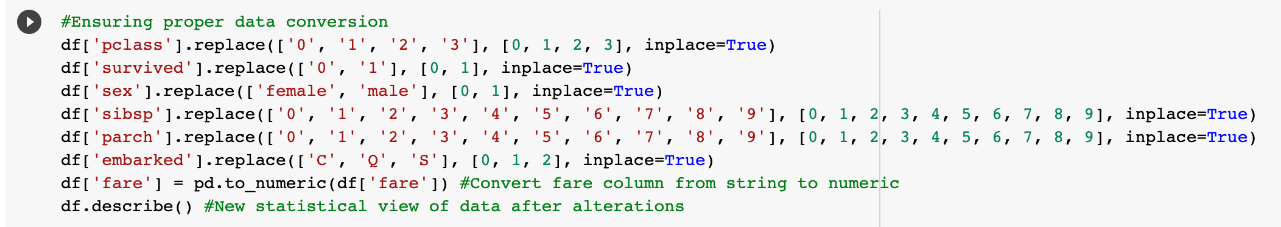
Convert categorical data
Convert categorical to numeric and strings to their numeric form so that the data can be used for models and visualizations.

Slide 17
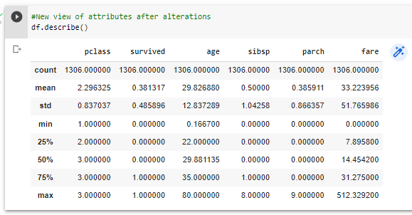
General stat after data alterations (cleaning)
As you can see the is a slight improvement in standard deviation of age after filling up zero values with mean value …...

Slide 18
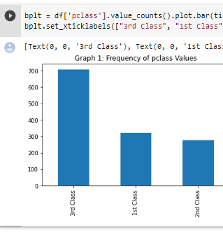
Data Visualization
The majority of the passengers had 3rd class accommodations. This is to be expected. Oddly enough, there are more passengers with 1st class accommodations than there are passengers with 2nd class accommodations. One would expect those statistics to be swapped.

Slide 19
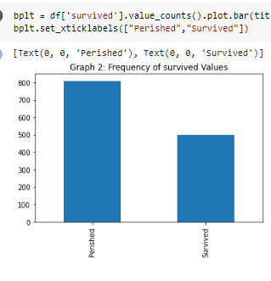
There is a higher number of passenger who perished in comparison to the number of passengers who survived.
This can be attributed to many factors such as health, age, strength, access to routes of egress, number of life boats and access to life boats.

Slide 20
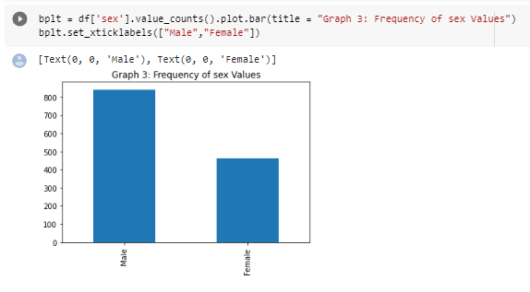
There were about twice the amount of males abord the ship in comparison to the number of females.

Slide 21
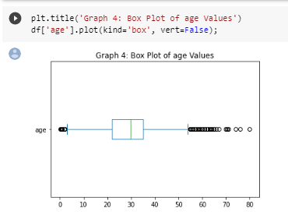
There are a cluster of outliers on the lower end of the graph and stretching out to the higher end of the graph.
These outliers can be attributed to babies, young children and eldery passengers being aboard the ship.

Slide 22
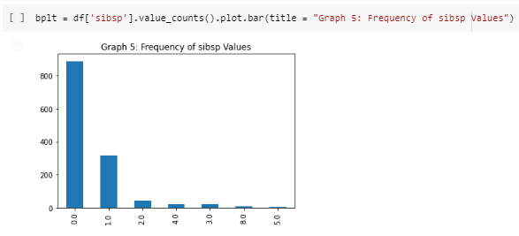
The vast majority of the passengers did not have any siblings or spouses aboard the ship.

Slide 23
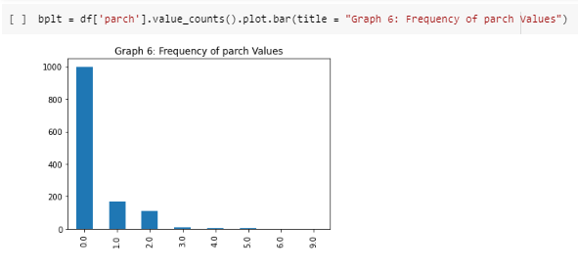
The vast majority of passengers did not have any parents or children aboard the ship.

Slide 24
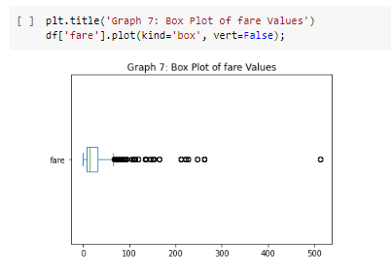
There are a number of outliers in the higher price ranges of the fare. Statistically speaking this is odd. It is likely these outliers are the fares for the 1st and 2nd class tickets which likely cost far more than the 3rd class tickets. These outliers will be left alone since it is a matter of record that these tickets were reportedly purchased at these prices.

Slide 25
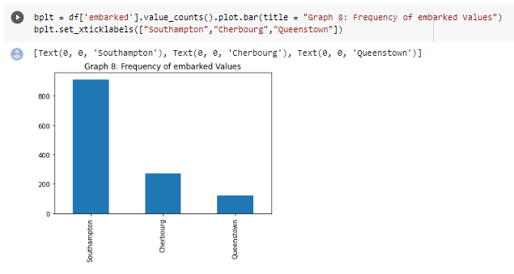
The majority of the passengers boarded the ship at Southampton while the minority of the passengers boarded at Cherbourg and Queenstown.

Slide 26
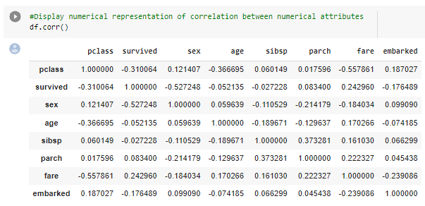
Display numerical representation of correlation between numerical attributes

Slide 27
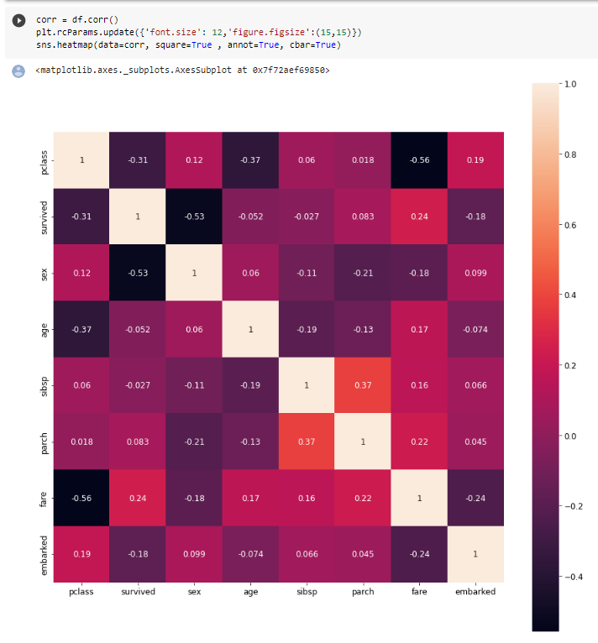
Correlation

Slide 28
Preliminary Conclusion
Judging from the generated graphs of the pair plot and the heat map, it would appear that there won't be many attributes that will contribute meaningful data to the models. I say this because the pclass, sex, age, sibsp and embarked attributes all have a negative correlation with the survived attribute. These attributes will likely receive a low precedence during feature selection.
It is possbile that these attributes have a low correlation with survived because they are quantifications of happenstance circumstances. For example, it doesn't matter if you're male or femamle or at which destination you've boarded the boat. Regardless of these attributes, you either have the same or a random chance of survival just like any other passenger.
The only 2 attributes that have a positive correlation with survived are parch and fare. I find this to be unexpected because I would consider these attributes to be happenstance circumstances just like the aforementioned attributes with negative correlations. parch is a count of how many parents and children you have aboard the ship. I expected parch and sibsp to have similar amounts of correlation to the survive attribute. Remember, sibsp is a count of how many siblings and spouses you have aboard the ship. Both parch and sibsp are similar in that regard.
Oddly enough, we see that parch has a positive correlation while sibsp has a negative correlation. It is possible that the chaos of the sinking event might've hindered the family members of sibsp to a higher degree than the members of parch. I also have to admit that this argument is predicated on the assumption that the family members of both groups were cooperative with each other and were in the physical position to act on that cooperation. Neither of these predicates are guaranteed in such a chaotic event. The correlation ratings of sibsp and parch are -.027 and .083 respectively. Numerically, these numbers aren't far apart so it is possible that the fact that one rating is negative while the other rating is something that just happens to be.
Another odd obeservation is the positive correlation between the survived and fare attribute. Perhaps the passengers who paid a higher fare for first class and second class tickets were housed in cabins that were advantageous in terms of securing a route of egress. I fully expected this attribute to have a negative correlation because how much one paid for their ticket is seemingly random. Even if that ticket houses you in a cabin that is near a route of egress, that does not mean you'll be near that route of egress once the ship starts sinking.
In summation, I believe it will be difficult to generate a model that predicts the survival of passengers with a high amount of accuracy due to the dropped columns with missing data and the remaining columns with low correlations to the survived attribute.

Slide 29
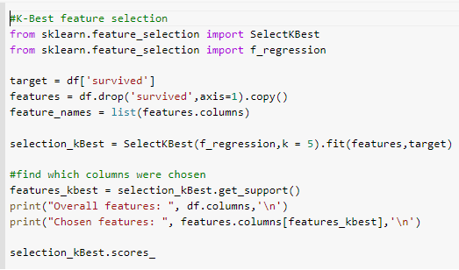
Feature Selection- K-best with F-regression
- F-tests works to compare the improvement of one statistical model to another, fitted to the data
- Helps identify the best model that best fits the population of the data
-Chooses the best k cases for each variable to our target variable.

Slide 30
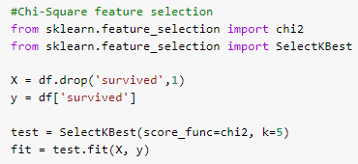
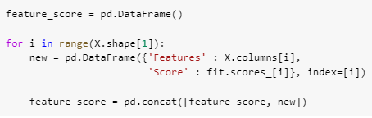
Feature Selection - Chi-Square
- Used for Categorical Data
- Tests the independence between two variables
- Takes the data from both variables to generate an observed count and expected count
- When two variables are independent, their expected counts and observed counts are closer together, leading to a smaller Chi-Squared value
- This means that higher Chi-Squared values indicates the two variables to not be independent

Slide 31
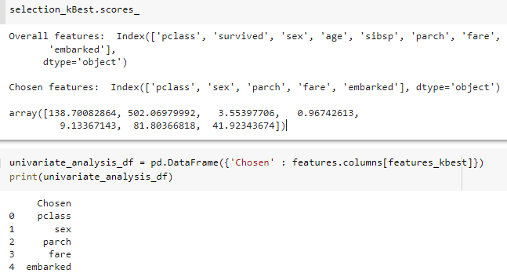
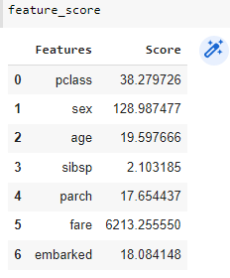
Feature Selection- Results
K-best Results
Chi-Square Results
Based on the results, we can see that most features selected by the two methods were the same. These features include fare, sex, pclass, and embarked. Where the two methods differed in results was that k-best found parch to be a top feature while chi square found age to be a more dependent feature.

Slide 32
Logistic Regression Models

Slide 33
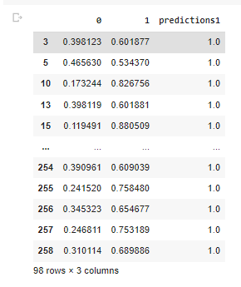
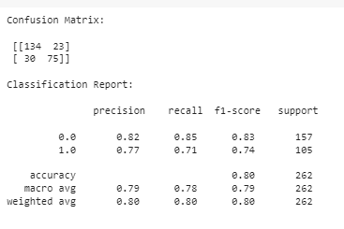
Logistic Regression Model from Original Data
Prediction is displayed, as well as the confusion matrix. Code can be referenced from the google collab.

Slide 34
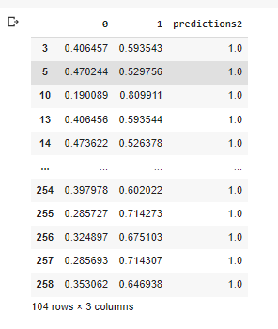
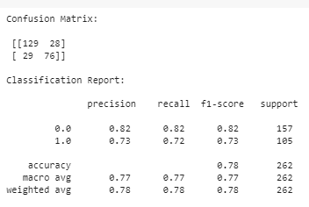
Logistic Regression Model from K-Best Selected Features
Prediction is displayed, as well as the confusion matrix. Code can be referenced from the google collab.

Slide 35
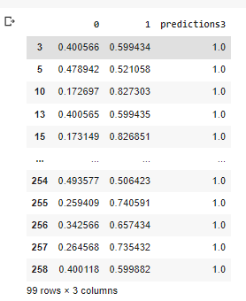
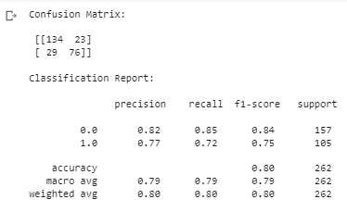
Logistic Regression Model from Chi Square Selected Features
Prediction is displayed, as well as the confusion matrix. Code can be referenced from the google collab.

Slide 36
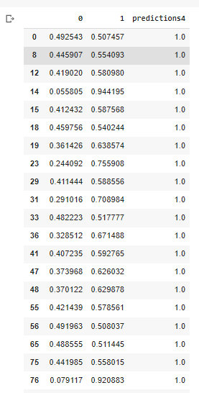
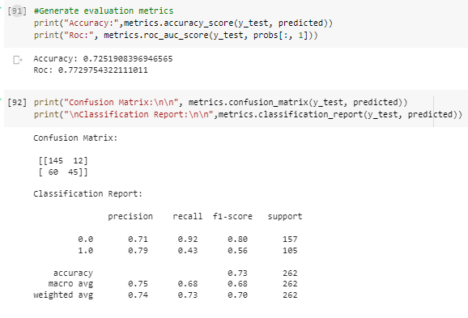
Logistic Regression Model from Features with High Correlation
Prediction is displayed, as well as the confusion matrix. Accuracy and ROC displayed as-well. Code can be referenced from the google collab.

Slide 37
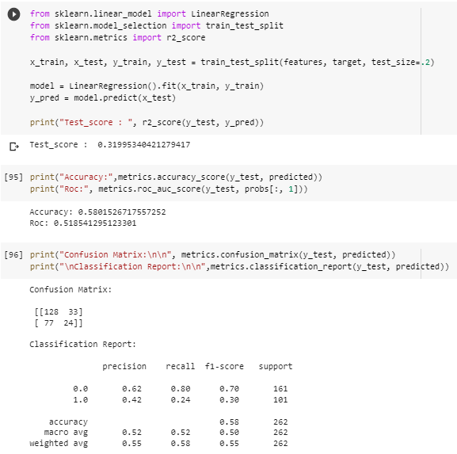
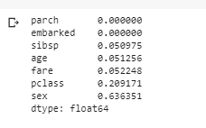
Tree Regression Model
Prediction is displayed, as well as the confusion matrix. Accuracy and ROC displayed as-well. Code can be referenced from the google collab.

Slide 38
Conclusion and findings
After creating multiple models from various methods of feature selection, there is one model that performs nearly as well as the model made from the original data. This is model3, the model created from attributes selected with the Chi Square test. Model3 has a slightly lower model score and ROC than model1, however, model3 outperforms the other models when it comes to accuracy, precision, recall and F1-score.
The attrib \utes that were selected by the ChiSquare test were fare, sex, pclass, age, and embarked. Some of these choices were unexpected. Let's start with the obvious. It comes as no surprise that fare was one of the selected attributes that influenced survival. The passengers who paid more for their tickets likely were housed in cabins near routes of egress. pclass serves as another indicator of this. We did not expect both of these attributes to show up in the best performing model since one would expect a decent amount of colinearity between these 2 attributes. Instead we see the opposite. The pclass and fare attributes have a correlation rating of -.56 which would indicate that they operate independently and contribute unique data to the model.
We did not expect to see the embarked attribute in the best performing model. One would think the place from which you've boarded the ship did not matter but apparently it does. This might just be something that happened randomly. It is also possible that a large number of the passengers who boarded the ship at Southampton are the same passengers who bought 1st class tickets which allowed them to escape the ship more easily.
The last 2 attributes in this model are age and sex. The fact they've been included in this model could be attributed to biases in who received aid and preferential treatment while escaping the sinking ship. It isn't too hard to imagine that the passengers who were young or elderly received extra aid in escaping the ship. Similarly, it is likely the female passengers were the recipients of additional aid since men are expected to be chivalrous in emergency situations such as this. Some men had probably had to stay on the sinking ship due to a lack of life boats. These reasons could be the factors that led to sex and age being selected features for this model.
Two attributes that unexpectedly did not make it into the model were parch and sibsp. parch is a count of how many parents and children a passenger has aboard the ship. sibsp is a count of how many siblings and spouses a passenger had aboard the ship. We fully expected these two attributes to show up in the final model because simple logic would dictate that passengers with family members aboard the ship would have a better chance at survival since they will likely help each other escape. This is not what we see. In fact, both of these attributes have a very low correlation with the survived attribute so it shouldn't be too much of a surprise that they did not make it into the best performing model.
In summation, the Chi Square test selected the features that created the best performing model.

Slide 39
References
https://www.history.com/topics/early-20th-century-us/titanic#:~:text=The%20RMS%20Titanic%2C%20a%20luxury,their%20lives%20in%20the%20disaster
https://github.com/awesomedata/awesome-public-datasets/issues/351

