Slide 1
& Machine learning FOR BUSINESS
MENU
ANALYSIS
AI & MACHINE LEARNING
AI
Propensity to Buy

Slide 2
TABLE OF CONTENT
AI & MACHINE LEARNING
WHY ML?
01
02
PROPENSITY TO BUY
NEXT STEP
03
04
MENU
AI & MACHINE LEARNING
Definition, type, roadmap, function
Why do we need machine learning
Prediction of buying customers in next 5 months
Future plan

Slide 3
AI & MACHINE LEARNING
MENU
AI & MACHINE LEARNING
Artificial Intelligence
Machine Learning
A technique which enables machine to mimic human behavior.
Subset of AI techniques which use statistical methods to enable machines to get better at task without explicit instructions and relying on patterns.
Deep learning
AI
ML
In a relationship:
Notes:
Machine Learning is like teaching your computer to play a game. Just like you learn to get better at a game, the computer learns to get better at tasks from lots of examples.
Why do this? Because computers are fast! They can help sort your emails, recommend a movie, and do many other things quickly once they've learned how to do it.
Artificial Intelligence (AI) is like a robot's brain. It allows computers to think and make decisions like a human. Just like your brain helps you think, learn, and solve problems, AI helps computers do the same!
Why is this cool? Because AI can help do things like talk to us (like Siri or Alexa), play games with us (like some computer games), and even drive cars! AI is about making computers smart so they can help us in our daily lives.

Slide 4
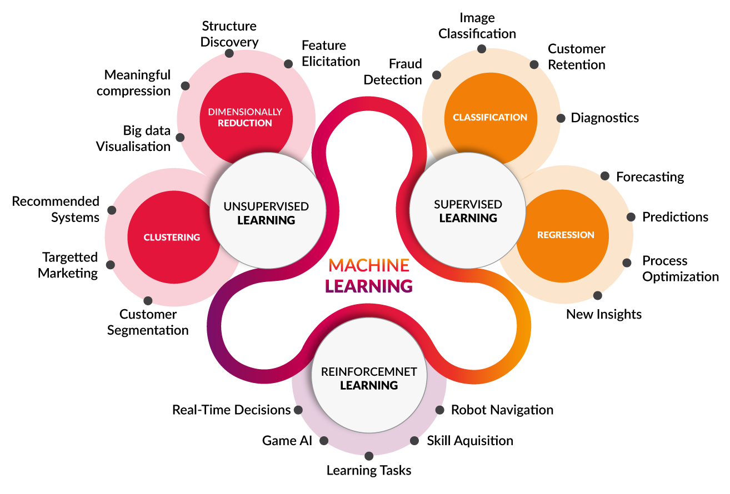
MENU
AI & MACHINE LEARNING

Slide 5








Machine learning roadmap
MENU
AI & MACHINE LEARNING
Training data
Train Model
Dataset
Feature Engineering
Evaluate model
Score model
Data cleaning
Test data
Test

Slide 6
Why do we need ml?
MENU
AI & MACHINE LEARNING
• There are some tasks that are too big and too hard for people to do quickly.
• Human can detect pattern, however with the growth of data, it’s impossible to detect thousands of pattern from data, not even mentioning the iterations.
• Human are more reluctant to mistakes when doing repeated jobs, while computers are less reluctant to it.

Slide 7

Propensity to buy
MENU
AI & MACHINE LEARNING
Here, the propensity to buy model is the predictive model that analyze the purchase behavior of customers by making distributional assumptions
Benefits:
Predict probability of customer to become churn
Predict CLV
Predict purchase volume
Model used: Lifetimes Library (https://lifetimes.readthedocs.io/en/latest/Quickstart.html)
Model limitation: only can be used for user with >1 transaction
**Lifetimes use the combination of Beta-Geometric/Negative Binomial (BG/NBD) model combined with the Gamma-Gamma model for estimating the customer lifetime value

Slide 8
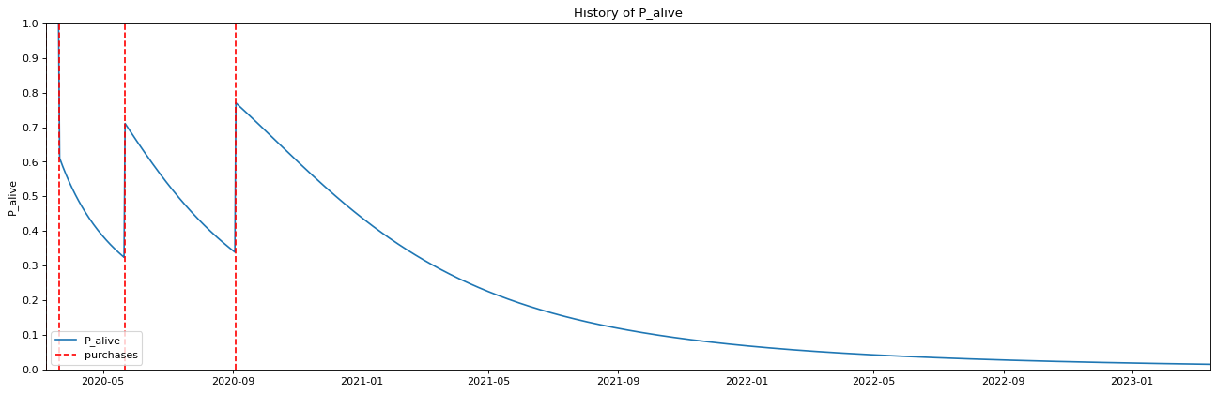
How the model works
MENU
AI & MACHINE LEARNING
The model uses several probability models.
The main factors affecting: the frequency of purchases, the period between every purchase
For example from the user purchase history below, the probability of alive at 1 May 2021 is 0.2
The probability alive will increase as the purchase frequency increases
The probability alive will decrease as the period increases
** P_Alive is (1 - probability customer becomes inactive), or the probability of the customer is still active in the merchant

Slide 9
Propensity to buy model assumptions
MENU
AI & MACHINE LEARNING
Assumption | Explanation
Customer’s transaction rate follows Poisson process | The customer’s transaction is a random process that is independent and has a mean rate
Heterogeneity in transaction rates among customers follows a Gamma distribution | Each customer has their own probability of buying that follows gamma distribution (a continuous distribution)
The probability of dropping out after transaction follows a geometric distribution | The geometric distribution is used to model the distribution of the number of transactions a customer makes before dropping out to generate a fixed parameter probability p
Heterogeneity in p follows a Beta distribution | Different customer may has different inactive probability (p). The distribution of p across the population of customers can be described by Beta distribution (a continuous probability distribution)
The transaction rate λ and the dropout probability p vary independently across customers. | The expected number of transactions per unit time (λ) and the inactive probability of a customer (p) are assumed to be independent of each other across different customers

Slide 10
Data description
MENU
AI & MACHINE LEARNING
Description | Lifetime Transactions from members who joined before 2021
Features | User ID, Transaction recency (date difference between last 2 transactions), Transaction frequency
Train Test Split | The Data was split into two parts, Train (trx date before Dec 2022), Test (trx date on Jan - May 2023)

Slide 11
Model evaluation
MENU
AI & MACHINE LEARNING
Below is the result for number of purchases in Jan – May 2023 (5 months purchase prediction):
Predicted Label
Positive Negative
FP = 40,477 | TN = 412,517
TP = 35,370 | FN = 60,309
True Positive Right Number of trx : 17,876
True Positive incorrect number of trx: 17,494
Accuracy (only true positive with right number of trx counted): 78.44%
Accuracy (All): 81.63%
Real Label
Positive Negative

Slide 12
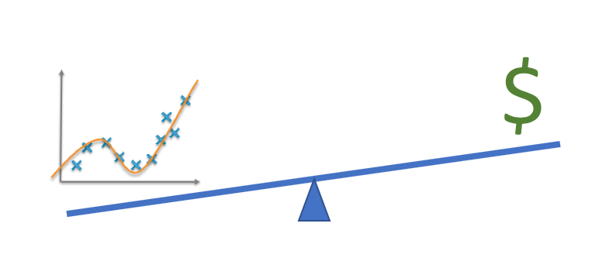
NExt Step
MENU
AI & MACHINE LEARNING
Increase model accuracy -> explore other data preprocessing
Deploy model for production purposes
Explore more Machine Learning models for business purposes

Slide 13

RESOURCES
MENU
AI & MACHINE LEARNING
https://www.getcensus.com/blog/primer-on-the-types-and-features-of-fraud-prediction-models
https://lifetimes.readthedocs.io/en/latest/Quickstart.html
https://github.com/CamDavidsonPilon/lifetimes/blob/master/lifetimes/fitters/beta_geo_fitter.py
https://towardsdatascience.com/predicting-customer-lifetime-value-with-buy-til-you-die-probabilistic-models-in-python-f5cac78758d9
https://cxl.com/blog/propensity-modeling/#h-1-selecting-the-features-for-your-propensity-model
Code:
https://github.com/cindysuyitno/Churn-Prediction

Slide 14
Big Data Icon Pack
MENU
ANALYSIS
CONTACT
Data ANALYSIS

