Slide 1
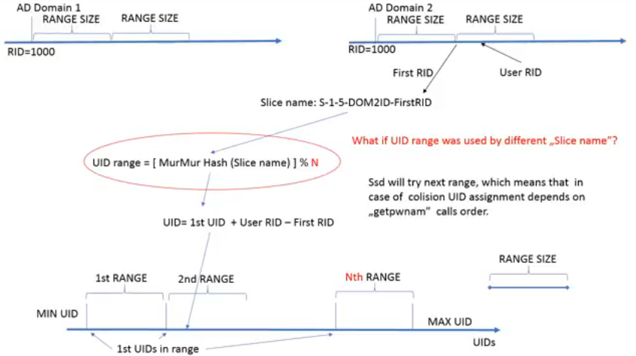
What may be an issue when using sssd algorithmic mapping from SID to UID/GID ?

Slide 2
1st, 2nd order colission – my definitions
Primary range 1
Primary range 1
Primary range 2
Primary range 3
Primary range is a UID/GID range that will be assigned to SIDs range based on
the calculation of MurMur hash % number of UID/GID ranges available.
Other ranges are called secondary ranges by sssd docs and code. I’m using terms
1st, 2nd, 3rd order secondary range to be more precise and explain potential issues.
Primary range 1
Primary range 2
Primary range 3
Primary range 1
3rd order secondary
Primary range 1
Primary range 1
1st order secondary
Primary range 3
Primary range 2
2nd order secondary
Primary range 1
Primary range 2
Primary range 1
1st order secondary
Primary range 3
1nd order secondary

