Slide 1
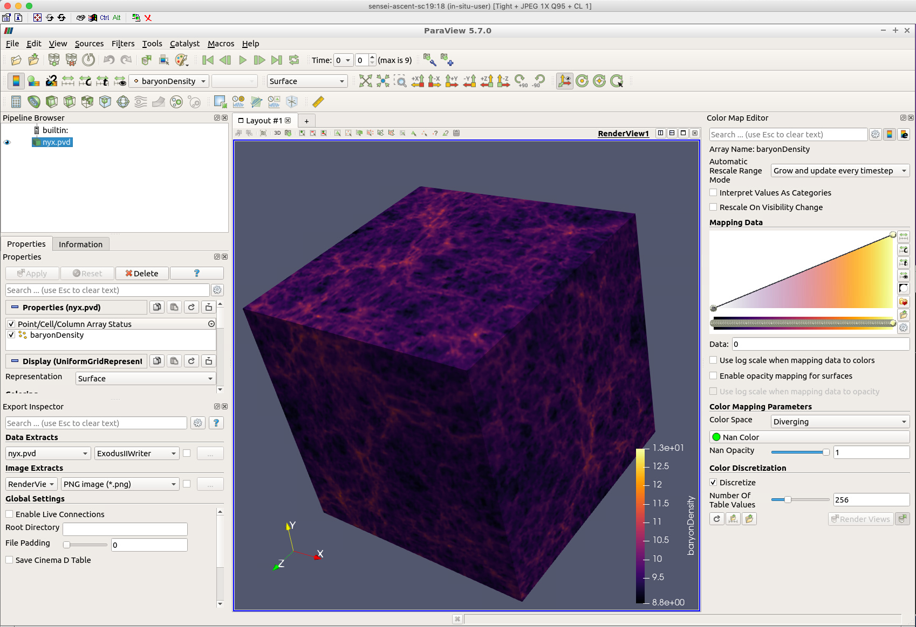
Cinema Workflow Example: Export a CDB from ParaView
Data:
10 time steps of Nyx data – nyx.pvd
Tasks:
Open a ParaView state file to load the Nyx dataset
Setup and export a Phi-Theta Cinema Database: nyx.cdb
Use CinemaCompare viewer to explore nyx.cdb
This tutorial uses a dataset from the open source Nyx cosmology simulation:
A. S. Almgren, J. B. Bell, M.J. Lijewski, Z. Lukic, E. Van Andel, "Nyx: A Massively Parallel AMR Code for Computational Cosmology" Astrophysical Journal, 765, 39, 2013. https://amrex-astro.github.io/Nyx/index.html

Slide 2
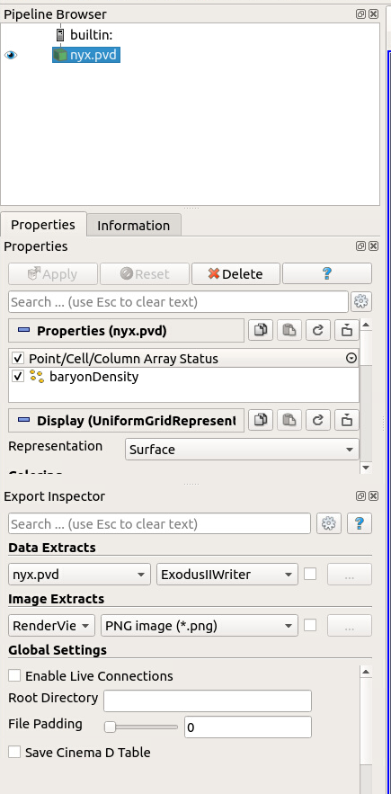
Cinema Workflow Example: Export a CDB from ParaView
Setup ParaView GUI with the dataset:
$ cd ~/cinema_tutorial
$ module unload paraview (if needed)
$ module load paraview/5.7.0
$ paraview --data=loadNyxDataset.pvsm
In the Pipeline Browser, click to highlight nxy.pvd
Notes:
Gives a list of all cinema commands. Ensure that the image and cv commands are listed.

Slide 3
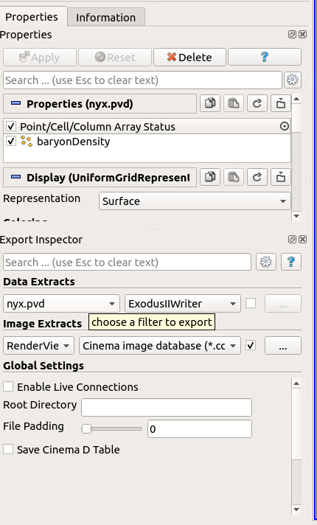
Cinema Workflow Example: Export a CDB from ParaView
Setup Cinema Database Export in Export Inspector View
Under Image Extracts, select the choices from the dropdown menus:
RenderView1
Cinema image database (*.cdb)
Click on the checkbox and use the ellipses menu to open the Save Screenshots menu
Notes:
Gives a list of all cinema commands. Ensure that the image and cv commands are listed.

Slide 4
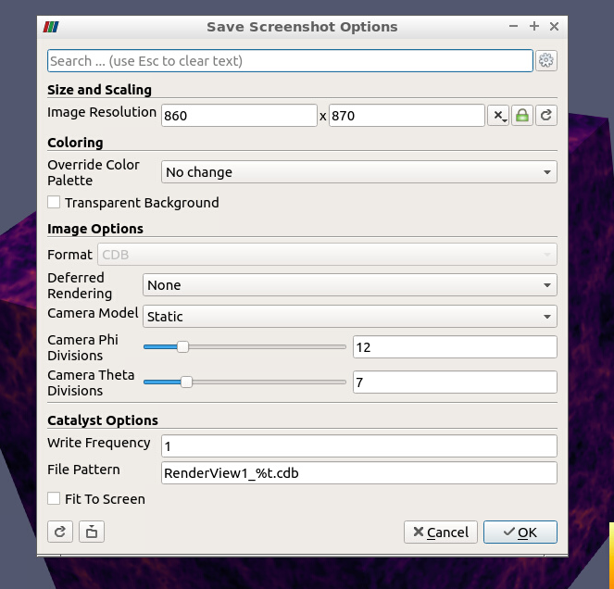
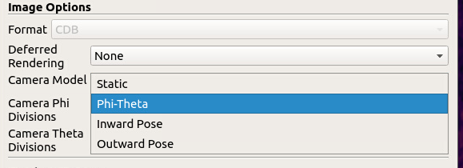
Cinema Workflow Example: Export a CDB from ParaView
Setup Cinema Database Export in Export Inspector View
Use the Camera Model dropdown menu to select Phi-Theta
Click OK
Notes:
Gives a list of all cinema commands. Ensure that the image and cv commands are listed.

Slide 5
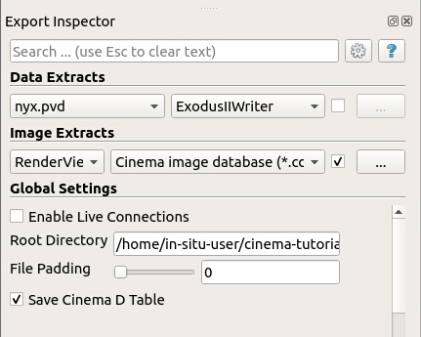
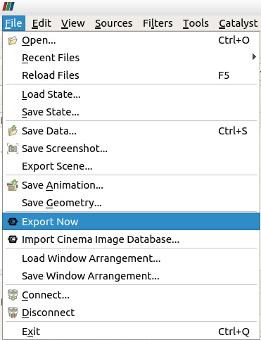
Cinema Workflow Example: Export a CDB from ParaView
Setup Cinema Database Export in Export Inspector View
Under Root Directory, give the full path and name of the Cinema database:
/home/in-situ-user/cinema_tutorial/cinema_compare/data/nyx.cdb
Click on Save Cinema D Table
Select File > Export Now
Notes:
Gives a list of all cinema commands. Ensure that the image and cv commands are listed.

Slide 6
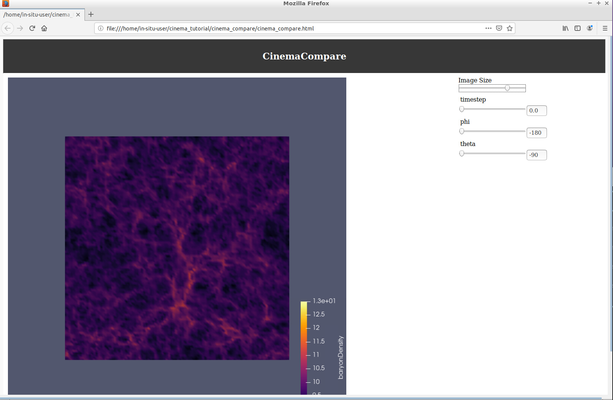
Cinema Workflow Example: Export a CDB from ParaView
Use CinemaCompare viewer to explore nyx.cdb
Select File > Exit (to exit ParaView)
Use the sliders to explore nyx.cdb
Open CinemaCompare Viewer:
$ firefox cinema_compare/cinema_compare.html
Notes:
Gives a list of all cinema commands. Ensure that the image and cv commands are listed.

