Slide 1
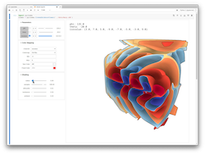
Cinema
Database Reader
Image
Renderer
Database Viewer
Cinema
Database

