Slide 1
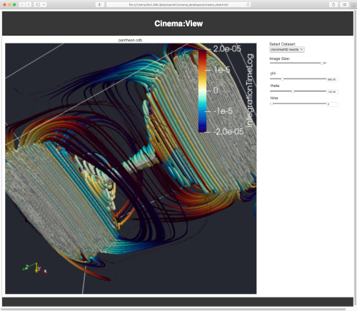
warpx
Simulation code
Paraview
Post-processing
script
CINEMA DB on disk
CINEMA
Verification

