Slide 1
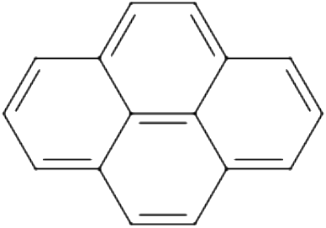
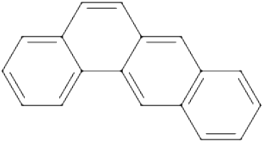

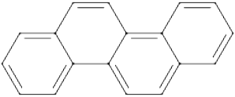
pyrene
tetracene
chrysene
tetraphene
System | Size | GVB | GVB-BCCC2b | GVB-BCCC2 | GVB-BCCC3b | DMRG
pyrene | 8 | 77.30 | 34.00 | 33.42 | 6.20 | -611.746513
tetracene | 9 | 79.70 | 33.83 | 33.07 | 6.97 | -688.622818
chrysene | 9 | 79.35 | 30.01 | 29.47 | 4.02 | -688.639252
tetraphene | 9 | 83.89 | 35.79 | 31.85 | 7.16 | -688.635897

