Slide 1
Cyclogon generated by a square
JoMendonca

Slide 2
Animation showing the generation of one arch of a cyclogon by a square as the square rolls over a straight line without slipping.

Slide 3
Create New Project 1) File > New > Project -> Empty Code Project Name: Assessment1 Location: C:\OpenGL

Slide 4
Add Existing Items 2) Start by downloading the ‘sinc.zip’ folder from ‘http://www.di.ubi.pt/~agomes/cg/praticas/sinc.zip’. After extracting the folder, put it on C:\OpenGL, for example. 3) Right-click Assessment1 > Add > Existing Item, and select main.cpp from C:\OpenGL\sinc\sinc 4) Download ‘ogl-master’ folder, extract it, and put it on C:\OpenGL, for example. 5) Right-click Assessment1 > Add > Existing Item, and select ‘shader.hpp’ and ‘shader.cpp’ from C:\OpenGL\ogl-master\common

Slide 5
Download libraries 6) Download ‘glm-master’ folder, extract it, and put it on C:\OpenGL, for example. 7) Download ‘glew-2.1.0’ folder, extract it, and put it on C:\OpenGL, for example. 8) Download ‘glfw-3.3.8.bin.WIN64’ folder, extract it, and put it on C:\OpenGL, for example.

Slide 6
Add glew32.dll (dynamic file) to the Project copy C:/OpenGL/glew-2.1.0/bin/Release/x64/glew32.dll to C:\OpenGL\Assessment1\x64\Debug and to C:\OpenGL\Assessment1\Assessment1\x64\Debug

Slide 7
Link directories in Properties 9) Right-click Assessment1 > Properties > C++ > General > C:\OpenGL\ogl-master C:\OpenGL\glm-master C:\OpenGL\glew-2.1.0\include C:\OpenGL\glfw-3.3.8.bin.WIN64\include

Slide 8
Link directories in Properties 10) Right-click Assessment1 > Properties > Linker > General > Additional Library Directories > C:\OpenGL\glew-2.1.0\lib\Release\x64 C:\OpenGL\glfw-3.3.8.bin.WIN64\lib-vc2022

Slide 9
Link Libraries in Properties 11) Right-click Assessment1 > Properties > Linker > Input > opengl32.lib glew32.lib glfw3.lib

Slide 10
Use the right shaders 12) Open ‘main.cpp’ from ‘Assessment1’ Project and change the lines to the following code: (we want to use the shaders from sinc’s folder) programID = LoadShaders ( "C:/OpenGL/sinc/SimpleVertexShader.vertexshader", "C:/OpenGL/sinc/SimpleFragmentShader.fragmentshader" );

Slide 11
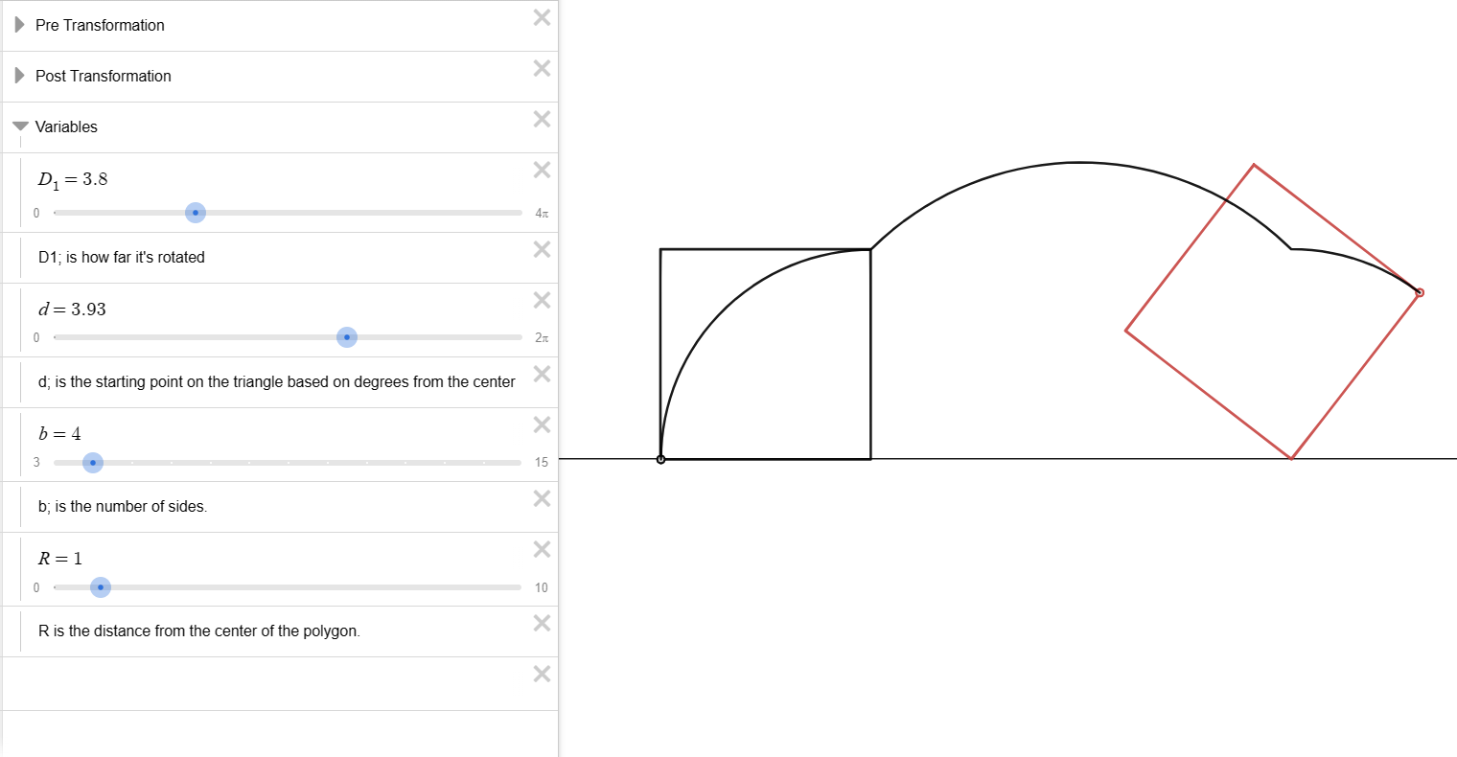
13) Go to the website Desmos: Rolling Polygons (Radians) | Desmos . In my case, the Cyclogon (R=1, since the line starts to draw on the border of the polygon) is generated by a square (polygon with 4 sides, so b=4) in the Wikipedia starts to draw the cyclogon on the down left side of the square (d=9.93)

Slide 12
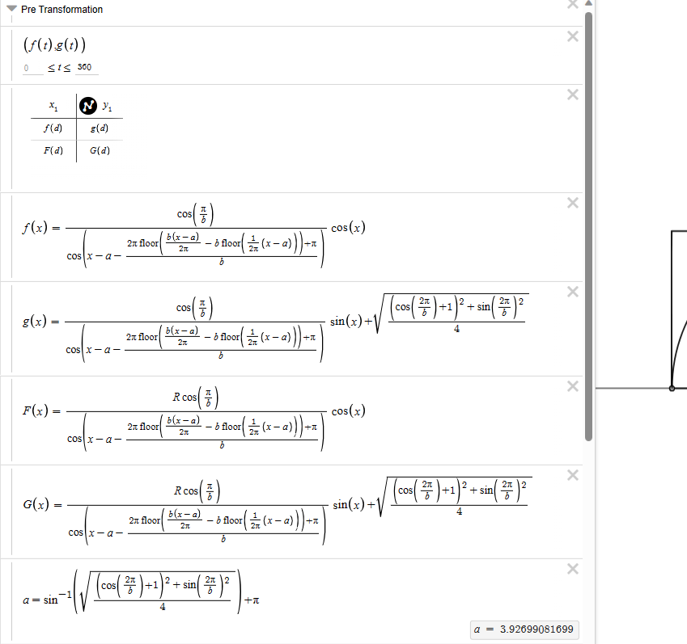
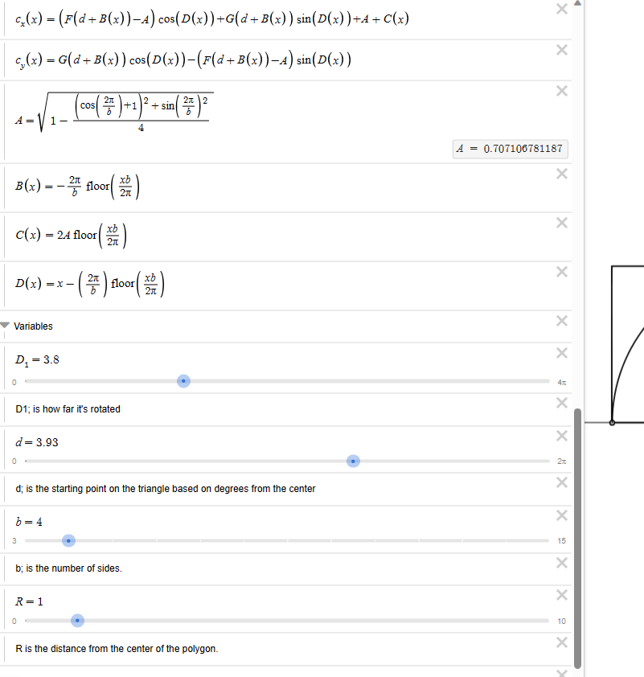
14) Click on Pre Transformation to see the functions of the first image, and Post Transformation for the second image functions.

Slide 13
15) Insert the following lines to main.cpp 15.1) pi is the pi number. 15.2) A is the constant that can be found on Post Transformation. 15.3) a is the constant that can be found on Pre Transformation. 15.4) d, b and R are already defined as we have seen from two slides ago.
#define pi 3.14159265359
#define A 0.707106781187
#define a 3.92699081699
#define d 3.93
#define b 4
#define R 1

Slide 14
16.1) function_fg(x,0) refers to the function F(x) 16.2) function_fg(x,1) refers to the function G(x) Both these functions can be seen on Pre Transformation
float functions_fg(float x, int i) {
float top_f = R * cos(pi / b);
float down_f = cos(x - a - ((2 * pi * floor(((b * (x - a)) /(2 * pi)) - b * floor((1 / (2 * pi)) * (x - a))) + pi) / b));
float first_f = top_f / down_f;
if (i == 0) {
float f = first_f * cos(x);
return f;
}
else {
float g = first_f * sin(x) + 0.7071067811865;
return g;
}
}

Slide 15
16.3) function_b(x) refers to the function B(x) 16.4) function_c(x) refers to the function C(x) 16.5) function_d(x) refers to the function D(x) Both these functions can be seen in Post Transformation
float function_b(float x) {
return (- ((2 * pi) / b)) * floor((x * b )/ (2 * pi));
}
float function_c(float x) {
return (2 * A * floor((x * b) / (2 * pi)));
}
float function_d(float x) {
return (x - ((2 * pi) / b) * floor((x * b) / (2 * pi)));
}

Slide 16
16.6) cx(x) refers to the function cx(x) 16.7) cy(x) refers to the function cy(x)
float cx(float x) {
return (((functions_fg(d + function_b(x), 0) - A) * cos(function_d(x)) + (functions_fg(d + function_b(x),1) * sin(function_d(x)))) + A + function_c(x));
}
float cy(float x) {
return ((functions_fg(d + function_b(x), 1) * cos(function_d(x))) - (functions_fg(d + function_b(x), 0) - A) * sin(function_d(x)));
}

Slide 17
17.1) The x value has to be equal to cx(x) * value1.
17.2) The y value has to be equal to cy(x) * value2.
Change the values 1 and 2, in order to fit the final graph (Cyclogone Generated by a Square)
std::vector<GLfloat> *sincpoints(GLfloat xmin, GLfloat xmax, GLfloat step){
float length = xmax - xmin;
int N = (int) length / step; // number of points on the curve
std::vector<GLfloat> *array = new std::vector<GLfloat>(N*3);
float x = xmin;
for( int i = 0 ; i < N; i++)
{
(*array)[i * 3] = cx(x)*3; // x value
(*array)[(i * 3) + 1] = cy(x)*0.2; // y value
(*array)[(i * 3)+2] = 0; // z value
x += step;
}
return array;
}

Slide 18
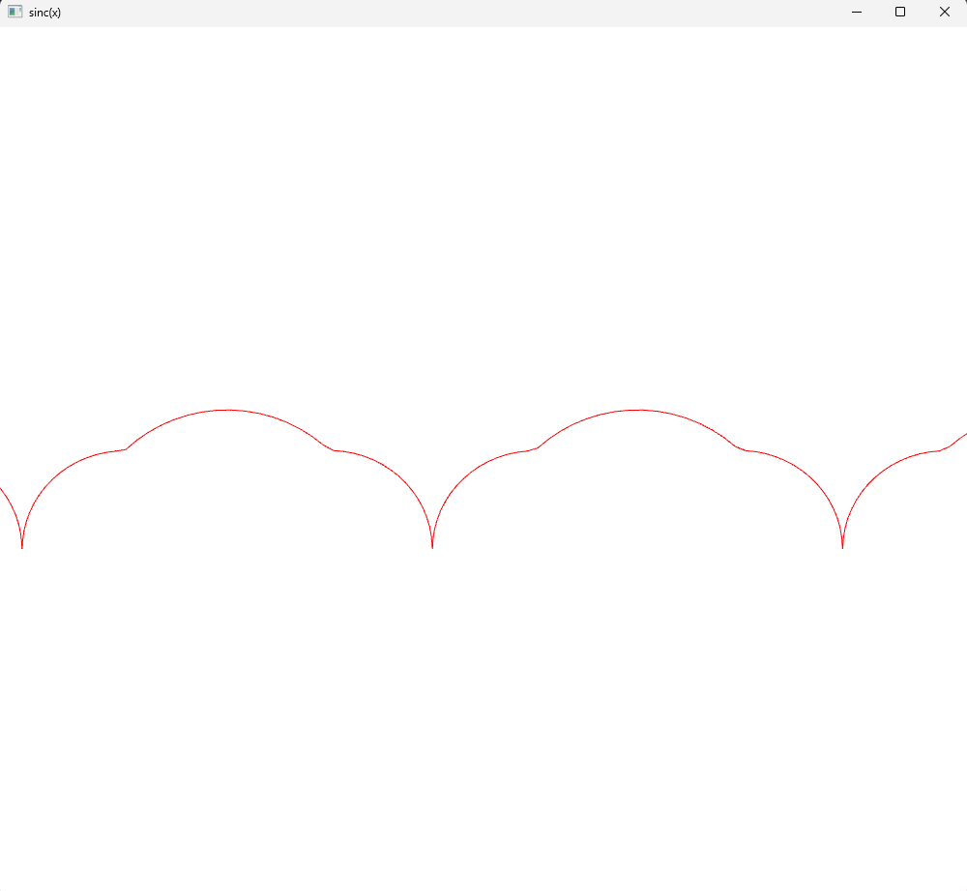
The final graph shall look something like this:

