Slide 1
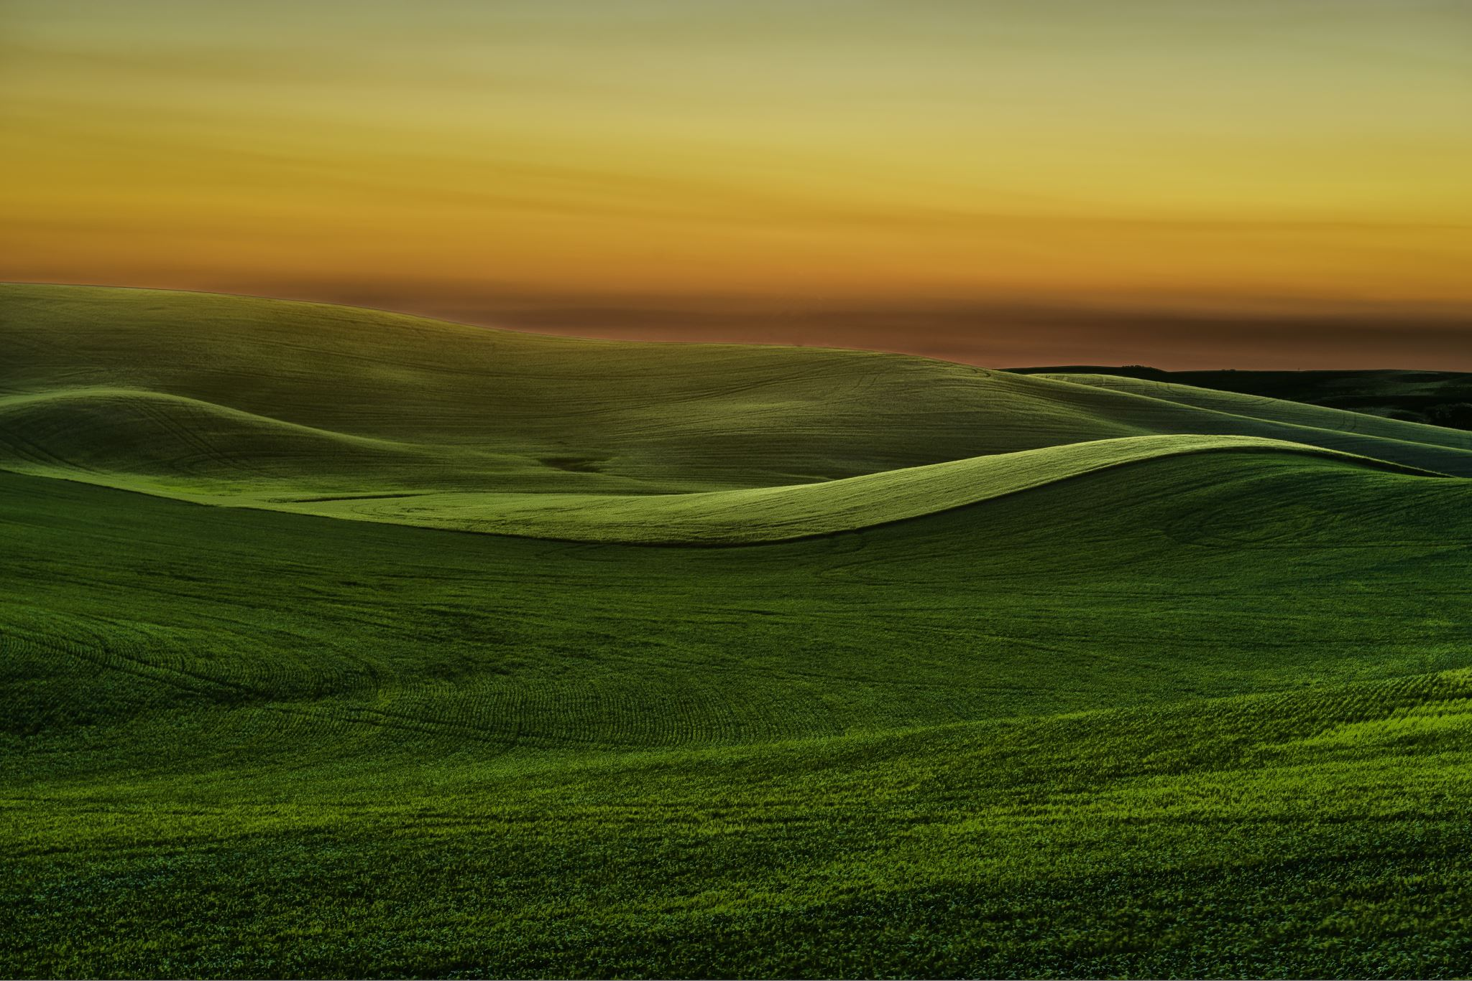
Welcome to SunriseOS
The animation-based simple PowerPoint OS
Push F5 to begin or click “Present”

Slide 2
Welcome to SunriseOS
The animation-based simple PowerPoint OS
This OS requires the font “Comfortaa” which is included in the installer and ZIP file!
It is automatically included in the .pptx file!
Start

Slide 3


User Selector
User
Guest

Slide 4
click anywhere to unlock
9/30/2020
4:27 AM

Slide 5
Welcome, user!
View desktop
Shut down

Slide 6






Desktop
Choose an app
Terminal
Documents
This PC
Account
LimeyStore
Feedback
Log out

Slide 7
> Pick a command below
Run program
Time & date
More commands
Exit

Slide 8
> The time and date is:
Wednesday, September 30, 2020 4:27 AM
Back

Slide 9
> Which program?
This PC
LimeyStore
Feedback
Documents
Back

Slide 10
Account
User
Change…
Since this is a release version, there are no settings.
Sorry about that. :/

Slide 11



This PC
This PC
Sunrise
Sunrise

Slide 12



This PC
This PC/Sunrise
Sunrise
Documents
Documents
Desktop
Desktop

Slide 13
This PC
This PC/Sunrise/Documents/
Sunrise
File1.txt
Documents
File1.txt
Desktop

Slide 14
This PC
This PC/Sunrise/Documents/File1.txt
Contents of File1.txt
Sunrise
Hello! This is a document made for testing. You can’t edit it; it’s just for show.
Documents
File1.txt
Desktop

Slide 15



The real LimeyStore is only available in the macro version, but you can play around with this test one.
Entertainment
Games
Themes

Slide 16
Entertainment
Work in progress
9/30/2020

Slide 17
Games
Work in progress
9/30/2020

Slide 18
Themes
Work in progress
9/30/2020

Slide 19
click anywhere to unlock
9/30/2020
4:27 AM

Slide 20
Welcome, guest!
View desktop
Shut down

Slide 21
Desktop
Choose an app
Documents
This PC
Feedback
Log out
Tip: Users get more features!

Slide 22
This PC
This PC
Sunrise
Sunrise

Slide 23
This PC
This PC/Sunrise
Sunrise
Documents
Documents
Desktop
Desktop

Slide 24
This PC
This PC/Sunrise/Documents/
Sunrise
File1.txt
Documents
File1.txt
Desktop

Slide 25
This PC
This PC/Sunrise/Documents/File1.txt
Contents of File1.txt
Sunrise
Hello! This is a document made for testing. You can’t edit it; it’s just for show.
Documents
File1.txt
Guests cannot edit files.
Desktop

