Slide 1
Warning
This presentation may contain:
  Master swordsmen
  Starship captains
  Lolcats
  Perhaps some talks about mods
No raccoons where harmed during the creation of this presentation

Slide 2
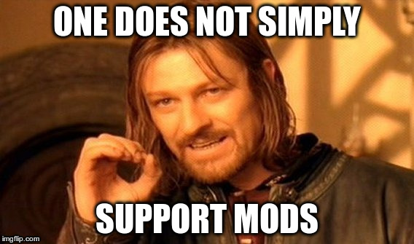
Moddability and You
a.k.a

Slide 3
Summary
What ? a.k.a: “What are you talking about anyway?”
Why ? a.k.a: ”What does it gets me?”
How ? a.k.a: “But I do not want to work more!”
Fears ! a.k.a: “They'll make my work dirty”
Beware ! a.k.a: “Oh I still need to make a good game?”

Slide 4
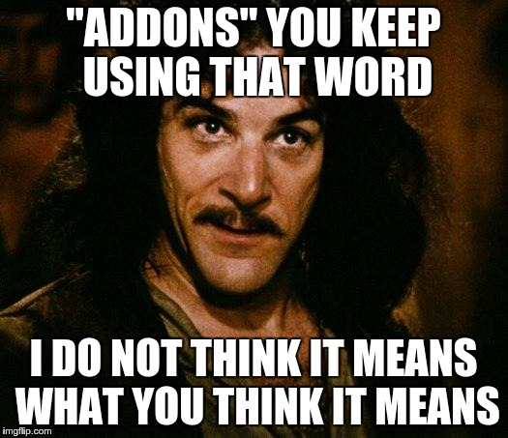
What ? a.k.a: “What are you talking about anyway?”

Slide 5
What ? a.k.a: “What are you talking about anyway?”
Addons, mods, plugins, extensions: same difference
Addons could allow players to:
  Change/add assets: sounds, tiles, …
  Define new NPCs, creatures, player types, ...
  Alter some gameplay features
  Allow for “full convertion” mods
Varying degrees of difficulty to implement
Notes:
Denomitaion is only a technicality; what matters is what they bring to the table

Slide 6
What ? a.k.a: “What do they do in ToME?”
Tales of Maj'Eyal is an extreme case of moddability:
  A simple addon can alter the very foundations of gameplay or just alter the tile of an object
  An addon can overload/superload anything in the game
  DLCs/Expansions are implemented using the same system as player made addons
  Can even push “addons” on the fly online to players
  The game can be ripped off to use the engine directly
Obviously an extreme example, usually a happy medium can be found as in Neverwinter or Kerbal Space Program
Notes:
Overload/superload: more on that later

Slide 7
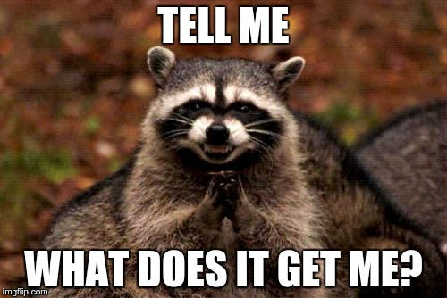
Why ? a.k.a: ”What does it gets me?”

Slide 8
Why ? a.k.a: ”What does it gets me?”
Draws creativity from your players
Creates player retention by
  Providing a constant stream of new content for players
  Providing a way for artists/designers/... to express themselves
Helps build a lasting community
Creates goodwill
Maybe even grab a few great designers/art creators/... for your own needs
OpenSource bonus: can prevent forks

Slide 9
Why ? a.k.a: ”How it helps ToME”
Nearly 500 registered addons on te4.org
From about 160 players, more actually
On the last million characters registered (about 10 months of data)
  580 287 used one or more non-official addons: 58% !
  304 609 used one addon: 30%
  223 100 used up to 10 addons: 22%
Out of the community I've found:
  Over 20 designers/coders that contributed to the game
  4 artists
Notes:
More than 160 players because some help but don't really release themselves
Grabbed designers: there is even one in the room: nagyal

Slide 10
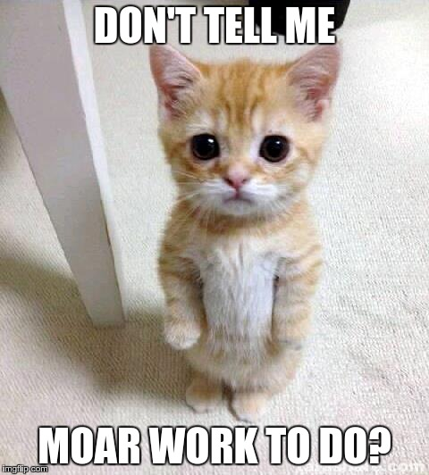
How ? a.k.a: “But I do not want to work more!”

Slide 11
How ? a.k.a: “But I do not want to work more!”
No such thing as a free meal: you got to work a bit :)
Maybe not that much:
  Do you have a structure that describes npcs ?
  Do you have a structure that describes objects ?
  …
Expose them!

Slide 12
How ? a.k.a: “But I do not want to work more!”
Simple text datafiles
Example: Angband
Simple text datafiles
Scripting capabilities
Example: Neverwinter Nights
Simple text datafiles
Expose the API of the game to compile plugins against
Example: Kerbal Space Program
Data as scripts
Fully scriptable game/engine
Example: Tales of Maj'Eyal

Slide 13
How ? a.k.a: “The Tools of War”
Rule number one of the Addons Club: “MAKE IT EASY FOR PLAYERS”
Rule number two of the Addons Club: verify rule one at all times

Slide 14
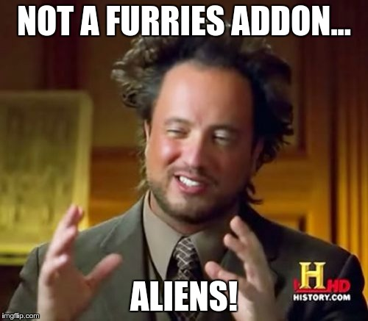
Fears ! a.k.a: “They'll make my work dirty”

Slide 15
Fears ! a.k.a: “They'll make my work dirty”
You want to preserve the purity of your world/scenario/...
You are afraid that people will bring weirdness and chaos?
Afraid they'll do a better job than you?
Guess what: they will!
Guess what: it does NOT matter!

Slide 16
Fears ! a.k.a: “Whacky things in ToME addons”
I've seen addons that do:
  Add furries races
  Add turtle races
  Make you ten times as powerful
  Add even worse balanced classes than my own
  Revive deleted parts of the game
  …
None would ever get into the official game
That's why it's great to have addons: catters to more players without compromising your canon work

Slide 17
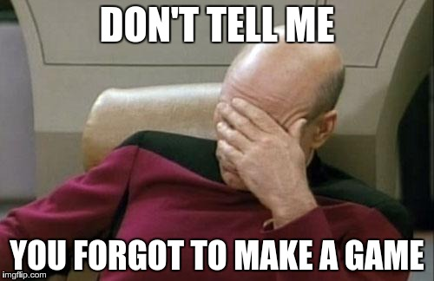
Beware ! a.k.a: “Oh I still need to make a good game?”

Slide 18
Beware ! a.k.a: “Oh I still need to make a good game?”
Sounds silly but never forget to make your game fun!
Addons should be an ADDITION to an already great game
A very moddable game without much content is called an engine.
Players do not flock to engines.

Slide 19
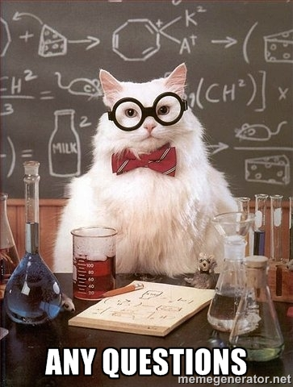
Questions ! a.k.a: “You've not been very clear”

