Slide 1
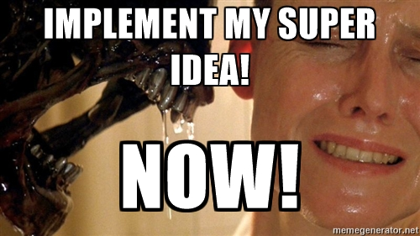
Game Communities
a.k.a

Slide 2
Summary
Why am I qualified to talk about that?
Why should you care about players?
Helping your players connect: Providing the tools!
How to be loved by your players!
How to reach a critical mass?
Should you always listen to players?
Money and other assorted benefits?!
Questions!

Slide 3
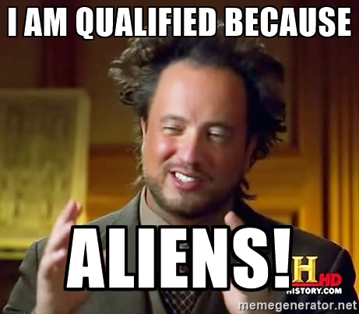
Why am I qualified ?
Notes:
Aliens are the answer to everything no ? Hum in this case it may be because PLAYERS!

Slide 4
Why am I qualified ?
Am I? No! But nobody can be.
Tales of Maj'Eyal currently has about 40k yearly unique players logged in. Last years it was 33k, 22k, 2k !
There are usualy between 200 and 300 simultaneous players on at any time, much more on big releases
Players have uploaded nearly 4 million character sheets and players for 823 years!
Notes:
Nobody can be, we all struggle, we all try to find ways and I'm just gonna talk about what works for me and what I perceive to be good

Slide 5
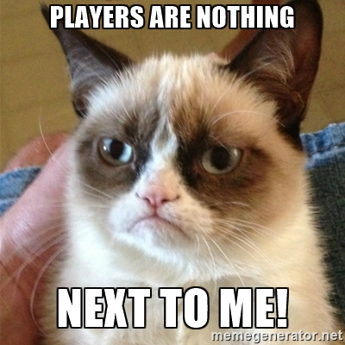
Why should you care about players?
Notes:
Yes it's true! Players did not make a great game like you did!
Or .. did they?! Maybe a game is great because of the players.

Slide 6
Why should you care about players?
It may sound stupid but it's a good question.
Maybe you don't, it depends on your game and on your mindset
There are many games where the players view the devs as some annoying persons that happen to make a game they like
But do you want to be one of those?
It brings many benefits: easier word of mouth, nice communities seem more welcoming to new players, more chances of “side content“
Notes:
- Maybe your game is a small „onshot“ kind of deal where you finish it, release it and move on to a new one
- Side content: streamers, fanfics, stories, addons, wikis, ...

Slide 7
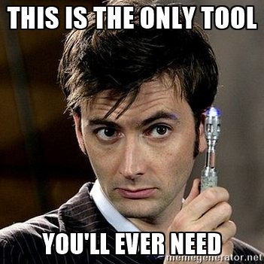
Helping your players connect: Providing the tools!
Notes:
One tool to rule them all. But not really.

Slide 8
Helping your players connect: Providing the tools! (1/2)
So you do want your players to feel part of something more
Give them tools to do so!
Those can take many forms: forums, blog, ingame chat, IRC channel, facebook, twitter, mailing lists, …
Stay on with the times though: sure mailing lists are fun but players seem to shun them
Provide multiple channels but still try to focus players
Notes:
Some channels are more for news and some more for community building. I want my players to subscribre to facebook/twitter but I dont actaully want them to do most of the community stuff over there.
Focus players because the last thing you want is fragmenting your community. Sure if you are world of warcraft you don't care. But you are most likely not.

Slide 9
Helping your players connect: Providing the tools! (2/2)
Tales of Maj'Eyal provides: A forum, a wiki, a blog with open comments, player “blogs“, an ingame chat
It also provides “side tools“: character sheets, addons, global stats about the game, datamining APIs, …
While the forums/... are an obvious thing to provide, do not underestimate the side tools.
They may not prodive direct interaction but they are there to fuel it on other tools
A good non ToME example is the levels sharing of KeeperRL
Notes:
Stats: Hundreds of thousands posts on the forums. Every single day there are between 4 and 10 thousands messages on the ingame chat. Over 700 addons.
KeeperRL really tries to make players use other player's levels. Nethack (and DCSS?) servers share ghost files and so on.
Skyrim has tons of addons to keep it alive.

Slide 10
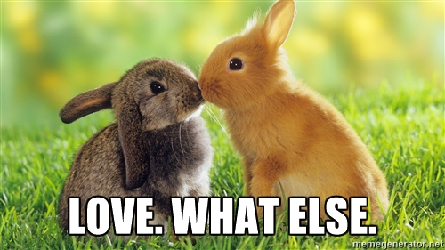
How to be loved by your players!
Notes:
AWWWWWWWW
Who doesn't like to be loved ?

Slide 11
How to be loved by your players!
Sounds self evident but: Don't be an ass
It's actually not an easy thing, textual communications always feel “harsher“ than what was intended, also take that in account. Use smileys, lighten your tone
It's usualy better to sound too cheerful than not enough
NEVER respond while angry
Yes sometimes you will be angry, some players may talk you down, ack like asses, whatever. Never stoop to their level
Always remember the silent majority: all those players that enjoy the game, like you and never say a word about it. You are building the game for them
Notes:
It is very hard to control oneself. Sometimes you feel the the person doesnt have a clue, you want to straighten them up. And you can, why not! But always be calm, always be warm.
If you really need defending, your other players, whom you've treated with love and respect, will likely come to the rescue anyway

Slide 12
How to be loved by your players!
Interact with your players. Be it on the forum, ingame chat, whatever. Make them feel like you care (and actually DO care!)
But don't overdo it. It's cool when players feel you care about them but it's also cool when they feel great because you talked to them
Never forget without them you would be nobody
In the end you have to strike a balance between too much and too few interactions
Notes:
Just beware to not forget to also develop your game ;)

Slide 13
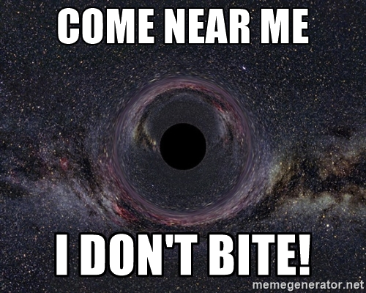
How to reach critical mass?

Slide 14
How to reach critical mass?
Ahah you really thought I'd have an answer to that one ? :)
A few ideas though:
  Persistance: keep on doing what you do, eventually people will come and then some and then some.
  Try to grab the attention of youtubers, even small ones. They do help.
  Tell your existing loyal minions to spread the good word for you.
  Whatever you can imagine!
Notes:
You could try to contact your fellow game devs and „exchange“ players through some promotions or whatever. Hell maybe just get in the street and shout your game's name! (unlikely to work but heh!)

Slide 15
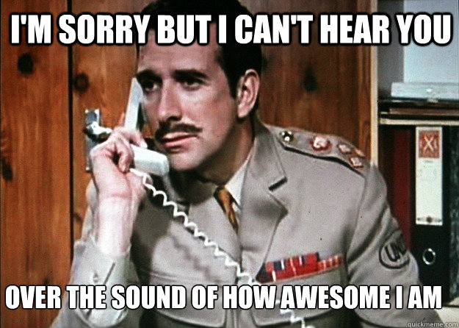
Should I always listen to players?
Notes:
Players will drown your with ideas, complains, requests, …
Get used to it!

Slide 16
Should I always listen to players? (1/2)
NO! Gamedev by democraty never works in practice
Always listen, but cherry pick what you want
In Tales of Maj'Eyal some of the best ideas come from the community. This is great, it makes players feel they have an impact on the game
But always try to ponder an idea from a player with the game as a whole: Sure a player may have a great idea to buff a class. But is it needed? Will it make the rest of the game weird? Too easy?
Notes:
Most/many players are really clueless about game balance. That does not mean they do not have great ideas. Take them, adjust them, throw them away. But do listen.

Slide 17
Should I always listen to players? (2/2)
Some players will always feel like they know the game better than you do
Don't discard them! They very well might!
In the end the way I find to work the best is what we call the “Benevolent Dictator“: never forget who is the boss, but be as nice a boss as possible
Notes:
Some will even act all superior because they feel they are better than you. I throw you back to the „keep calm“ advise.

Slide 18
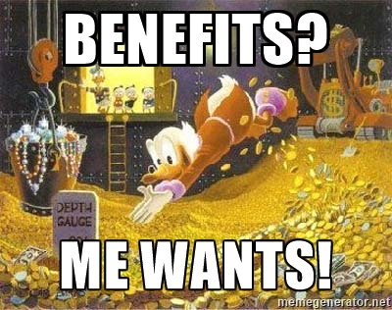
Money and other assorted benefits!
Notes:
We all want to be scrooge mcduck yes? Well forget about it, it is highly unlickely you'll get anywhere near rich from gamedev. If that's your only goal; go work on something else I'm afraid.

Slide 19
Money and other assorted benefits! (1/2)
Let's get over the first one quickly: happy players => better reviews => players talk about your game => more people play => more money
Now for the more interresting part, the other benefits!
It may be silly but it feels GOOD to be loved and will help keep you motivated
It is always hard to find great talents to work with you on your projects
But having a big community of friendly people increase your odds of finding “The Right One“.
Notes:
Many many times did I feel like not working anymore and I read a random post, or saw people talking about the game, or whatever. And I was rejuvenated.
This is super important!

Slide 20
Money and other assorted benefits! (2/2)
I'll take my own example, I always was on the lookout for a graphics person.
Once upon a time I stumbled on an angband forum over a guy named Shockbolt and quickly grabbed him to work on ToME
He was great but also busy and most importantly not a player
Then someday out of the blue, some guy named Rexorcorum, posted a small addon that added a few tiles to the game
I saw the opportinuty and asked him to work with me. And thus he now does all graphical stuff of ToME and is your host for this IRDC!
All hail him!
Notes:
The same happened for many things. Nowadays most of the game's unique items are made by a community member. He is way better at that than I am. And this is the most important thing: recognize the greatness in others that you do not have and use it!
All my community managers come straight up from the community, they naturalyl emerged. People like stuntofthelitter, aura of the dawn, dekar and sheila are huge boons.

Slide 21
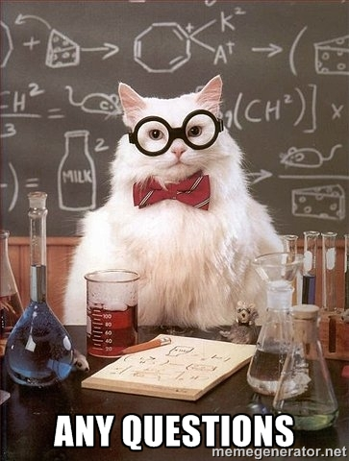
Questions ! a.k.a: “You've not been very clear”
Notes:
Closing words: Love them and they will love you back. And you'll get lots of benefits! So kinda like friends with benefits, but without sex ;)

