Slide 1
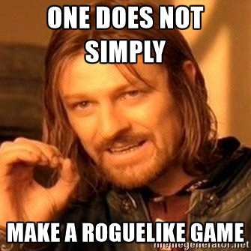
T-Engine
a.k.a

Slide 2
Summary
What is a Roguelike, and what is a Roguelike Engine?
What does T-Engine4 provides?
Why is it good?
Why is it bad?
Why not use an existing engine?
Questions!

Slide 3
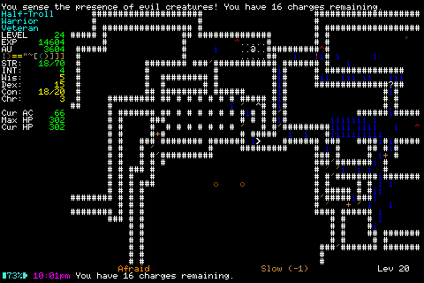
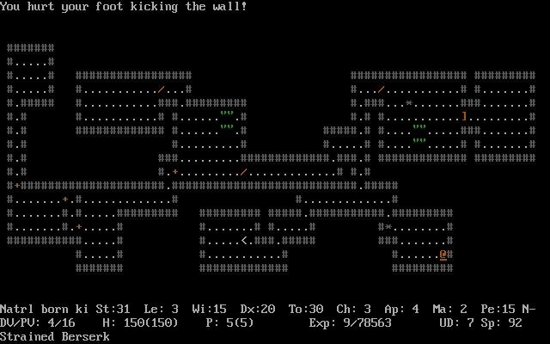
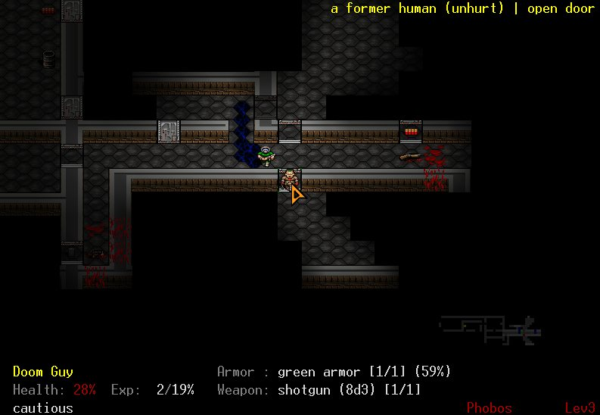
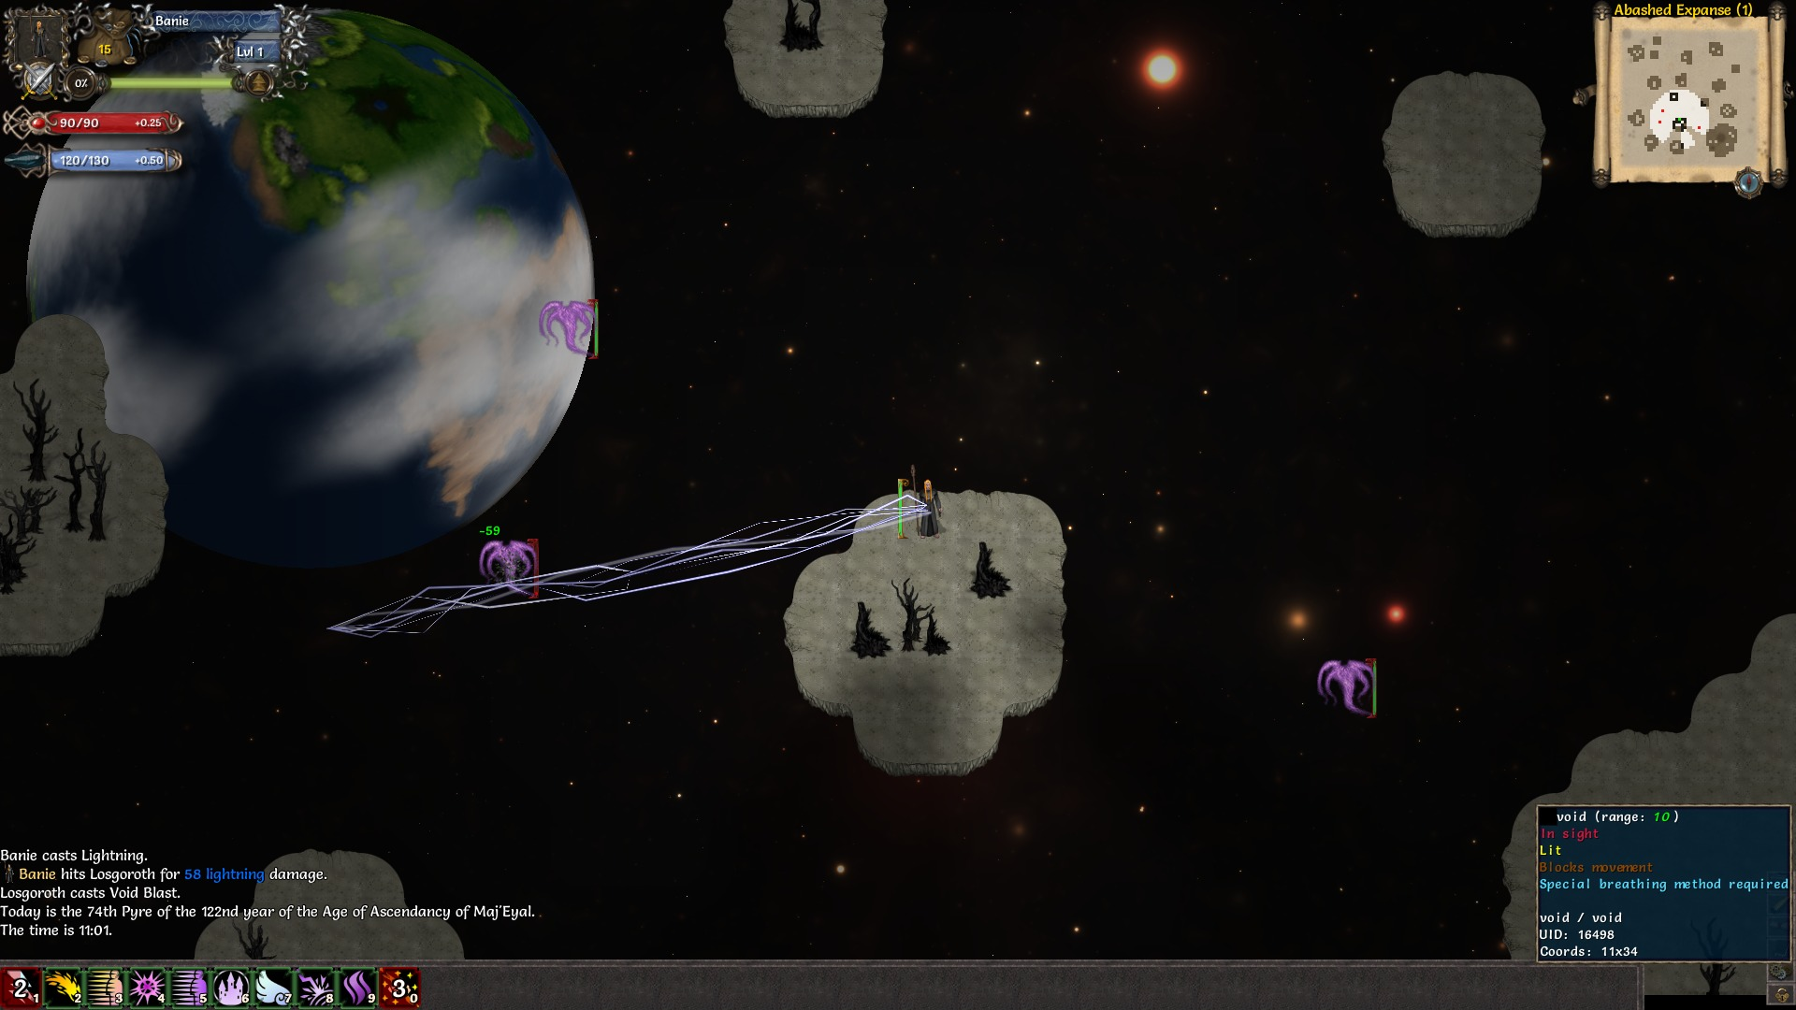
What is a Roguelike?
Notes:
I'll be using a rather classic definition
- Grid based
- Single player
- Entities on a map
- Turn based (optional)
- Random levels (optional)
- Permadeath (optional)
This is in no way the only definition, but for the scope of the engine it works

Slide 4
What is a Roguelike Engine?
This is very simple: a Roguelike Engine let's you create Roguelikes!
It should concentrate on providing tools to build a game
But not impose a game framework: it's an engine, not a moddable game!
It should probably be called a Roguelike Engine Engine
Notes:
* Tools like:
- a map, entities you can put inside it
- ways to save & reload
- ways to „talk“ to the player (UI creation)
* Not a moddable game:
- it must be careful to not make itself challenging to make various games with. It has a scope (a certain type of Rls) and should strive to not decide on gameplay for those
* Roguelike Engine Engine because of all the above: with it you can build your game „engine“: gameplay logic aka a set of gameplay rules to which you then feed a whole bunch of data to make the game

Slide 5
What does T-Engine4 provides? (1/3)
The usual low level stuff: RNG, file access, OS independence, direct access to OpenGL, memory management, ressources loading, and a slew of various utility functions, …
Automatic support for addons
User Interface building: tools to create any kind of dialogs & interfaces with ready-made skinnable UI elements
Notes:
- OpenGL direct access is obviously to only be used fo implement stuff the engine doesnt do by default
- Addons support to me are very important; I make games for the long run, and to sustain a game long after release addons are great; lets your players express themselves, lets them get way more content. As a player I tend to automatically shun un-moddable games
- UI controls are fully skinnable, ToME itself uses many different skins: normal ones, a tombstone one, a parchment one, …

Slide 6
What does T-Engine4 provides? (2/3)
A Map / Entities system with data inheritance, multi-layering
Premade OPTIONAL gameplay subsystems for Map & Entities: experience gains, life handling, talents, map generators, ...
“Smart Data“: all the datas are functionning Lua code and can contain functions, events, can superload normal code, ..
Notes:
- Gameplay subsystems are never auto loaded, you decide to use them to gain time; they are made in a way to try to impose as little restrictions as possible
- Smart Data: Say you have a NPC that needs some special stuff every turn, you dont need to add a very custom flag to it and handle said flag in the game logic; you can just superload the „act“ method! Or you can respond to various events, ..
- Smart Data: you can derive a new entity from a previous one, I.E: make an „orc“ templateand then derive all orcs form it, only changning a few properties on each

Slide 7
What does T-Engine4 provides? (3/3)
Powerful save/reload system by serialisation: nearly never have to think about that when building a game
Online features: ingame chat, uploadable character sheets, and more!
Turn based or realtime, or a mix of the two, gameplay
Notes:
- Save/reload: it may sound silly and trivial but from experience it's never easy to build a save/reload system. You always need to think about it. No more!
- Online stuff: Ingame chat, even in a singleplayer game I've found to be a great thing; players love it, they can talk about game stuff, they can help out each others, ..
Obviously some features require my acceptation since it uses my server

Slide 8
Why is it good?
Because of everything we saw in the previous slide!
Because you want to focus on making a game and can not be bothered tinkering with low level stuff or “cumbersome“ stuff like map generation, data organisation, …
It makes your game portable
It uses the best language ever: Lua ;)

Slide 9
Why is it bad?
Because you want to make a game outside its scope
Because it does not prodive graphical “editors“ to click in. It's a coder's engine first and foremost
Badly documented. My bad.
Notes:
No editor, though it's possible to build some for it and maps can (are are) made with Tiled

Slide 10
Why not use an existing engine?
Yes things like Unreal Engine4 and Unity are a thing
But they were not (or much less so) when I started so I had no choice
They are much more generic (and complex) things. Sure you can screw them up in the way you wish but it takes effort
They are more geared toward 3D stuff
They were not fit for me, but are in no way a bad choice

Slide 11
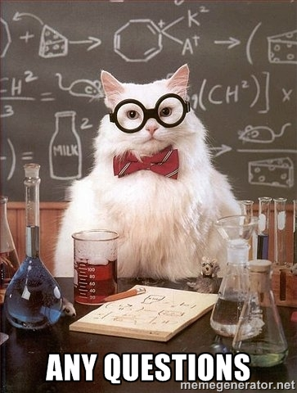
Questions ! a.k.a: “You've not been very clear”

