Slide 1
GEOSTRATEGY

Slide 2
HISTORY
IS ONLY A BY-PRODUCT OF GEOGRAPHY

Slide 3
GEOSTRATEGY
INFLUENCE OF GEOGRAPHIC FACTORS IN FOREIGN AFFAIRS

Slide 4
IT MEANS
THAT PLACE MATTERS

Slide 5
THE MOST PROFOUND
STRUGGLES OF HUMANITY
ARE NOT ABOUT IDEAS
BUT ABOUT CONTROL OVER TERRITORY
SPECIFICALLY THE HEARTLAND AND RIMLAND OF EURASIA

Slide 6
IDEAS MATTER
AND SPAN GEOGRAPHY
BUT THERE IS A GEOGRAPHIC LOGIC TO WHERE IDEAS TAKE HOLD

Slide 7
LIBERALISM
HAS ITS DEEPEST ROOTS IN BRITAIN AND THE UNITED STATES
BOTH ISLAND NATIONS AND SEA POWERS

Slide 8
BUT
TO EMBRACE GEOGRAPHY
IS NOT TO ACCEPT IT AS AN IMPLACABLE FORCE AGAINST WHICH HUMANKIND IS POWERLESS

Slide 9
RATHER
IT SERVES TO QUALIFY HUMAN FREEDOM AND CHOICE
WITH A MODEST ACCEPTANCE OF FATE

Slide 10
GLOBALIZATION
IS REINFORCING THE RELEVANCE OF GEOGRAPHY

Slide 11
MASS COMMUNICATIONS
AND ECONOMIC INTEGRATION
ARE WEAKENING MANY STATES
EXPOSING A WORLD OF SMALL FRACTIOUS REGIONS

Slide 12
WITHIN THEM
LOCAL ETHNIC AND RELIGIOUS SOURCES OF IDENTITY ARE REASSERTING THEMSELVES

Slide 13
THE POLITICAL FUTURE
WILL BE DEFINED BY CONFLICT AND INSTABILITY
WITH A SIMILAR GEOGRAPHIC LOGIC

Slide 14
GLOBALIZATION
IS WEAKENING SOCIAL ORDERS
AND OTHER CREATIONS OF HUMANKIND
LEAVING THE NATURAL FRONTIERS AS THE ONLY RESTRAINT

Slide 15
IN OTHER WORDS
WE DELUDE OURSELVES
BY THINKING WE CONTROL OUR DESTINIES

Slide 16
THE GOVERNMENT OF A COUNTRY
IS CONFRONTED BY CERTAIN STRATEGIC IMPERATIVES
NO MATTER WHAT FORM THE GOVERNMENT TAKES

Slide 17
FOR EXAMPLE
IMPERIAL RUSSIA, THE SOVIET UNION AND POST-SOVIET RUSSIA
ALL HAVE FACED THE SAME SET OF STRATEGIC IMPERATIVES

Slide 18
GEOPOLITICS
STUDY OF SPATIAL POLITICS
A NEOLOGISM INVENTED BY RUDOLF KJELLEN FROM THE UNIVERSITY OF GOTEBORG

Slide 19
GEOPOLITICAL THOUGHT
EMERGED AT THE CLOSE OF THE 19TH CENTURY
AS GEOGRAPHERS AND OTHER THINKERS
SOUGHT TO ANALYZE, EXPLAIN AND UNDERSTAND
THE TRANSFORMATION AND FINITE SPACES OF THE FIN DE SIECLE WORLD

Slide 20
GEOPOLITICS
DIFFERS MORE FROM THE MORE EMPIRICALLY-FOCUSED SOCIAL SCIENCES
APART FROM REPEATABLE OBSERVATIONS
IT ALSO BUILDS ON A TRADITION OF WISDOM, ANECDOTAL OBSERVATIONS, AND EDUCATED GUESSWORK

Slide 21
IT EMBRACES
NOT ONLY ECONOMICS, POLITICAL SCIENCE, HISTORY, GEOGRAPHY
BUT ALSO THE CRITICAL-THEORY TRADITION

Slide 22
THE LINK WITH CRITICAL THEORY
IS THE CONVICTION THAT CONTINUING CRITIQUE OF CONTEMPORARY SOCIETY
IS ESSENTIAL NOT ONLY TO UNDERSTAND THE WORLD WE LIVE IN
BUT ALSO TO MAINTAIN IT INTO THE FUTURE

Slide 23
GEOECONOMICS
IS THE STUDY OF SPATIAL, CULTURAL, AND STRATEGIC ASPECTS OF RESOURCES
WITH THE AIM OF GAINING A SUSTAINABLE COMPETITIVE ADVANTAGE

Slide 24
GEOECONOMICS DIFFERENT FROM GEOPOLITICS
GEOPOLITICS PRIMARILY CONCERNED WITH POLITICAL AND MILITARY ACTIVITIES
GEOECONOMICS WITH ECONOMIC ACTIVITIES

Slide 25
GEOECONOMICS DIFFERENT FROM GEOPOLITICS [2]
ACTIVITIES IN GEOPOLITICS PRIMARILY UNDERTAKEN BY INDIVIDUALS REPRESENTING THE NATION STATE
IN THE SECOND CASE WITH ECONOMIC ACTIVITIES

Slide 26
KJELLEN’S DEFINITION WAS
THE THEORY OF THE STATE AS A GEOGRAPHICAL ORGANISM OR PHENOMENON IN SPACE

Slide 27
TWO KEY CONCEPTS
POWER
SPACE

Slide 28
KARL HAUSHOFER
WHOSE IDEAS INSPIRED THE NAZI REGIME
ADDED POLITICAL PROCESSES

Slide 29
KARL HAUSHOFER [2]
‘GEOPOLITICS IS THE NEW NATIONAL SCIENCE OF THE STATE … A DOCTRINE ON THE SPATIAL DETERMINISM OF ALL POLITICAL PROCESSES, BASED ON THE BROAD FOUNDATIONS OF GEOGRAPHY, ESPECIALLY OF POLITICAL GEOGRAPHY.’

Slide 30
GEOECONOMICS
RELATIONSHIP BETWEEN GEOGRAPHY AND ECONOMY

Slide 31
OBJECTIVE
EXPLAIN THE DYNAMICS BEHIND THE MAJOR CHANGES OCCURING IN THE WORLD

Slide 32
COLIN S GRAY
WHEREAS HISTORIANS AND POLITICAL SCIENTISTS HAVE BEEN EDUCATED TO KNOW MORE AND MORE ABOUT LESS AND LESS, AND ARE PROFESSIONALLY PROGRAMMED TO DISECT PHENOMENA, GEOPOLITICIANS ARE COMMITTED TO THE ALL TOO RARE ACTIVITY OF PUTTING THINGS TOGETHER.

Slide 33
COLIN S GRAY (2)
IT IS A CROWNING GLORY OF GEOPOLITICAL THEORY THAT IT SEEKS TO CONNECT, RATHER THAN DISCONNECT; IT IS, IN A WORD, HOLISTIC.

Slide 34
DAVID CRIEKEMANS
GEOPOLITICS IS THE SCIENTIFIC FIELD OF STUDY BELONGING TO BOTH POLITICAL GEOGRAPHY AND INTERNATIONAL RELATIONS, WHICH INVESTIGATES THE INTERACTION BETWEEN POLITICALLY ACTING (WO)MEN AND THEIR SURROUNDING TERRITORIALITY

Slide 35
GEOSTRATEGIC ANALYIS
WHO ARE THE ACTORS?
WHO WANTS WHAT?
WITH WHOM?
AGAINST WHOM?
HOW?
WHY?
WHAT ARE THE MEANS?
WHEN?
WHERE?

Slide 36
FRIEDRICH RATZEL
GERMAN GEOGRAPHER
COMMONLY SEEN AS THE FATHER OF MODERN POLITICAL GEOGRAPHY

Slide 37
KEY IDEAS
STATES ARE, AND ACT, LIKE INDIVIDUALS
THEY ARE BORN, GROW AND DIE
SURVIVAL OF THE FITTEST ALSO APPLIES TO NATIONS
STRUGGLE FOR EXISTENCE IS STRUGGLE FOR SPACE

Slide 38
RATZEL’S LAWS OF NATURE
THE SPACE OF STATES GROWH WITH POPULATION EXPANSION – LEBENSRAUM CONCEPT
THE EXPANSION OF STATES FOLLOWS OTHER MANIFESTATIONS OF THE GROWTH OF PEOPLES
STATES GROW BY ABSORBING SMALLER, WEAKER RIVALS

Slide 39
RATZEL’S LAWS OF NATURE (2)
TERRITORIAL GROWTH MANIFESTS ITSELF AT THE PERIPHERY, BY MOVING THE BORDER
IN THEIR GROWTH, STATES STRIVE TO ABSORB GEOGRAPHICALLY AND POLITICALLY VALUABLE TERRITORY
THE FIRST STINGS TO THE TERRITORIAL GROWTH OF PRIMITIVE STATES COME FROM OUTSIDE

Slide 40
RATZEL’S LAWS OF NATURE (3)
THE TENDENCY TO TERRITORIAL ANNEXATION IS TRANSMITTED AMNG STATES AND INCREASES IN INTENSITY

Slide 41
WAR
IS A NATURAL PHENOMENON IN THE POLITICAL STRUGGLE TO ACQUIRE AS MUCH POWER AS POSSIBLE

Slide 42
ALFRED THAYER MAHAN
ONE OF THE FATHERS OF AMERICAN GEOSTRATEGIC THINKING
‘THE INFLUENCE OF SEA POWER UPON HISTORY’
COMMAND OF SEABORNE COMMERCE IS THE KEY TO WINNING WARS
NEED OF AN OVERBEARING POWER ON THE SEAS

Slide 43
MAHAN
SAW THE INDIAN AND PACIFIC OCEANS AS THE HINGES OF GEOPOLITICAL DESTINY
FOR THEY WOULD ALLOW A MARITIME NATION TO PROJECT POWER ALL AROUND THE EURASIAN RIM
AND THEREBY AFFECT POLITICAL DEVELOPMENTS DEEP INTO CENTRAL ASIA

Slide 44
ALFRED THAYER MAHAN [2]
FREQUENT QUOTE
‘WHOEVER CONTROLS THE INDIAN OCEAN DOMINATES ASIA. THIS OCEAN IS THE KEY TO THE SEVEN SEAS IN THE 21ST CENTURY. THE DESTINY OF THE WORLD WILL BE DECIDED IN THESE WATERS.’
BUT … MAHAN NEVER SAID THAT

Slide 45
THE WHOLE INDIAN OCEAN SEABORD
IS A VAST WEB OF ENERGY TRADE

Slide 46
MAIN THREATS
SOMALI PIRATES
NORTH KOREAN NUCLEAR SMUGGLERS
WATER-BORNE JIHADISTS
DRUG- AND PEOPLE-TRAFFICKERS

Slide 47
RACE OF NAVAL ARMS
NEW AIRCRAFT-CARRIERS FOR INDIA
NEW DESTROYERS AND SUBMARINES FOR CHINA

Slide 48
CHINA
IS NOW TRYING TO SECURE SEA LANES

Slide 49
HALFORD MACKINDER
‘MAN AND NOT NATURE INITIATES, BUT NATURE IN LARGE MEASURE CONTROLS’

Slide 50
HALFORD MACKINDER [1]
1904 – ‘THE GEOGRAPHICAL PIVOT OF HISTORY’
‘WHO RULES EAST EUROPE COMMANDS THE HEARTLAND; WHO RULES THE HEARTLAND COMMANDS THE WORLD ISLAND; WHO RULES THE WORLD ISLAND COMMANDS THE WORLD’ – FORESAW RISE OF RUSSIA

Slide 51
HALFORD MACKINDER [2]
CENTERED HIS MAP ON A VAST COMPLEX OF INTERIOR DRAINAGE BASINS IN CENTRAL ASIA HE CALLED THE ‘PIVOT AREA’
IN THESE AREAS DENSELY CONSOLIDATED AND MORE POWERFUL STATES WOULD NATURALLY TEND TO DEVELOP
THE CALLED THESE AREAS ‘THE NATURAL SEAT OF POWER’

Slide 52
HALFORD MACKINDER [3]
SURROUNDING THE INLAND CENTRAL ASIAN PIVOT AREA WAS AN ‘INNER CRESCENT’ AND AN ‘OUTER CRESCENT’ OF PENINSULAS AND MAJOR WATERSHEDS THAT EITHER DRAINED DIRECTLY TO THE OCEAN OR DRAINED TO RIVERS ACCESSIBLE FOR MUCH OF THEIR LENGTH FROM THE OCEAN

Slide 53
HALFORD MACKINDER [4]
THUS A CENTRAL AREA OF ‘WHOLLY’ INLAND TERRITORIAL CONSOLIDATION (PIVOT AREA) WAS SURROUNDED BY AN OUTER AREA OF ‘WHOLLY’ OCEANIC TERRITORIAL CONSOLIDATION
WITH A TRANSITIONAL AREA BETWEEN THE TWO EXPECTED TO BE DOMINATED BY NEITHER INLAND NOR OCEANIC CONSOLIDATED

Slide 54
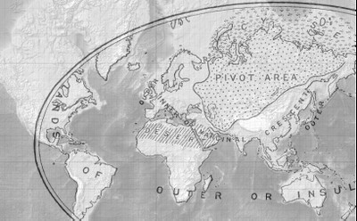

Slide 55
THE OUTER AREA
CORRESPOND TO FOUR GREAT RELIGIONS

Slide 56
TWO MONSOON LANDS
ONE IN THE EAST FACING THE PACIFIC OCEAN: BUDDHISM
THE OTHER IN THE SOUTH FACING THE INDIAN OCEAN: HINDUISM

Slide 57
TWO MARGINAL REGIONS
EUROPE WATERED BY THE ATLANTIC TO THE WEST: CHRISTIANITY
MIDDLE EAST DEPRIVED OF MOISTURE: ISLAM

Slide 58
IN THE 1920s AND 1930s
SOME ANALYSTS QUESTIONNED MACKINDER’S LOGIC

Slide 59
MILITARIZATION OF AIR
WOULD FUNDAMENTALLY REDRAW THE STRATEGISTS’ MAP

Slide 60
THE ARCTIC
WAS SEEN BY MACKINDER AS A STRATEGIC BARRIER
WHILE IN FACT IT WAS A STRATEGIC CORRIDOR

Slide 61
GEOGRAPHY
IS MORE OR LESS IMMUTABLE
BUT THE MILITARY SIGNIFICANCE OF GEOGRAPHICAL FEATURES
IS A FUNCTION OF THE TECHNOLOGIES AVAILABLE TO MASTER THEM

Slide 62
LAND SUPREMACY
VERSUS MARITIME DOMINATION

Slide 63
NARELAND
FOR NATURAL RESOURCES LAND
IS A MODERN CONCEPT BY WHICH ALL GEOGRAPHICAL LOCATIONS CONTAINING ECONOMICALLY-IMPORTANT NATURAL RESOURCES
ARE KEY TO GEOSTRATEGY

Slide 64
SUPPORT FOR THIS THEORY
INCLUDES US INVOLVEMENT IN THE MIDDLE EAST
CHINA’S INVOLVEMENT IN OIL EXTRACTION AND FARMLAND IN AFRICA

Slide 65
THROUGHOUT PRE-INDUSTRIAL HISTORY
TERRITORY TENDED TO BE CONSOLIDATED BY EITHER ONE OF JUST TWO DIFFERENT FORMS OF MOBILITY

Slide 66
FORMS OF MOBILITY
THE GREAT HORSE AND CAMEL SOCIETIES OF CENTRAL ASIA LIKE THE HUN CONSOLIDATED TERRIROTY WITH THEIR INLAND MOBILITY
THE POWERFUL MARITIME SOCIETIES OF EUROPE LIKE THE NORSE AND GREEK CONSOLIDATED TERRITORY WITH THEIR SKILLS OF OCEANIC MOBILITY

Slide 67
THE CENTRAL ASIAN PIVOT AREA
COVERS A TOTAL AREA NOT MUCH LARGER THAN THE AREA OF THE UNITED STATES AND CANADA

Slide 68
THE FUTURE OF THE WORLD
A CLOSED POLITICAL SYSTEM
COUNTRIES WOULD BE INCORPORATED INTO SPHERES OF INFLUENCE
LEADING TO WHAT WE CALL TODAY ‘GLOBALIZATION’
‘NATURAL SEATS OF POWER’ WOULD BE INFLUENCED BY TECHNOLOGY

Slide 69
NICHOLAS JOHN SPYKMAN
AMERICAN
RIMLAND THESIS CF TO HEARTLAND THESIS
‘WHO CONTROLS THE RIMLAND CONTROLS EURASIA: WHO RULES EURASIA CONTROLS THE DESTINIES OF THE WORLD’

Slide 70
THE RIMLAND
THE BELT BETWEEN THE SEA AND THE HEARTLAND – EU, MIDDLE EAST, PARTS OF INDIA AND OF CHINA

Slide 71
SPYKMAN’S 1943 PREDICTIONS
RISE FOR CHINA AND NEED FOR US TO PROTECT JAPAN
RISE OF AN INTEGRATED EUROPEAN POWER WHICH WOULD BECOME INCONVENIENT FOR THE US

Slide 72
ZBIGNIEW BRZEZINSKI
1997 – THE GRAND CHESSBOARD
IMPORTANCE OF EURASIA FOR GLOBAL US PRIMACY
THE US HAS TO PREVENT POTENTIAL RIVALS – CHINA, IRAN, RUSSIA AND TURKEY – FROM GAINING CONTROL OR INFLUENCE IN THE REGION

Slide 73
GEORGE MODELSKI
OFFERED A NOVEL CYCLICAL THEORY OF WORLD LEADERSHIP

Slide 74
ACCORDING TO HIS THEORY
HEGEMONIC WAR OCCURS PERIODICALLY
USHERS IN A TRIUMPHANT WORLD LEADER
WHO PRESIDES OVER THE INTERNATIONAL SYSTEM FOR 100 YEARS

Slide 75
HIS RULE
IS LEGITIMATE

Slide 76
ULTIMATELY
DECONCENTRATION OCCURS
THE LEADER LOSES HIS INFLUENCE AND LEGITIMACY
THERE IS A NEW STRUGGLE FOR SUPREMACY

Slide 77
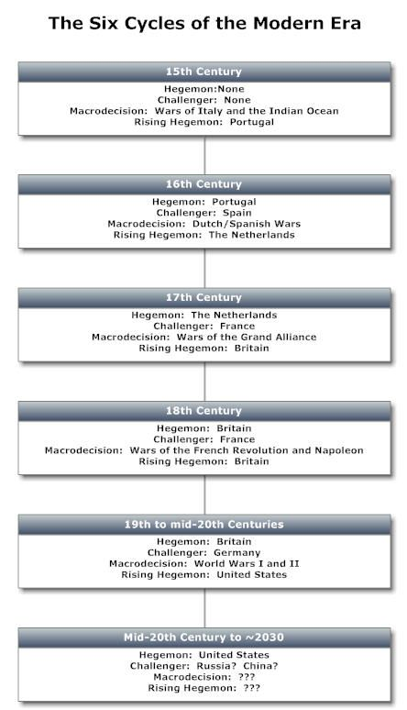

Slide 78
KONDRATIEFF CYCLICAL THEORY

Slide 79
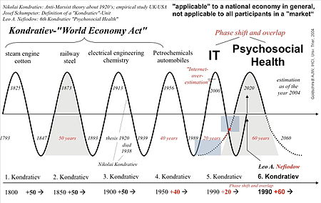

Slide 80
KONDRATIEFF
STUDIED PRODUCTION AND PRICE INDICES FROM 1780 TO 1920

Slide 81
CAME TO THE FOLLOWING CONCLUSION
BEFORE AND DURING THE BEGINNING OF THE RISING WAVE OF EACH LONG CYCLE
THERE ARE PROFOUND CHANGES IN THE CONDITIONS OF THE SOCIETY’S ECONOMIC LIFE

Slide 82
THESE CHANGES MANIFEST THEMSELVES
IN SIGNIFICANT TECHNOLOGICAL CHANGES
WHICH ARE PRECEDED BY SIGNIFICANT TECHNICAL DISCOVERIES AND INVENTIONS
BY THE INVOLVEMENT OF NEW COUNTRIES IN WORLDWIDE ECONOMIC RELATIONS

Slide 83
THESE CHANGES … [2]
CHANGES IN GOLD PRODUCTION AND MONETARY CIRCULATION
SOCIAL UPHEAVALS (WARS AND REVOLUTIONS)

Slide 84
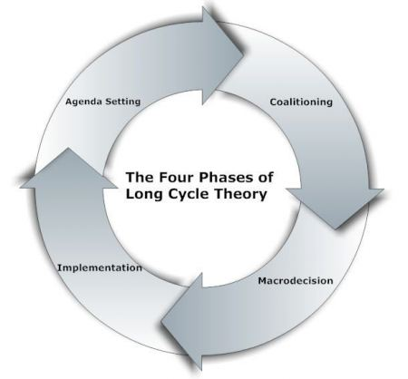

Slide 85
YVES LACOSTE
GEOPOLITICS IS THE SCIENTIFIC STUDY OF TERRITORIAL POWER RIVALRIES AND THEIR REPERCUSSIONS IN/FOR THE PUBLICS OPINION

Slide 86
CONFLICTING TERRITORIAL CLAIMS
ARE OFTEN RELATED TO THE RIVALRY OF REPRESENTATIONS OF A GIVEN TERRITORY IN THE COLLECTIVE MENTALITY OF HUMAN GROUPS

Slide 87
THESE GEOPOLITICAL REPRESENTATIONS
ARE CONNECTED TO NATIONAL MYTHS, SYMBOLS, RELIGION AND A CERTAIN INTERPRETATION OF HISTORY
HAVE A HUGE IMPACT ON STRATEGIES FOR THE CONTROL OF A GIVEN TERRITORY CONTESTED BY TWO OR MORE ETHNIC GROUPS

Slide 88
TODAY
GEOECONOMICS HAS TAKEN THE ASCENDENCY OVER GEOPOLITICS

Slide 89
WE ARE MOVING
FROM A UNIPOLAR WORLD LED BY THE US
TO A MULTIPOLAR WORLD
IN WHICH THE BRICS ARE AMONG THE NEW POLES OF ECONOMIC POWER

Slide 90
CLASSICAL QUESTIONS
ARE RISING POWERS ‘REVISIONIST’ POWERS GEARED TOWARDS OVERTHROWING THE INTERNATIONAL ORDER AND SUBSTITUTING IT TO THEIR ALTERNATIVE VIEW
OR ARE THEY WITH THE SAME INTERESTS AND VIEWS OF ESTABLISHED POWERS

Slide 91
BRAZIL, CHINA, INDIA
BENEFIT FROM THE INTERNATIONAL TRADING REGIME
THEY HAVE A STAKE IN PRESERVING THE SYSTEM

Slide 92
TODAY’S RISING POWERS
ARE STATUS-QUO POWERS

Slide 93
COUNTRIES FAVORED BY NATURE
AND PRODUCING RAW MATERIALS ON WHICH OTHER COUNTRIES DEPEND
AND FEW SUPPLIERS
CAN EXCHANGE PRODUCT FOR POLITICAL POWER

Slide 94
RUSSIA
NATURAL JUNCTION BETWEEN EAST AND WEST AND NORTH AND SOUTH OF THE EURASIAN LAND MASS
THIS MEANS INVESTMENTS ARE REQUIRED IN THE COMMUNICATIONS SYSTEMS (RAILROADS, ROADS, PORTS, PIPELINES)

Slide 95
NATURAL RESOURCES
21% OF WORLD’S RAW RESOURCES
45% OF WORLD’S NATURAL GAS
13% OF WORLD’S OIL
23% OF WORLD’S COAL
PRECIOUS METALS
MINERALS
LUMBER

Slide 96
ITS CENTRAL POSITION
IN THE EURASIAN LAND MASS
PUTS IT ASTRIDE THE SHORTEST, CHEAPEST PIPELINE AND TRANSIT ROUTES
FOR THOSE RESERVES IT DOES NOT DIRECTLY CONTROL

Slide 97
RUSSIA
IS USING ITS ENERGY RESOURCES AND GEOGRAPHICAL POSITION
TO BULLY BOTH SUPPLIERS (IN CENTRAL AND SOUTHWEST ASIA) AND USERS (PRIMARILY IN EUROPE) INTO SUPPORTING ITS POLITICAL PROJECTS

Slide 98
ITS PRESSURE
ON STATES SEEKING TO CREATE ALTERNATE PIPELINE ROUTES THAT CIRCUMVENT RUSSIAN TERRITORY
WAS MADE EXPLICIT IN THE 2008 GEORGIA WAR

Slide 99
IN WINTER OF 2006
THE RUSSIANS CEASED GAS SUPPLIES TO UKRAINE
IN ORDER TO FORCE POLITICAL CONCESSIONS FROM THEIR NEIGHBOR AND CLIENT

Slide 100
RUSSIA
IS USING ITS ENERGY COMPANIES
TO EXPLOIT THE FREE MARKET

Slide 101
CHINA
HAS A NEAR-MONOPOLY (93%) ON RARE EARTHS EXTRACTION (EUROPIUM, YTTRIUM, …)
HAS IMPOSED EXPORT QUOTAS AND FURTHER REDUCED THEM
USED AS CATALYSTS IN GREEN CARS AND FOR A VARIETY OF IT PRODUCTS
HAVE NO SUBSTITUTE

Slide 102
PRODUCERS MUST MOVE TO CHINA
TO HAVE ACCESS TO THE PRODUCT

Slide 103
CENTRAL ASIA
LANDLOCKED
PROXIMITY TO GREAT POWERS
GAS AND OIL
PIPELINES
ETHNIC CAULDRON

Slide 104
TURKEY
SITS AT CROSSROADS OF EUROPE, RUSSIA, CENTRAL ASIA AND MIDDLE EAST
COMPETING PIPELINES WILL CROSS IT – NABUCCO, SOUTH STREAM

Slide 105
GERMAN CHANCELLOR SCHROEDER
BELIEVED THAT AN INTEGRATION OF GERMANY AND RUSSIA
WOULD ENABLE THEM TO COMPETE WITH CHINA AND THE US

Slide 106
IN THIS PARTNERSHIP
RUSSIA WOULD PROVIDE ENERGY RESOURCES
AND GERMANY TECHNOLOGIES

Slide 107
BY ALLOWING
GERMAN HEAVY INDUSTRY TO HAVE LOW ENERGY PRICES
IT ALLOWS IT TO GAIN MARKET SHARE IN RUSSIA

Slide 108
IN THE MEANTIME
RUSSIA WANTS TO DIVERSIFY FROM ITS CURRENT EUROPEAN-ORIENTED NETWORK
AND BUILD LINKS WITH CHINA

Slide 109
THE ADVANTAGE FOR CHINA
IS THAT RUSSIA WILL HAVE A RELATIVELY STABLE SUPPLIER
WITH REDUCED TRANSPORTATION RISKS

Slide 110
SOME MAJOR CONTEMPORARY ISSUES
RISE OF STATE CAPITALISM
RESOURCE NATIONALISM
ISLAMIC RADICALISM

Slide 111
GEOPOLITICAL REASONING
TAKES INTO CONSIDERATION THE GEOGRAPHICAL DIMENSION THAT SHOULD BE CONSIDERED NOT ONLY IN ITS PHYSICAL SENSE
BUT ALSO IN TERMS OF DEMOGRAPHIC, CULTURAL AND ECONOMIC ASPECTS AS WELL

Slide 112
THERE ARE
PERMANENT FACTORS
VARIABLE FACTORS

Slide 113
PERMANENT FACTORS
GEOGRAPHIC POSITION
CONFIGURATION OF TERRITORY
ENDURING CULTURAL IDENTITY SUCH AS LANGUAGE AND RELIGION

Slide 114
VARIABLE FACTORS
CAN BE INTERNAL TO THE COUNTRY
OR EXTERNAL AT GLOBAL LEVEL

Slide 115
VARIABLE FACTORS
DEMOGRAPHY
SOCIO-POLITICAL STRUCTURE
ALLIANCE CONFIGURATION
STRATEGIC MOTIVATIONS
GEO-ECONOMIC INTERESTS
TECHNOLOGICAL FACTORS

Slide 116
GEOPOLITICAL ANALYSIS
IS AN ANALYSIS OF THE INTERACTIONS BETWEEN SOCIO-POLITICAL SITUATIONS AND THEIR TERRITORIAL DIMENSIONS TAKING INTO CONSIDERATION THE HISTORIC, GEOGRAPHIC, STRATEGIC, POLITICAL, IDENTITY, DEMOGRAPHIC AND ECONOMIC FACTORS RELATED TO THESE SITUATIONS

Slide 117
MOST IMPORTANT FACTORS
PHYSICAL GEOGRAPHY
NATURAL RESOURCES
IDENTITY FACTORS
GEOPOLITICAL REPRESENTATIONS
ETHNIC COMPOSITION AND DEMOGRAPHY
BOUNDARIES
HISTORICAL FACTORS
SOCIO-ECONOMIC FACTORS
STRATEGY OF ACTORS

Slide 118
EACH OF THESE FACTORS
CAN INTERACT WITH ANY OTHER

Slide 119
FACTORS OF PHYSICAL GEOGRAPHY
LOCATION
SIZE
PHYSICAL SHAPE

Slide 120
LOCATION DEFINES
DISTANCES FROM IMPORTANT GEOGRAPHIC ZONES SUCH AS AXES OF ROAD COMMUNICATION, HARBORS, RIVERS, IMPORTANT CITIES OR REGIONS
NEIGHBORING STATES
CLIMATE

Slide 121
IDENTITY FACTORS
ETHNICITY
LANGUAGE
RELIGION

Slide 122
THEY INFLUENCE
PERCPETIONS
BELIEFS
NORMS
VALUES
OF A GIVEN COMMUNITY

Slide 123
FACTORS OF ETHNIC COMPOSITION
CULTURAL DIFFERENCES AND SIMILARITIES
PERCEPTION OF ONE COMMUNITY BY THE OTHER
COLLECTIVE HISTORICAL MEMORY
DISTRIBUTION OF ECONOMIC AND POLITICAL POWER

Slide 124
GEOPOLITICS OF ENERGY

Slide 125
HISTORY OF CRUDE OIL
7000 YEARS OF TRYING TO FIND USES
IT WAS KNOWN THAT IT BURNED WELL
USED FOR INCENDIARY WEAPONS AND HAIR DRESSING
NO LARGE-SCALE APPLICATION AS AMOUNT SEEPING UP WAS RELATIVELY SMALL

Slide 126
HISTORY OF CRUDE OIL [2]
IN 19TH CENTURY MODERN DRILLING TECHNOLOGY USED TO SEARCH FOR WATER AND LED TO DISCOVERY OF FIRST LARGE RESERVOIRS OF CRUDE OIL
USED FOR ILLUMINATION SUBSTITUTING WHALE OIL
WHALING WAS EXPENSIVE, UNSAFE AND INEFFICIENT

Slide 127
HISTORY OF CRUDE OIL [3]
PROCESSING CRUDE OIL LED TO KEROSENE
ELECTRICITY DISCOVERED END OF 19TH CENTURY
MORE EFFICIENT AND MORE DESIRABLE THAN OIL-BASED ILLUMINATION
OIL INDUSTRY UNSURE OF ITS FUTURE

Slide 128
HISTORY OF CRUDE OIL [4]
CRUDE OIL LEADS TO CHEAP AND EFFICIENT TRANSPORTATION FUEL
LEADING TO THE EMERGENCE OF MODERN SHIPPING
DIESEL ENGINES FOR TRAINS AND BIG TRUCKS
INTERNAL COMBUSTION ENGINE USING GASOLINE FOR AUTOMOBILES

Slide 129
OIL
OIL IS HIGHLY EFFICIENT IN TERMS OF ENERGY AND STORAGE COSTS ARE CHEAP
CRUDE OIL IS ONE OF THE CHEAPEST LIQUIDS ON THE PLANET

Slide 130
GAS
80% EXPORTED THROUGH PIPELINES WHICH IS A FIXED SINGLE DESTINATION INFRASTRUCTURE
BUYER AND SELLER LOCKED INTO ONE ANOTHER
LONG TERM CONTRACTS (25 YEARS) WITH FIXED RATES
LNG STILL RELATIVELY SMALL PORTION OF MARKET

Slide 131
ALTERNATIVES
MUST BE PRODUCED ON MASSIVE SCALE
MUST BE ABLE TO PRODUCE IT AT A REASONABLE COST
WE WILL BE LIVING IN A HYDROCARBON-BASED ENERGY ECONOMY FOR DECADES

Slide 132
OIL IS THE LIFEBLOOD OF OUR SOCIETY
CONTROLING OR MANIPULATING THE SUPPLY OF OIL CAN CREATE MASSIVE ECONOMIC AND SOCIAL DISLOCATIONS IN OIL-DEPENDENT SOCIETIES
MODERN MILITARIES CANNOT OPERATE WITHOUT IT
CONTROL OF OIL GIVES STRATEGIC LEVERAGE

Slide 133
IN POST WWII PERIOD
ASSURING RELIABLE SUPPLIES OF CRUDE OIL HAS BEEN AN IMPORTANT GOAL FOR THE US

Slide 134
OWNERSHIP
IN US IF YOU OWN THE LAND YOU ALSO OWN THE SUBSURFACE RIGHTS
IN BRITAIN SUBSURFSCE RIGHTS STILL BELONG TO THE STATE

Slide 135
AMERICAN INVOLVEMENT IN THE MIDDLE EAST
IS THE MOST POINTED EXAMPLE
WITH SEVERAL CONFLICTS OVER THE PAST TWO OR THREE DECADES MOTIVATED BY THE STRATEGIC PLACEMENT OF OIL

Slide 136
HYDRAULIC FRACTURING
AND THE DISCOVERY OF LARGE OIL RESERVES IN THE US
HAS ALLOWED THE COUNTRY TO EVOLVE OUT OF ITS STATUS AS AN OIL IMPORTER TO THAT OF AN OIL EXPORTER

Slide 137
DOMESTIC STRATEGIES TO REDUCE OIL DEPENDENCE
TAXES
INVEST IN PUBLIC TRANSPORTATION
INVEST IN ALTERNATIVE FUELS
DEVELOP COAL-CLEANING TECHNOLOGY

Slide 138
OTHER PRODUCERS ON AMERICAN CONTINENT
CANADA
MEXICO
VENEZUELA

Slide 139
CANADA
OIL FROM TAR SANDS
ONLY MAKES SENSE ECONOMICALLY WHEN PRICES ARE HIGH

Slide 140
MEXICO
FIRST TO NATIONALIZE IN LATE 1930s
BECAME A LARGER PLAYER IN THE 1970s BY SUPPLYING US
PEMEX MONOPOLY

Slide 141
PEMEX
CORRUPTION
INEFFICIENCY
PRODUCTION CAPACITY PROBLEMS
GOVERNMENT INTERFERENCE WHICH TAKES ALL THE REVENUE IT GENERATES SO UNABLE TO MAINTAIN INFRASTRUCTURE
PRESENT GOVERNMENT BREAKING MONOPOLY

Slide 142
VENEZUELA
50/50 DEAL WITH THE PRIVATE OIL COMPANIES IN THE 1940s
NAATIONALIZATION IN THE 1970s
HUGO CHAVEZ COMES TO POWER IN 1998
LATIN AMERICAN POPULISM
USES OIL SECTOR AS A POLITICAL TOOL TO HELP CONSTITUENTS AND GAIN INTERNATIONAL INFLUENCE

Slide 143
BRAZIL
PETROBRAS NATIONAL OIL COMPANY
LARGE DISCOVERIES OF UNDER SALT DEPOSITS
NEED OF TECHNOLOGY AND INVESTMENTS

Slide 144
OPEC
WANTS TO REESTABLISH CONTROL
HAS A SAY OVER INVESTMENT AND PRICING DECISIONS

Slide 145
CONCESSIONS
IN A DEFINED TERRITORY THE INVESTOR HAS FULL ACCESS TO THE SUBSURFACE RESOURCES
PRODUCTION IS THE PROPERTY OF THE INVESTOR
STATE GETS BONUS, ROYALTIES, TAXES

Slide 146
IN CASE OF STATE DISSATISFACTION
NATIONALIZATION
EXPROPRIATION
50-50

Slide 147
SAUDI ARABIA
NATIONAL COMPANY SAUDI ARAMCO
SINCE THE 1970s NO FOREIGN INVESTMENT INTO UPSTREAM OIL SECTOR
MOST CAPABLE NATIONAL OIL COMPANY IN THE WORLD
FINANCE VIRTUALLY EVERYTHING ON THEIR OWN

Slide 148
SAUDI ARABIA [2]
ONLY COUNTRY IN THE WORLD THAT HAS SUSTAINED A STEADY SURPLUS CAPACITY
VERY LOW PRODUCTION COSTS
POPULATION VERY LOW
HAVE RELIED ON A SMALL NUMBER OF LARGE OIL FIELDS

Slide 149
SAUDI FIELDS
DAWAR FIELD: ROUGHLY HALF THE KINGDOM’S OIL PRODUCTION
100 OIL FIELDS DISCOVERED: 30 IN PRODUCTION, 10 GIANT FIELDS ACCOUNTING FOR MORE THAN 90% OF OIL PRODUCTION
FIELDS OLD AND PRODUCTION HAS PEAKED

Slide 150
PRODUCTION SHARING AGREEMENTS (PSA)
AGREEMENT BETWEEN THE STATE AND AN INVESTOR DEALING WITH A SPECIFIED TERRITORY FOR A SPECIFIED AMOUNT OF TIME
STATE HAS WORD TO SAY IN WHAT THE INVESTOR WILL BE DOING WITH REGARDS TO INVESTMENT
STATE SHARES PRODUCTION WITH INVESTOR

Slide 151
PRODUCTION SHARING AGRREEMENT [2]
DEFINED BY CONTRACT
INITIAL COMPENSATORY PRODUCT WHICH IS THE AMOUNT OF PRODUCT THAT THE INVESTOR NEEDS TO BREAK EVEN
EVERYTHING PAST COMPENSATORY PRODUCT GETS SPLIT UP

Slide 152
STATE
KEEPS OWNERSHIP RIGHTS
HIGHER SAY IN GOINGS ON

Slide 153
BIGGEST OIL COMPANIES
SAUDI ARAMCO
GAZPROM
NATIONAL IRANIAN OIL COMPANY
EXXON MOBIL
ROSNEFT

Slide 154
PEAKISTS
THERE IS A PEAK POINT OF PRODUCTION AT SOME POINT WHERE ONCE HIT EVERYTHING SUBSEQUENT TO IT WILL FALL INTO DECLINE
SOME PEOPLE ARGUE WE ARE ALMOST THERE

Slide 155
RISKS
RESOURCE RISK
PRODUCTION RISK
GEOSTRATEGIC RISK

Slide 156
RESOURCE RISKS
FACTORS THAT COULD VARIABLY EFFECT THE RESOURCE BASE OF A PRODUCTION COMPANY
UNCERTAINTY ABOUT RESERVES
DEPLETION RATE
RATE AND SIZE OF NEW DISCOVERIES

Slide 157
PRODUCTION RISKS
FACTORS THAT CAN VARIABLY AFFECT A COUNTRY’S ABILITY TO EXPLOIT RESERVES
IMPACT OF PRICE
SIZE AND SUSTAINABILITY OF INVESTMENT FLOWS
NATIONAL POLICY

Slide 158
GEOSTRATEGIC RISKS
INTERNAL TO THE COUNTRY: BASIC POLICAL STABILITY AND INTERNAL SECURITY
EXTERNAL TO THE COUNTRY: EMBARGOS AND MILITARY STRIKES

Slide 159
IRAN
NEEDS MAJOR FOREIGN INVESTMENTS TO INCREASE PRODUCTION - $150 BILLION
IF NEGOTIATION BREAKTHROUGH US COMPANIES WOULD MOVE IN

Slide 160
FUTURE SCENARIO IRAQ
KURDS IN NORTH
SHIAS IN SOUTH
TREMENDOUS UNCERTAINTY IN MIDDLE

Slide 161
THREE BIGGEST PLAYERS RUSSIA
GAZPROM: STATE OWNED GAS COMPANY WITH HUGE RESERVES AND MONOPOLY OF GAS EXPORTS
ROSNEFT: NATIONAL OIL COMPANY
TRANSNEFT: STATE OWNED CONTROLS OIL PIPELINES

Slide 162
PRIVATE COMPANIES
LUKOIL
NOVATEK
SIBNEFT
TNK

Slide 163
UNDER PUTIN
ENERGY IS A STRATEGIC ASSET AND THE STATE NEEDS TO CONTROL HOW THEY ARE MARKETED AND DIVIDED OUT
REESTABLISHING RUSSIA AS A POWERHOUSE
RISING ENERGY PRICES IS A MUST FOR SUCH A POLICY

Slide 164
RUSSIA ALSO PURCHASES
FROM KAZAKHSTAN, TURKMENISTAN, UZBEKISTAN BUT NOT PAYING MARKET PRICES
TIED TO RUSSIA UNLESS OTHER COUNTRIES PAY FOR INFRASTRUCTURE

Slide 165
RUSSIA VERY BIG GAS SUPPLIER
80% OF PRODUCTION GOES TO EUROPE
PROBLEM WITH UKRAINE AS TRANSIT COUNTRY
ATTEMPT TO CREATE GAS OPEC WITH ALGERIA, EGYPT, IRAN, LIBYA AND QATAR FAILED AS MOST COUNTRIES HAVE LONG TERM CONTRACTS

Slide 166
ASIA
MOST ARE DEMOCRACIES
MOST ARE CAPITALISTIC BUT WITH A LOT OF GOVERNMENT INTERFERENCE IN ENERGY SECTOR PARTICULARLY IN OIL ACQUISITION POLICIES
HEAVY MILITARY IMPLICATIONS AND INSTABILITY

Slide 167
BIG COUNTRIES
CHINA
INDIA
PAKISTAN

Slide 168
SMALL COUNTRIES
JAPAN
PHILIPPINES
SINGAPORE
SOUTH KOREA
TAIWAN

Slide 169
JAPAN
ALIGNED WITH US
RESOURCE DEPENDENT – NO OIL OR GAS
RELIANT ON SUPPLY LINES
WORRIED ABOUT STABILITY OF ENERGY SUPPLY

Slide 170
CHINA
WORRIED ABOUT US, JAPAN, INDIA, AUSTRALIA
WORRIED ABOUT ENCIRCLEMENT CAMPAIGN
ISSUE WITH TAIWAN

Slide 171
INDIA
WORRIED ABOUT CENTRAL ASIA, CHINA AND PAKISTAN
CANT REALLY COUNT ON US

Slide 172
TWO MAJOR GEOPOLITICAL DRIVERS
THAT COULD INFLUENCE THE ENERGY SCENE DURING THE MANY DECADES TO COME

Slide 173
THEY ARE
THE RISE OF CHINA
POTENTIAL INSTABILITY OF OIL / GAS SUPPLIES, AND CONSEQUENTLY OIL / GAS PRICES, FROM SPECIFIC REGIONS

Slide 174
CHINA
GROWTH RATE EXPECTED TO AVERAGE 6% PER YEAR UNTIL 2035
SMALL DEBT
MASSIVE FOREIGN RESERVES
COMPETITIVE MANUFACTURING CENTERS
GROWING CONSUMING BASE

Slide 175
RELATIONS WITH THE US
RELATIONS WILL PROBABLY BE RESHAPED
LARGEST IMPORT MARKET FOR THE US
THIRD LARGEST EXPORT MARKET FOR THE US
THIS CREATES A LARGE TRADE DEFICIT

Slide 176
RELATIONS WITH THE US [2]
CHINA HOLDS ABOUT 25% OF US DEBT

Slide 177
POLITICAL INSTABILITIES
CAN POTENTIALLY REDUCE, OR EVEN ELIMINATE, OIL PRODUCTION

Slide 178
80% OF WORLD OIL SUPPLY
IN THE HANDS OF NATIONAL OIL COMPANIES

Slide 179
INVESTMENT RESTRICTIONS
CAN REDUCE REAL AND POTENTIAL OUTPUT

Slide 180
COUNTRIES MOST LIKELY TO BE AFFECTED
INDONESIA
IRAN
MEXICO
NIGERIA
RUSSIA
VENEZUELA

Slide 181
GEOPOLITICS OF ENERGY

Slide 182
THREE COMPETING MODELS
ANGLO-AMERICAN INTERNATIONAL MARKET
RUSSIAN MODEL ENERGY HEGEMONY
CHINESE MODEL PETRO-MERCANTILISM

Slide 183
THE AMERICAN MODEL
IS BEING ATTACKED BY RUSSIA AND CHINA

Slide 184
RUSSIA
HAS BECOME AN AGGRESSIVE POWER ONCE MORE
USING ITS ENERGY RESOURCES AS A WEAPON
ENCOURAGING OTHER PETRO-STATES SUCH AS IRAN AND VENEZUELA TO FOLLOW SUIT

Slide 185
CHINESE NATIONAL OIL COMPANIES
ARE STRIKING DEALS AROUND THE WORLD TO SECURE ENERGY RESOURCES FOR THEIR EXCLUSIVE USES
BYPASSING THE MARKET SYSTEM IN FAVOR OF A NEO-MERCANTILISM
EMBRACED BY OTHER ASIAN NATIONS

Slide 186
AMERICAN STRATEGY TOWARDS CHINA
COMPETE FOR ACCESS TO SUPPLIES IN AFRICA AND LATIN AMERICA
CONTAINMENT IN SOUTH CHINA SEA BY SELLING WEAPONS TO NEIGHBORING COUNTRIES
DISCOURAGE BUILDING OF INFRASTRUCTURE
PRESSURE OIL PRODUCERS

Slide 187
AS DEMAND CONTINUES TO INCREASE
AND SUPPLIES ARE STRETCHED
STATES THAT FORMERLY EMBRACED THE US-LED MARKET PARADIGM ARE BEING FORCED TO RECONSIDER THEIR LOYALTY TO THAT SYSTEM

Slide 188
PRODUCERS
ARE TEMPTED TO USE THE ENERGY HEGEMONY MODEL

Slide 189
CONSUMERS
FEEL PRESSURE TO SECURE THEIR OWN SUPPLIES
AND THUS JOIN THE PETRO-MERCANTILIST MODEL

Slide 190
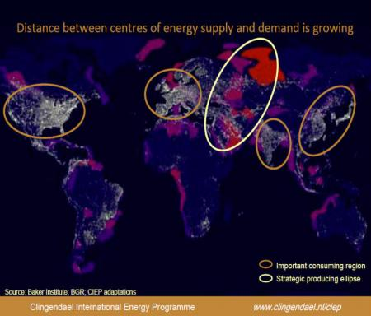

Slide 191
THE GEOPOLITICS OF GAS

Slide 192
SHALE GAS
THE US HAS HUGE QUANTITIES OF UNCONVENTIONAL SHALE GAS THAT ARE COMMERCIALLY VIABLE
CHANGING THE STRATEGIC PICTURE FOR THE UNITED STATES
BY MAKING IT SELF-SUFFICIENT IN GAS IN THE FORESEABLE FUTURE

Slide 193
THE RESULT
SHIFT IN PATTERNS OF TRADE
LEADING OTHER COUNTRIES IN EUROPE AND ASIS TO EXPLORE THEIR OWN SHALE GAS POTENTIAL

Slide 194
THESE DEVELOPMENTS
ARE PUTTING PRESSURE ON OIL-LINKED GAS CONTRACT
SEPARATE NATURE OF LONG-STANDING OF NORTH-AMERICAN, EUROPEAN AND ASIAN GAS MARKETS
STRATEGIC SHIFTS SUCH AS THE WEAKENING OF RUSSIA’S DOMINANCE IN THE EUROPEAN GAS MARKET

Slide 195
MARITIME CHOKEPOINTS

Slide 196
CHOKEPOINTS
ARE NARROW CHANNELS ALONG WIDELY USED GLOBAL SEA ROUTES
SOME SO NARROW THAT RESTRICTIONS ARE PLACED ON THE SIZE OF THE VESSEL THAT CAN NAVIGATE THROUGH THEM
THEY ARE A CRITICAL PART OF GLOBAL ENERGY SECURITY DUE TO THE HIGH VOLUME OF OIL IN TRANSIT

Slide 197
OVER ONE HALF OF THE OIL PRODUCED
IS MOVED BY TANKERS ON FIXED MARITIME ROUTES

Slide 198
TWO MOST STRATEGIC CHOKEPOINTS
STRAITS OF HORMUZ
STRAIT OF MALACCA

Slide 199
THE BLOCKAGE OF A CHOKEPOINT
EVEN TEMPORARILY
CAN LEAD TO SUBSTANTIAL INCREASES IN THE PRICE OF OIL

Slide 200
CHOKEPOINTS CAN BE CAUSED BY
PIRATES
TERRORIST ATTACKS
POLITICAL UNREST
SHIPPING ACCIDENTS

Slide 201
STRAIT OF HORMUZ

Slide 202
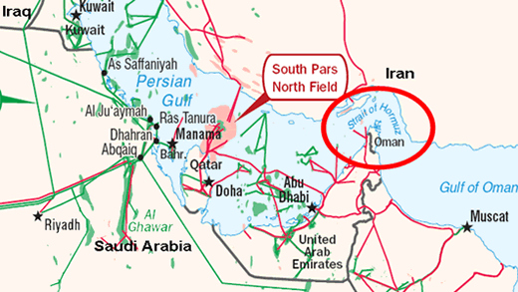

Slide 203
STRAIT OF HORMUZ
BY FAR THE WORLD’S MOST IMPORTANT CHOKEPOINT
WITH AN OIL FLOW OF ABOUT 17 BILLION BARRELS A DAY
35% OF ALL SEA-BORNE TRADED OIL
20% OF TRADED OIL
85% GOING TO ASIA
20% OF LNG

Slide 204
AT ITS NARROWEST POINT
STRAIT IS 30 KM WIDE
WIDTH OF SHIPPING LANE IN ANY DIRECTION IS ONLY 3 KM
SEPARATED BY A 3 KM BUFFER ZONE

Slide 205
MOST POTENTIAL OPTIONS
TO BY-PASS HORMUZ
THE PIPELINES ARE CURRENTLY NOT OPERATIONAL

Slide 206
STRAIT OF MALACCA

Slide 207
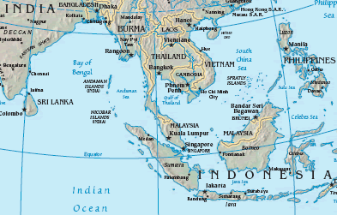

Slide 208
STRAIT OF MALACCA
LOCATED BETWEEN INDONESIA, MALAYSIA AND SINGAPORE
LINKS THE INDIAN OCEAN TO THE SOUTH CHINA SEA AND PACIFIC OCEAN
SHORTEST SEA ROUTE BETWEEN PERSIAN GULF SUPPLIERS AND ASIAN MARKETS

Slide 209
OIL SHIPMENTS
SUPPLY CHINA AND INDONESIA
TWO OF THE WORLD’S FASTEST GROWING ECONOMIES
KEY CHOKEPOINT IN ASIA
CRUDE OIL MAKES UP 90% OF FLOW
REST HYDROCARBON PRODUCTS
2.5 KM WIDE
60 000 VESSELS TRANSIT PER YEAR

Slide 210
IF THE STRAITS WERE BLOCKED
NEARLY HALF OF THE WORLD’S FLEET WOULD BE REQUIRED
TO REROUTE AROUND THE INDONESIAN ARCHIPELAGO
CHINA IS ON SCHEDULE TO COMPLETE THE MYANMAR-CHINA OIL AND GAS PIPELINE IN 2013

Slide 211
SUEZ CANAL

Slide 212
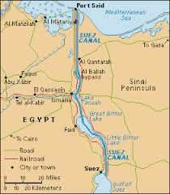

Slide 213
SUEZ CANAL
CONNECTS RED SEA WITH MEDITERRANEAN SEA
20% OF SHIPS ARE OIL TANKERS
6% WERE LNG TANKERS

Slide 214
BAB EL-MANDAB

Slide 215
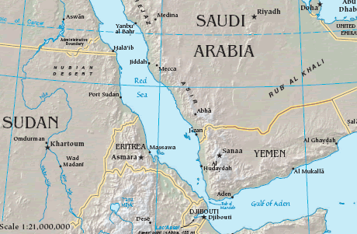

Slide 216
BAB EL-MANDAB
CHOKEPOINT BETWEEN HORN OF AFRICA AND MIDDLE EAST
STRATEGIC LINK BETWEEN MEDITERRANEAN SEA AND INDIAN OCEAN

Slide 217
TURKISH STRAITS

Slide 218
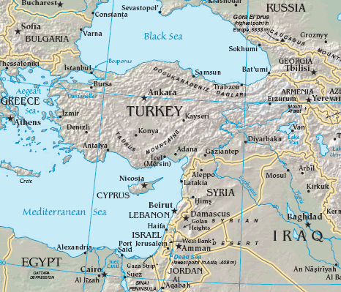

Slide 219
TURKISH STRAITS
FORMED BY BOSPORUS AND DARDANELLES
DIVIDE ASIA FROM EUROPE
CONNECTS BLACK SEA WITH SEA OF MARMARA
ONE OF THE EXPORT ROUTES FROM OIL FROM CIS TO SOUTHERN EUROPE

Slide 220
TURKISH STRAITS
ONE OF THE WORLD’S MOST DIFFICULT WATERWAYS AS VERY SINUOUS
ANNUAL PASSAGE OF 50 000 VESSELS OF WHICH 5 500 OIL TANKERS
RIGHT OF FREE PASSAGE IN TIME OF PEACE

Slide 221
PANAMA CANAL

Slide 222
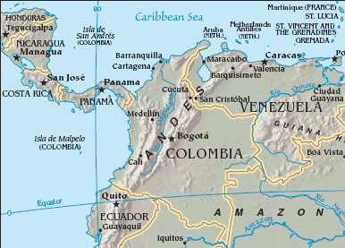

Slide 223
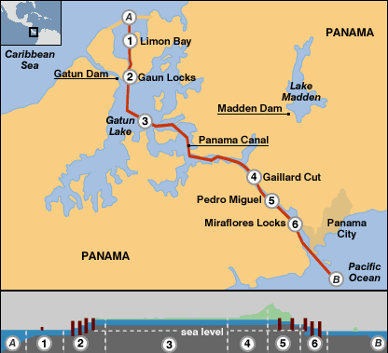

Slide 224
PANAMA CANAL
CONNECTING PACIFIC OCEAN WITH CARIBBEAN SEA AND ATLANTIC OCEAN
14 000 VESSELS PER YEAR OF WHICH 60% IS US COAST TO COAST TRAFFIC
CLOSURE WOULD REQUIRE REROUTING THROUGH STRAITS OF MAGELLAN AND CAPE HORN

Slide 225
PANAMA CANAL
EXPANSION DUE TO BE COMPLETED BY 2014
IMPORTANCE HAS DIMINISHED

