Slide 1
Creation of a NoSQL DataBase for Credit Card Fraud Detection
Martina Baga (16055A) Sara Cinquini (27283A)
A.A. 2022-2023

Slide 2
Table of Contents
01
02
03
04
Python code
Information about the datasets and their creation
UML Class Diagram
Diagram and constraints
Logical Data Model
Implementation choices
Cypher script
Loading of the CSV files, observations and execution of the queries

Slide 3
1
Python Code
Information about the datasets and their creation

Slide 4
Changes applied to the Python code
File format
Starting date
From .pkl to .csv files
2022-10-03
We have transformed the .pkl files into the .csv format for making them easier to use.
We have used a specific starting date which refers to the starting date of the New generation data models and DBMSs’ course.

Slide 5
Dataset creation
Dataset | SMALL | MEDIUM | LARGE
Size | 100 MB | 205 MB | 314 MB
Customers | 2500 | 5000 | 7500
Terminals | 5000 | 9000 | 14000
Days | 365 | 365 | 365
Starting date | 2022-10-03 | 2022-10-03 | 2022-10-03
r | 5 | 5 | 5
For generating the transactions, we have set as number of days 365.
Following the example reported by the generator code, the number of terminals always exceeds the number of customers. Although in a real scenario it would be more plausible to use a larger number of people.
Notes:
Qui possiamo fare entrambe le considerazioni, quella sul numero di giorni e quella sul nr di customer < nr di terminali

Slide 6
Dataset creation time
Dataset | nr CUSTOMERS | nr TERMINALS | nr TX generated | TG CUSTOMER TABLE | TG TERMINAL TABLE | TG TX | TA TERMINALS to CUSTOMERS
SMALL | 2500 | 5000 | 1745300 | 0,018 | 0,011 | 7,50E+01 | 0,66
MEDIUM | 5000 | 9000 | 3500393 | 0,049 | 0,049 | 1,70E+02 | 1,5
LARGE | 7500 | 14000 | 5286887 | 0,057 | 0,057 | 2,30E+02 | 2,2
TG = time to generate (in s)
TA = time to associate (in s)

Slide 7
2
UML Class Diagram
Diagram and constraints

Slide 8
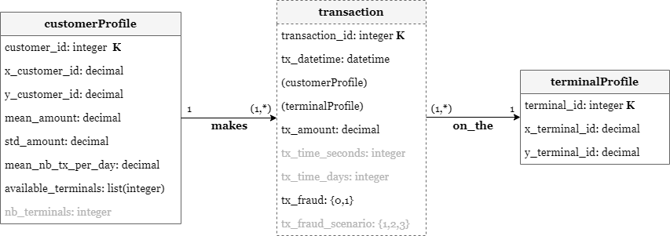
UML Class Diagram
We have included not only the fields specified by the project documentation, but also the data used to create the dataset (the ones identified by the grey colour).

Slide 9
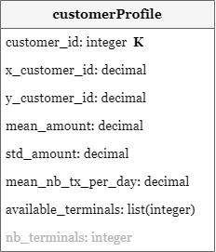
Customer
customer_id is a unique identifier for each customer;
the pair (x_customer_id, y_customer_id) defines the geographical location of the customer;
mean_amount and std_amount are the mean and standard deviation of the transaction amounts for the customer;
mean_nb_tx_per_day is the average number of transactions per day for the customer;
available_terminals is the set of terminals geographically close to the customer position and on which he/she can do transactions;
nb_terminals is equal to the length of available_terminals.

Slide 10
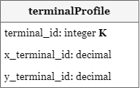
Terminal
terminal_id is a unique identifier for each terminal;
(x_terminal_id, y_terminal_id) is a pair of real and positive coordinates in a 100∙100 grid that defines the geographical location of the terminal.

Slide 11
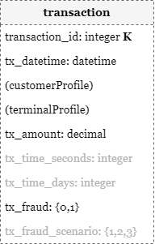
Transaction
a transaction is a payment card transaction consists of any amount paid by a customer to a merchant at a certain time;
transaction_id is a unique identifier for each transaction;
tx_datetime is the date and the time at which the transaction occurs;
customer_id is the unique identifier for the customer that paid to a merchant;
terminal_id is the unique identifier for the merchant, or more precisely the terminal to whom the customer paid;

Slide 12
Transaction - cont
tx_amount is a positive value for the amount of the transaction;
tx_time_seconds and tx_time_days are positive values representing the number of seconds and of days passed from the simulator’s starting date up to the moment in which the transaction takes place;
tx_fraud is a binary variable, with the value 0 for a legitimate transaction or the value 1 for a fraudulent transaction;
tx_fraud_scenario is a positive value in the range [1, 3] representing one of the three possible fraud scenarios used for adding fraudulent transactions to the dataset.

Slide 13
UML Class Diagram
In a realistic scenario these are the possible outcomes:
a customer does not have any terminals near and for this reason he can not make any transaction;
a terminal is not used for a specific period of time.
For these reasons the minimum cardinality of these relationships should be initialised at 0.
Since a customer can execute many transactions, we have decided to create an entity instead of a relationship.
However the script used by the simulator uses random functions, that is why we do not have the certainty that this happens. Therefore a customer can execute at least one transaction because of the script used by the simulator for generating the dataset.
A transaction is associated with only one customer.
A customer can pay a merchant by using his terminal only if that terminal is included in the customer’s list available_terminals.
A transaction can be executed only on one terminal.

Slide 14
3
Logical Data Model

Slide 15
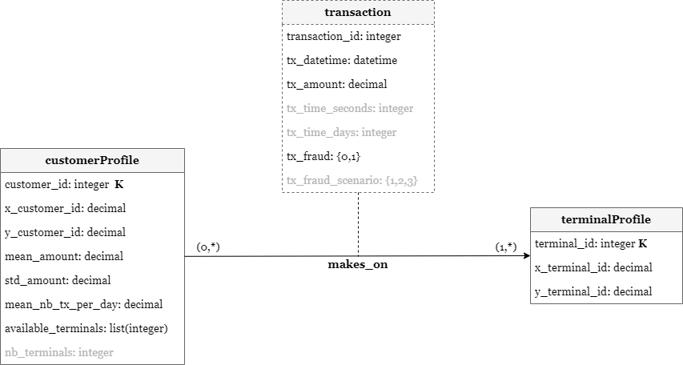
Implementation choices
Data Model 1
Data Model 2
Since a customer can make many transactions, we have represented each transaction as an entity (Data Model 1) and not as a relationship between customer and terminal (Data Model 2).

Slide 16
Implementation choices - cont
The decision to adopt the Data Model 1 led to the creation of two different relationships, one between customer and transaction (makes) and another one between transaction and terminal (on_the) rather than a single relationship between customer and terminal (makes_on) like the Data Model 2.
Although the number of relationships in the Data Model 1 is twice the number of relationships in the Data Model 2, this implementation choice has allowed us to gain advantages in the execution of the queries. In fact most of the queries in the provided document do not involve the three entities at the same time. As a result, having two relationships instead of only one, has allowed us to reduce the amount of information to access.

Slide 17
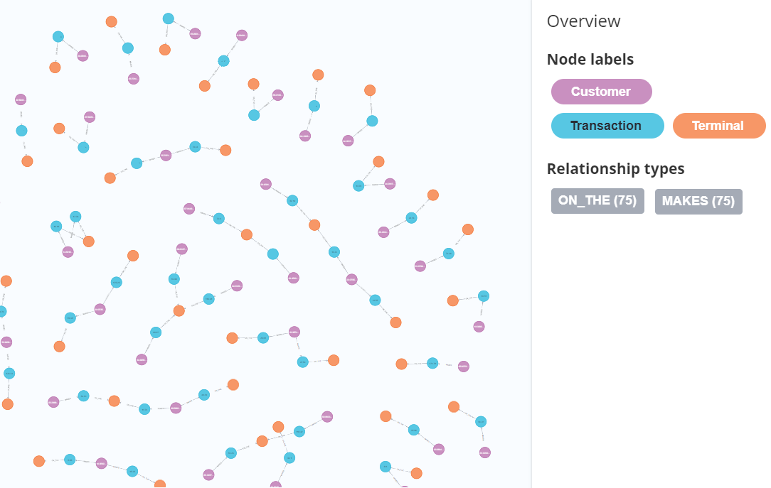
Graph database
We have decided to organise data according to a graph because we have to maintain information about the relationships between the nodes and the queries in the workload needed to navigate through these relationships.
In this sense the connection between customers, terminals and transactions can be represented by edges, while the classes themselves take shape through the concept of node.
Furthermore financial services, like fraud detection, are common use cases for graph databases.

Slide 18

Neo4j
Neo4j is one of the data management systems developed for working with graph databases.
In particular it works on property graphs, graphs with labels and/or properties for both nodes and edges.
Neo4j is more suitable for some big data and analytics applications than row and column databases or free-form JSON document databases for many use cases.

Slide 19
4
Cypher, Load and Queries
Loading of the CSV files, observations and execution of the query

Slide 20
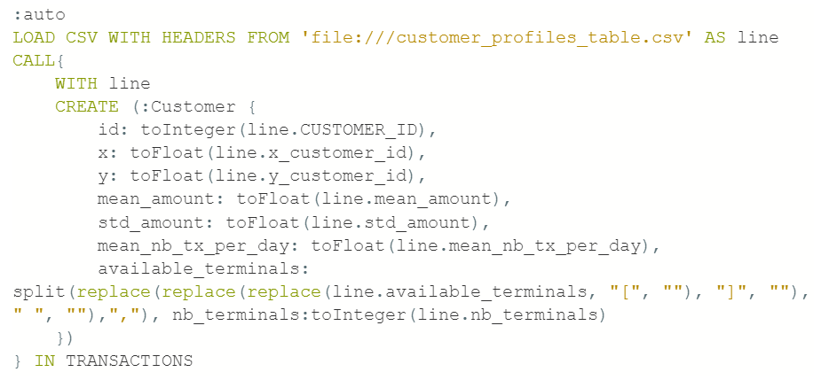
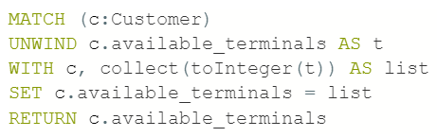
Loading of the CSV files
We have used the LOAD CSV clause to import data to the graph. CALL{...} allows the execution of subqueries (queries inside of other queries).
Customer
Loading of the table referring to customers with the subsequent transformation from array of strings to array of integers of available_terminals.
Furthermore subqueries can be made to execute in separate, inner transactions, producing intermediate commits and this is useful with large write operations. In order to execute a subquery in separate transactions, we have added IN TRANSACTIONS after the subquery.

Slide 21
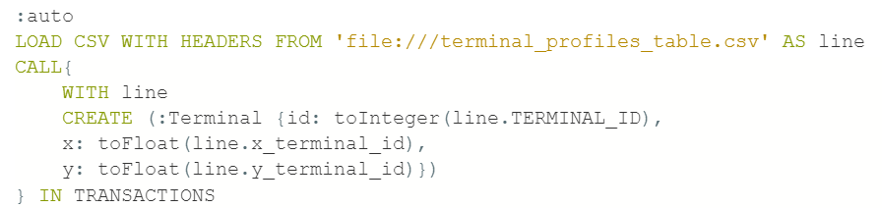
Loading of the CSV files
Terminal
Loading of the table referring to the terminals.

Slide 22
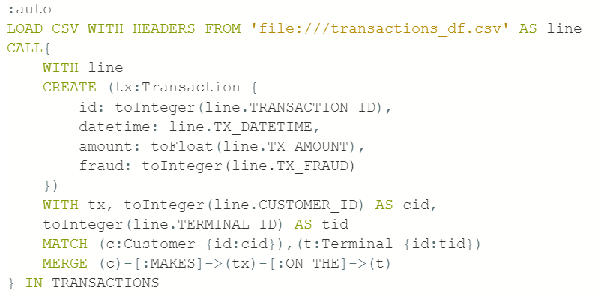
Loading of the CSV files
Transaction
Loading of the table referring to the transactions.

Slide 23
Dataset loading time
About the parameters of the databases.
For the SMALL dataset we used:
dbms.memory.heap.initial_size=4G
dbms.memory.heap.max_size=4G
For the MEDIUM dataset we used:
dbms.memory.heap.initial_size=6G
dbms.memory.heap.max_size=6G
For the LARGE dataset we used:
dbms.memory.heap.initial_size=8G
dbms.memory.heap.max_size=8G

Slide 24
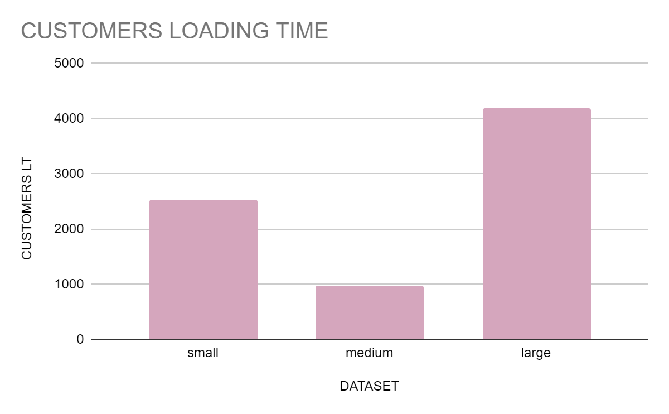
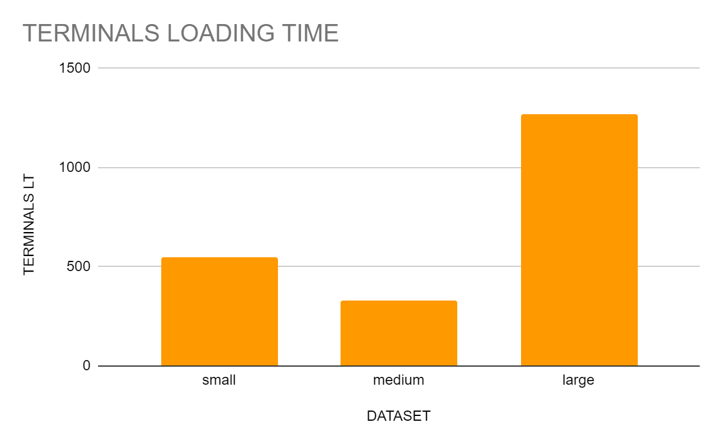
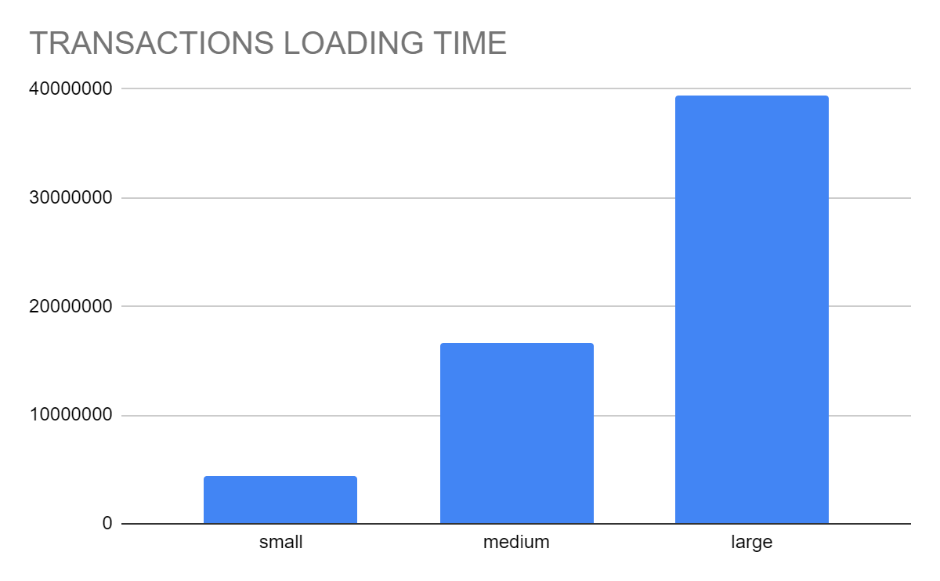
Dataset loading time
DATASET | CUSTOMERS LT | TERMINALS LT | TRANSACTIONS LT
SMALL | 2524 | 550 | 4454819
MEDIUM | 980 | 330 | 16645816
LARGE | 4183 | 1270 | 39429964

Slide 25
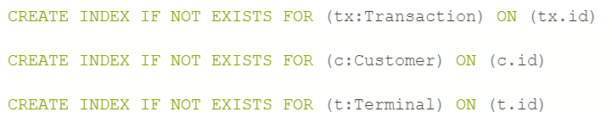
Queries
General optimization: creation of indexes.

Slide 26
Queries
1
For each customer identifies the amount that he/she has spent for every week of the current semester.
2
For each terminal identify the possible fraudulent transactions. The fraudulent transactions are those whose import is higher or lower than 10% of the average import of the transactions executed on the same terminal in the previous semester.
3
Given a user u, determine the “co-customer-relationships CC of degree k”. A user u’ is a co-customer of u if you can determine a chain “u1-t1-u2-t2-…tk-1-uk” such that u1=u, uk=u’, and for each 1<=i, j<=k, ui <> uj, and t1,..tk-1 are the terminals on which a transaction has been executed. Therefore, CCk(u)={u’| a chain exists between u and u’ of degree k}. Please, note that depending on the adopted model, the computation of CCk(u) could be quite complicated. Consider at least the computation of CC3(u) (i.e. the co-customer relationships of degree 3).

Slide 27
Queries
4.1a
Each transaction should be extended with the period of the day {morning, afternoon, evening, night} in which the transaction has been
4.1b
Each transaction should be extended with the kind of products that have been bought through the transaction {high tech, food, clothing, consumable, other}. The values can be chosen randomly.
executed.
4.2
Customers that make more than three transactions related to the same types of products from the same terminal should be connected as “buying_friends”. Therefore also this kind of relationship should be explicitly stored in the NOSQL database and can be queried.
5
Identify the buying-friend of degree K (i.e. the customers that are related through a chain of buying-friend relationships of degree K). Again, depending on the model the operations can become quite complicated. We expect that you write a script for K=4.

Slide 28
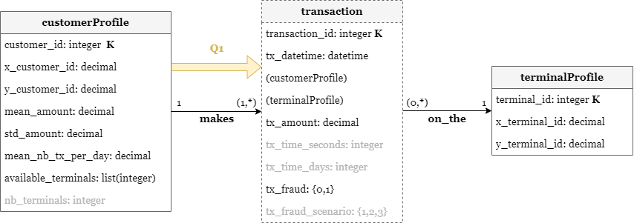
1
“For each customer identifies the amount that he/she has spent for every week of the current semester.”

Slide 29
1
“For each customer identifies the amount that he/she has spent for every week of the current semester.”
In this query we are going to be looking up transactions’ datetime frequently. Therefore, for better performance, we have created an index on datetime property for the Transaction node in the following way.
Since our dataset starts from October 2022, we have also checked that if the current semester is the second one, the months to take into account are only the ones in the same year of the current date and not the ones in 2022.
To create a flexible query, we have decided to use the function date() that returns the current date value. Starting from this date, we have identified the current semester and the relative year.
CREATE INDEX IF NOT EXISTS FOR (tx:Transaction) ON (tx.datetime)
Query
MATCH (c:Customer)-[:MAKES]->(tx:Transaction)
WITH apoc.date.fields(tx.datetime, 'yyyy-MM-dd HH:mm:ss') AS d, c, tx
WITH date({year: d.years, month: d.months, day: d.days}) AS dtx, c, tx, date() AS cd
WITH dtx, c, tx, cd,
CASE
WHEN cd.month<=6 AND dtx.month<=6 AND cd.year=dtx.year THEN tx.amount
WHEN cd.month>6 AND dtx.month>6 AND cd.year=dtx.year THEN tx.amount
ELSE NULL
END AS amount
WHERE amount IS NOT NULL
RETURN c.id AS customer_id, dtx.week AS week, sum(amount) AS tot_amount
Notes:
to create a flexible query, we have decided to use the function date() that returns the current date value. Starting from this date, we have identified the current semester and the relative year.
since our dataset starts from October 2022, we have also checked that if the current semester is the second one, the months to take into account are only the ones in the same year of the current date and not the ones in 2022.

Slide 30
1
“For each customer identifies the amount that he/she has spent for every week of the current semester.”
Dataset 1 (small) | 147 ms
Dataset 2 (medium) | 800 ms
Dataset 3 (large) | 900 ms

Slide 31
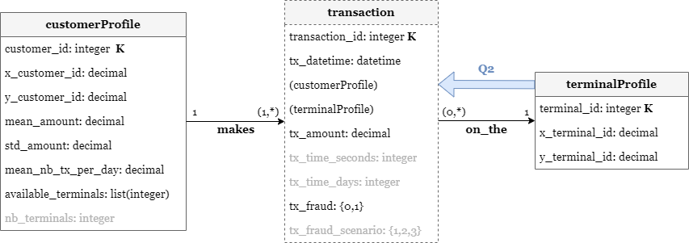
2
“For each terminal identify the possible fraudulent transactions. The fraudulent transactions are those whose import is higher or lower than 10% of the average import of the transactions executed on the same terminal in the previous semester.”

Slide 32
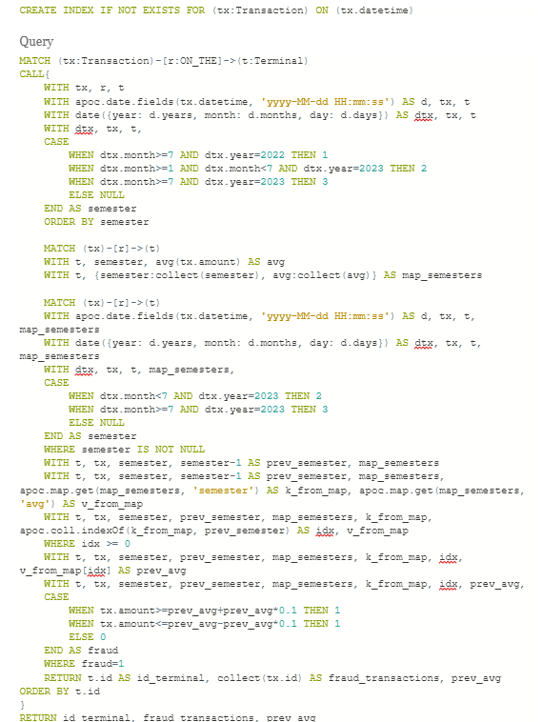
2
“For each terminal identify the possible fraudulent transactions. The fraudulent transactions are those whose import is higher or lower than 10% of the average import of the transactions executed on the same terminal in the previous semester.”
We can divide the query in three different parts.

Slide 33
2
“For each terminal identify the possible fraudulent transactions. The fraudulent transactions are those whose import is higher or lower than 10% of the average import of the transactions executed on the same terminal in the previous semester.”
In this query we are going to be looking up transactions’ datetime frequently. Therefore, for better performance, we have created an index on datetime property for the Transaction node in the following way (already executed for Q1).
To simplify the management of the semesters, we have decided to associate an integer to each semester with the following criteria:
semester 1 = October, November and December 2022
semester 2 = January, February, March, April, May and June 2023
semester 3 = July, August, September and October 2023
Part 1
CREATE INDEX IF NOT EXISTS FOR (tx:Transaction) ON (tx.datetime)
MATCH (tx:Transaction)-[r:ON_THE]->(t:Terminal)
CALL{
WITH tx, r, t
WITH apoc.date.fields(tx.datetime, 'yyyy-MM-dd HH:mm:ss') AS d, tx, t
WITH date({year: d.years, month: d.months, day: d.days}) AS dtx, tx, t
WITH dtx, tx, t,
CASE
WHEN dtx.month>=7 AND dtx.year=2022 THEN 1
WHEN dtx.month>=1 AND dtx.month<7 AND dtx.year=2023 THEN 2
WHEN dtx.month>=7 AND dtx.year=2023 THEN 3
ELSE NULL
END AS semester
ORDER BY semester
Notes:
In order to simplify the management of the semesters, we have decided to associate an integer to each semester in the period between October 2022 and October with the following criteria:
semester 1 = October, November and December 2022
semester 2 = January, February, March, April, May and June 2023
semester 3 = July, August, September and October 2023
Query optimization
In this query we are going to be looking up transactions’ datetime frequently. Therefore, for better performance, we have created an index on datetime property for the Transaction node in the following way (already executed for Q1).

Slide 34
2
“For each terminal identify the possible fraudulent transactions. The fraudulent transactions are those whose import is higher or lower than 10% of the average import of the transactions executed on the same terminal in the previous semester.”
Part 2
MATCH (tx)-[r]->(t)
WITH t, semester, avg(tx.amount) AS avg
WITH t, {semester:collect(semester), avg:collect(avg)} AS map_semesters
Looking at the data in our datasets, we have noticed that on some terminals no transitions have been executed in some semesters. Since the average of the transactions is computed for each semester with at least one transaction, these values cannot be stored temporarily into an array because the order would not be respected if no transitions have been executed in at least one semester (above all if the missing average is relative to semesters 1 and/or 2).
In order to somehow preserve the order, we have decided to keep also an array with the id of the semesters for which it has been possible to compute the average. These two arrays have been stored temporarily into a map (map_semesters) composed of two key-value pairs: {semester: [...], avg: [...]}.
Notes:
Looking at the data in our datasets, we have noticed that on some terminals no transitions have been executed in some semesters. Since the average of the transactions is computed for each semester with at least one transaction, these values cannot be stored temporarily into an array because the order would not be respected if no transitions have been executed in at least one semester (above all if the missing average is relative to semesters 1 and/or 2). For example, let’s consider a terminal where no transactions have been carried out in semester 2. The array associated with this terminal is [avg1, avg3] and this would be a problem since the index of each value does not match the id of the semester. Therefore, in order to somehow preserve the order, we have decided to keep also an array with the id of the semesters for which it has been possible to compute the average. These two arrays have been stored temporarily into a map (map_semesters) composed of two key-value pairs: { semester: [...], avg: [...]}.

Slide 35
2
“For each terminal identify the possible fraudulent transactions. The fraudulent transactions are those whose import is higher or lower than 10% of the average import of the transactions executed on the same terminal in the previous semester.”
Since semester 1 is the first semester in our dataset, all transactions carried out in that period have not been considered in the evaluation of fraudulent transactions because the previous semester does not exist.
We recover ALL the avg of the considered terminal (v stands for value).
Part 3
MATCH (tx)-[r]->(t)
WITH apoc.date.fields(tx.datetime, 'yyyy-MM-dd HH:mm:ss') AS d, tx, t, map_semesters
WITH date({year: d.years, month: d.months, day: d.days}) AS dtx, tx, t, map_semesters
WITH dtx, tx, t, map_semesters,
CASE
WHEN dtx.month<7 AND dtx.year=2023 THEN 2
WHEN dtx.month>=7 AND dtx.year=2023 THEN 3
ELSE NULL
END AS semester
WHERE semester IS NOT NULL
WITH t, tx, semester, semester-1 AS prev_semester, map_semesters
WITH t, tx, semester, semester-1 AS prev_semester, map_semesters, apoc.map.get(map_semesters, 'semester') AS k_from_map, apoc.map.get(map_semesters, 'avg') AS v_from_map
Starting from the semester in which the transaction has been executed, we can compute the prev_semester.
We recover ALL semesters of the considered terminal
(k stands for key).
Notes:
Since semester 1 is the first semester in our dataset, all transactions carried out in that period have not been considered in the evaluation of fraudulent transactions because the previous semester does not exist. This consideration is applied by the condition WHERE semester IS NOT NULL (line 28).

Slide 36
2
“For each terminal identify the possible fraudulent transactions. The fraudulent transactions are those whose import is higher or lower than 10% of the average import of the transactions executed on the same terminal in the previous semester.”
We check if the prev_semester calculated before exists
(it is possible that in the pre_semester no transactions have been executed).)
Now that we know that pre_semester exists, we can get the value of its avg.
Part 3 - cont
WITH t, tx, semester, prev_semester, map_semesters, k_from_map, apoc.coll.indexOf(k_from_map, prev_semester) AS idx, v_from_map
WHERE idx >= 0
WITH t, tx, semester, prev_semester, map_semesters, k_from_map, idx, v_from_map[idx] AS prev_avg
WITH t, tx, semester, prev_semester, map_semesters, k_from_map, idx, prev_avg,
CASE
WHEN tx.amount>=prev_avg+prev_avg*0.1 THEN 1
WHEN tx.amount<=prev_avg-prev_avg*0.1 THEN 1
ELSE 0
END AS fraud
WHERE fraud=1
RETURN t.id AS id_terminal, collect(tx.id) AS fraud_transactions, prev_avg ORDER BY t.id
}
RETURN id_terminal, fraud_transactions, prev_avg

Slide 37
2
“For each terminal identify the possible fraudulent transactions. The fraudulent transactions are those whose import is higher or lower than 10% of the average import of the transactions executed on the same terminal in the previous semester.”
Dataset 1 (small) | 1682 ms
Dataset 2 (medium) | 3679 ms
Dataset 3 (large) | 10743 ms

Slide 38
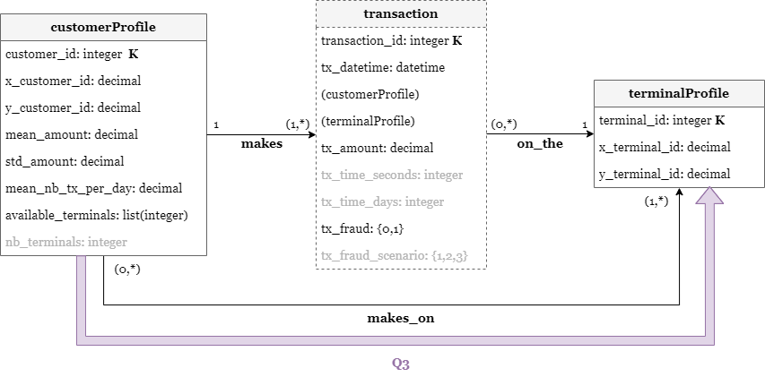
“Given a user u, determine the “co-customer-relationships CC of degree k”. A user u’ is a co-customer of u if you can determine a chain “u1-t1-u2-t2-…tk-1-uk” such that u1=u, uk=u’, and for each 1<=i, j<=k, ui <> uj, and t1,..tk-1 are the terminals on which a transaction has been executed. Therefore, CCk(u)={u’| a chain exists between u and u’ of degree k}. Please, note that depending on the adopted model, the computation of CCk(u) could be quite complicated. Consider at least the computation of CC3(u) (i.e. the co-costumer relationships of degree 3).”
3

Slide 39
“Given a user u, determine the “co-customer-relationships CC of degree k”. A user u’ is a co-customer of u if you can determine a chain “u1-t1-u2-t2-…tk-1-uk” such that u1=u, uk=u’, and for each 1<=i, j<=k, ui <> uj, and t1,..tk-1 are the terminals on which a transaction has been executed. Therefore, CCk(u)={u’| a chain exists between u and u’ of degree k}. Please, note that depending on the adopted model, the computation of CCk(u) could be quite complicated. Consider at least the computation of CC3(u) (i.e. the co-costumer relationships of degree 3).”
3
For this query was necessary executed two different operations:
Relationship creation
Execution of the query

Slide 40
“Given a user u, determine the “co-customer-relationships CC of degree k”. A user u’ is a co-customer of u if you can determine a chain “u1-t1-u2-t2-…tk-1-uk” such that u1=u, uk=u’, and for each 1<=i, j<=k, ui <> uj, and t1,..tk-1 are the terminals on which a transaction has been executed. Therefore, CCk(u)={u’| a chain exists between u and u’ of degree k}. Please, note that depending on the adopted model, the computation of CCk(u) could be quite complicated. Consider at least the computation of CC3(u) (i.e. the co-costumer relationships of degree 3).”
3
For this query was necessary executed two different operations:
Relationship creation
:auto
MATCH (c:Customer)-[:MAKES]->(:Transaction)-[:ON_THE]->(t:Terminal)
CALL {
WITH c, t
MERGE (c)-[r:MAKES_ON]->(t)
} IN TRANSACTIONS
Dataset 1 (small) | 16318 ms
Dataset 2 (medium) | 91740 ns
Dataset 3 (large) | 181697 ms

Slide 41
“Given a user u, determine the “co-customer-relationships CC of degree k”. A user u’ is a co-customer of u if you can determine a chain “u1-t1-u2-t2-…tk-1-uk” such that u1=u, uk=u’, and for each 1<=i, j<=k, ui <> uj, and t1,..tk-1 are the terminals on which a transaction has been executed. Therefore, CCk(u)={u’| a chain exists between u and u’ of degree k}. Please, note that depending on the adopted model, the computation of CCk(u) could be quite complicated. Consider at least the computation of CC3(u) (i.e. the co-costumer relationships of degree 3).”
3
Suppose that nodes c1 and c2 are co-customer of degree k=3. The result of the query should not report both the pairs (c1, c2) and (c2, c1). Therefore we have added the condition WHERE c1.id<c2.id in order to obtain each pair only once. The idea is that for each node we have to look only at the nodes with an ID greater than its one because all the possible co-customers with an ID lower than its one have been already returned.
For this query was necessary executed two different operations:
Relationship creation
Execution of the query
MATCH (c1:Customer)-[r:MAKES_ON*3]-(c2:Customer)
WHERE c1.id<c2.id
RETURN DISTINCT c1.id, c2.id
Notes:
Suppose that nodes c₁ and c₂ are co-customer of degree k=3. The result of the query should not report both the pairs (c₁, c₂) and (c₂, c₁). Therefore we have added the condition WHERE c1.id<c2.id in order to obtain each pair only once. The idea is that for each node we have to look only at the nodes with an ID greater than its one because all the possible co-customers with an ID lower than its one have been already returned.

Slide 42
“Given a user u, determine the “co-customer-relationships CC of degree k”. A user u’ is a co-customer of u if you can determine a chain “u1-t1-u2-t2-…tk-1-uk” such that u1=u, uk=u’, and for each 1<=i, j<=k, ui <> uj, and t1,..tk-1 are the terminals on which a transaction has been executed. Therefore, CCk(u)={u’| a chain exists between u and u’ of degree k}. Please, note that depending on the adopted model, the computation of CCk(u) could be quite complicated. Consider at least the computation of CC3(u) (i.e. the co-costumer relationships of degree 3).”
3
Execution of the query
* These execution times refer to the query performed with k=4. In fact, unlike the large dataset, the execution of the query on the small and on the medium ones did not produce any result for k=3. Therefore we have deduced that there is no co-customer-relationship of degree 3 in these two datasets.
Dataset 1 (small) | 12594 ms*
Dataset 2 (medium) | 44400 ms*
Dataset 3 (large) | 154885 ms
Notes:
Suppose that nodes c₁ and c₂ are co-customer of degree k=3. The result of the query should not report both the pairs (c₁, c₂) and (c₂, c₁). Therefore we have added the condition WHERE c1.id<c2.id in order to obtain each pair only once. The idea is that for each node we have to look only at the nodes with an ID greater than its one because all the possible co-customers with an ID lower than its one have been already returned.

Slide 43
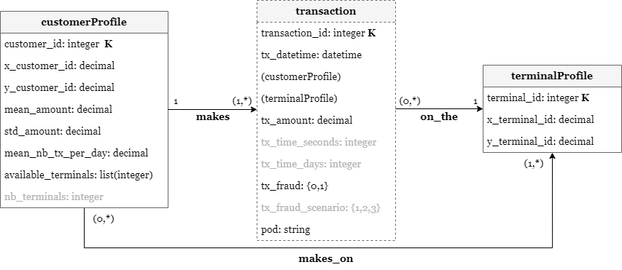
“Each transaction should be extended with the period of the day {morning, afternoon, evening, night} in which the transaction has been executed.”
4.1a

Slide 44
“Each transaction should be extended with the period of the day {morning, afternoon, evening, night} in which the transaction has been executed.”
In this query we are going to be looking up transactions’ datetime frequently. Therefore, for better performance, we have created an index on datetime property for the Transaction node in the following way (already executed for Q1).
4.1a
The different Period Of the Day (POD) are so divided:
morning = [5.00, 12.00)
afternoon = [12.00, 17.00)
evening = [17.00, 21.00)
night = [21.00, 5.00)
CREATE INDEX IF NOT EXISTS FOR (tx:Transaction) ON (tx.datetime)
Query
:auto
MATCH (tx:Transaction)
CALL{
WITH tx
WITH tx,apoc.date.fields(tx.datetime,'yyyy-MM-dd HH:mm:ss') AS d
WITH tx, d.hours AS h
WITH tx, h,
CASE
WHEN h>=5 AND h<12 THEN 'morning'
WHEN h>=12 AND h<17 THEN 'afternoon'
WHEN h>=17 AND h<21 THEN 'evening'
WHEN h>=21 OR h<5 THEN 'night'
ELSE NULL
END AS pod
SET tx.pod=pod
} IN TRANSACTIONS
Notes:
The different Period Of the Day (POD) are so divided:
morning = [5.00, 12.00)
afternoon = [12.00, 17.00)
evening = [17.00, 21.00)
night = [21.00, 5.00)
In this query we are going to be looking up transactions’ datetime frequently. Therefore, for better performance, we have created an index on datetime property for the Transaction node in the following way (already executed for Q1).

Slide 45
“Each transaction should be extended with the period of the day {morning, afternoon, evening, night} in which the transaction has been executed.”
4.1a
Dataset 1 (small) | 16529 ms
Dataset 2 (medium) | 23976 ms
Dataset 3 (large) | 157098 ms

Slide 46
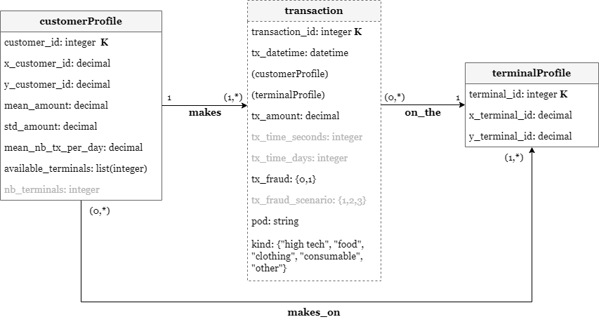
“Each transaction should be extended with the kind of products that have been bought through the transaction {high tech, food, clothing, consumable, other}. The values can be chosen randomly. “
4.1b

Slide 47
“Each transaction should be extended with the kind of products that have been bought through the transaction {high tech, food, clothing, consumable, other}. The values can be chosen randomly. “
4.1b
:auto
MATCH (tx:Transaction)
CALL{
WITH tx
WITH tx, apoc.text.random(1, '12345') AS r
WITH tx, r,
CASE
WHEN r='1' THEN 'high tech'
WHEN r='2' THEN 'food'
WHEN r='3' THEN 'clothing'
WHEN r='4' THEN 'consumable'
WHEN r='5' THEN 'other'
ELSE NULL
END AS kind
SET tx.kind=kind
} IN TRANSACTIONS
apoc.text.random() generates a random string taking as input a length parameter and an optional string of valid characters. We have provided a string of numbers with the following correlations.
Notes:
Considerations
The function apoc.text.random() generates a random string taking as input a length parameter and an optional string of valid characters. We have provided a string of numbers with the following correlations:
1 = high tech
2 = food
3 = clothing
4 = consumable
5 = other

Slide 48
“Each transaction should be extended with the kind of products that have been bought through the transaction {high tech, food, clothing, consumable, other}. The values can be chosen randomly. “
4.1b
Dataset 1 (small) | 12629 ms
Dataset 2 (medium) | 41299 ms
Dataset 3 (large) | 124398 ms

Slide 49
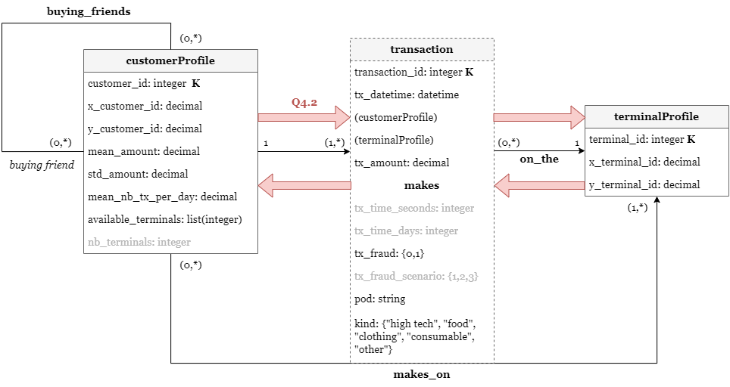
“Customers that make more than three transactions related to the same types of products from the same terminal should be connected as “buying_friends”. Therefore also this kind of relationship should be explicitly stored in the NOSQL database and can be queried. “
4.2

Slide 50
“Customers that make more than three transactions related to the same types of products from the same terminal should be connected as “buying_friends”. Therefore also this kind of relationship should be explicitly stored in the NOSQL database and can be queried. “
4.2
In this query we are going to be looking up transactions’ kind frequently. Therefore, for better performance, we have created an index on kind property for the Transaction node in the following way.
CREATE INDEX IF NOT EXISTS FOR (tx:Transaction) ON (tx.kind)
Query
MATCH (a:Customer)-[:MAKES]->(txa:Transaction)-[:ON_THE]->(t:Terminal)
WITH t, a, txa.kind AS kind, count(txa.id) AS nr_txa
MATCH (b:Customer)-[:MAKES]->(txb:Transaction)-[:ON_THE]->(t)
WHERE txb.kind=kind AND a.id<>b.id
WITH t, b, kind, count(txb.id) AS nr_txb, a, nr_txa
WHERE nr_txa>3 AND nr_txb>3
MERGE (a)-[:BUYING_FRIENDS]-(b)
The new relationship BUYING_FRIENDS is not oriented. Furthermore we have removed all the loops by considering only couples of customers different from each other. This consideration is applied by the condition a.id<>b.id.
Notes:
The new relationship BUYING_FRIENDS is not oriented. Furthermore we have removed all the loops by considering only couples of customers different from each other. This consideration is applied by the condition a.id<>b.id.
Query optimization
In this query we are going to be looking up transactions’ kind frequently. Therefore, for better performance, we have created an index on kind property for the Transaction node in the following way.

Slide 51
“Customers that make more than three transactions related to the same types of products from the same terminal should be connected as “buying_friends”. Therefore also this kind of relationship should be explicitly stored in the NOSQL database and can be queried. “
4.2
Dataset 1 (small) | 278817 ms
Dataset 2 (medium) | 307298 ms
Dataset 3 (large) | 642345 ms

Slide 52
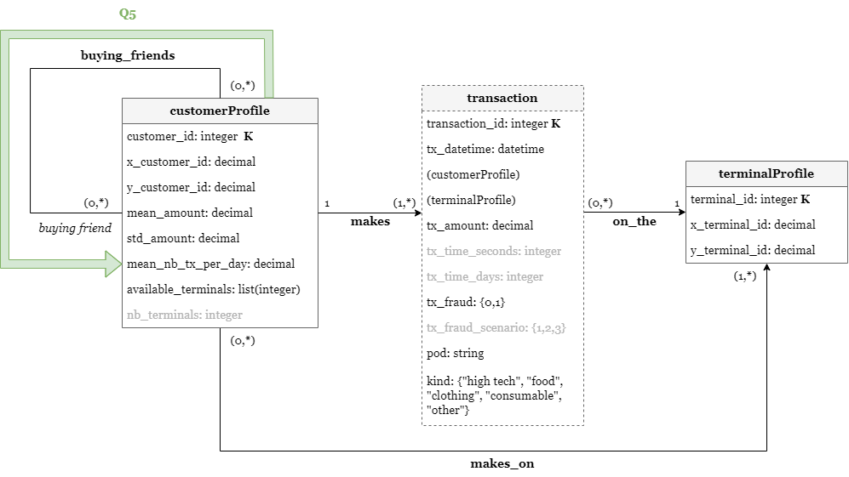
“Identify the buying-friend of degree K (i.e. the customers that are related through a chain of buying-friend relationships of degree K). Again, depending on the model the operations can become quite complicated. We expect that you write a script for K=4.”
5

Slide 53
“Identify the buying-friend of degree K (i.e. the customers that are related through a chain of buying-friend relationships of degree K). Again, depending on the model the operations can become quite complicated. We expect that you write a script for K=4.”
5
MATCH (c1:Customer)-[:BUYING_FRIENDS*4]-(c2:Customer)
WHERE c1.id<c2.id
RETURN DISTINCT c1.id, c2.id
Suppose that nodes c1 and c2 are buying-friends of degree K=4. The result of the query should not report both the pairs (c1, c2) and (c2, c1). Therefore we have added the condition WHERE c1.id<c2.id in order to obtain each pair only once. The idea is that for each node we have to look only at the nodes with an ID greater than its one because all the possible buying-friends with an ID lower than its one have been already returned.
Notes:
Suppose that nodes c₁ and c₂ are buying-friends of degree K=4. The result of the query should not report both the pairs (c₁, c₂) and (c₂, c₁). Therefore we have added the condition WHERE c1.id<c2.id in order to obtain each pair only once. The idea is that for each node we have to look only at the nodes with an ID greater than its one because all the possible buying-friends with an ID lower than its one have been already returned.

Slide 54
“Identify the buying-friend of degree K (i.e. the customers that are related through a chain of buying-friend relationships of degree K). Again, depending on the model the operations can become quite complicated. We expect that you write a script for K=4.”
5
Dataset 1 (small) | 648 ms
Dataset 2 (medium) | 704 ms
Dataset 3 (large) | 1856 ms
Notes:
Suppose that nodes c₁ and c₂ are buying-friends of degree K=4. The result of the query should not report both the pairs (c₁, c₂) and (c₂, c₁). Therefore we have added the condition WHERE c1.id<c2.id in order to obtain each pair only once. The idea is that for each node we have to look only at the nodes with an ID greater than its one because all the possible buying-friends with an ID lower than its one have been already returned.

Slide 55
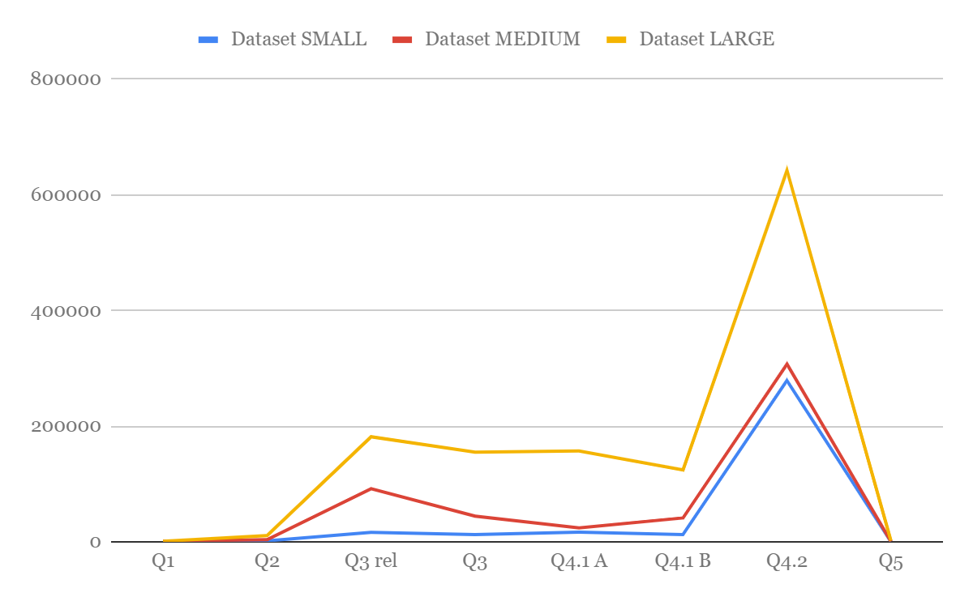
Queries

Slide 56

Thanks!
Do you have any questions?
You can find our project here:

