Slide 1
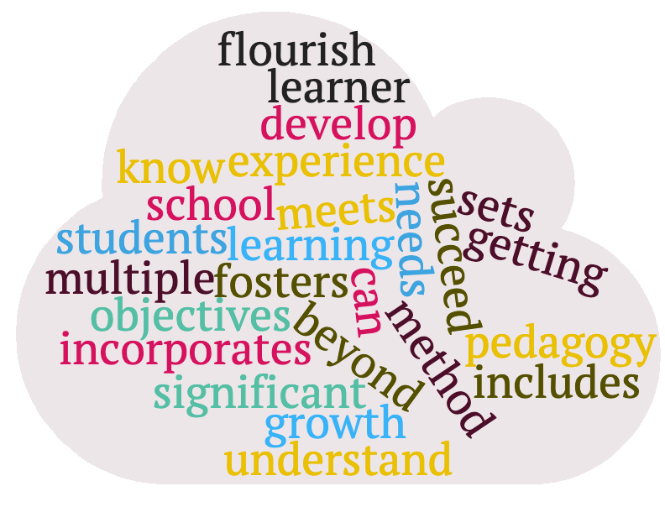
10 Transdisciplinary Ethical Future Focused Principles
Cindy Cheng, Christine D’Amico, Eric Thomas and Jamila Vorise
PFF 530, Summer 2020
Attention CGU Staff
It is time to move towards transdisciplinary, ethical, future focused teaching practices! Our presentation will teach you how to shift your classroom norms from information transmission. to full student engagement!
Definition of Transdisciplinary Pedagogy: This is an instructional method that incorporates the significant objectives of multiple disciplines. It is focused on design thinking, which includes getting to know and understand your students so that you can develop a learning experience that meets the needs of the learner, fosters growth and sets them up to flourish and succeed in school and beyond.
Multiliteracies to expand thoughts, modes and contexts
Transdisciplinary to explore topics through other lenses
UDL to provide options for leveled assignments
SAMR guides technology to move towards redefinition
Employ Outcome Based Assessment to measure learning
Build Community the process of implementing community building activities
Engagement - student led mini-lectures, transparent rubrics
Bloom’s and Fink’s Taxonomies - focus classwork on higher order assignments
Cynefin Frame to scaffold learning towards the complex/complicated
Communication/Oration include a mix of communication components to increase versatility in expressing effectively

