Slide 1
Homework 2
1. Save the source code as 0305_1.c, 0305_2.c, 0305_3.c.
2. Save the results by printing the screen and paste them into a PowerPoint file as 0305.pptx.
3. Compress the four files into a single ZIP file and upload to E3 platform.
Deadline: 03/19 1:00AM
The grade will be determined by 1. Correctness 2. Uploaded time.

Slide 2
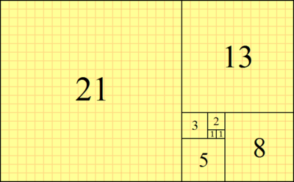
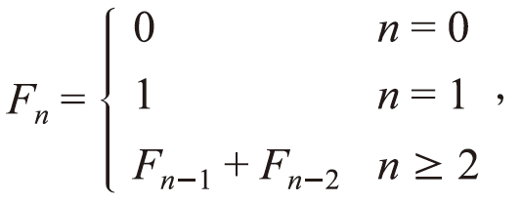
Program 1
Write a program in C or C++ to calculate the Fibonacci series fib(n) using a recursive function and get the results (six decimal places) of
fib(6) / fib(5)
fib(9) / fib(8)
fib(12) / fib(11)
The definition of the Fibonacci series is:
Golden rectangle
fib(n-1) : fib(n)= 1:1.618

Slide 3
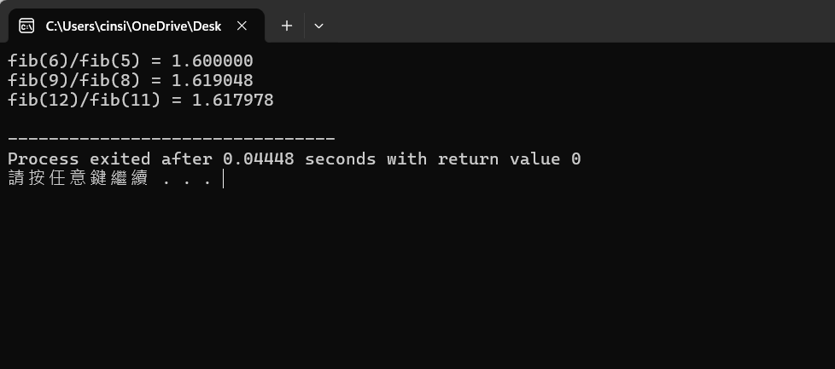
Program 1

Slide 4
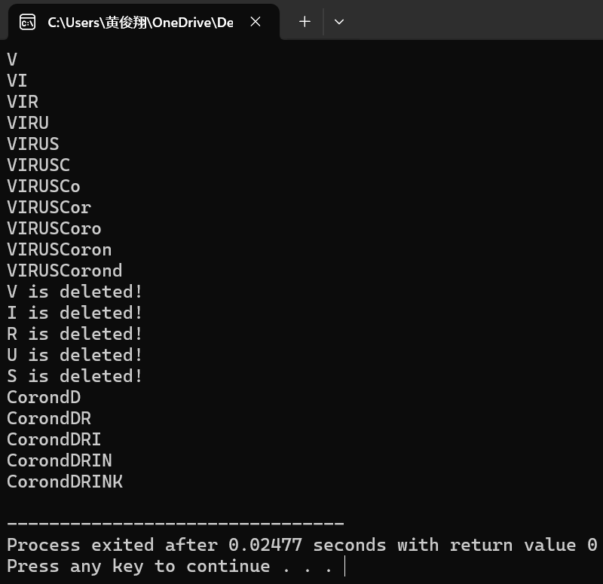
Program 2
Write a program in C or C++ to implement the circular queue structure by completing 0305_2.c (Please download it from the E3 platform).

Slide 5
Program 3
Write a program in C or C++ to evaluate a given infix arithmetic expression
Translate arithmetic expression from infix to postfix expression
Evaluate the postfix arithmetic expression
Operators: +, -, *, /, %
Operands: Positive integers from 0 to 9
Testing: 5*3-2+6/2-9%5+1

Slide 6
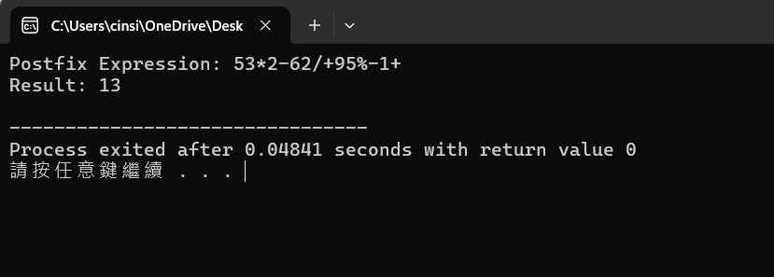
Program 3

