Slide 1
MINI PROJECT 1
NYKAA ANALYSIS

Slide 2
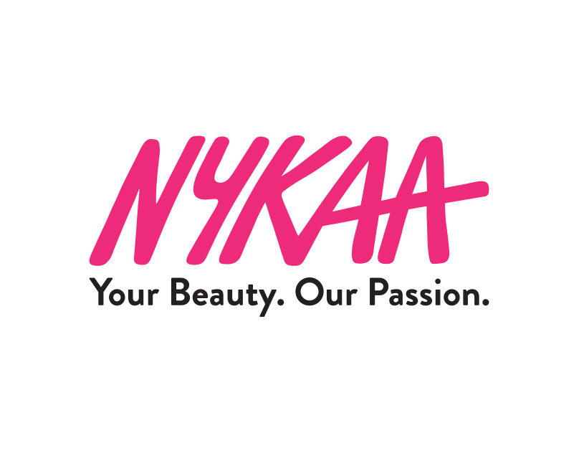
Nykaa – Your Beauty, Our Passion
Reflects the brand's commitment to empowering individuals to feel confident and beautiful. It shows that Nykaa is deeply passionate about offering quality beauty products and personalized care to its customers.

Slide 3
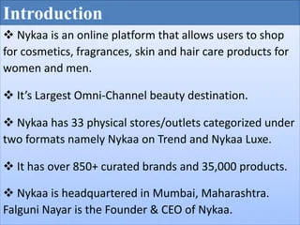
Nykaa is a leading online platform in India for beauty and wellness products. It offers a range of makeup, skincare, haircare, fragrances, and wellness products, including both Indian and international brands. Strengths:
Large variety of beauty products, trusted for authentic brands, beauty advice, and reviews. Popular For: Cosmetics, skincare, and haircare products.

Slide 4
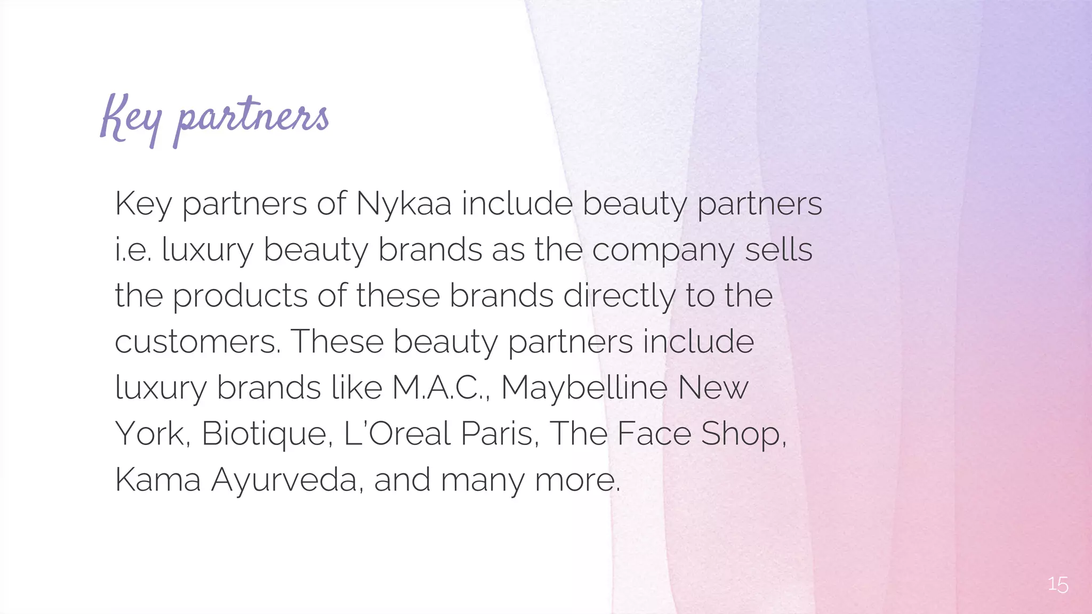
Dataset Overview:
Sources: Twitter, Instagram, Facebook, Google Reviews, Trustpilot, Nykaa product pages
Main Variables:
Review Sentiment: Positive, Negative, Neutral
Themes: Product Quality, Delivery, Customer Service
Fashion Trends: Emerging styles and preferences
Customer Satisfaction: Overall feedback on experience
Preprocessing Steps:
Remove irrelevant and duplicate posts
Verify and correct sentiment labels
Purpose:
Understand brand perception, key trends, and customer feedback
Benchmark Nykaa against competitors

Slide 5
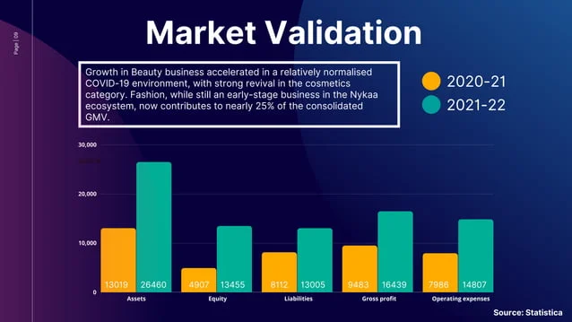
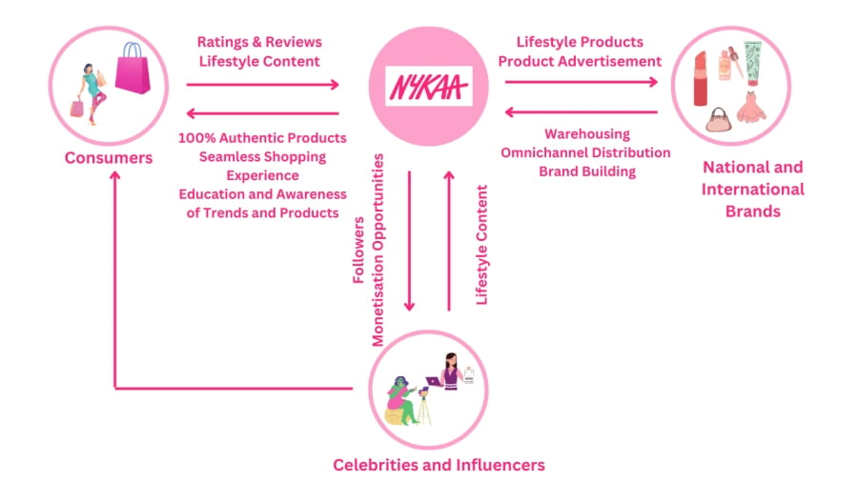

Slide 6
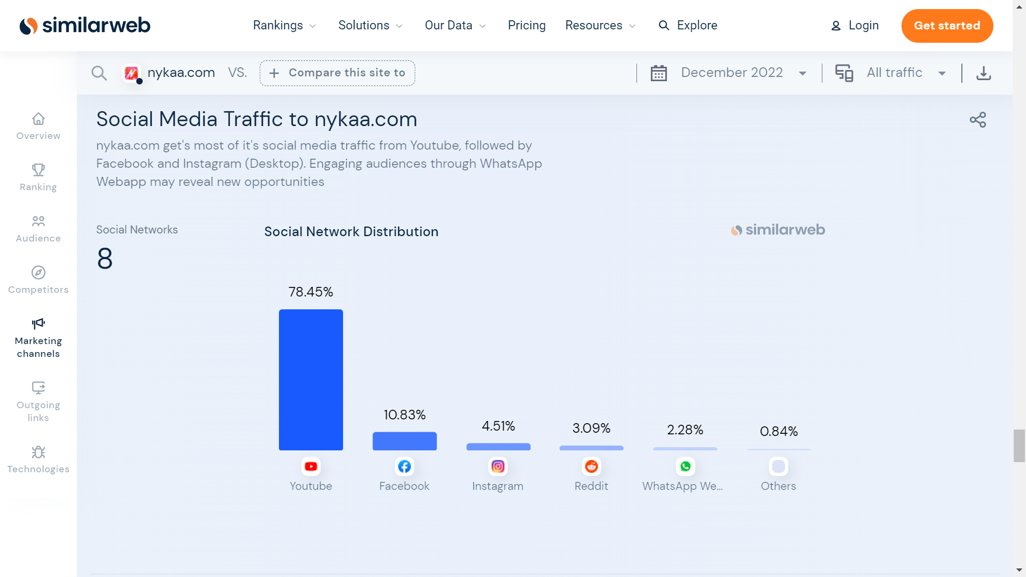
Step 1: Introduction to Social Media and Review Analysis

Slide 7
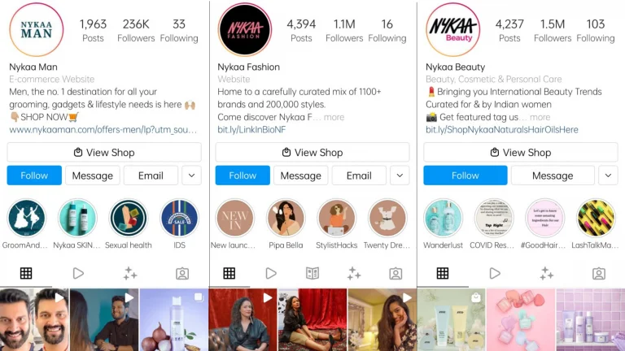
Nykaa’s social media and review analysis:
Nykaa utilizes social media marketing to engage customers and track brand perception.
Customer reviews highlight product quality and delivery service as key factors influencing satisfaction.

Slide 8
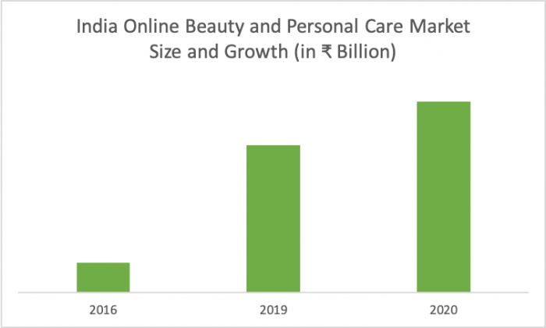
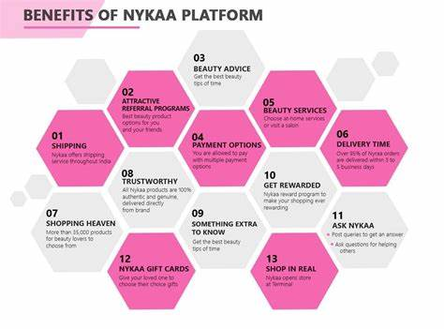
Step 2: Data collections

Slide 9
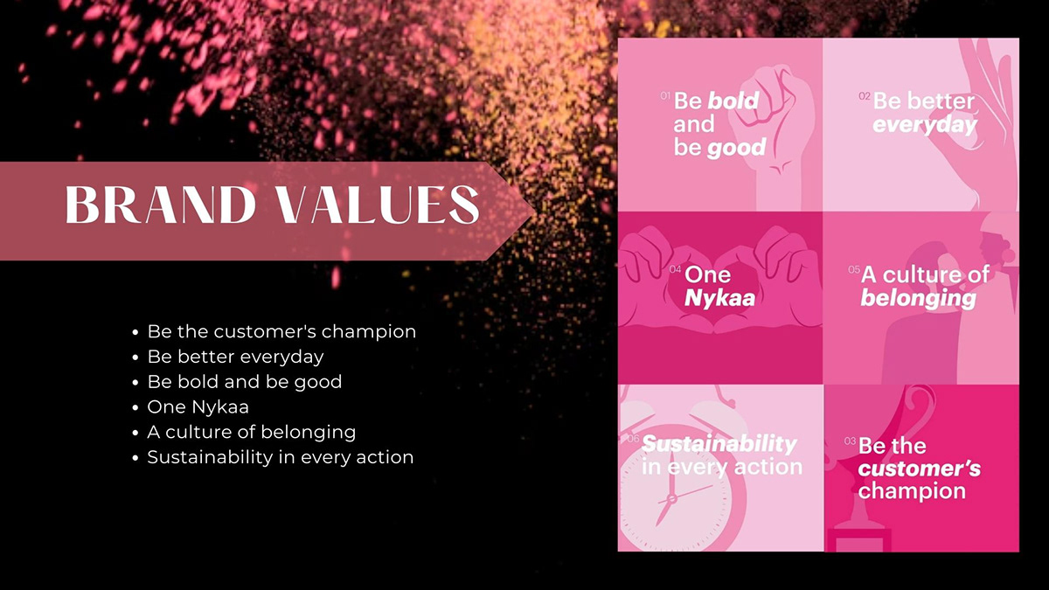
Step 3: Brand Perception Analysis
Understand how people feel about Nykaa by analyzing reviews and social media posts. This shows if the brand image is strong, trusted, and liked by customers.

Slide 10
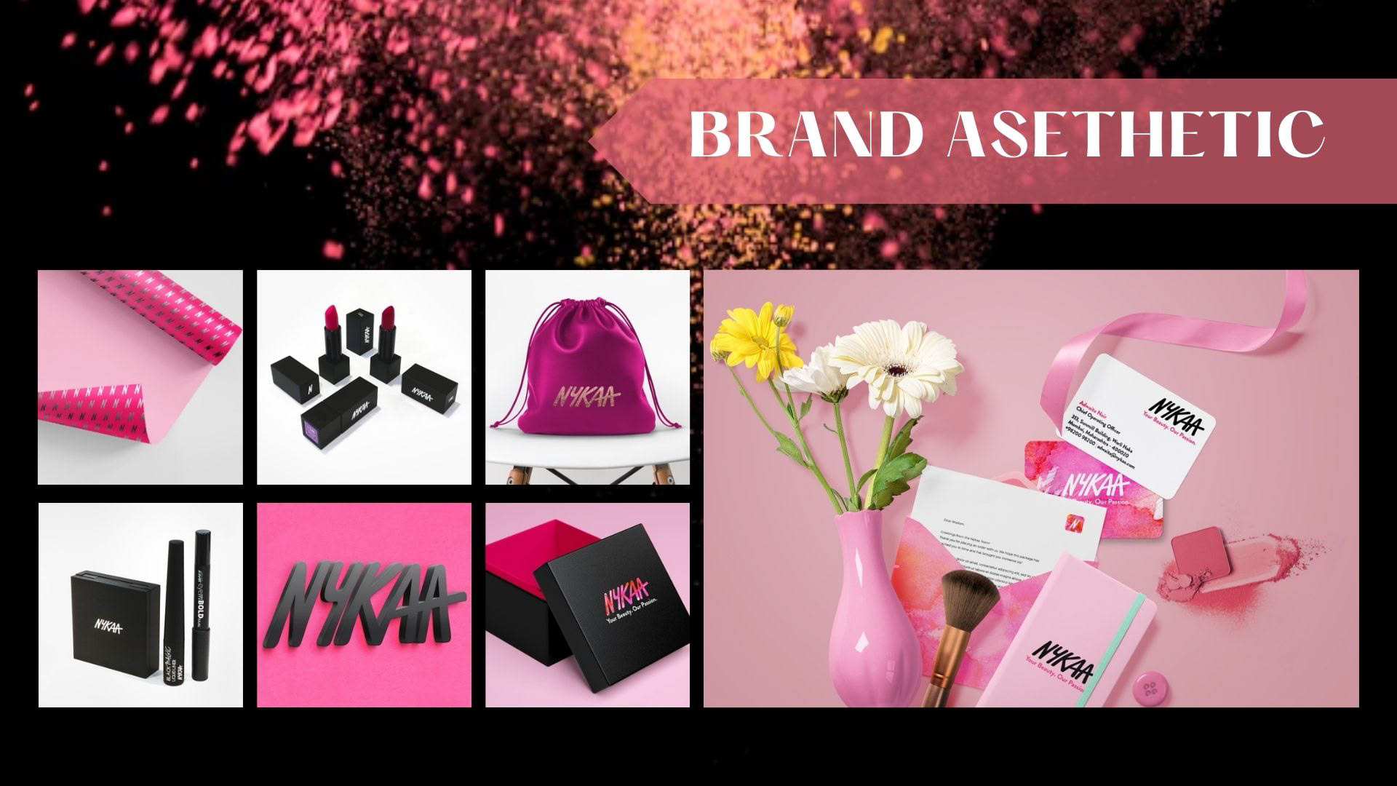

Slide 11
Step 4:
Nykaa Customer Review Analysis
Aspect | Positive Reviews | Negative Reviews
Employee Experience | Learning opportunities, good exposure | Work-life balance concerns, management issues
Customer Service | Wide range of products, good discounts | Delivery delays, refund issues
Product Quality | Variety of brands, authentic products | Damaged or expired products reported
User Experience | Easy-to-use app & website | Technical glitches, slow customer support

Slide 12
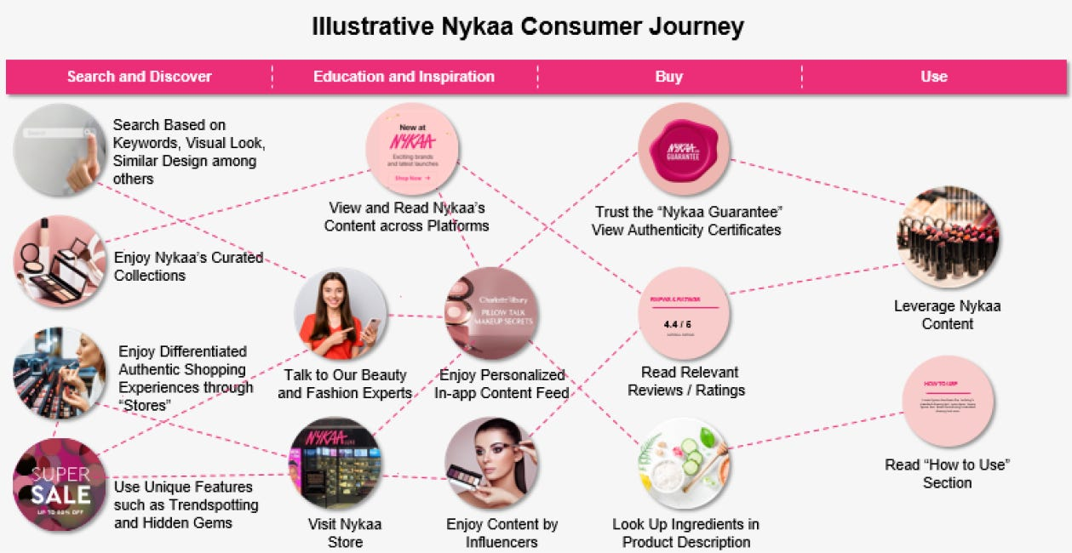

Slide 13
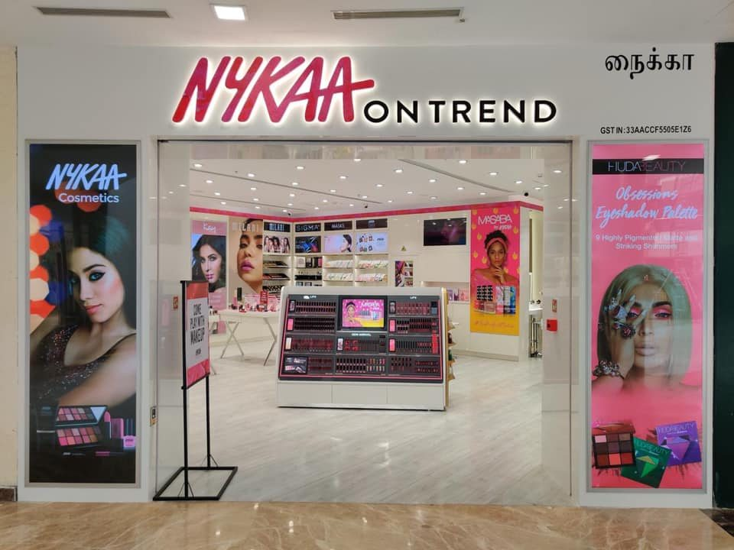
Step 5: Market Trends Identification

Slide 14
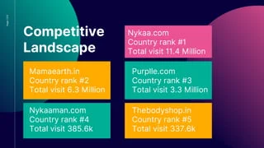
Step 6:Competitive Landscape Assessment
involves comparing Nykaa with platforms like Amazon Fashion, Flipkart, and AJIO to evaluate strengths and gaps. Key focus areas include customer satisfaction, variety of fashion products, and overall brand reach in the market.

Slide 15
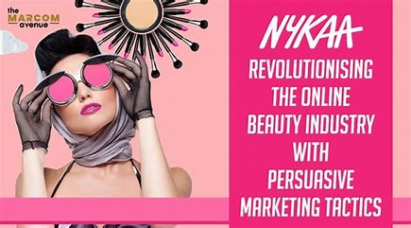
STEP 7:Strategic Recommendations
Are clear action plans to help Nykaa grow based on the analysis.This includes improving customer experience, expanding product variety, and boosting online visibility.

Slide 16
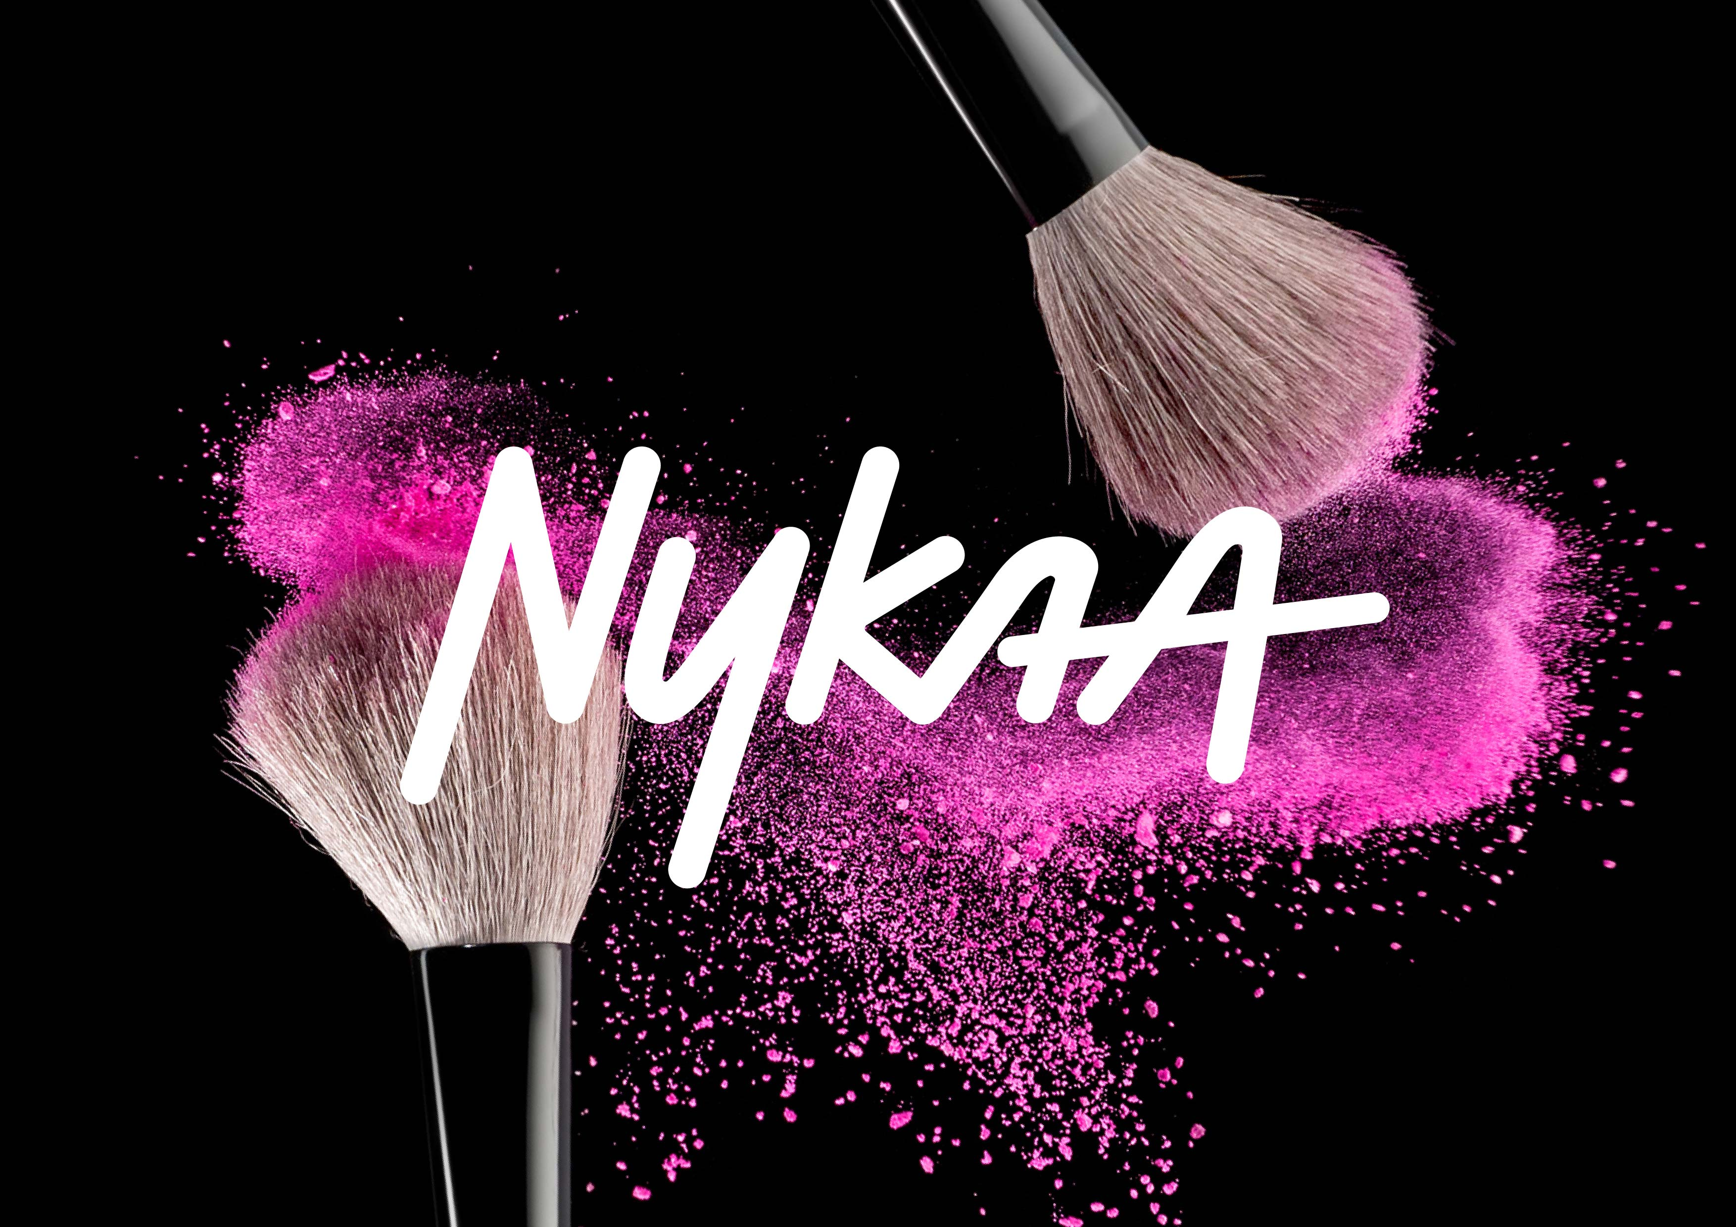
The Nykaa brand project revealed strong customer engagement on Instagram and positive sentiment on product pages, especially for skincare items. Trustpilot reviews highlighted consistent satisfaction with delivery and packaging. However, Twitter feedback pointed to occasional delays and customer service concerns.0

