Slide 1

Cintia Izumi Shinoda
Data Analyst Intern’s Tech Test

Slide 2
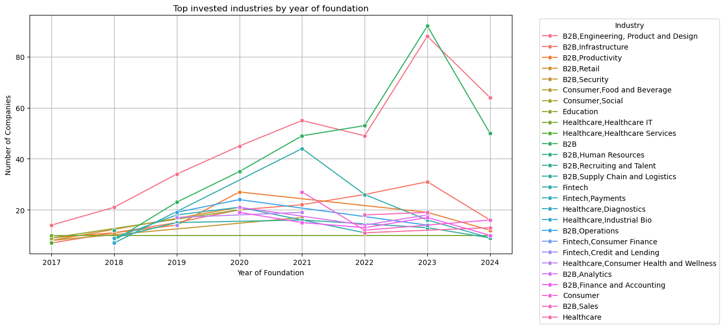
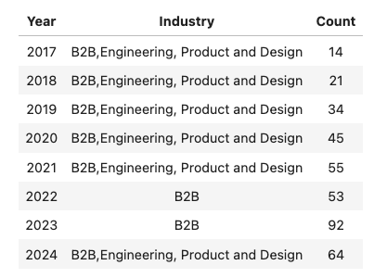
Landscape
The most invested industry
by year of foundation:
* The analysis focused on data from 2017 onwards, as significant variation becomes more apparent from this point

Slide 3
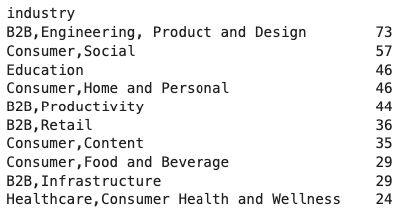
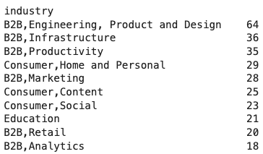
Industries
Top 10 unsuccessfull industries:
Top 10 successful industries:

Slide 4
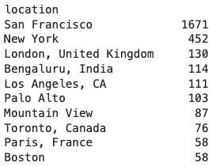
Characteristics:
Top 10 cities with the highest amount of founded companies:
Team size of successful companies:
Largest team size of successful companies: | 8600
Average team size of successful companies: | 104

Slide 5
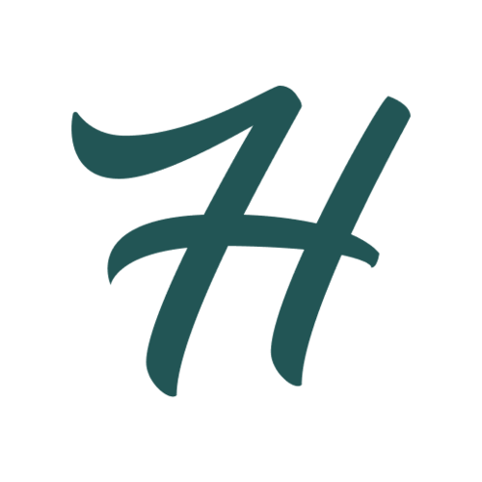

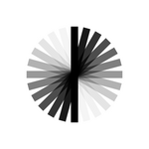
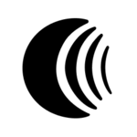
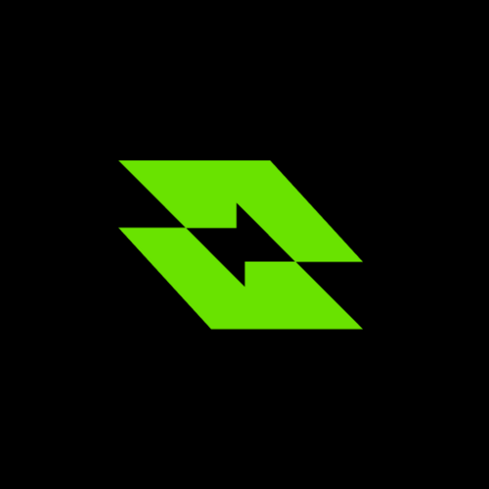
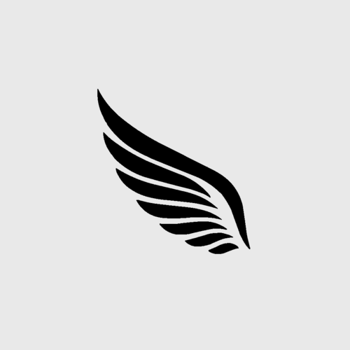
Where to invest
Industry to invest:
Based solely on the data from this dataset, I would invest in the “B2B, Engineering, Product, and Design” industry, as it has the highest nunber of newly founded companies, suggesting a strong demand for services provided by this sector.
However, it is also the industry with the highest number of companies marked as “Inactive”, which aligns with the fact that investing in startups in inherently high-risk.
Company to invest:
I would consider invest in the following companies:
HumanLayer
Fix AI
Andoria
Vocera
Replexica
(Codebuff)*
vly.ai
These companies participated in the most recent Y Combinator batch (Fall 2024), operate in the B2B, Engineering, Product, and Design industry, and are located in one of the top 10 cities with the highest number of founded companies.
* Codebuff was not found on the Y Combinator website

