Slide 1
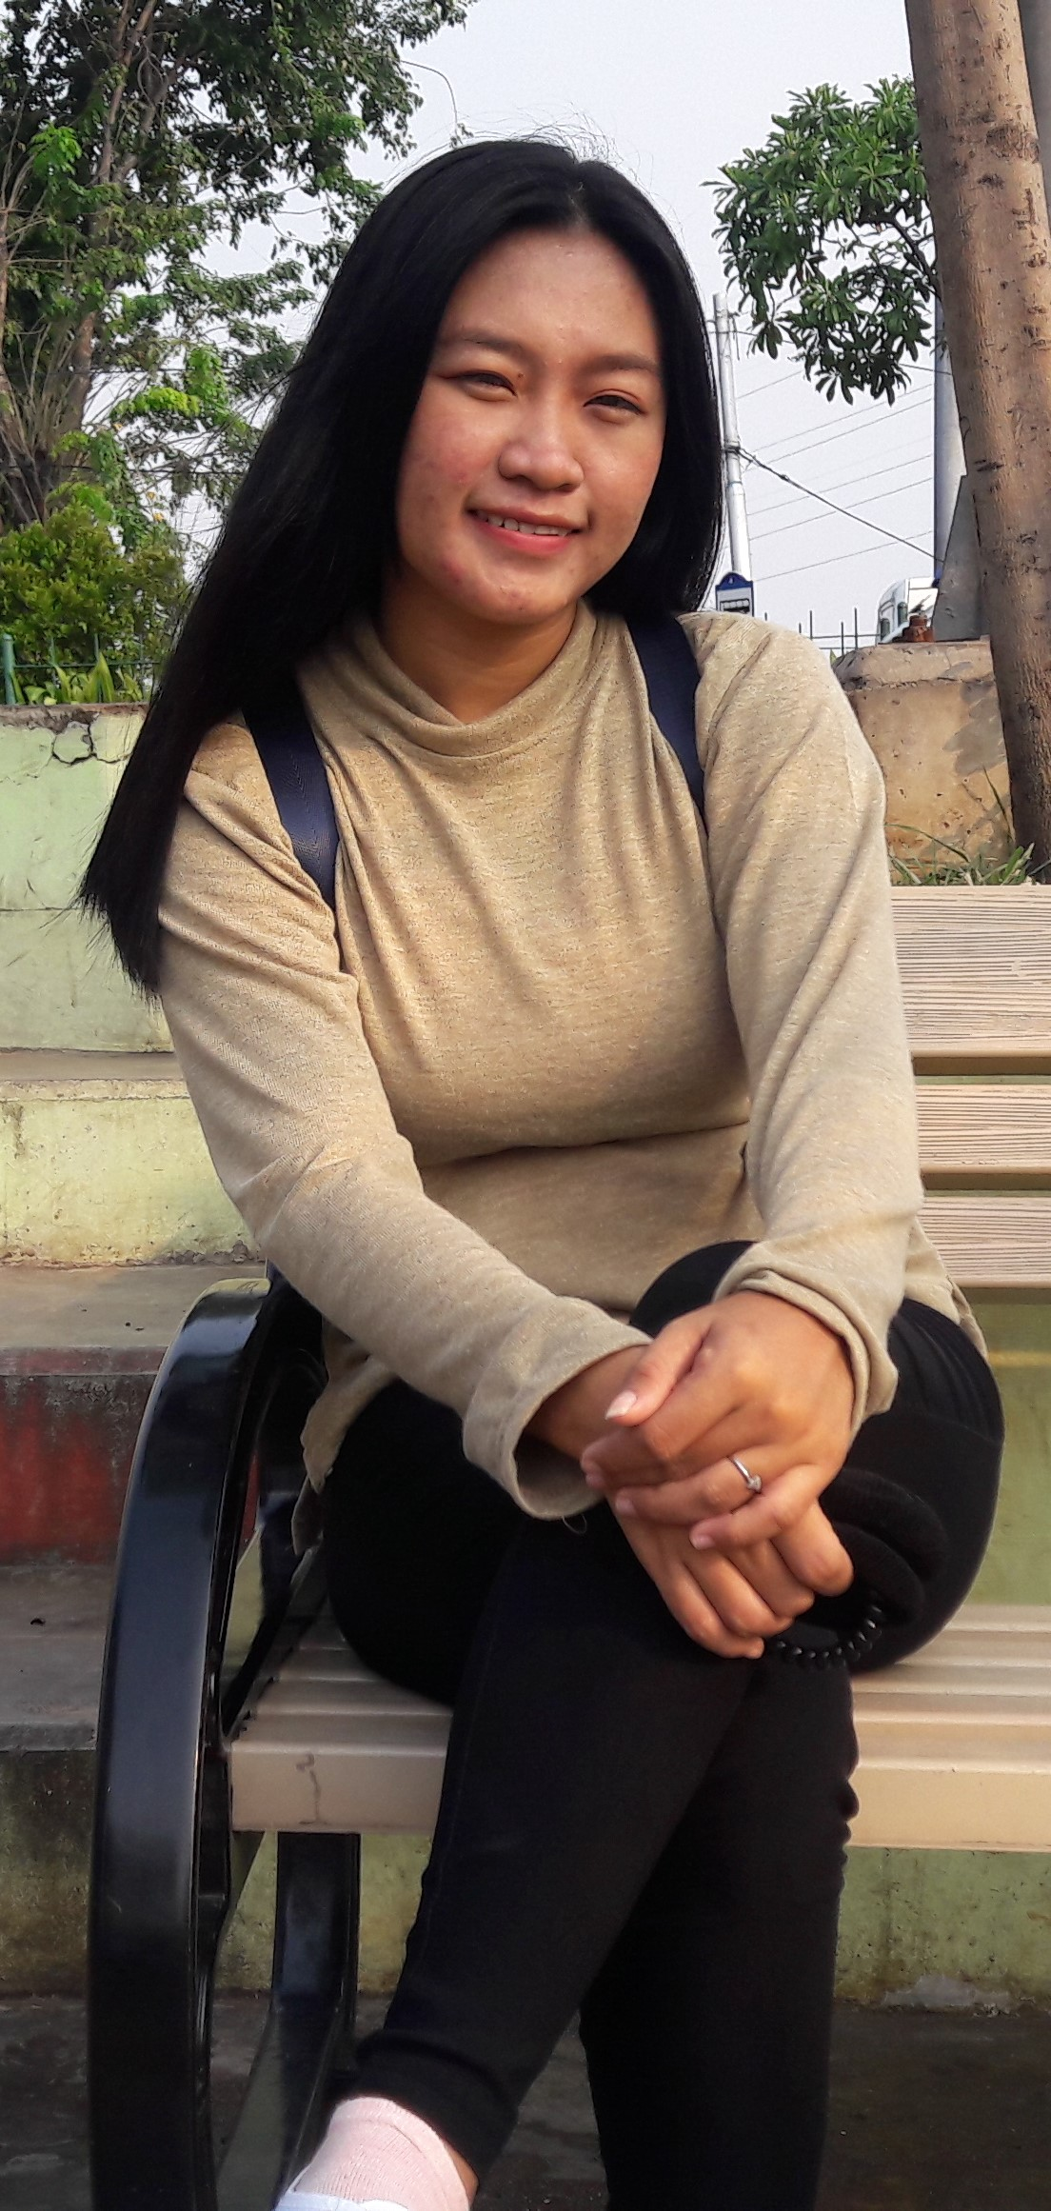




My Personal information Hello ,, My name is Cintia Febriana. I am 27 years old. I was born in Jakarta, February 3, 1993. I live in Kebon Jahe Rt 021 Rw 012 Kelurahan Kapuk, Cengkareng Subdistrict, West Jakarta. I have Indonesian Citizenship and My Religion is Christian. Currently I study at Gunadarma University Jakarta. My hobby is reading and aspirations I want to become a flight attendant late
Submission Web Pemula
Contact

