Slide 1
MDS and Clustering of Reddit Subreddit Posts
Dakota Cintron

Slide 2
Reddit & Subreddits
Reddit is an entertainment, social news networking service, and news website
Subreddits are essentially forums on different topics
Notes:
Reddit is an entertainment, social news networking service, and news website
Reddit community members can submit content such as text posts, or direct links
Essentially an online bulletin board system
Users can upvote and downvote posts
Subreddits are essentially forums on different topics
Over 5,000 subreddits listed on redditlist.con
Many different topics
Redditlist provides rank of subreddits sorted by number of subscribers
Also provides other measures of subreddits including recent activity and growth(24hrs)

Slide 3
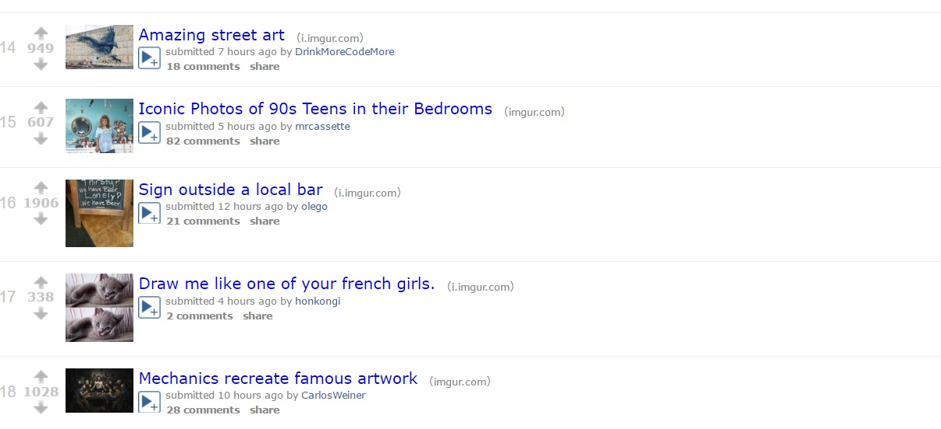

Slide 4
Goals
Explore the (dis)-similarity of 14 highly subscribed to subreddits:
AskReddit
Funny
TodayILearned (TIL)
Pics
Science
Worldnews
IAmA
Videos
Gaming
Movies
Aww
News
AskScience
Television

Slide 5
Methods
Employ python and scrapy framework to obtain as many post titles as possible from each subreddit
Uses “spiders” , “selectors, & “regex” to navigate webpage HTML
Employ text analysis methods in R to clean the data
Identify the number of unique words
Identify frequently used words
Make word clouds
Use r packages tm and wordcloud
Use number of words shared between subreddits as measure of similarity
The greater the # of shared words, the more similar the subreddits
Employ MDS (SMACOF in R) & Clustering Methods

Slide 6
Text Objects in R

Slide 7
> review_text.asi [1] "How do fruits \"know\" that animals spread their seeds?,RichardsIsGod How were the very first computer languages/operating systems coded?,HungoverHero777 Why do some people's bruises readily appear while others hardly show?,FarFromAmusing What are the biological/pharmacological mechanics involved that cause tinnitus (ototoxicity) to occur after taking antibiotics i.e. vancomycin/cephalexin?,xRAPIERx How do nuclear power plants draw and convert energy for our use?,Dazd95 If there is no \"absolute\" velocity, how can we determine centripetal force?,Huugnuut Is the set of all countably infinite sets countably infinite?,N0TaCreativeUsername When looking at pictures of Earth taken from space, why do you see only black and no stars?,romfus87 Is there any particular reason that some planets rotate very fast on their axis, while others rotate slowly?,ed123dead Why does excessive wing angle of attack (AoA) cause roll?,accounttoberacist Do light waves cast a shadow?,GOD_DAM_IT Is there a liquid with the same density of our atmosphere at 1 atm? If so, would a glass full of it not experience refraction?,ColonolCool How do microbes in the human body survive our immune systems?,ChainedBroletariat Can you charge your phone from a plant? Is this legit?,EyePad Why does the carboniferous period have a mean surface temp equal or lower than today, when it had 2x the atmospheric CO2?,Snaz5 Why does light change direction when it refracts?,pynoobpy AskScience AMA Series: I'm Alexis Kaushansky, a Principal Investigator at the Center for Infectious Disease Research in Seattle, WA. I research malaria and the interactions between host and pathogens. Iâ€™m excited to talk to you about it. AMA!,CIDResearch Why do people change the tone of their voice depending on who their talking to?,Mellow-as-fuk Why is the counterweight arm of a trebuchet always shorter than the sling/launching
Notes:
- Mention this is an uncleaned version of the text
- Mention the presence of user tags & that the text is from AskScience section

Slide 8
> head(frequency.tvs, n=20)
show season new series game thrones discussion shows netflix
64 51 43 37 30 29 27 27 22
one anyone thread best dead like star television time
19 17 17 16 16 16 16 16 16
will prince
16 15
Notes:
- Cleaned version of the text
- Top twenty words for television subreddit

Slide 9
Results
Subreddit | Pages Captured | Posts Captured | Top 5 Words | Unique Words
AskReddit | 39 | 907 | Whats reddit thing youve ever | 2752
Funny | 36 | 828 | just like dog dont new | 2422
TodayILearned | 35 | 802 | til one first people can | 6367
Pics | 36 | 884 | found like just one picture | 3178
Science | 33 | 756 | new study researchers scientists may | 5052
Worldnews | 36 | 857 | new says china police will | 4120
IAmA | 29 | 669 | ama request iama ask author | 3267
Videos | 33 | 773 | video new first ever like | 2982
Gaming | 34 | 779 | game dark souls games new | 2591
Movies | 34 | 789 | movie movies film one best | 3356
Aww | 39 | 924 | little dog just meet cat | 2445
News | 23 | 516 | man new police says found | 2903
AskScience | 41 | 974 | can like black mass different | 4010
Television | 26 | 598 | show season new series game | 2833
Notes:
Post and pages captured not necessarily related to unique words

Slide 10
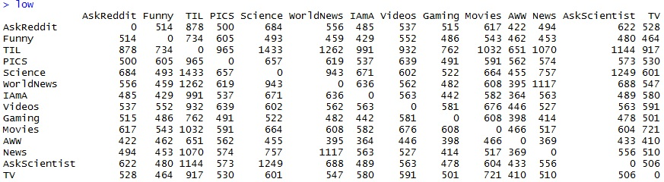
Matrix of Similarities

Slide 11
Notes on Similarities
TIL & Science most similar
1143 matched words
AWW and IAmA least similar
364 matched words
TIL very similar to many of other subreddits (assuming this is driven by # of unique words in TIL)

Slide 12
Word Cloud Examples

Slide 13


Slide 14
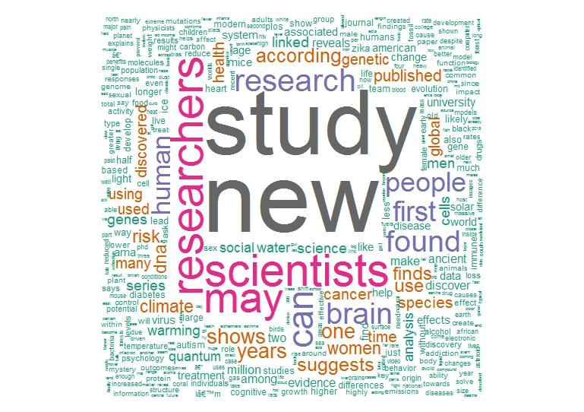
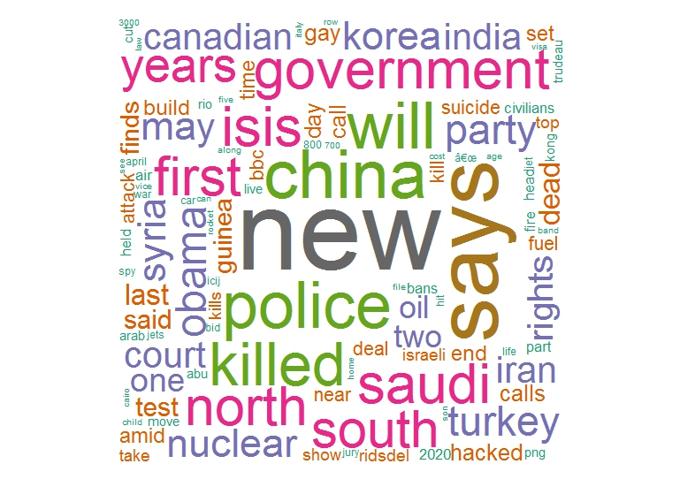

Slide 15
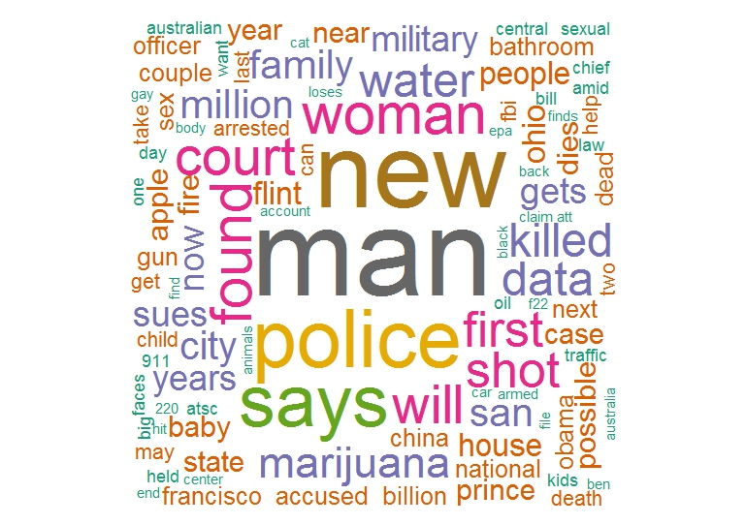

Slide 16
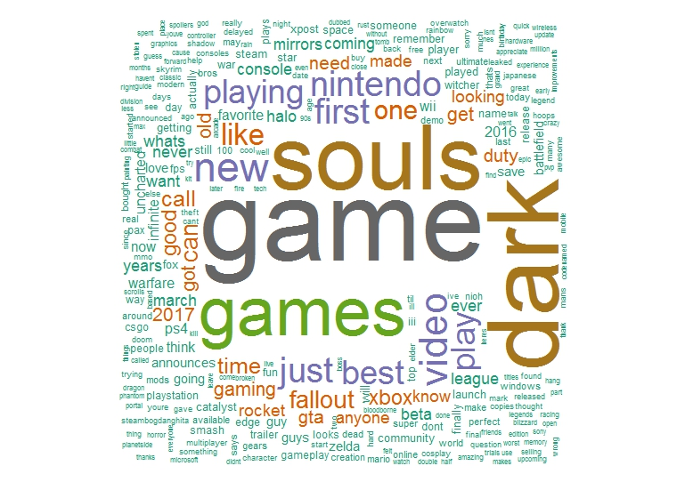

Slide 17
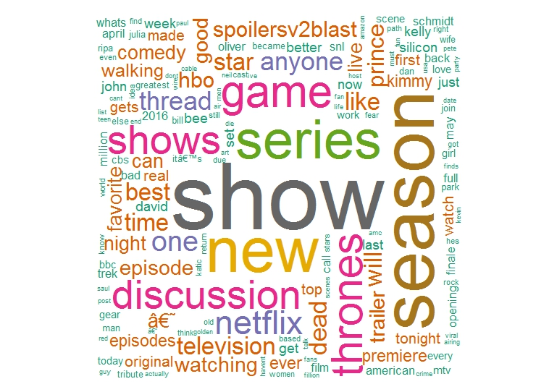

Slide 18
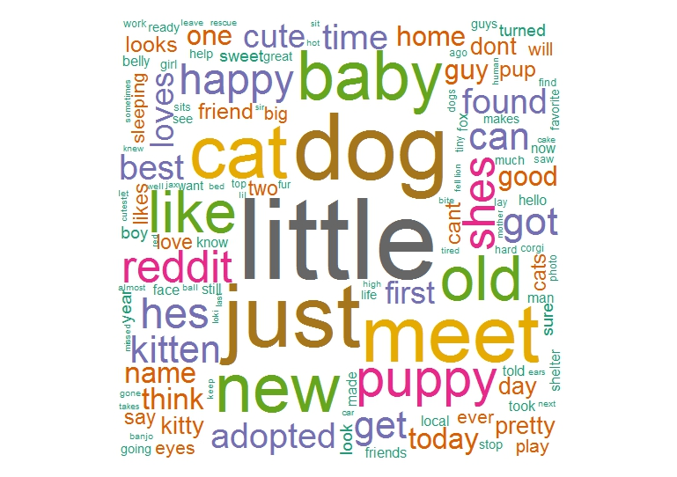

Slide 19
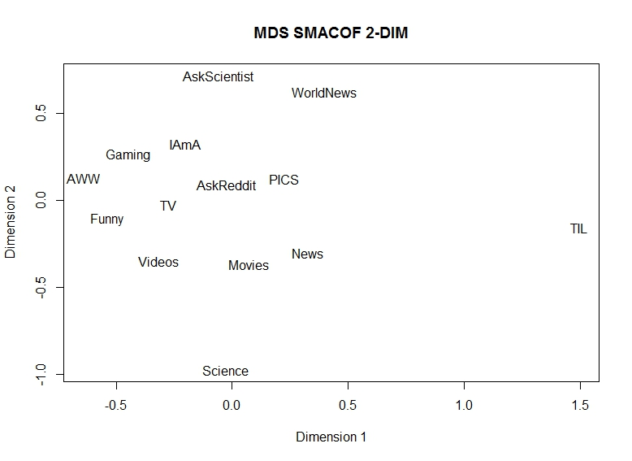
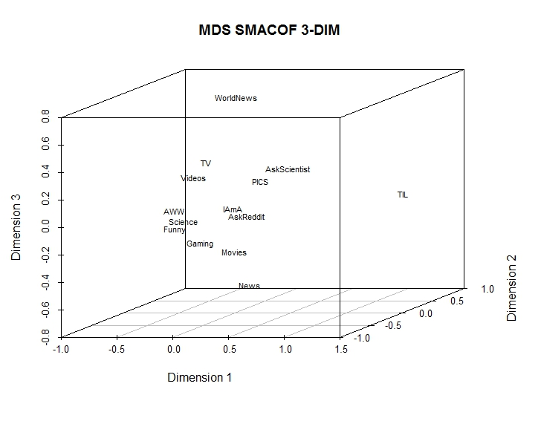
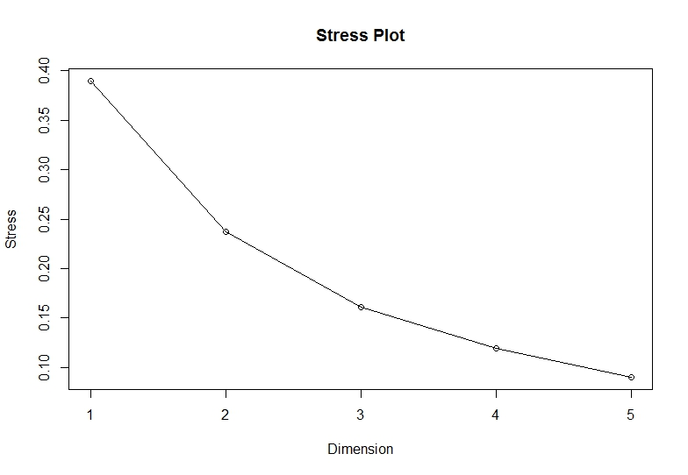
MDS

Slide 20
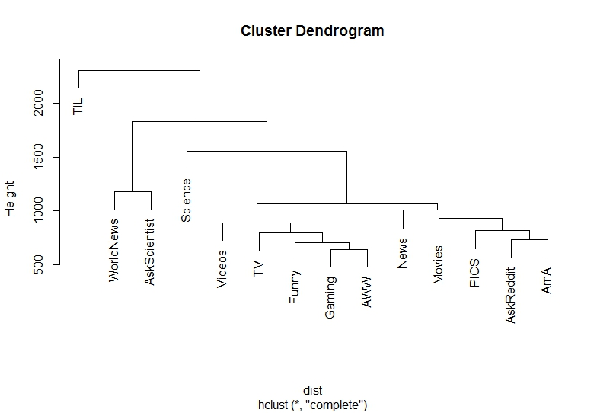
Hierarchical Clustering

Slide 21
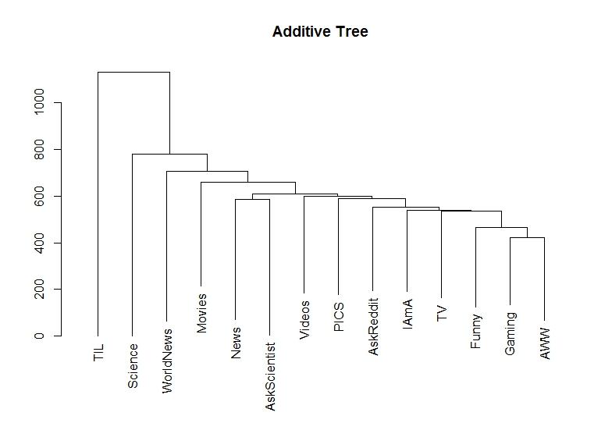
Additive Tree

Slide 22
Conclusions
We can see that the Additive Tree and Hierarchical Clustering solutions produced sensible clusters
Videos/TV
Movies/Pics
AskReddit/IAmA
The 2-Dimension MDS results showed:
Dimension 1: possibly a measure of number of unique words in subreddit
Dimension 2: possibly a measure of overlap between subreddits

Slide 23
Conclusions
Limitations:
No control on number of pages and posts captured
Do not have the universe of posts on Reddit
Temporal effect
Gaming for instance mentions “Dark Souls” a game recently released
TV mentions “Game” and “Thrones” a show recently released
Don’t understand python & scrapy fluently
Directions for Future Research
Include comments from subreddit posts
Consider other measures of similarity between subreddits
Study username patterns (SNA)
Examine change in word use patterns

Slide 24
Questions?

