Slide 1
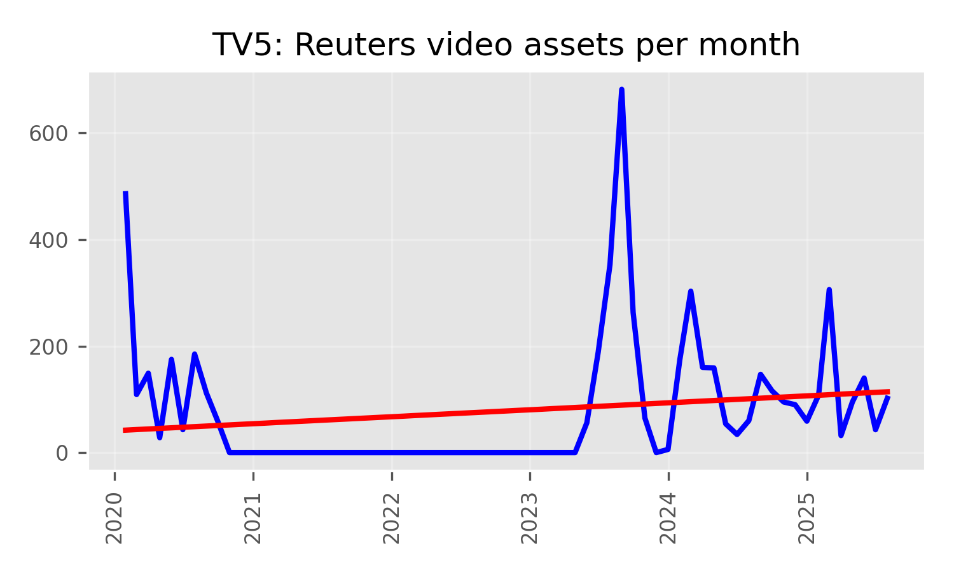
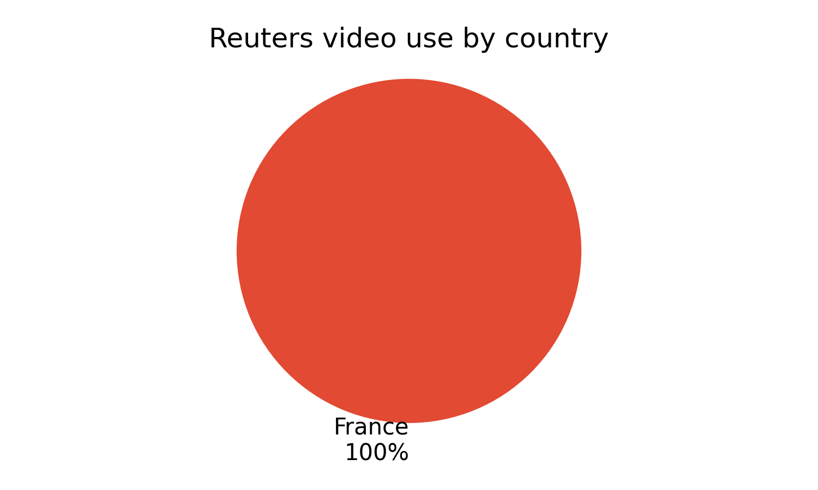
TV5's use of Reuters video progressed its gentle downwards trend in 2025, which has seen baseline usage gentle in the last 5 years.
It remains very reliant on Reuters video for coverage from the US and used nearly 5,237 video assets from 1 countries.
Major stories
• CONGO: 20.1%
• SENEGAL: 14.6%
• NIGER: 14.1%
Of all detections of Reuters video on TV5 in 2025.

