Slide 1

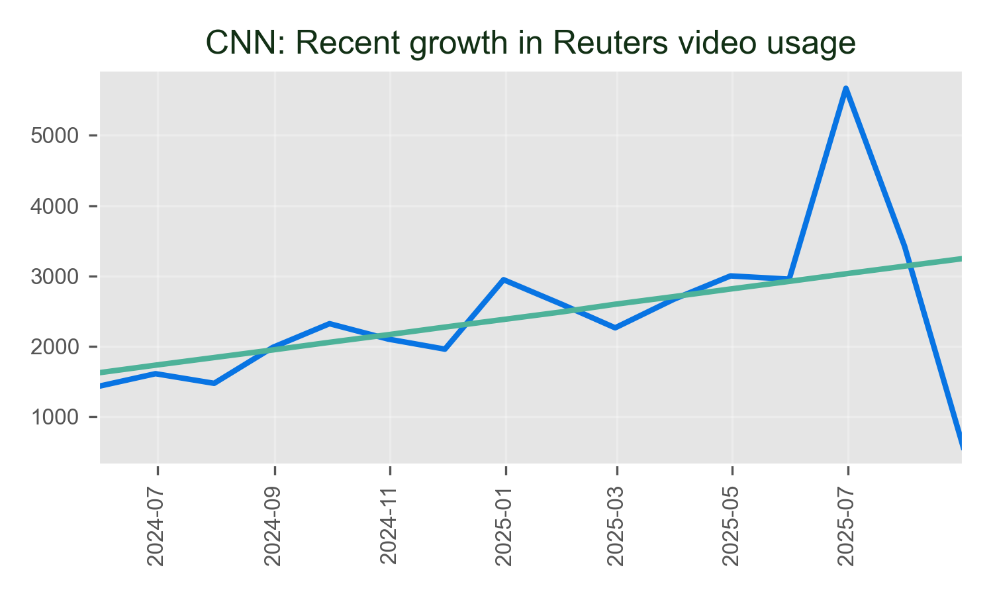
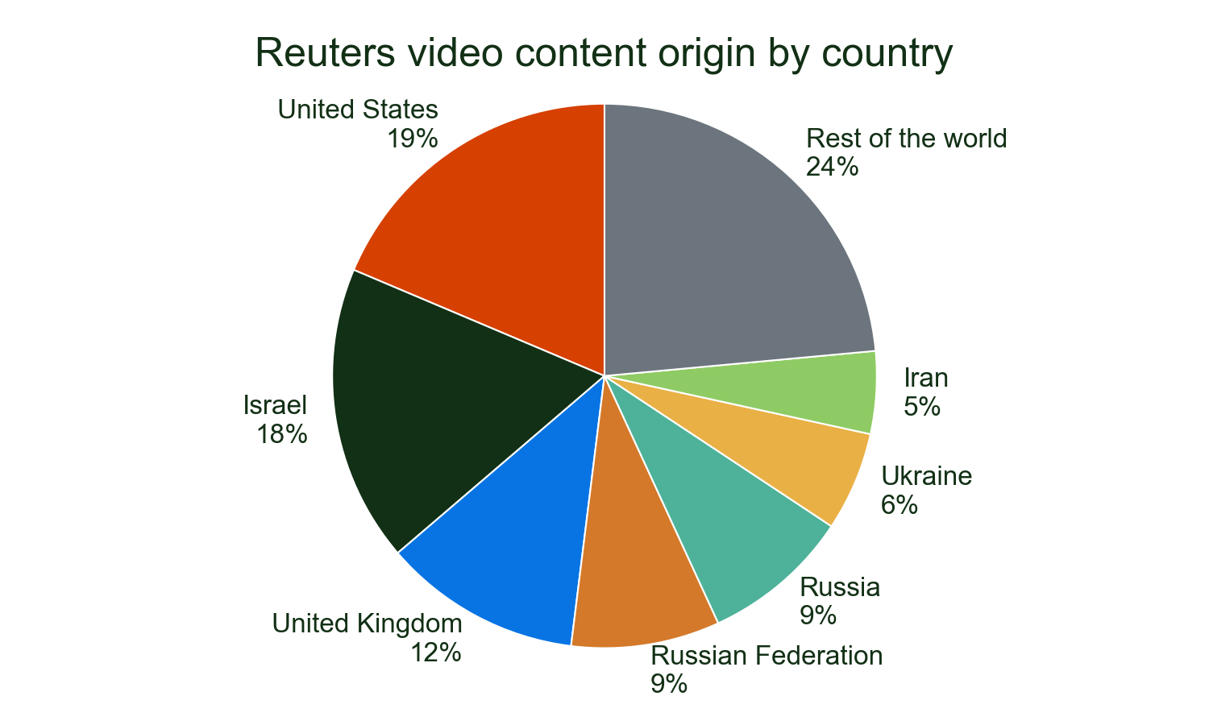
CNN continues to demonstrate strong engagement with Reuters premium video content, with over 65,000 detections showcasing the enduring value of our strategic partnership. This substantial usage reflects CNN's trust in Reuters as a reliable source for breaking news and critical global coverage, particularly during major international events.
Reuters content has been instrumental in CNN's coverage of the most significant global stories, including comprehensive reporting on Israel and Ukraine developments. Our partnership ensures CNN has access to Reuters' unparalleled newsgathering network, delivering authoritative video content that keeps their audiences informed on the world's most important events.
Major stories
• ISRAEL: 25.9%
• UKRAINE: 9.8%
• ADVISORY ISRAEL: 9.4%
Of all detections of Reuters video on CNN in 2025.

