Slide 1

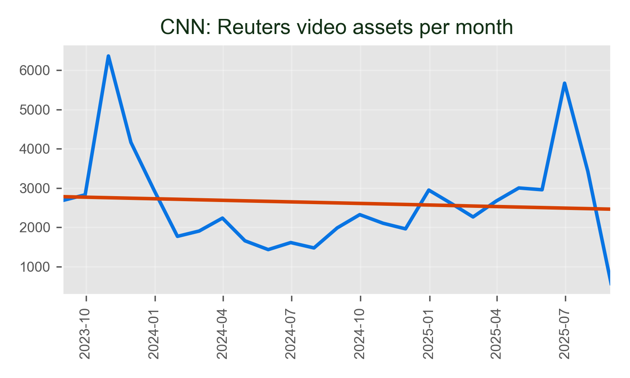
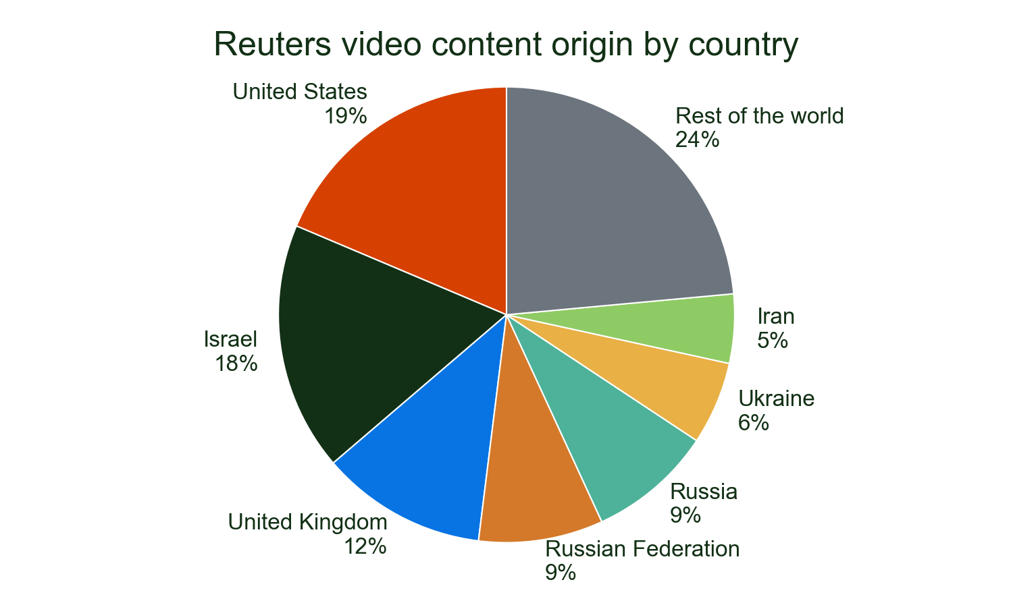
CNN's use of Reuters video progressed its gentle upwards trend in 2025, which has seen baseline usage gentle in the last 2 years.
It remains very reliant on Reuters video for coverage from the US and used nearly 65,509 video assets from 1 countries.
Major stories
• ISRAEL: 25.9%
• UKRAINE: 9.8%
• ADVISORY ISRAEL: 9.4%
Of all detections of Reuters video on CNN in 2025.

