Slide 1
Online Safety
Why it matters & what to know!

Slide 2
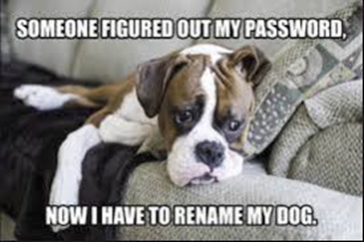
TOPICS:
PASSPHRASES
PERSONAL INFORMATION/Emails
SAFE DOWNLOADS
SAFE BROWSING
VPNs

Slide 3
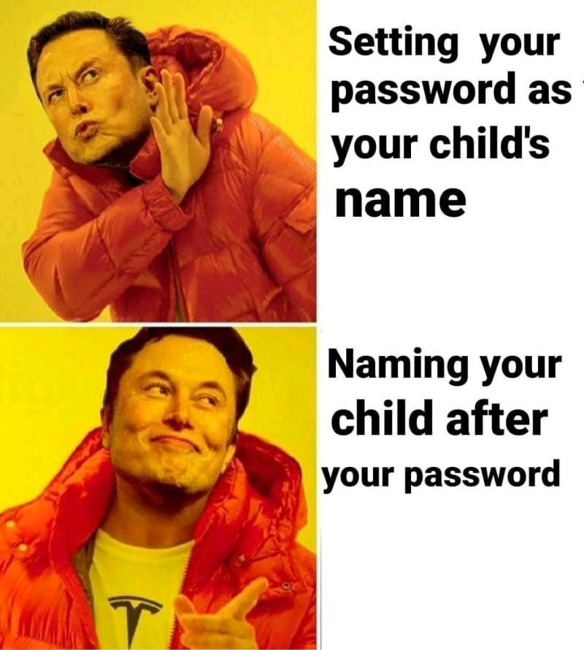
PASSPHRASES
Forget the word password.
PHRASES >> WORD
Good: Bad:
teamUSAolympics2021
cyberCyyberccyber
Good4youyoulookhappy
ctf{phrases_not_words}
Password
1234567890
<lastname,firstname>
Test123
New0000

Slide 4
Password Cracking demo:
https://www.betterbuys.com/estimating-password-cracking-times/
Other password cracking/Bruteforcing tools:
JohnTheRipper
Hashcat
Brutus
Medusa

Slide 5
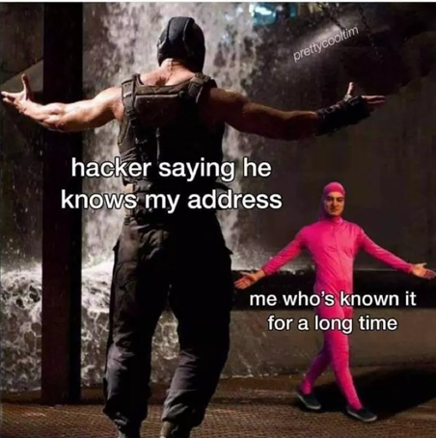
PERSONAL INFORMATION
If you put it out there, it will stay there!
Especially home address, Phone number & email accounts
Email accounts: Once you start signing up for important things, use a spam email account to sign up for non-important accounts.
For example: Banking, School Account, anything with Payment Info.
Vs Game accounts, Blogs, Social media
Check out https://haveibeenpwned.com/ if your email has been included in a breach

Slide 6
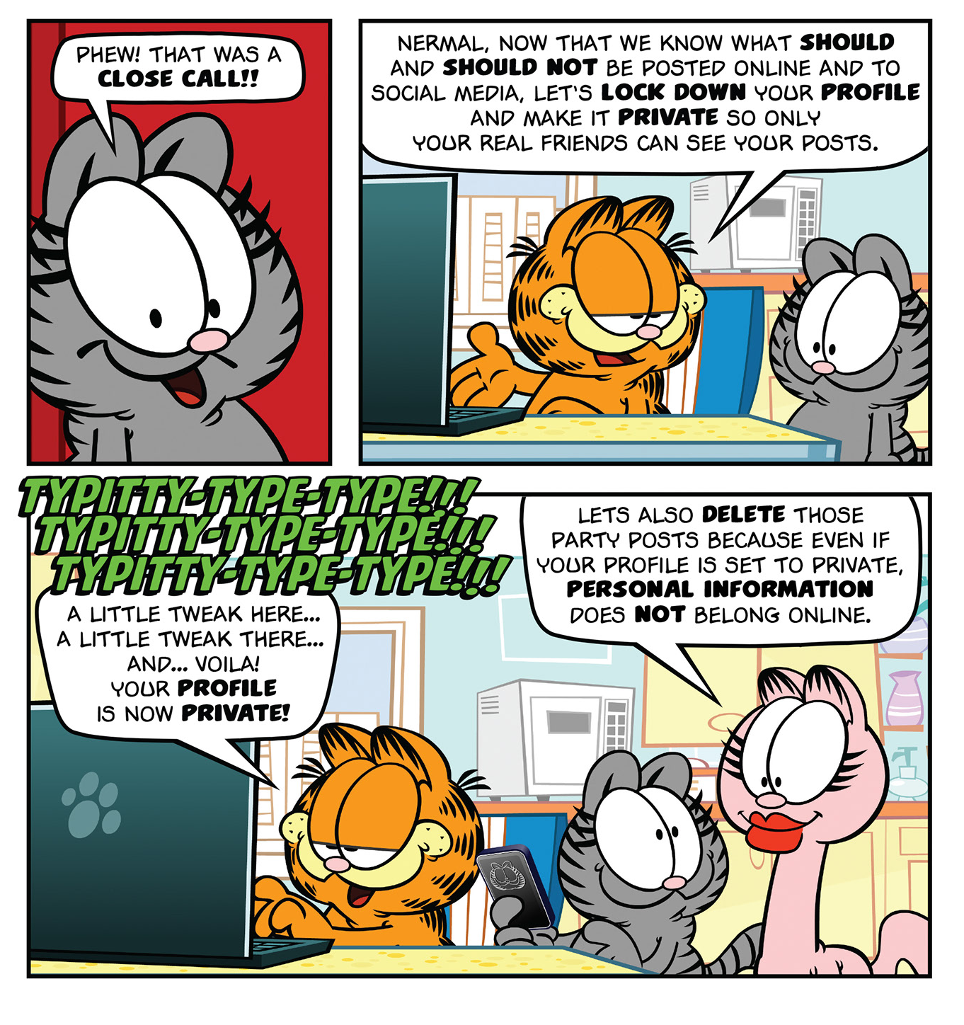
Demo:
Have I been pwned?

Slide 7
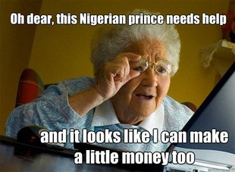
SAFE DOWNLOADS
Ask an Adult first, better safe than sorry.
Use a link-checker like
https://www.psafe.com/dfndr-lab/
Download from Secure sites only, Don’t just
download from a search result

Slide 8
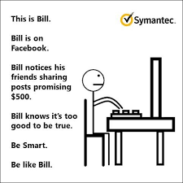
Safe Browsing
Browsers can store a lot of information on you
Take time to review the privacy and ad settings
When using payments, look for the lock!
HTTP vs HTTPS

Slide 9

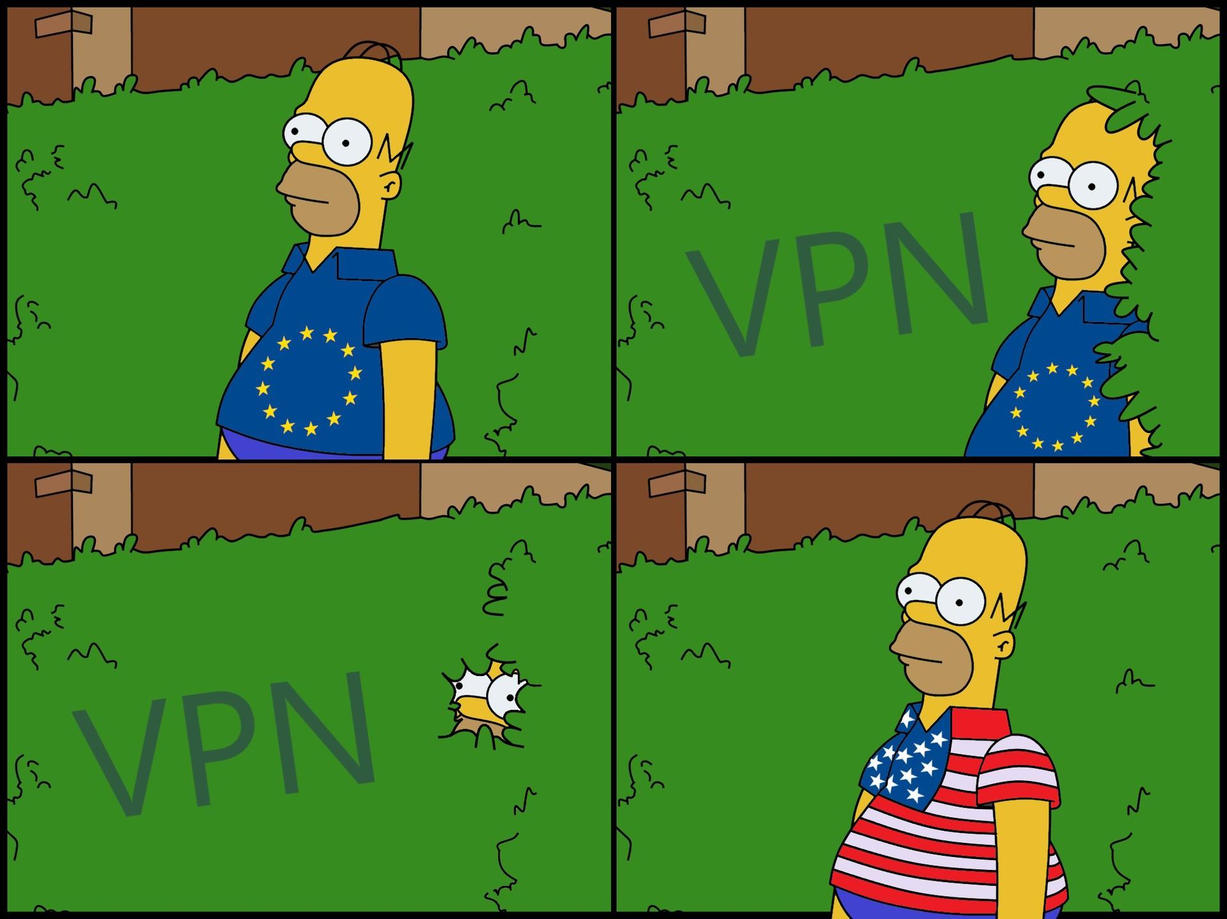
VPNs
Virtual Private network
VPNs obscure or hide the data that you are sending on the internet!
Great for use on public networks where you might not know who’s listening
People can still see the traffic, but just see it as VPN traffic.

