Slide 1
Online Safety
Why it matters & what to know!

Slide 2
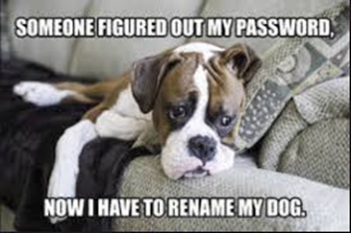
TOPICS:
PASSPHRASES
PERSONAL INFORMATION/Emails
SAFE DOWNLOADS
BROWSER & VPNs

Slide 3
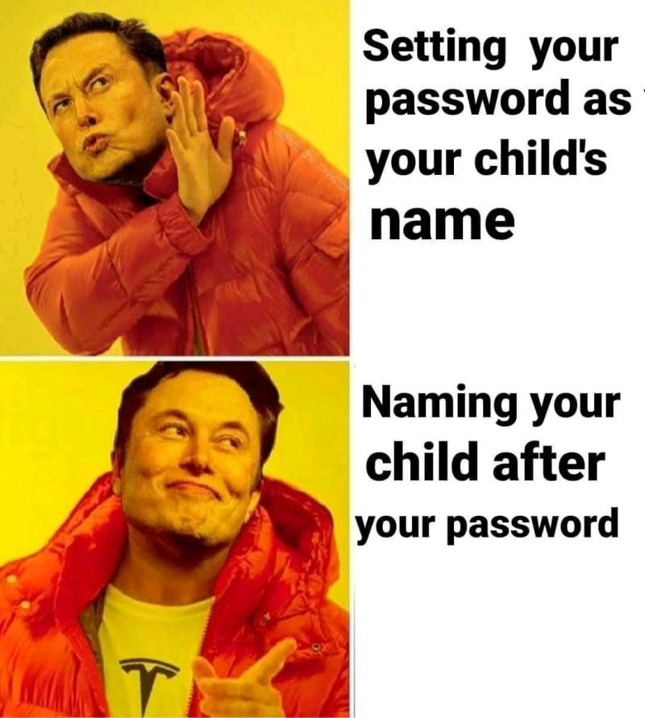
PASSPHRASES
Forget the word password.
PHRASES >> WORD
Good: Bad:
fortn!teWarzone
cyberCyyberccyber
good4youyoulookhappy
Password
1234567890
<lastname,firstname>
Test123
New0000

Slide 4
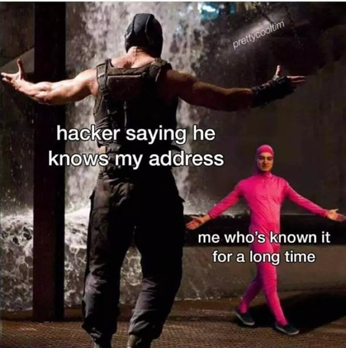
PERSONAL INFORMATION
If you put it out there, it will stay there!
Especially home address, Phone number & email accounts
Email accounts: Once you start signing up for important things, use a spam email account to sign up for non-important accounts.
For example: Banking, School Account, anything with Payment Info.
Vs Game accounts, Blogs, etc.
Check out https://haveibeenpwned.com/ if your email has been included in a breach

Slide 5
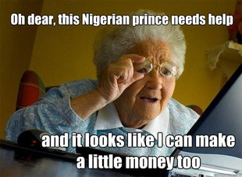
SAFE DOWNLOADS
Ask an Adult first, better safe than sorry.
Use a link-checker like
https://www.psafe.com/dfndr-lab/
Download from Secure sites only, Don’t just
download from a search result

Slide 6
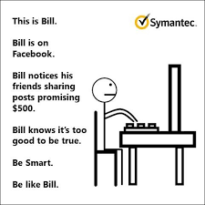
BROWSER & VPN
Browsers can store a lot of information on you
Take time to review the privacy and ad settings
Use a VPN while on open public networks

