Slide 1

Firewalls
October 6th
Network Security Emphasis

Slide 2
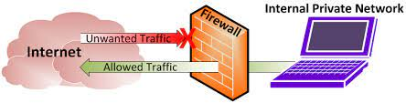
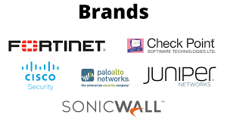
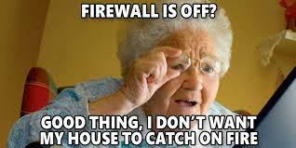

Slide 3
What is a firewall?
Checkpoint, Filter, Wall, etc.
Works by monitoring incoming and outgoing traffic and allows or denies such data based on a set of rules.
Software: Installed on a computer and listens to traffic through port numbers and applications
Hardware: piece of equipment on the network between network and Gateway

Slide 4
Specific types of Firewalls
Packet filtering: examines packets by checking source and destination IP addresses, with two types: Stateful and Stateless
Stateful: Track traffic based on the context of previous sessions and current session, detecting traffic patterns and flows
Stateless: Focus only on individual packets against the rules defined.

Slide 5
Other Types
Next-gen Firewalls: Include technologies such as deep packet inspection, encrypted traffic inspection
Proxy Firewalls: Filter network traffic at application level
Network Address Translation: Allow muple devices to connect via a single IP Address
Stateful Multilayer Inspection Firewalls: Filter packets at network, transport and application levels, examining against multi-layered levels of rules.

Slide 6
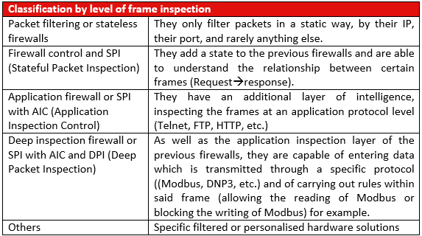

Slide 7
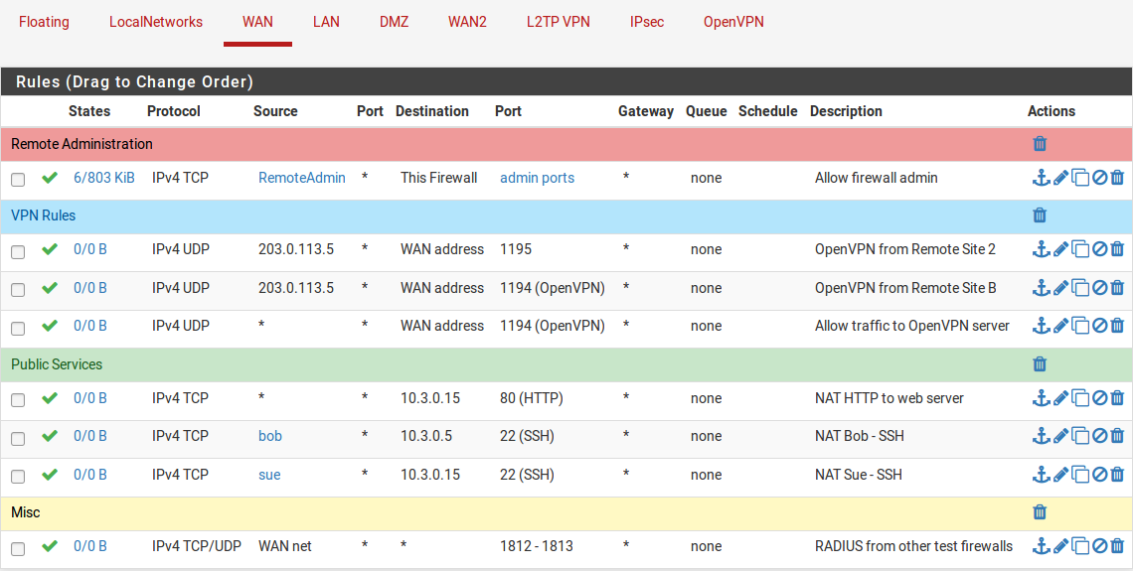
Example of Rules in pfSense
Firewalls typically contain default deny rules at the end, thus anything that doesn’t match a rule, aka is whitelisted, is then dropped or blocked.

Slide 8
Hands on:
We’re gonna install pfSense onto our VMs with the following settings:
Two network adapters (one bridged and then one on the internal virtual network)
NAT the web interface to the external IP
Block all traffic except Ping, SSH, HTTP & HTTPS
https://www.pfsense.org/download/
If we have time: iptables
https://www.hostinger.com/tutorials/iptables-tutorial

Slide 9
Firewall Resources
https://www.pfsense.org/getting-started/
https://techexpert.tips/pfsense/pfsense-server-installation/
https://www.comparitech.com/blog/vpn-privacy/setup-configure-pfsense/
https://www.itcentralstation.com/products/comparisons/palo-alto-networks-ng-firewalls_vs_pfsense
https://www.cisco.com/c/en/us/products/security/firewalls/what-is-a-next-generation-firewall.html
https://www.fortinet.com/resources/cyberglossary/stateful-firewall
https://www.linkedin.com/learning/comptia-security-plus-sy0-601-cert-prep-8-network-security-design-and-implementation/firewall-rule-management?u=2153100

Slide 10
Other Practices/Simulations
https://groups.inf.ed.ac.uk/tulips/projects/1617/FirewallWebApp/
https://tryhackme.com/room/extendingyournetwork
https://exampremium.com/comptia-security/comptia-security-simulation-8/
https://getcertified4less.com/uploads/file/SecurityMiniCourseHandbook.pdf

Slide 11
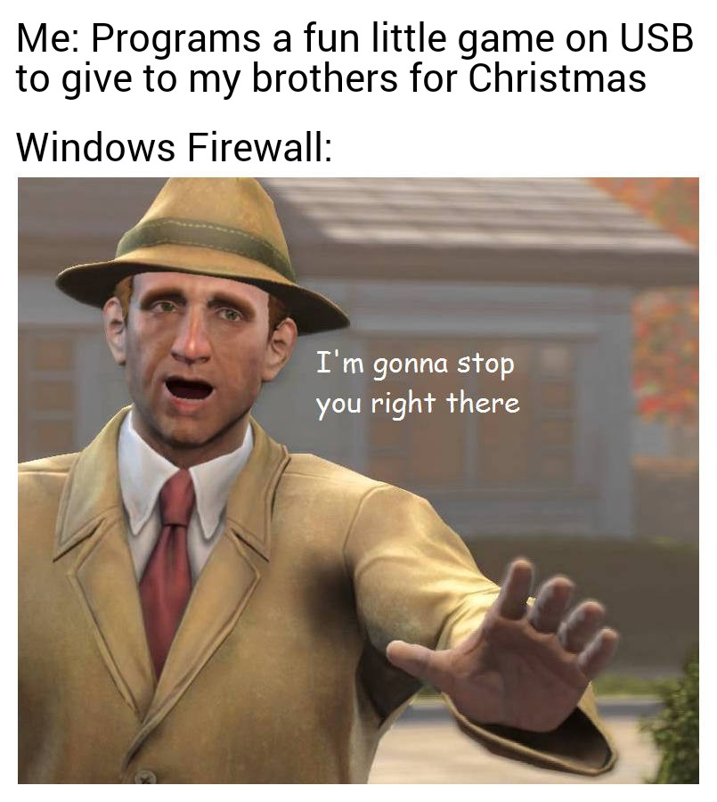
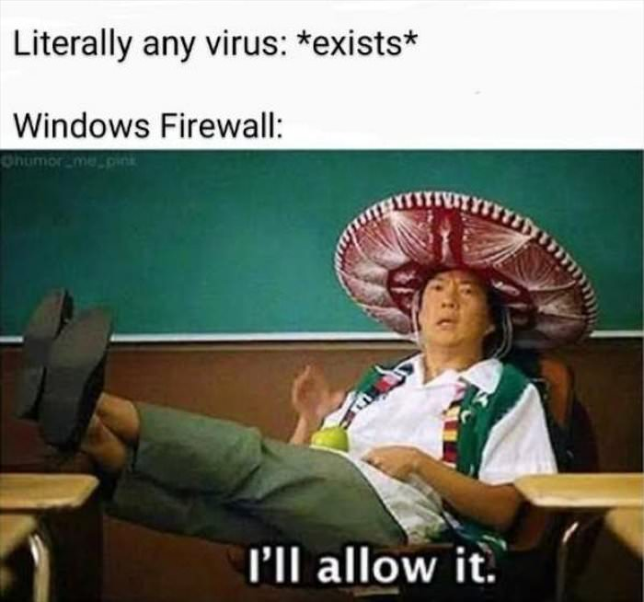
Memes just cuz

