Slide 1
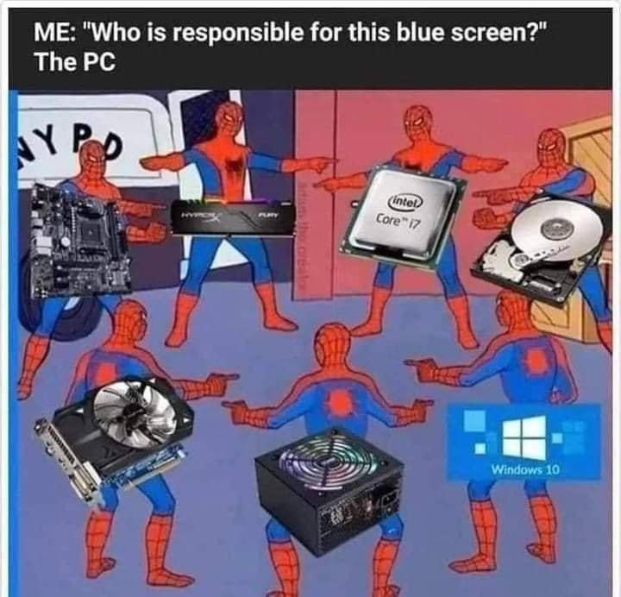
Hardware

Slide 2
PARTS OF A COMPUTER

Slide 3
PARTS OF A SERVER

Slide 4
CABLE BUILDING

