Slide 1
PetCare
Projet de bachelor Systèmes d’Informations et Sciences des Services CUI 2021
DAVID Loïc

Slide 2
Motivation
Animal = responsabilités quotidiennes
Créer routine
Téléphone omni-présents
Application pratique

Slide 3
État de l’art Scientifique
App coaching et santé humaine
Obésité (Cueto V, 2019)
Perte de poids (So Mi Jemma Cho, 2020)
Rémission cancer (Monteiro-Guerra F, 2020)
Service informatique et santé animale
Puce RFID (S. O. Ogunlere, 2018)
Zone rurale (Esron D. Karimuribo, 2016)
Pet monitoring (Alexis Anne A Luayon, 2019) (Junior, 2020)

Slide 4
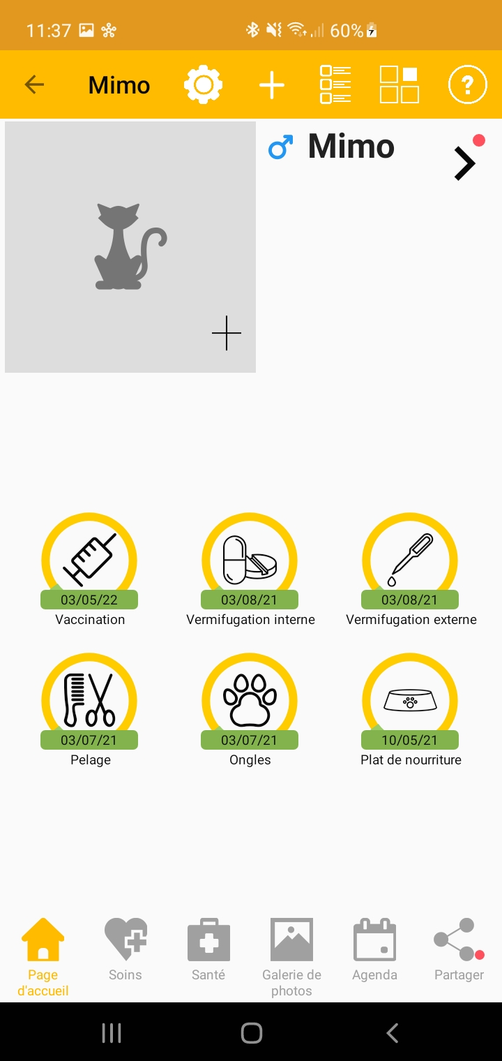
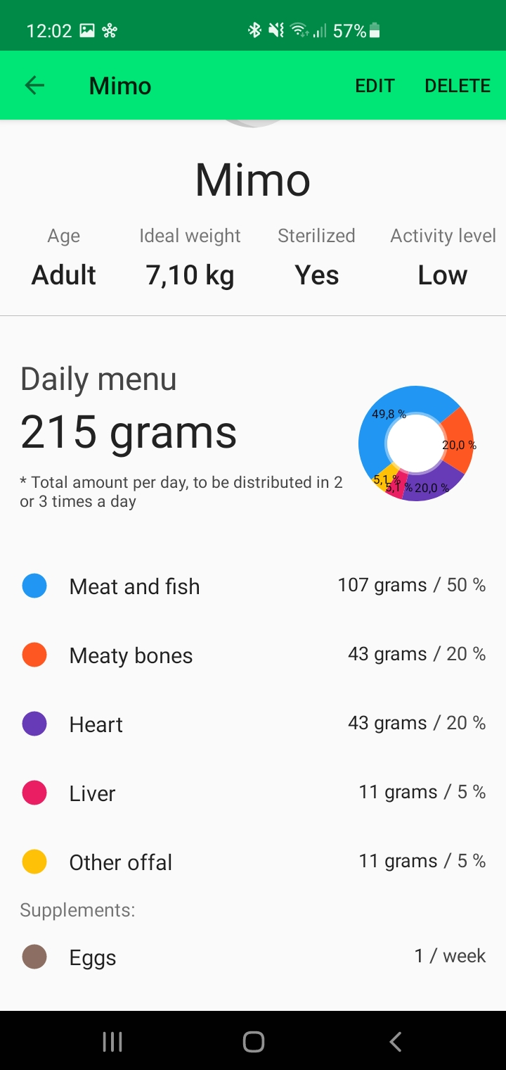
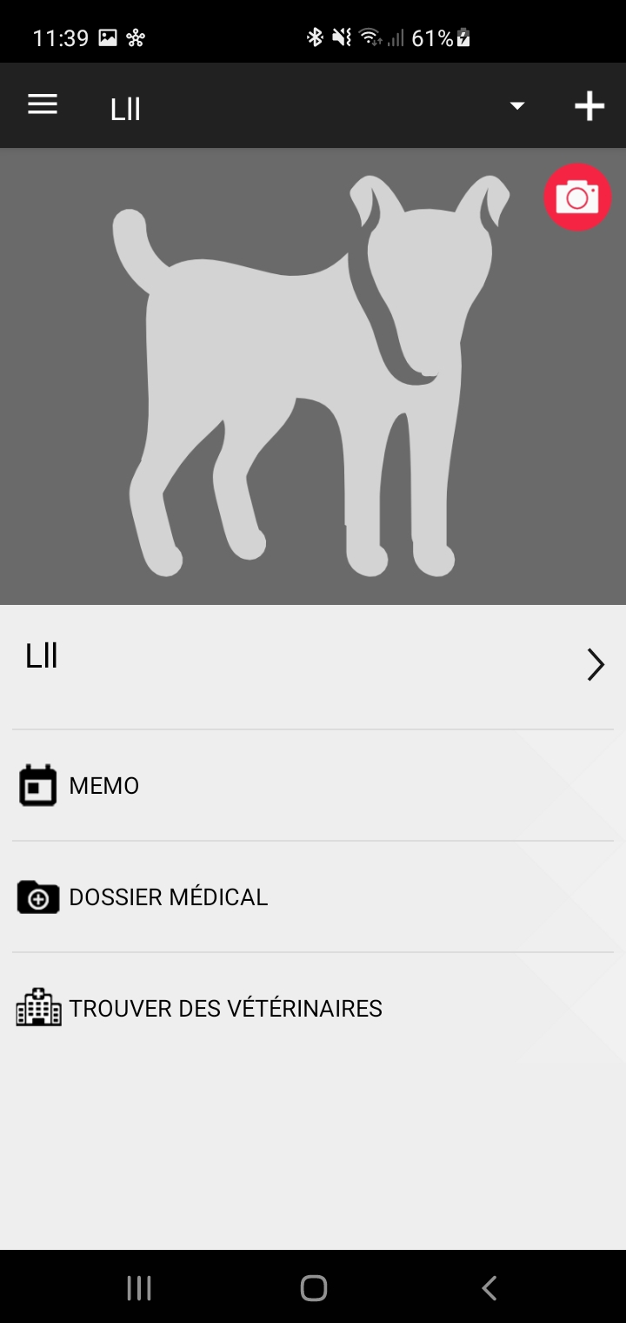
État de l’art Commercial
11pets
Barftastic
Dog Health

Slide 5
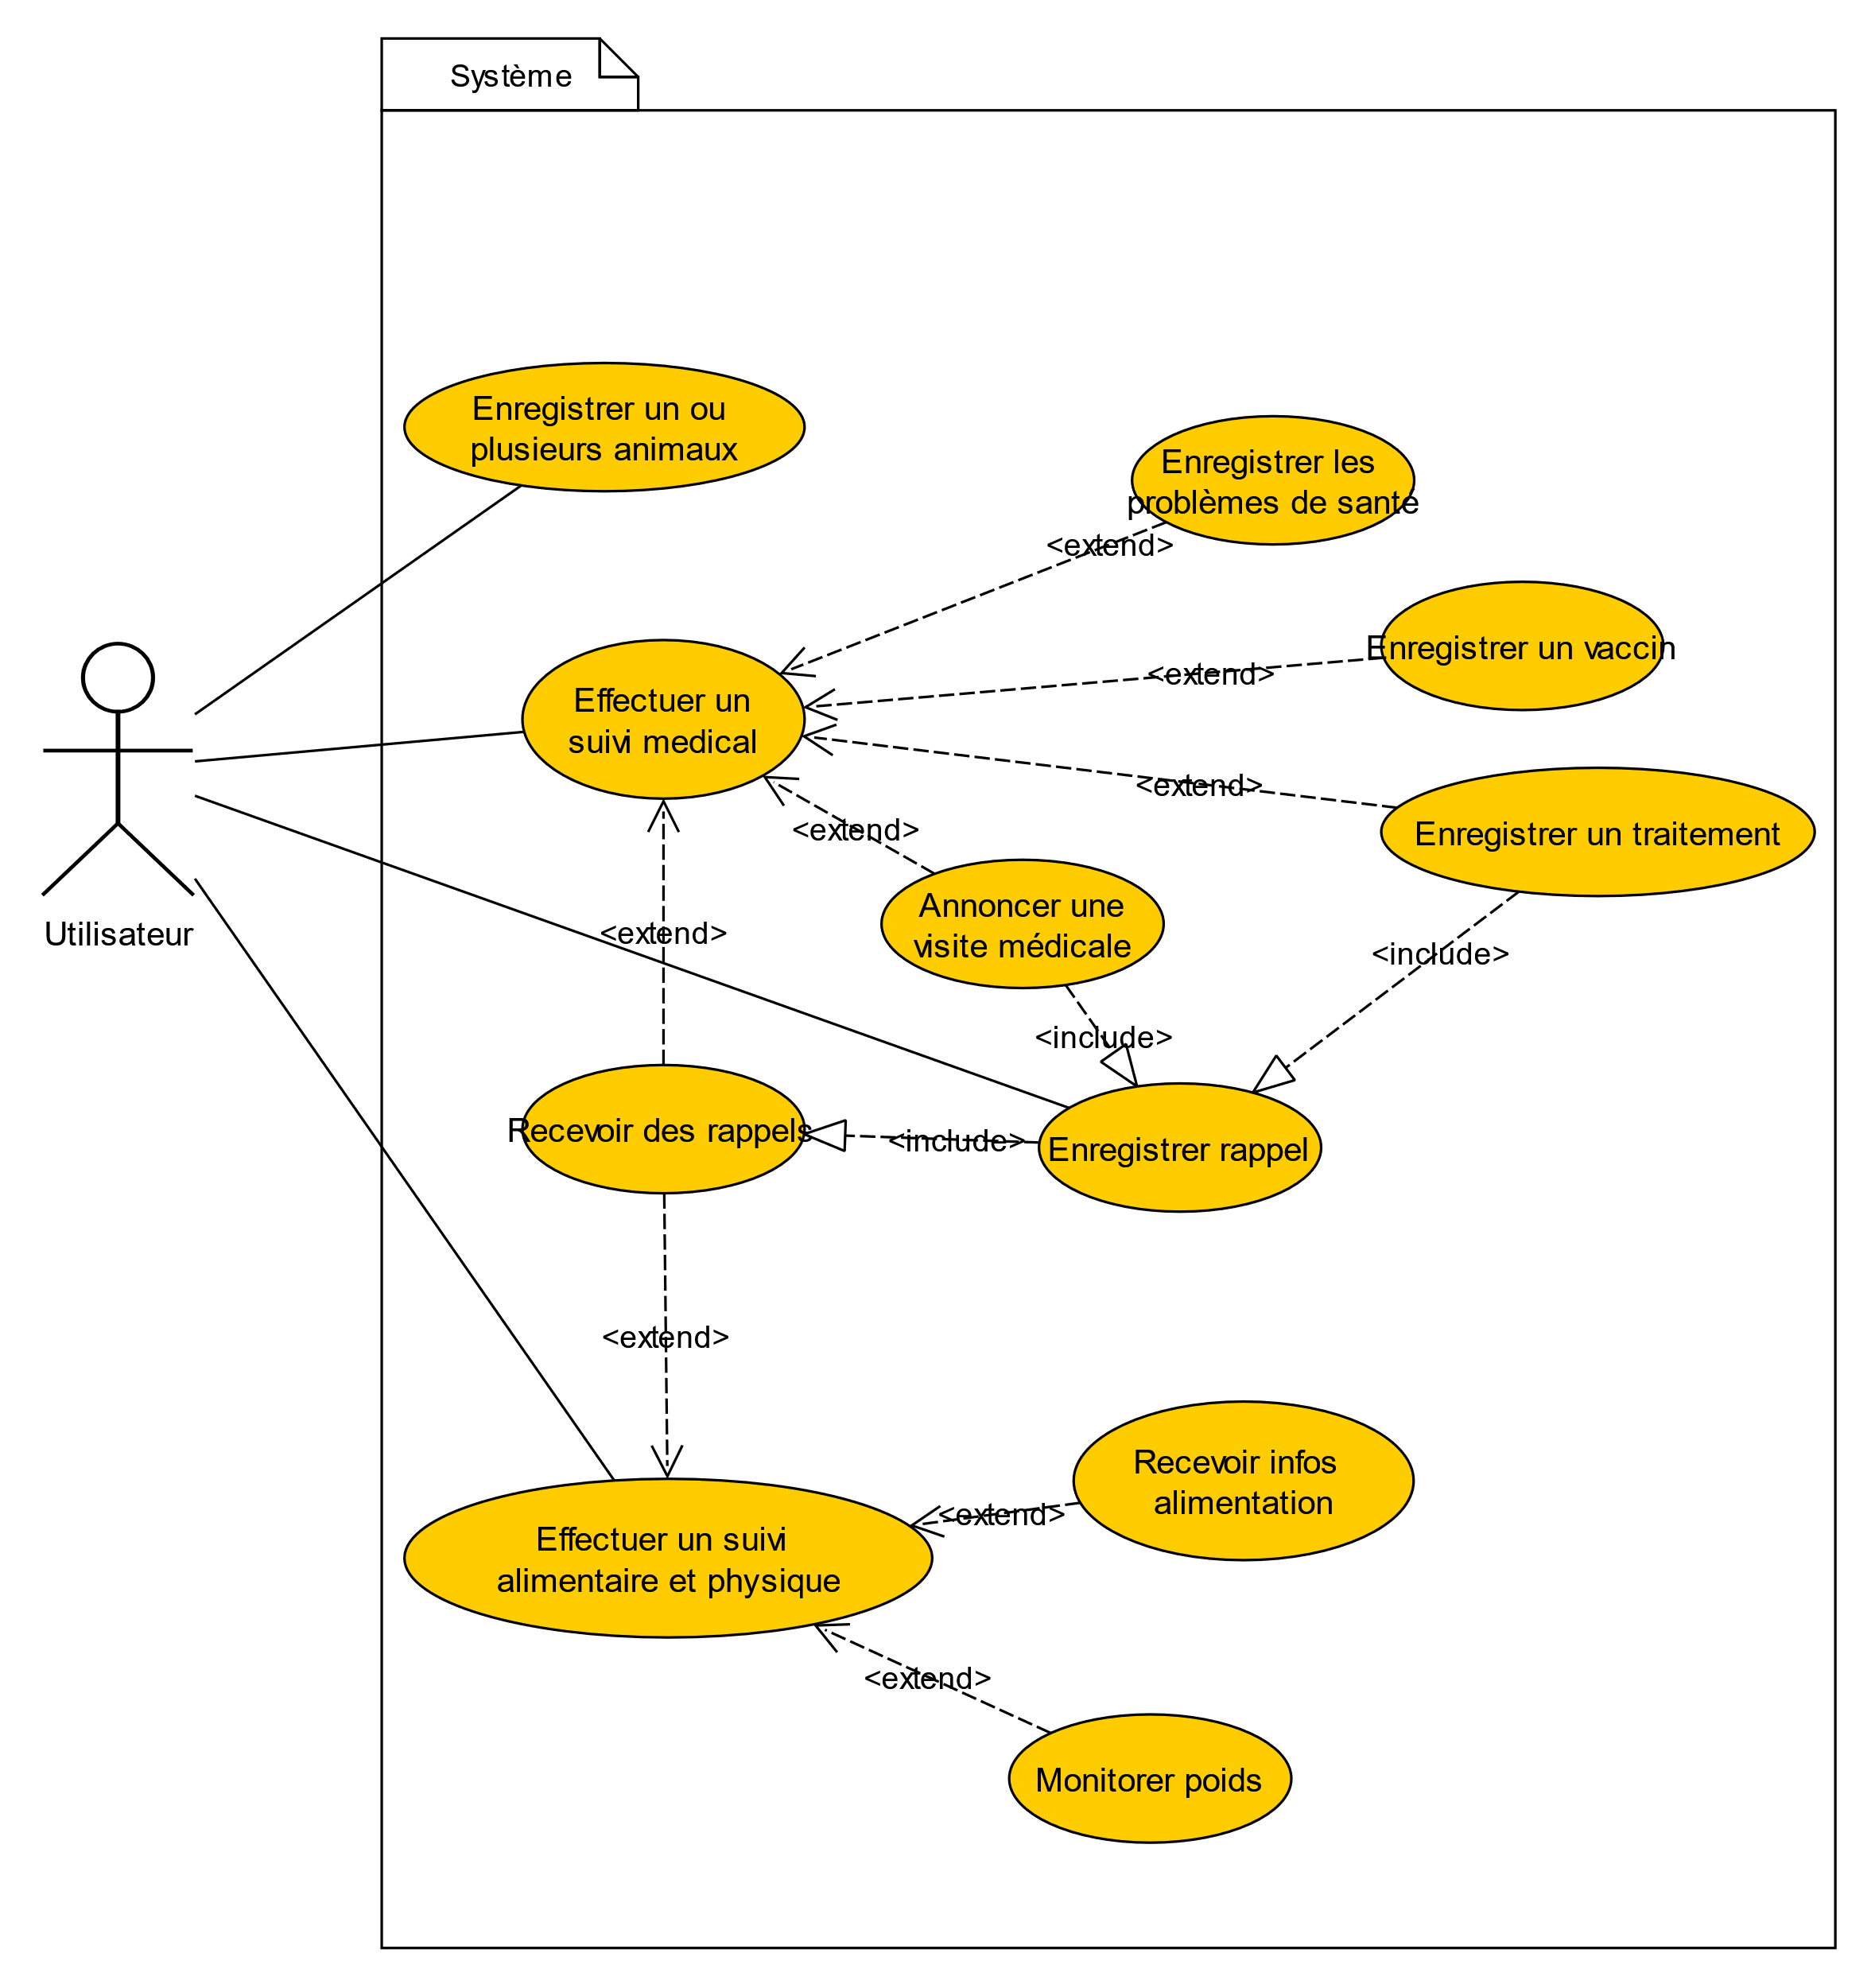
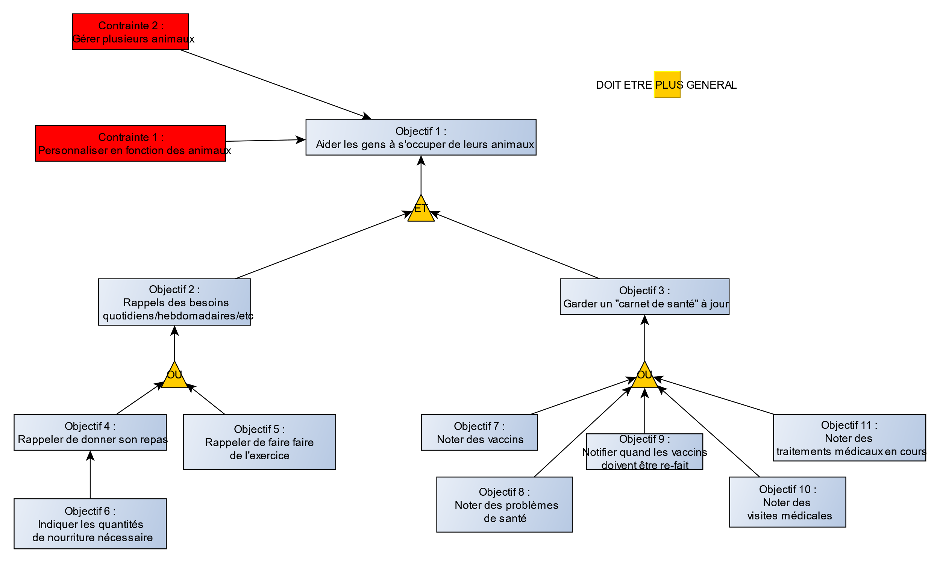
Conception
App de suivi
Plusieurs animaux
Simple d’utilisation

Slide 6
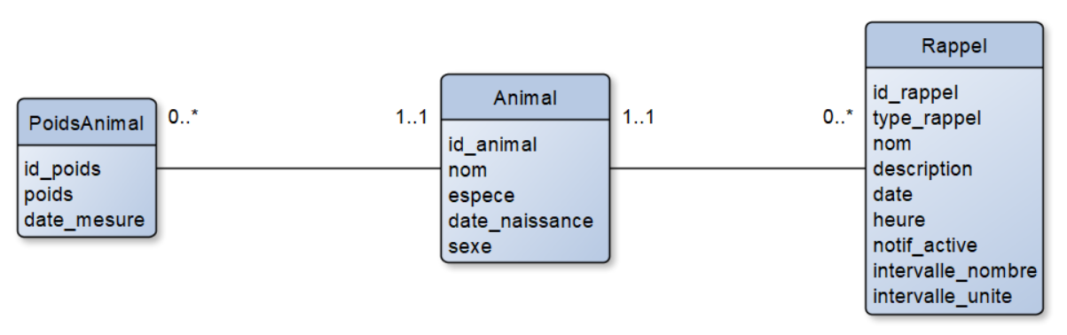
Conception base de données
Animaux, rappels, poids
Limitations de Room

Slide 7
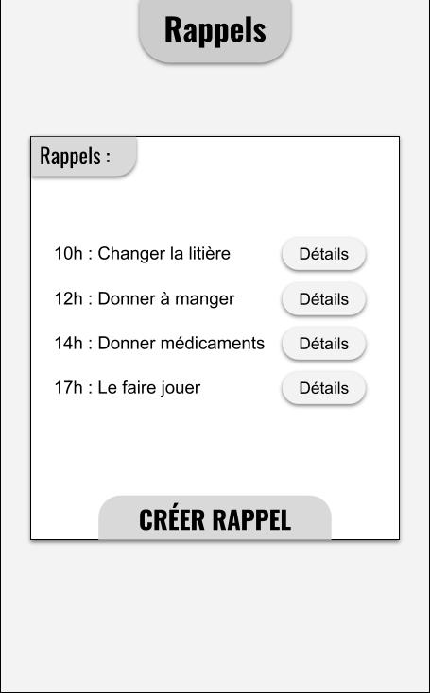
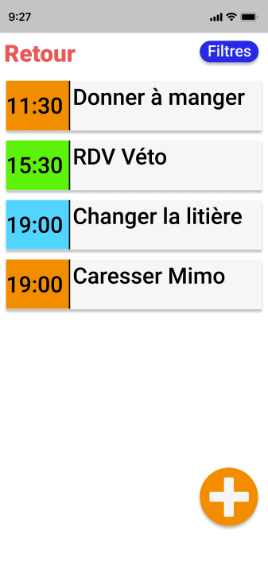
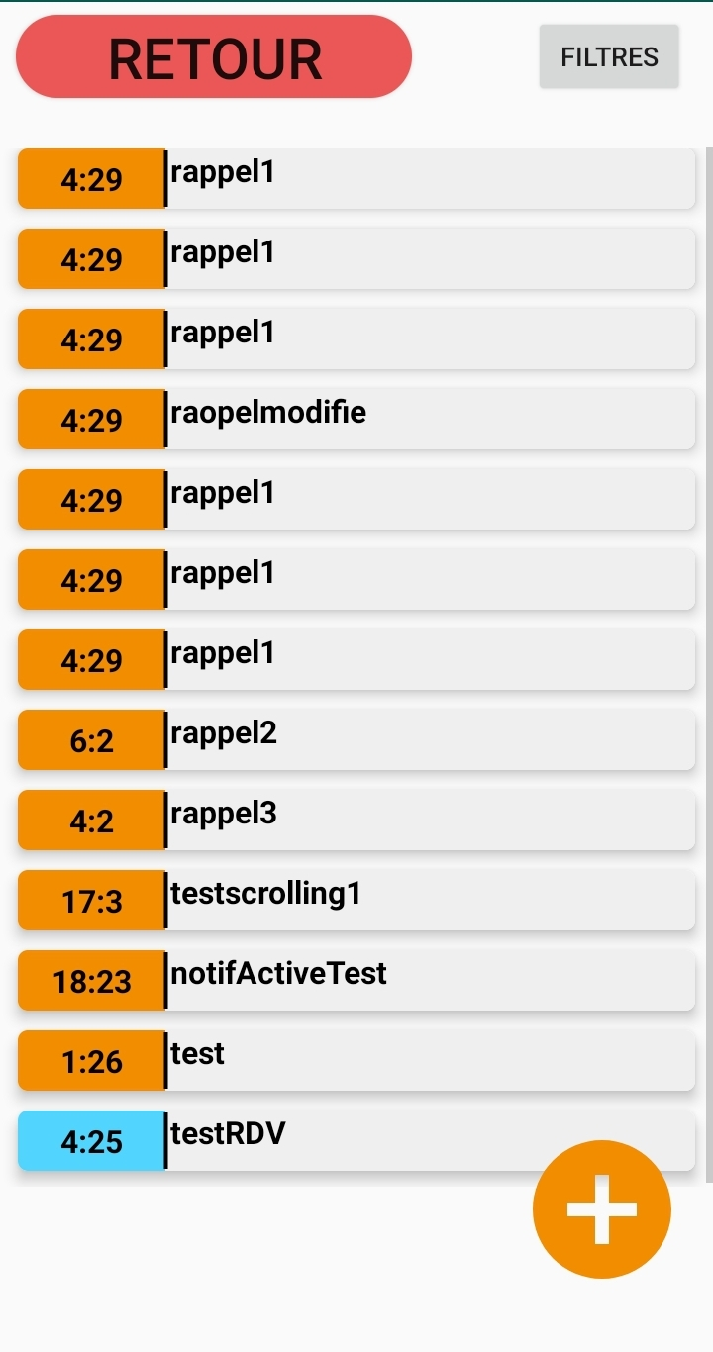
Interface

Slide 8
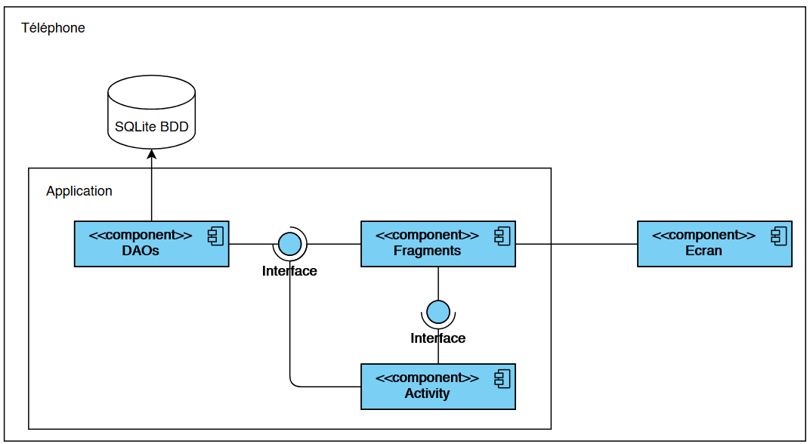
Implémentation
Fragments, Activités, Room

Slide 9
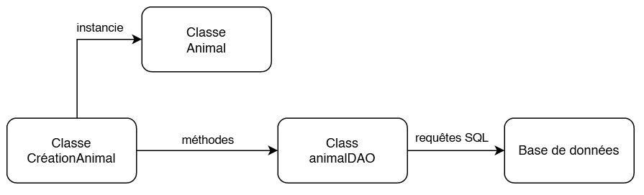
DAO
Table et classe
Lien Java -> SQL

Slide 10
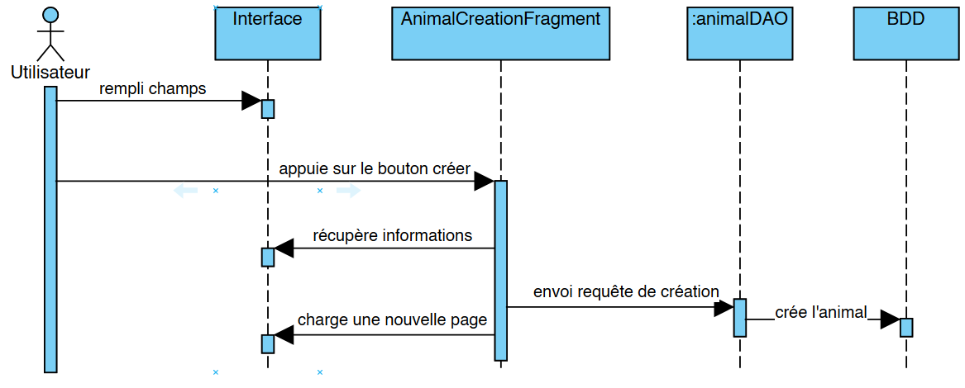
Diagrammes de séquences (Ajout animal)

Slide 11
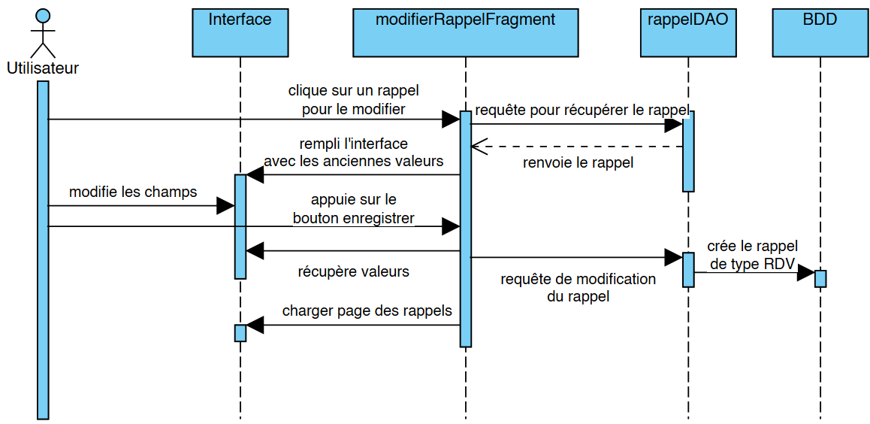
Diagrammes de séquences (Modification)

Slide 12
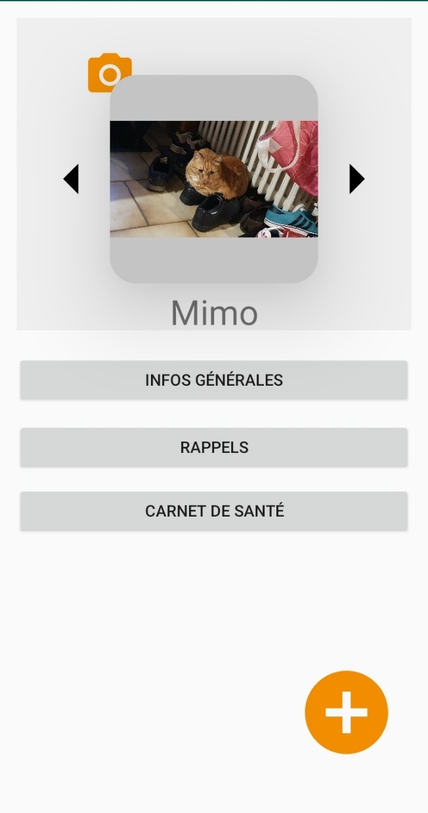
Évaluation et démo
+ Rappels, Animaux, Poids
- Notifications
Bugs

Slide 13
Conclusion
Aspects non-terminés :
Apparence
Graphe compréhensible
Filtre
Notifications
Rappels par défaut
Améliorations :
Meilleurs rappels
Vérifier inputs
Notes

Slide 14
Références
Articles :
Alexis Anne A Luayon, G. F. (2019). PetCare: a smart pet care IoT mobile application. (A. f. Machinery, Éd.) IC4E '19: Proceedings of the 10th International Conference on E-Education, E-Business, E-Management and E-Learning. Récupéré sur https://dl.acm.org/doi/10.1145/3306500.3306570
Cueto V, W. C. (2019). Impact of a Mobile App–Based Health Coaching and Behavior Change Program on Participant Engagement and Weight Status of Overweight and Obese Children: Retrospective Cohort Study. JMIR Mhealth and Uhealth. Récupéré sur http://mhealth.jmir.org/2019/11/e14458/
Esron D. Karimuribo, E. K. (2016). Potential use of mobile phones in improving animal health service delivery in underserved rural areas: Experience from Kilosa and Gairo districts in Tanzania. Spring Nature. Récupéré sur https://www.researchgate.net/publication/309515243_Potential_use_of_mobile_phones_in_improving_animal_health_service_delivery_in_underserved_rural_areas_Experience_from_Kilosa_and_Gairo_districts_in_Tanzania
Junior, R. L. (2020). IoT applications for monitoring companion animals: A systematic literature review. 2020 14th International Conference on Innovations in Information Technology. Récupéré sur https://ieeexplore.ieee.org/document/9299045
Monteiro-Guerra F, S. G.-L. (2020). A Personalized Physical Activity Coaching App for Breast Cancer Survivors: Design Process and Early Prototype Testing. JMIR Mhealth Uhealth . Récupéré sur https://mhealth.jmir.org/2020/7/e17552
S. O. Ogunlere, S. E. (2018). Animal Care Automated System - Software Development and Implementation. International Journal of Computer Applications. Récupéré sur https://www.semanticscholar.org/paper/Animal-Care-Automated-System-Software-Development-Ogunlere-Ebiesuwa/72e3dfdc3880b7a48c5a5a04a05cf25dcfaf675b
So Mi Jemma Cho, J. H.-S. (2020). Effect of Smartphone-Based Lifestyle Coaching App on Community-Dwelling Population With Moderate Metabolic Abnormalities: Randomized Controlled Trial. Journal of Medical Internet Research. Retrieved from https://pubmed.ncbi.nlm.nih.gov/33034564/

