Slide 1
CTPentru Toti
Semester Project

Slide 2
Team members:
Iacobuț Florin-Cosmin
Calomfirescu Radu-Adrian

Slide 3
Why CTPentru Toti?
Minimization of time loss
Increased efficiency for citizens and busses
Better homogeneity during peak hours
Fluidization of traffic
Saves time

Slide 4
The making of CTPentru Toti
Produced in native Angular
Uses the Tranzy API
Designed for a new era in technology

Slide 5
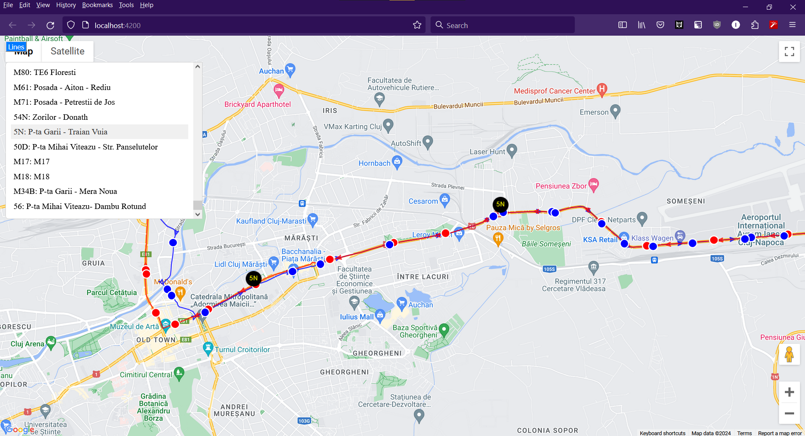

Slide 6
Benefits
Offers a simple and intuitive design
Easy to navigate and access desired information
Accurate and reliable data
Quick response time and fluidity

Slide 7
Bibliography:
Tranzy API: https://ctpcj.ro/index.php/ro/despre-noi/stiri/tranzy-aplicatia-care-eficientizeaza-mobilitatea-urbana/1378
CTP Cluj-Napoca: https://ctpcj.ro/index.php/ro/
CFR Repository: https://github.com/FlashWebIT/cfr-iris-scraper/tree/master
Angular: https://angular.io/

Slide 8
Thank you for your attention!

