Slide 1
Graphs and Properties Questions Method Results Conclusion
Properties of
Erdős–Rényi Graphs
Philosophy 412 - Bedau
Presentation by
Cole Campton
February 2015

Slide 2
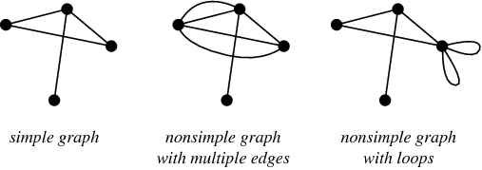
Graphs and Properties Questions Method Results Conclusion
Graphs and Properties
Erdős–Rényi Graphs
Graphs are simply any set of nodes and edges connecting them.
A model for generating random graphs that sets an edge between each pair of nodes with equal probability.
Properties
The focus is on Simple-Undirected Erdős–Rényi Graphs
Defn: Simple graphs have at most one edge connecting two nodes.
Defn: Undirected graphs connect nodes in both directions.
[1]
February 2015

Slide 3
Graphs and Properties Questions Method Results Conclusion
Questions
For a graph with a given number of nodes how does the number of paths affect:
The average path distance between any two given points?
The maximum distance across the graph?
Whether it's possible to cross each edge exactly once?
  Euler Paths and the Königsberg bridge problem
How closely clustered the graph is?
February 2015

Slide 4
Graphs and Properties Questions Method Results Conclusion
Graphs and Properties Questions Method Results Conclusion
Method
The number of paths between any two given points?
Simply check the path length between all permutations of nodes and find an average.
The maximum distance across the graph?
While checking the path length between all permutations of nodes store the largest.
Whether it's possible to cross each edge exactly once? - Euler Path
Euler's solution found that a graph (Königsberg) has an Euler Path if exactly zero or two nodes have an odd degree. If two the path will start at one and end at the other. We count the number of odd nodes for each cluster.
How closely clustered the graph is?
This is measured by the largest eigenvalue of the adjacency matrix – the symmetric matrix with a 1 between connect nodes and 0 otherwise.
February 2015
February 2015
Sub Topic 2

Slide 5
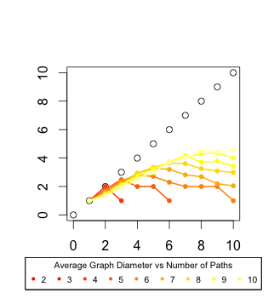
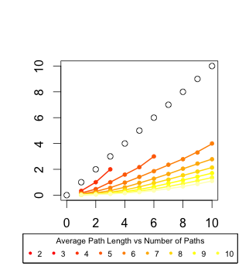
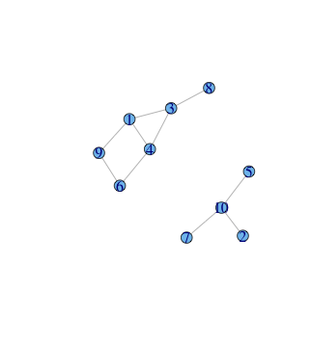
Graphs and Properties Questions Method Results Conclusion
Graphs and Properties Questions Method Results Conclusion
Results and Conclusion
Graph Example:
10 Nodes – 10 Edges
This explanation works well with eigenvalue data. Graphs of more nodes have a higher chance to have several clusters of smaller size because of the Erdős–Rényi model.
There is interesting discontinuous shape up until 5 nodes because a for node graph become complete with 10 edges, 4 with 6, etc. The complete 4 node graph is not Euler while the complete 5 node graph must be. All odd node complete graphs have Euler paths and all even don't. As may be expected for non complete graphs, subgraphs tend toward having Euler paths 50% of the time.
February 2015
February 2015
Sub Topic 2

Slide 6
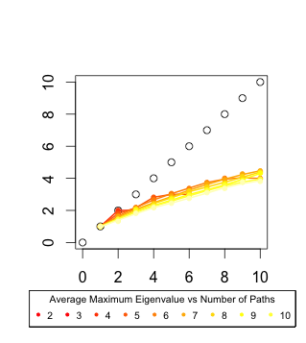
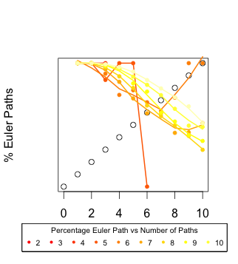
Graphs and Properties Questions Method Results Conclusion
Graphs and Properties Questions Method Results Conclusion
Results and Conclusion
This explanation works well with eigenvalue data. Graphs of more nodes have a higher chance to have several clusters of smaller size because of the Erdős–Rényi model.
There is interesting discontinuous shape up until 5 nodes because a for node graph become complete with 10 edges, 4 with 6, etc. The complete 4 node graph is not Euler while the complete 5 node graph must be. All odd node complete graphs have Euler paths and all even don't.Large non complete graphs are more likely to have isolated pairs which have Euler paths. As edges are added there are less likely to be these small groups.
February 2015
February 2015
Sub Topic 2
Sub Topic 1

Slide 7
Graphs and Properties Questions Method Results Conclusion
Graphs and Properties Questions Method Results Conclusion
Citations and Resources
Citations
[1] Weisstein, Eric W. "Simple Graph." From MathWorld--A Wolfram Web Resource. http://mathworld.wolfram.com/SimpleGraph.html
Resources
iGraph R Library - http://igraph.org/r/
R - http://www.r-project.org/
R Studio - http://www.rstudio.com/
Reproducibility
https://github.com/cipan/Erd-s-R-nyi-Graphs
Set.seed(37251)
February 2015
February 2015
Sub Topic 2

