Slide 1
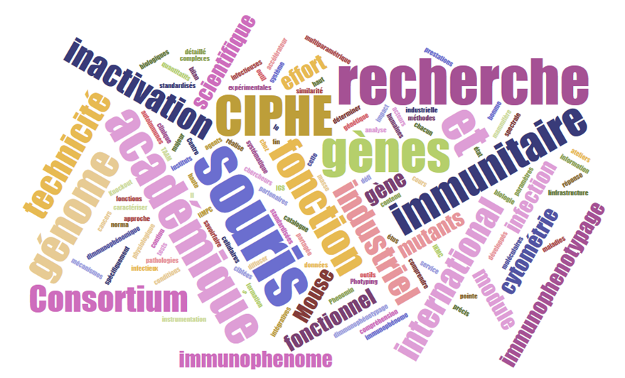



CIPHE CMP app tutorial
Maelle Marine MONIER
Bioinformatician

Slide 2
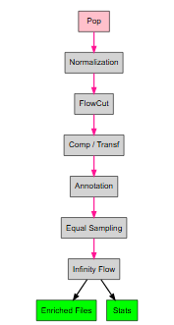
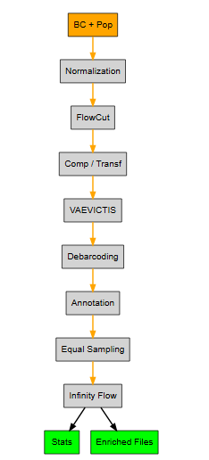
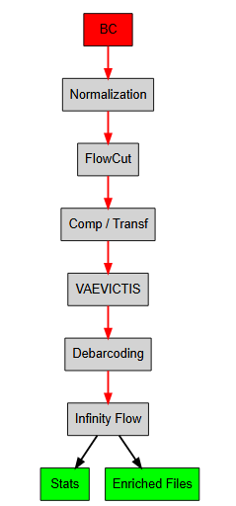
Objectives
The aim of this application is to interface analysis tools in a workflow for the analysis of CMP (computational cytometry) data. This makes it possible to manage large quantities of files simultaneously.
3 workflows are possible in this app, depending on the project:
1- Analysis on pop without barcoding
2- Analysis on pop + barcoding
3- Analysis on one population with barcodes

Slide 3
App accessibility
1 - To access to the app, go to your favorite browser and tap
10.71.1.6:1234
OR go to GoT (10,71,1,22)
2 – In WINSCP, create a folder for your experiment here: /mnt/md0/CMP/input
And put your files in it (one folder per plate)

Slide 4
SECTION 1 : DATA MANAGMENT
CIPHE CMP app:
DATA MANAGMENT

Slide 5
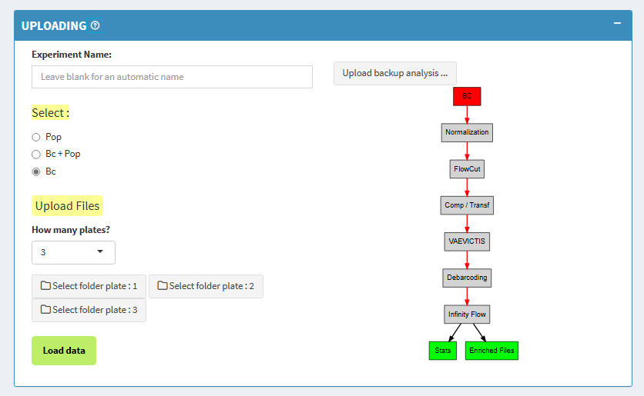
DATA MANAGMENT
Name of your experiment
Upload
Select your experiment
(Bc = barcode)
Indicate your plate number
Choose the path to your FCS files for each plate
Load the FCS files

Slide 6
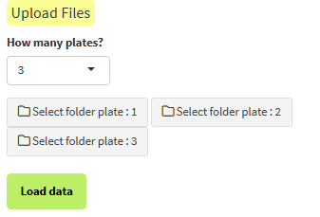
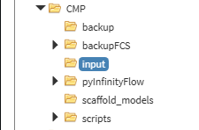
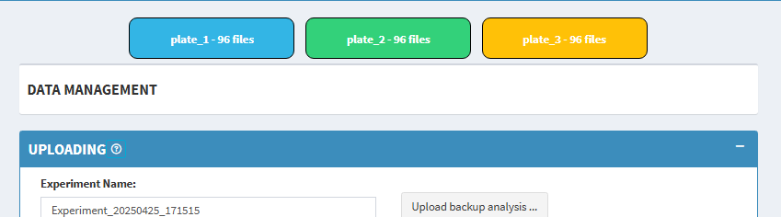
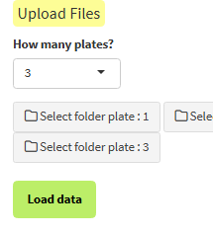
STEP BY STEP : load your data
1- For each plate please click on the button
2- Click on path to your FCS for the selected plate
3- Repeat these steps for the other plates
4- Click on Load data

Slide 7

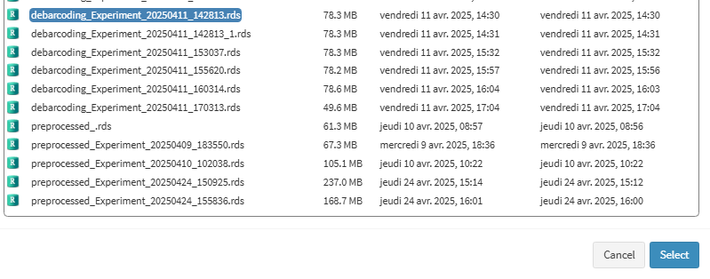
STEP BY STEP : load your data
RDS backup:
Click on Upload backup analysis.
Select the RDS project file you previously saved.

Slide 8
SECTION 2 : PREPROCESSING
CIPHE CMP app:
PREPROCESSING

Slide 9
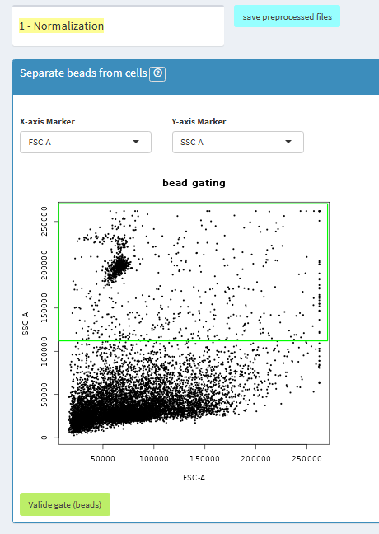
1 – NORMALIZATION BETWEEN PLATES
With your mouse, select beads
Then, click on validate gate. This step will extract beads for the normalization and also remove all events in the selections from your files

Slide 10
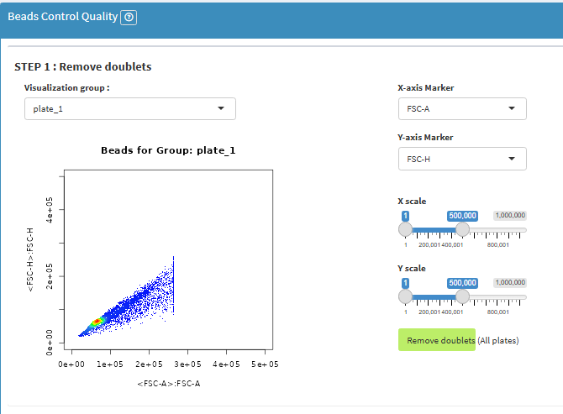
1 – NORMALIZATION BETWEEN PLATES
Bead gating step 1 : Click to remove doublets from your beads

Slide 11
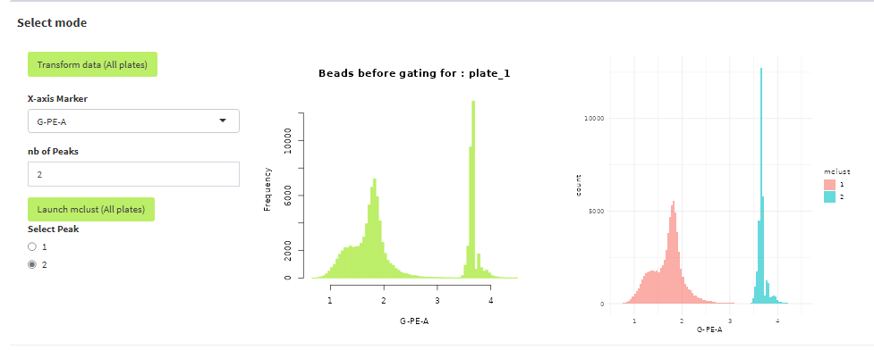
1 – NORMALIZATION BETWEEN PLATES
1- Transform beads with logicle(500) (just for better visualization)
2- Choose marker with the better distinction between peaks
3- Indicate the number of bead peaks
4- Launch clusterint algorithm
5- Choose the bead peak that you want to use for the normalization

Slide 12
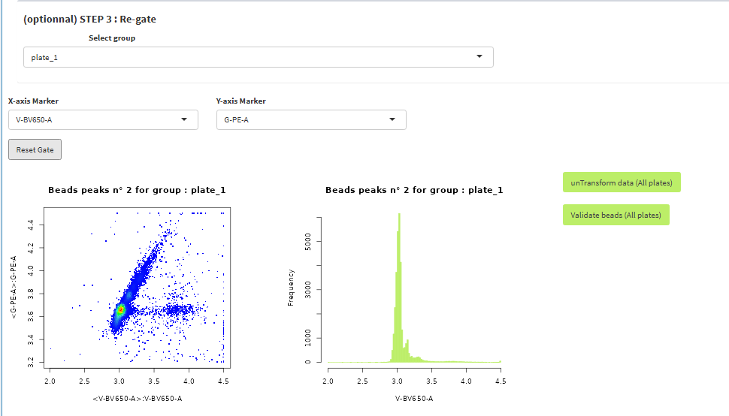
1 – NORMALIZATION BETWEEN PLATES
For each plate, perform manual gating to select only beads and not debris
And after
Click on untransform beads
And finally, click on validate beads

Slide 13
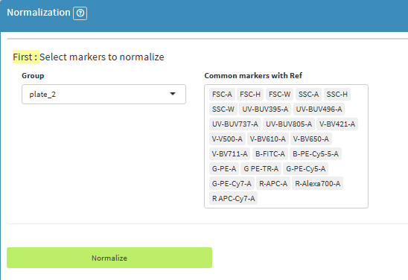
1 – NORMALIZATION BETWEEN PLATES
Select markers to normalize for each Group
Then, click on Normalize

Slide 14
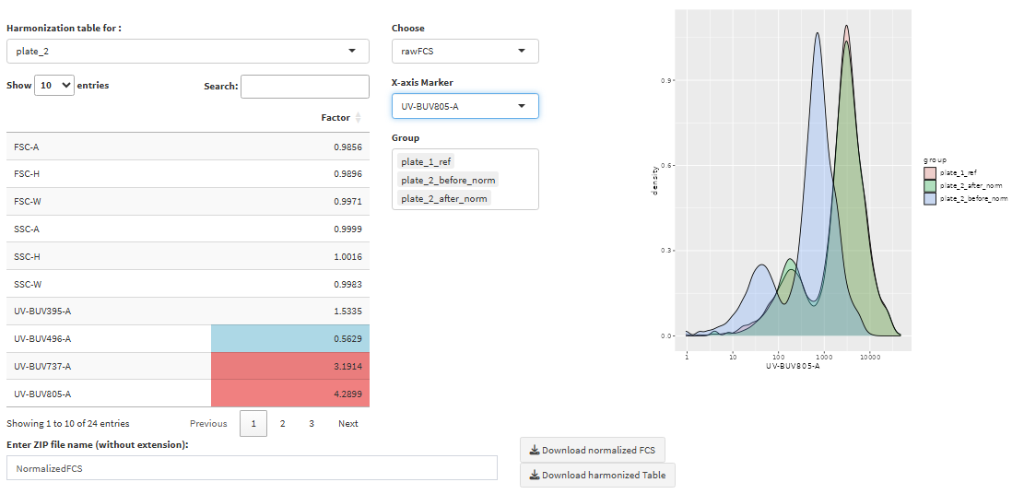
Normalization outputs

Slide 15
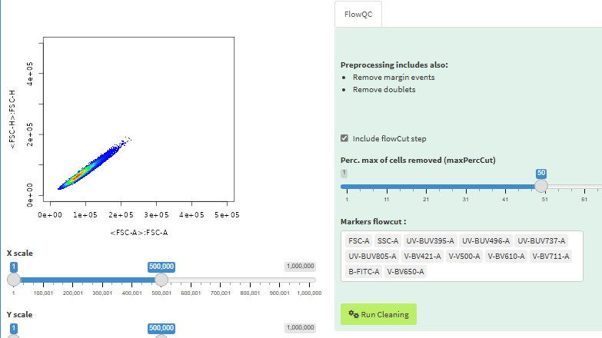
2 – FLOWQC
This section is designed to clean your FCS files by removing technical artifacts and unwanted events.
Remove margin events: These are extreme events that fall outside the detector range and may distort analysis.
Remove doublets: These are overlapping events (e.g., two cells passing together) that should be excluded from single-cell analysis.
Use FlowCut: FlowCut is an automated quality control algorithm that detects and removes abnormal regions in flow cytometry data over time. It uses statistical and signal drift detection to identify unstable acquisition periods, improving data consistency.
→ Configure FlowCut thresholds and select relevant markers before launching the cleaning process on all files.

Slide 16
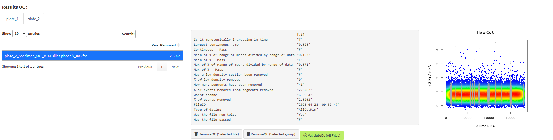
flowCut output
For each plate, you have a table with the file name, and the associated percentage of deleted cells. For more information on a particular file, click on the file in the table.

Slide 17

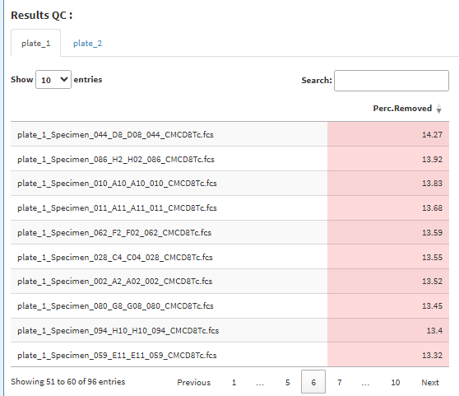
flowCut outputs
Click on Perc.Removed to display the files in ascending or descending order.
SAVE FLOWCUT FILTERING :
Remove the flowCut filtering on the file that you have selected
Remove the flowCut filtering on the plate
Validate QC once you have checked the results

Slide 18
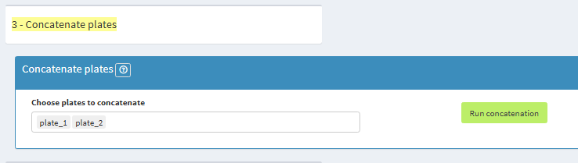
3- Concatenate plates
This section allows you to concatenate plates. The data parameters will be those present in the first plate you selected.
! Repeat this action as many times as you have plates to concatenate. !

Slide 19
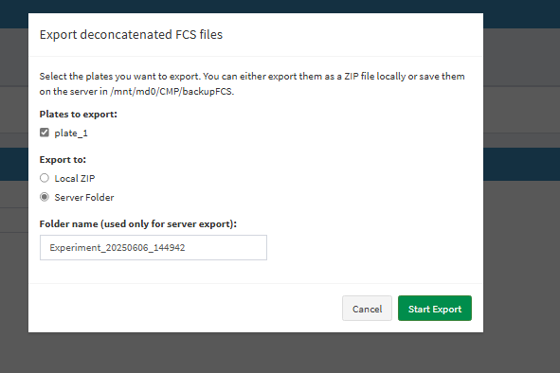
3- Concatenate plates
After concatenation, export the plates containing the files (e.g. if you concatenated Plate 1 and Plate 2, export Plate 1).
Then refresh the application and re-import the files.

Slide 20
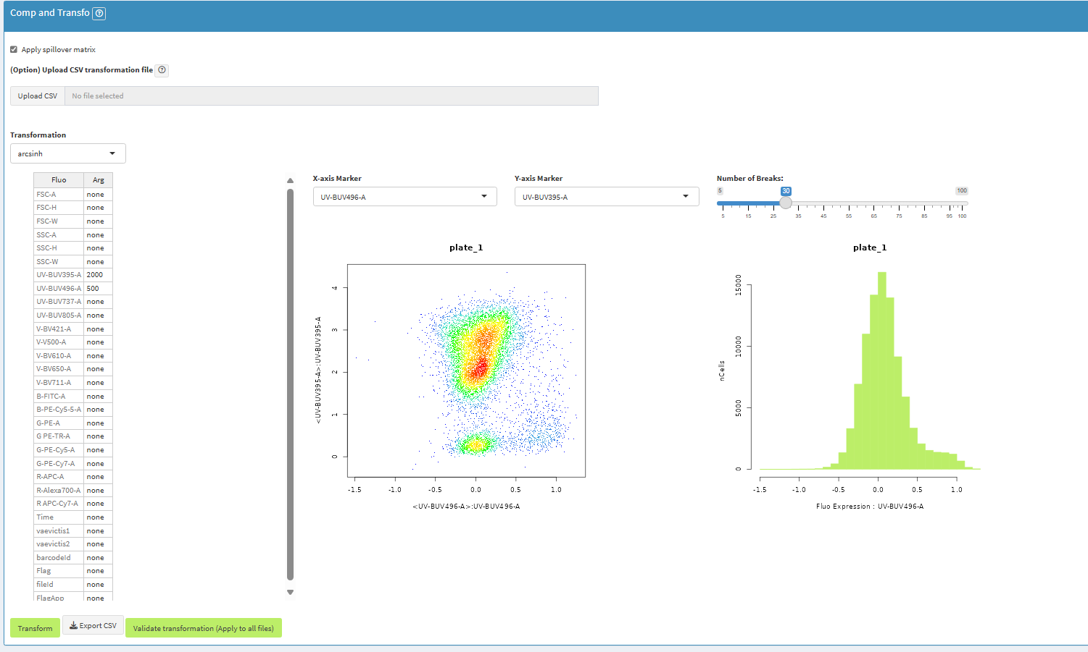
4-Compensation and transformation
Apply comp
Upload csv file, divided in two column (Fluo and Arg) delimited by a comma
Choose transfo : arcsinh, logicle
Change cofactor
Export transformation table
Apply transform to visualize your data transformation
FINAL : Click to validate the transformation table

Slide 21
SECTION 3 : DEBARCODING
CIPHE CMP app:
DEBARCODING

Slide 22
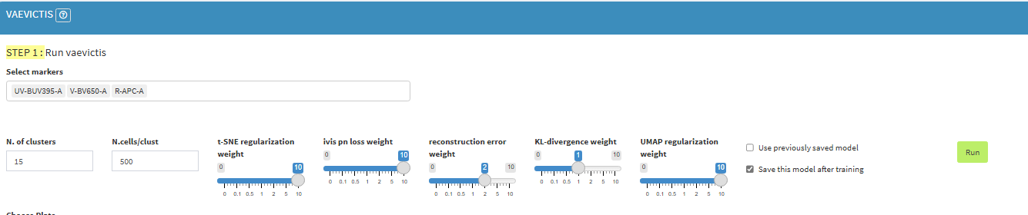
1- Run vaevictis
Run vaevictis on subset of each file and each plate
VAEVICTIS RUN:
1. Marker selection: Choose the markers you want to use for clustering. These should be relevant for distinguishing cell populations.
2. Run on subset: Click Run to apply VAEVICTIS on a subset of all your files (combined from all plates).

Slide 23
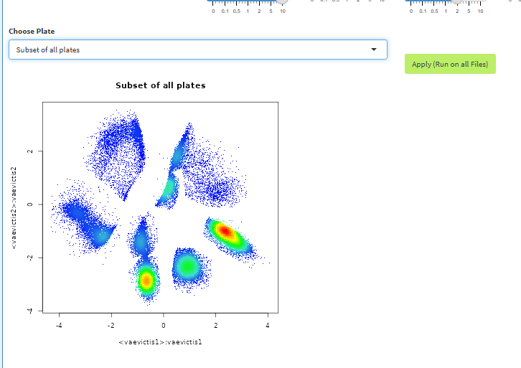
1- Run vaevictis
3. Visualize results: Review the plots generated to assess cluster separation and quality.
4. Apply to all: If satisfied with the preview, click Apply (Run on all files) to perform the full clustering process.

Slide 24
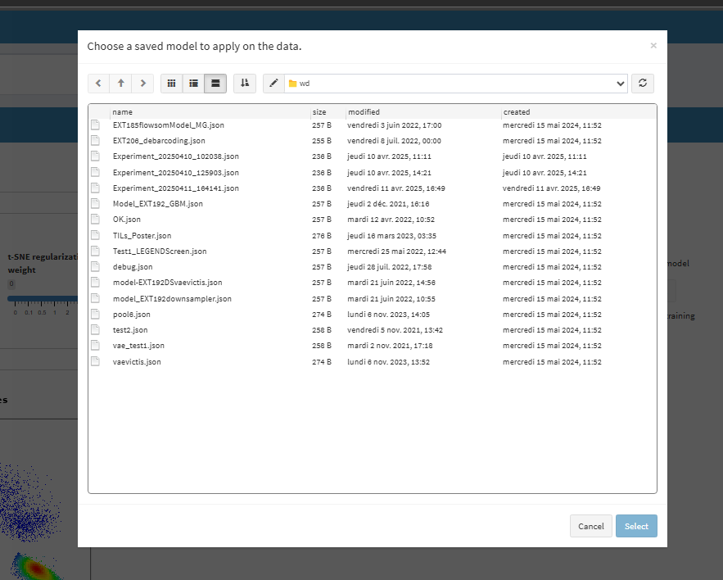

1- Run vaevictis
Load a saved model

Slide 25
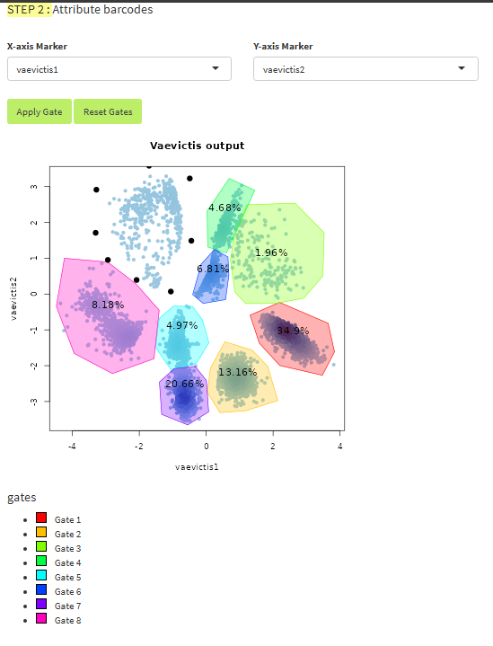
1- Run vaevictis
Manual gating : just click on the plot to gate barcode, and then, click on apply Gate

Slide 26
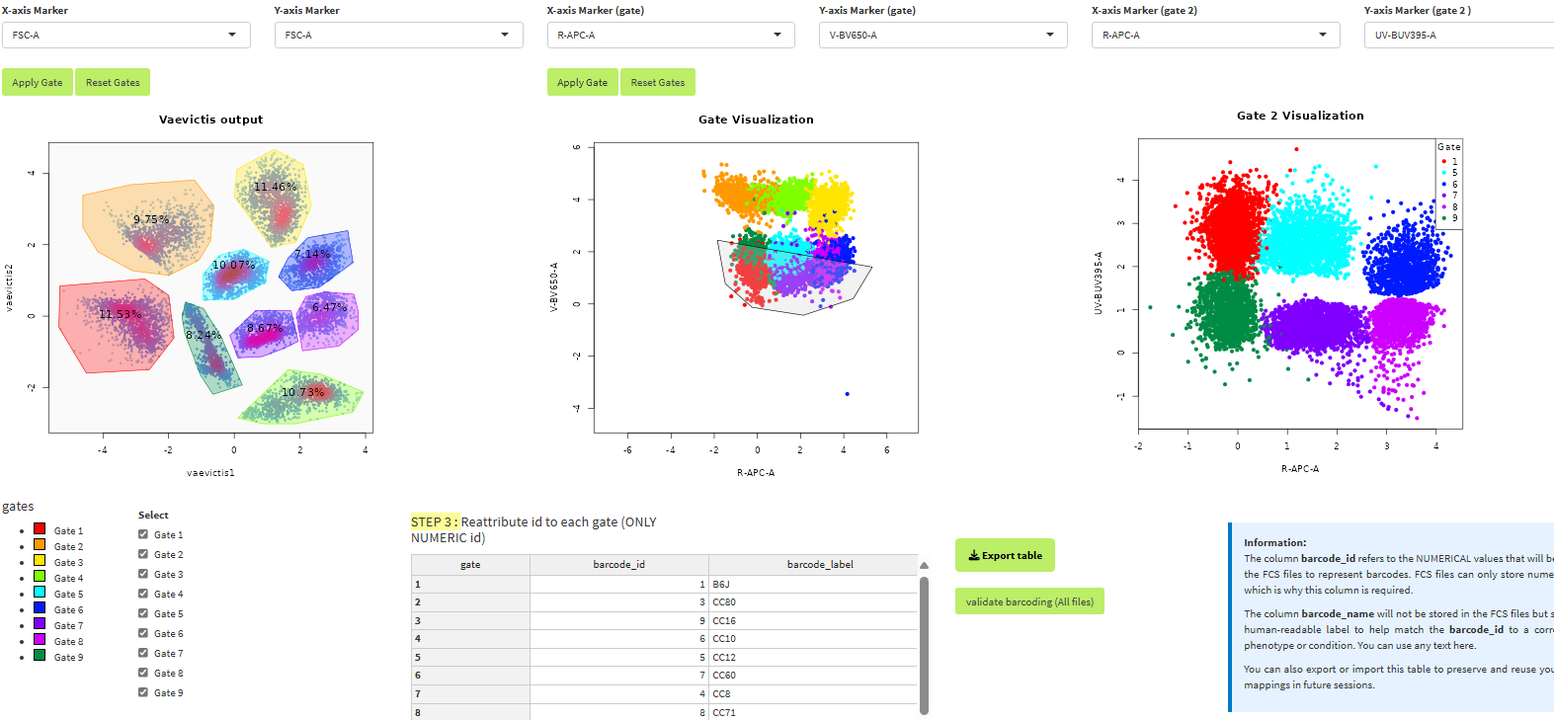
2- debarcoding
Visualize each gate/barcode in a second plot. Select gate that you want to see in the plot

Slide 27
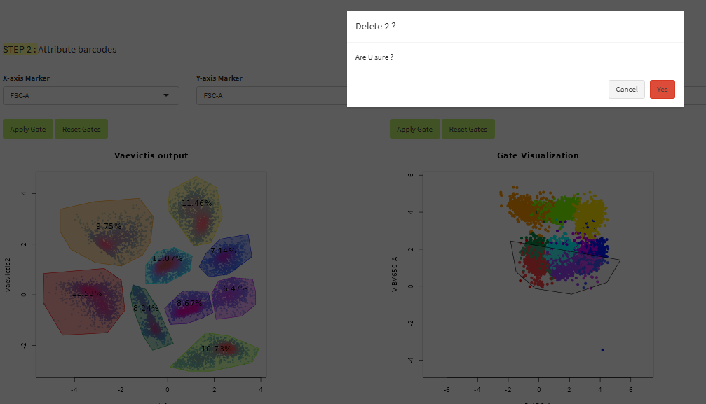
2- debarcoding
To delete just one gate, click on the gate

Slide 28
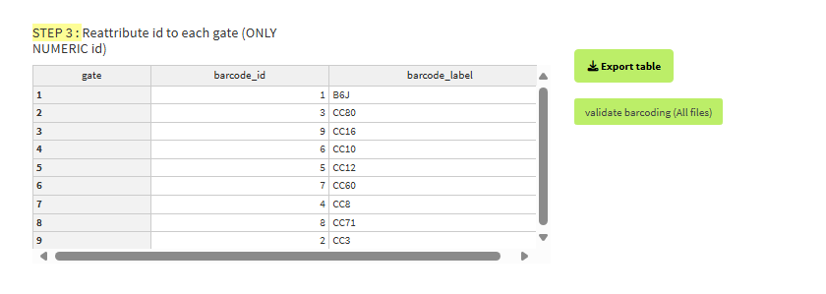
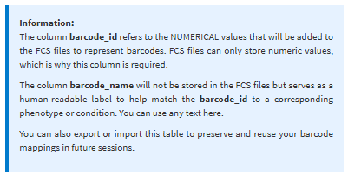
2- debarcoding
Once the table is debarcoded, click on validate barcode so that it enriches all your files with barcodes (all cells outside the gates will be removed from the files)

Slide 29
Important information: Only the gates on the left-hand plot count; the gate on the middle plot is for visualization purposes only.

Slide 30
SECTION 4 : ANNOTATION
CIPHE CMP app:
ANNOTATION

Slide 31
ANNOTATION
This section allows you to annotate a subset of your dataset based on reference files. You can choose between two methods: Scyan or Scaffold. Both methods apply annotations to a subset of the data. Once the annotation is done, scroll down to the 'QC Annotation’ section to inspect the results using UMAP and scatter plots. If you are satisfied with the results, click on 'Run on all files’ to apply the annotation to all FCS files across your plates.

Slide 32
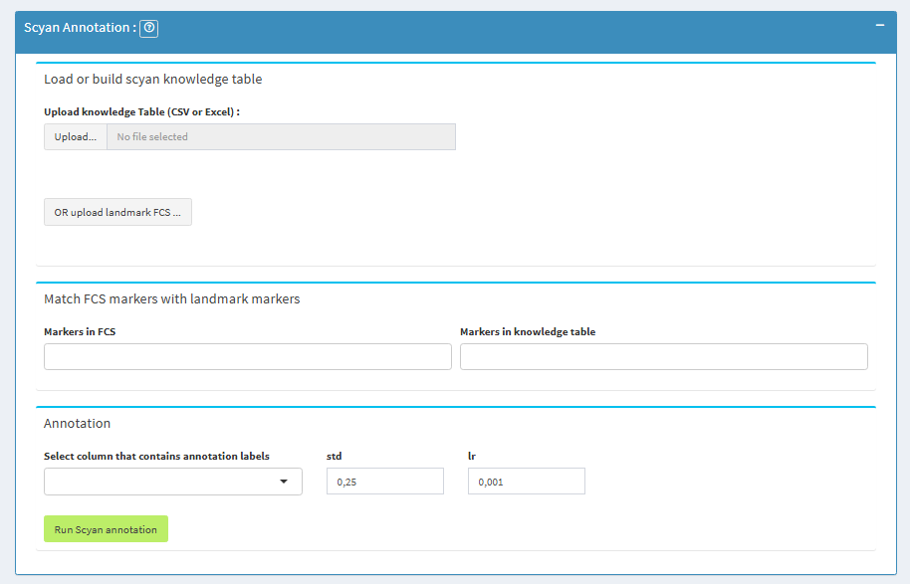
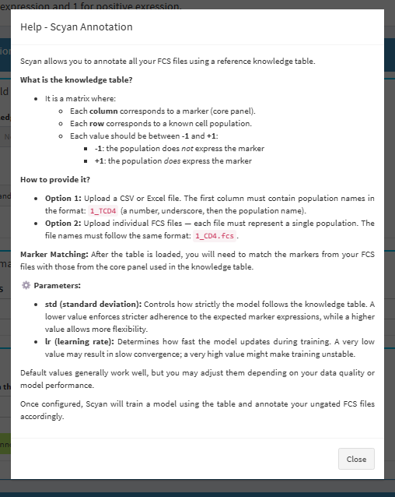
SCYAN ANNOTATION
As with all parts, click on the help button for information on this part.

Slide 33
SCYAN ANNOTATION
What is the knowledge table?
It is a matrix where:
Each row corresponds to a known cell population.
Each value should be between -1 and +1:
-1: the population does not express the marker
+1: the population does express the marker
How to provide it?
Option 1: Upload a CSV or Excel file. The first column must contain population names in the format: 1_TCD4 (a number, underscore, then the population name).
Option 2: Upload individual FCS files — each file must represent a single population. The file names must follow the same format: 1_CD4.fcs.

Slide 34
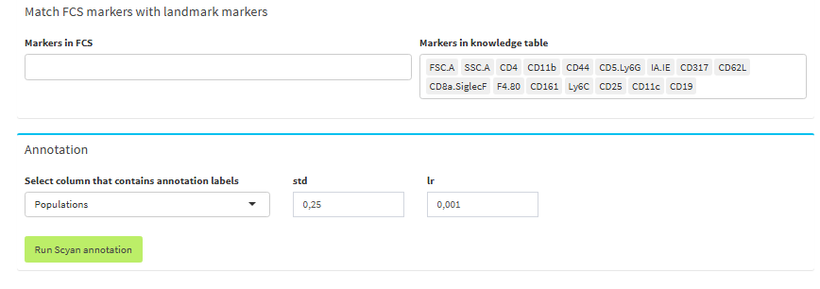
SCYAN ANNOTATION
Marker Matching: After the table is loaded, you will need to match the markers from your FCS files with those from the core panel used in the knowledge table.
⚙️ Parameters:
std (standard deviation): Controls how strictly the model follows the knowledge table. A lower value enforces stricter adherence to the expected marker expressions, while a higher value allows more flexibility.
lr (learning rate): Determines how fast the model updates during training. A very low value may result in slow convergence; a very high value might make training unstable.
Default values generally work well, but you may adjust them depending on your data quality or model performance.
Once configured, Scyan will train a model using the table and annotate your ungated FCS files accordingly.

Slide 35
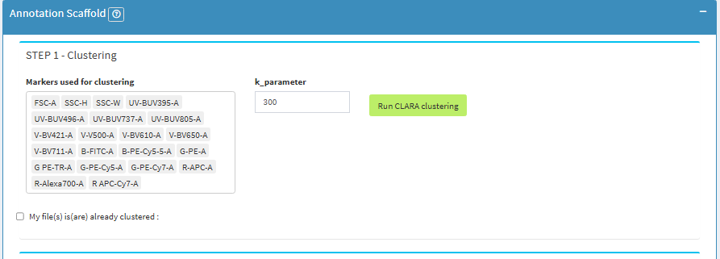
SCAFFOLD ANNOTATION
Step 1 – Clustering:
By default, the clustering algorithm used is CLARA.
Select the markers you want to use for clustering and click Run CLARA clustering.

Slide 36
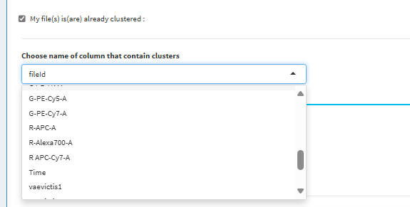
SCAFFOLD ANNOTATION
Step 1 – Clustering:
If your file is already clustered, check the box “My files are already clustered” and select the column that contains the cluster labels.

Slide 37
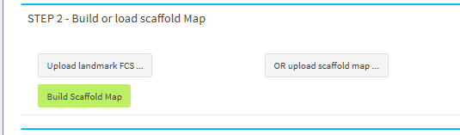
SCAFFOLD ANNOTATION
Step 2 – Build or Load Scaffold Map:
You can build a Scaffold reference map from annotated FCS files.
Each FCS file must contain a single cell population, and the filename should follow the format: 1_TCD4.fcs
(ID number + underscore + population name).
Alternatively, you can upload a previously built Scaffold map if you already have one.

Slide 38
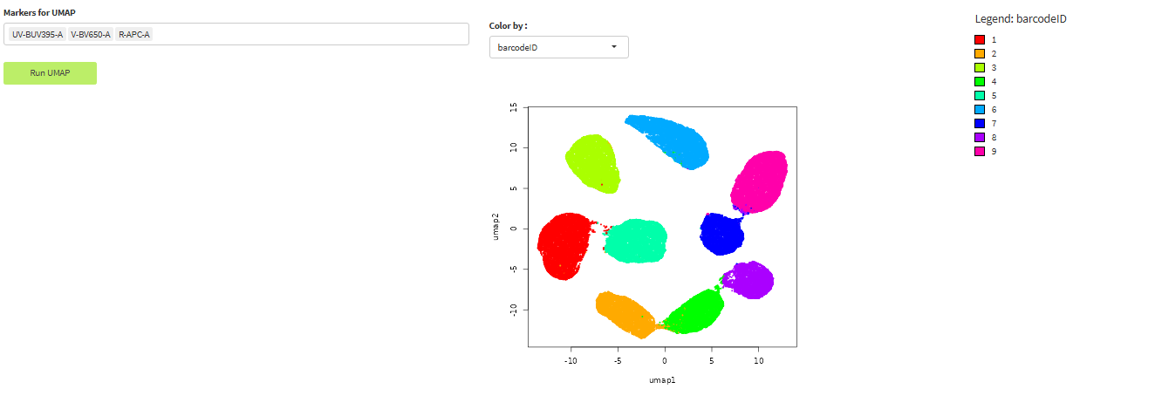
ANNOTATION QC
This section allows you to visually assess the quality of your annotations using UMAP projection.
A subset of all FCS files is used to generate a UMAP embedding.
Annotations (from Scyan or Scaffold) are overlaid on the UMAP for inspection.
If the clustering and annotation look correct, you can apply the annotation to all files by clicking the corresponding button.
This step helps verify that the model-based annotations align with known population structures before full application.

Slide 39
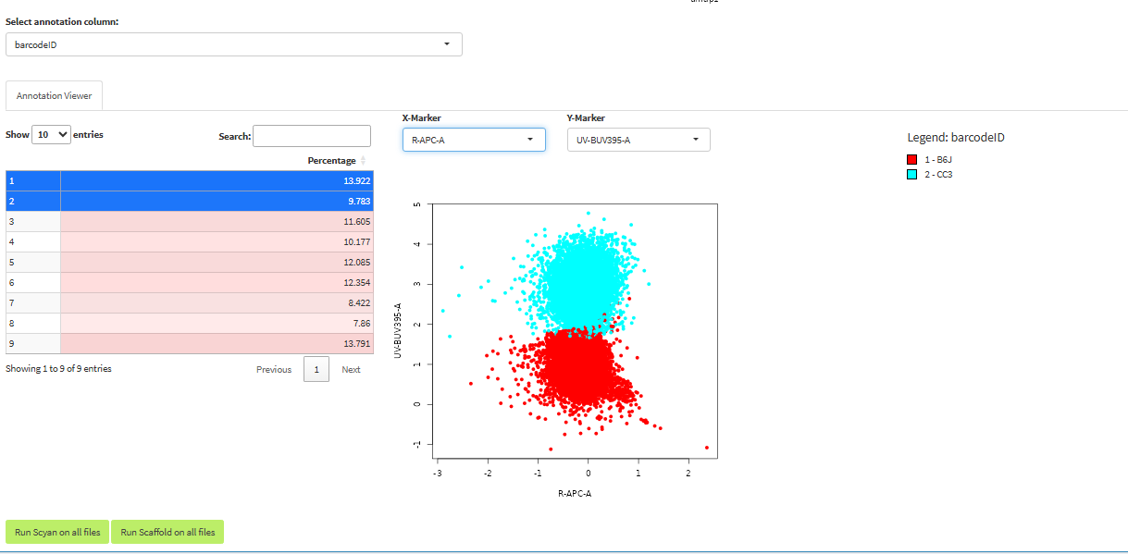
This section allows you to visually assess the quality of your annotations using UMAP projection.
A subset of all FCS files is used to generate a UMAP embedding.
Annotations (from Scyan or Scaffold) are overlaid on the UMAP for inspection.
If the clustering and annotation look correct, you can apply the annotation to all files by clicking the corresponding button.
This step helps verify that the model-based annotations align with known population structures before full application.

Slide 40

If you are satisfied with the results, click on 'Run on all files’ to apply the annotation to all FCS files across your plates.

Slide 41
SECTION 5 : pyInfinityFlow
CIPHE CMP app:
pyInfinity Flow

Slide 42
Help – pyInfinityFlow
The pyInfinityFlow module allows you to predict unmeasured markers based on backbone markers using a deep learning model.
Step 1 – Data setup:
For each plate, upload a TXT file containing plate information.
This file must contain two tab-separated columns:
Infinity_target
Infinity_isotype
Step 2 – Marker selection:
Select core panel markers as backbone markers (used for prediction).
Designate the markers you want to impute as exploratory.
Step 3 – Run pyInfinityFlow:
Select the number of cores to use, based on your machine's capabilities.
Click Run pyInfinityFlow to start the prediction process.
Step 4 – Statistics:
This part allows you to compute statistics either on:
The original measured values, or
The predicted values from pyInfinityFlow.
First, define the positivity threshold for each ISO file to interpret marker expression

Slide 43
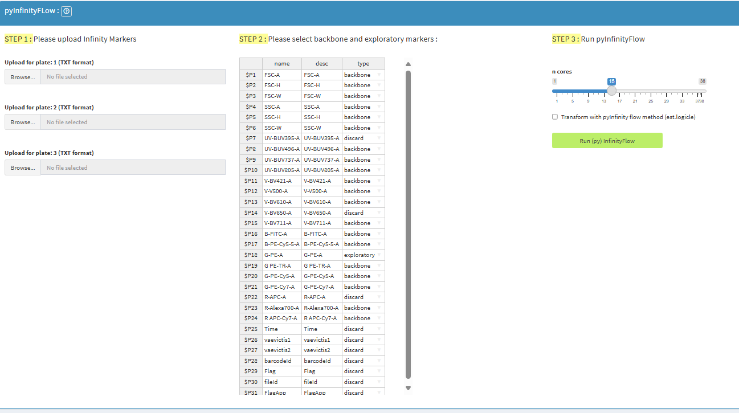
pyInfinityFlow

Slide 44
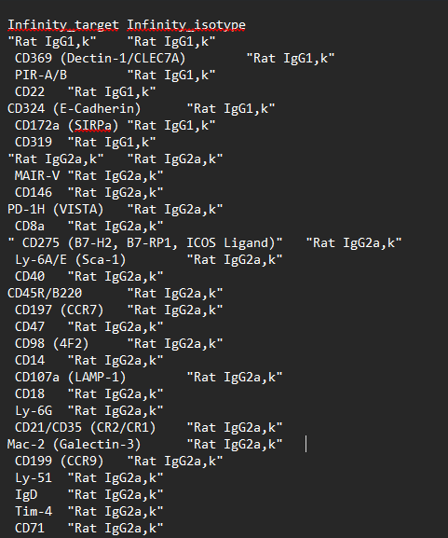
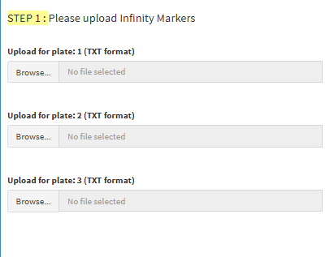
1-pyInfinityFlow
Step 1 – Data setup:
For each plate, upload a TXT file containing plate information.
This file must contain two tab-separated columns:
Infinity_target
Infinity_isotype

Slide 45
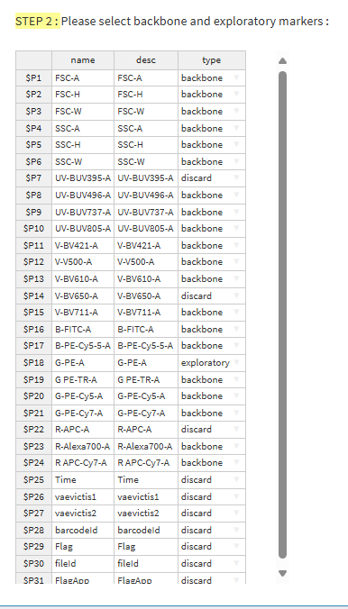
1-pyInfinityFlow
Step 2 – Marker selection:
Select core panel markers as backbone markers (used for prediction).
Designate the markers you want to impute as exploratory.

Slide 46
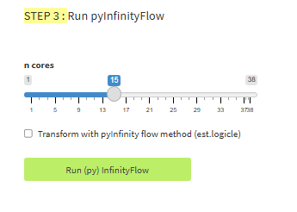
1-pyInfinityFlow
Please indicate the number of cores and check box if you want to transform your data with estimate logicle. If you have already transform your data in section 2-Preprocessing, please do not check box
Step 3 – Run pyInfinityFlow:
Select the number of cores to use, based on your machine's capabilities.
Click Run pyInfinityFlow to start the prediction process.

Slide 47
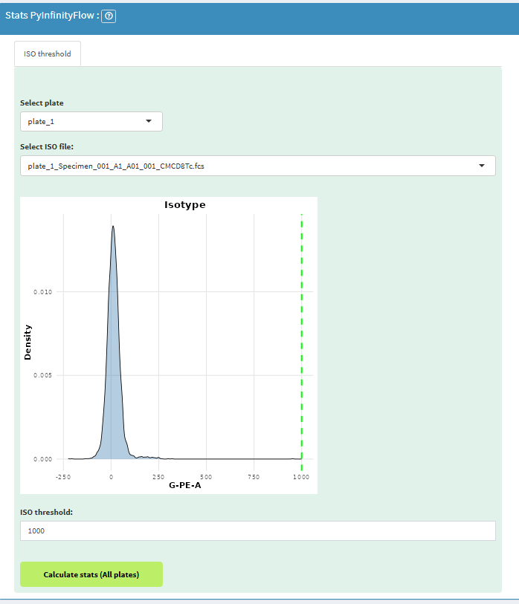
2- Stats pyInfintiyFlow
Step 4 – Statistics:
This part allows you to compute statistics either on:
The original measured values, or
The predicted values from pyInfinityFlow.
First, define the positivity threshold for each ISO file to interpret marker expression.

Slide 48
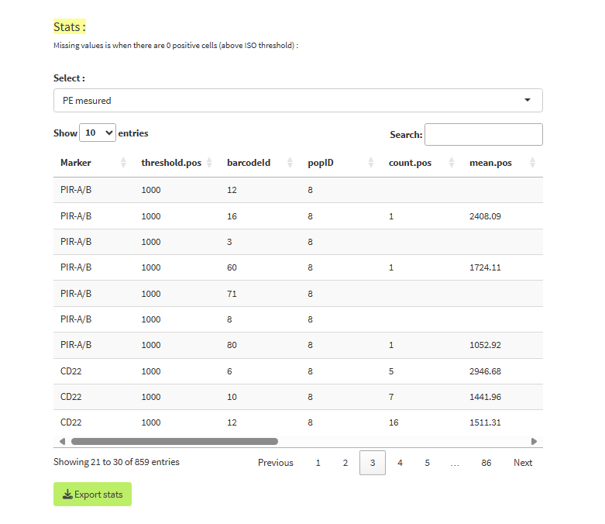
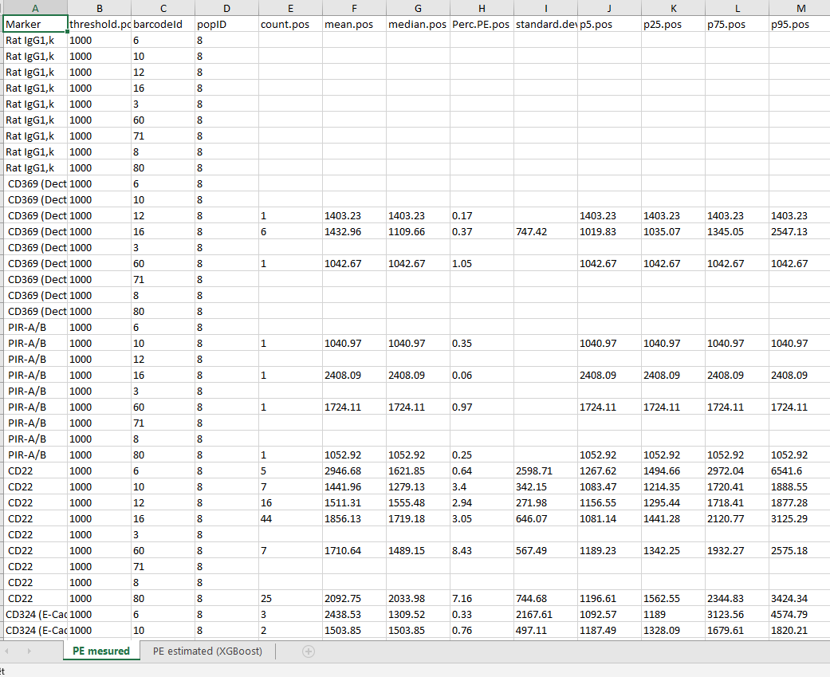
2- Stats pyInfintiyFlow
Calculate and export stats for PE mesured or estimated by pyInfinityFlow

Slide 49
CIPHE CMP app:
Backups

Slide 50
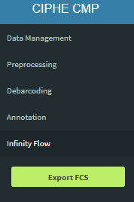
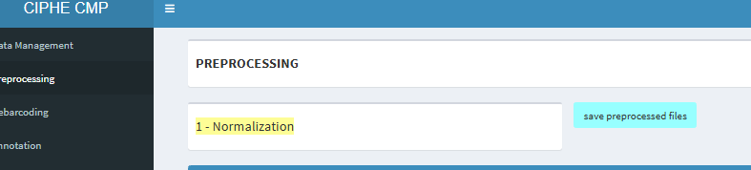
Backups
1 – Save FCS files
2 – Save project
Saves the entire project and everything you've done in the application, so you can continue the analysis later.
Useful for saving only the FCS files of one or more plates for further analysis in another tool.

Slide 51
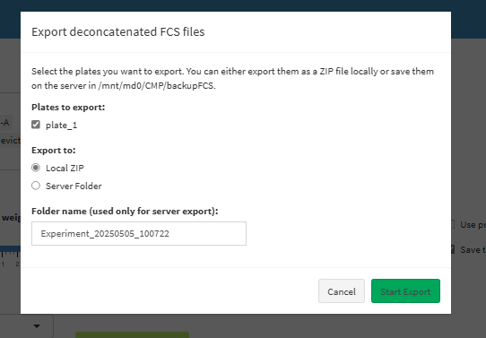
Backups
1 – Save FCS files
Useful for saving only the FCS files of one or more plates for further analysis in another tool.

Slide 52
Backups
2 – Save project
You'll find save buttons for each section (I recommend saving after each minimum section).
Saves the entire project and everything you've done in the application, so you can continue the analysis later.

