Slide 1
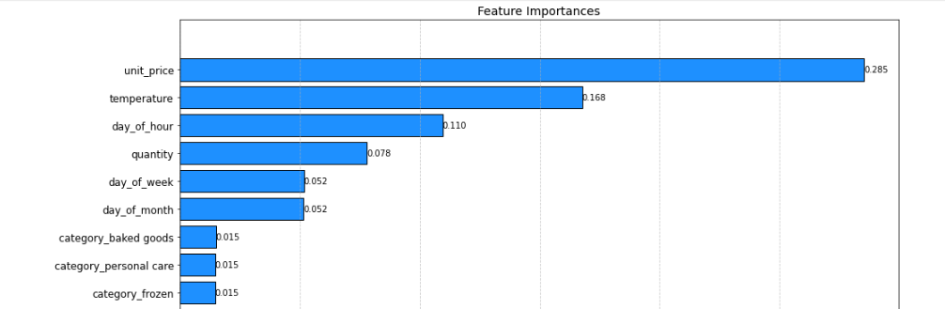
Modeling results & insights
Relative importance of features
Price is important
Unit price was the most important feature in the model when predicting estimated stock percentage.
Item category did not tell us much about stock levels.
More IoT data
Temperature was an important feature in the model. With more IoT data on storage temperature across a longer period, the accuracy of the model is likely to improve.
Productionisation
In order to test this model for production, we need more data across a wider set of features.

