Slide 1
AI Audiences
History enrichment by connecting Identities

Slide 2
Activity Tables used
Sizmek Activity Table
s3://zeta-dcp-prod-private-tables/sizmek_user_activity_daily_parquet/
Zync Activity Table
s3://zeta-dcp-prod-private-tables/zync_user_activity_daily_orc/
Disqus Activity Table
s3://disqus-hive-analytics/tables/user_activity_daily_orc/
sizmek cookie | zcode | count
zync cookie | zcode | count
disqus cookie | zcode | count
Note: These tables involves date ranges

Slide 3
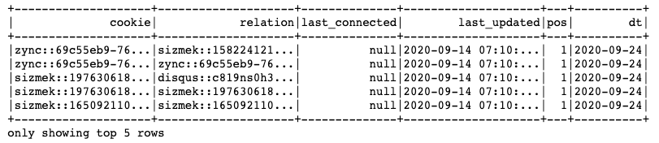
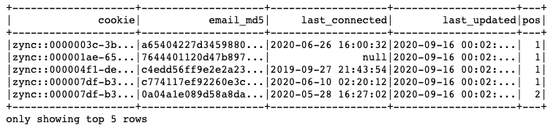
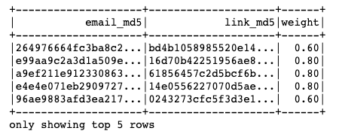
ID Table available:
Cookie Cookie Relations:
s3://zeta-dcp-prod-private-tables/datacloud_cookie_cookies_relations_links_export/
Cookie – Email mappings
s3://zeta-dcp-prod-private-tables/datacloud_cookie_emails_links_export/
Email-Email mappings
s3://zeta-dcp-prod-private-tables/persistent_identifier/pid_email_links/
Note: These tables involves date of processing

Slide 4
ID Table used
Cookie Cookie Relations:
s3://zeta-dcp-prod-private-tables/datacloud_cookie_cookies_relations_links_export/
In V1, We consider
source==zync && destination==Sizmek
Source==disqus && destination==sizmek
We did not consider (but I think we should now)
Source==Sizmek && destination==zync
Source==Sizmek && destination==disqus
source | cookie | destination | cookie
Zync | …… | Sizmek | ……
Disqus | …… | Sizmek | ……
Note: These tables involves date of processing

Slide 5
V1
Processed Sizmek Activity Table
sizmek cookie | zcode | count
Combined Activity table that is
used for AI Audience modeling
sizmek cookie | zcode | count
Processed Zync Activity Table
zync cookie | zcode | count
Cookie Cookie Map
sizmek cookie | zcode | count
sizmek cookie | zcode | count
Processed Disqus Activity Table
disqus cookie | zcode | count
Cookie Cookie Map

Slide 6
ID resolution (cookie-cookie):
In v1 (left image)
(a,1) & (b,1) get rolled up into (1)
(c,2) & (c,3) remain separate (2,3)
In v2 (left image) option to
(a,1) & (b,1) get rolled up into (1)
(c,2) & (c,3) can be rolled up (c’)=(2,3)
In (right image)
(a,1), (b,1), & (c,1) will rollup into (1)
(c,2), (c,3), & (c,1) will rollup into (c’)=(2,3,1)
Hence we will
zync cookie | Sizmek cookie
a | 1
b | 1
c | 2
c | 3
zync cookie | Sizmek cookie
a | 1
b | 1
c | 2
c | 3
c | 1
Notes:
Rolling of cookies
before email mapping, or
After email mapping
For right image:
(1,1,1) will rollup, (2,3,1) will rollup

Slide 7
V2 (step 1)
Processed Sizmek Activity Table
email | sizmek cookie | zcode | count
abc1 | xyz1
sizmek cookie | zcode | count
Cookie Email Map
email | sizmek cookie | zcode | count
NA | xyz2
Processed Zync Activity Table
email | zync cookie | zcode | count
abc3 | xyz3
zync cookie | zcode | count
Cookie Email Map
email | zync cookie | zcode | count
NA | xyz4
Processed Disqus Activity Table
email | disqus cookie | zcode | count
abc5 | xyz5
disqus cookie | zcode | count
Cookie Cookie Map
email | disqus cookie | zcode | count
NA | xyz6

Slide 8
V2 (step 2)
email | sizmek cookie | zcode | count
abc1 | xyz1
email | zync cookie | zcode | count
abc3 | xyz3
Processed Sizmek Activity Table (from step1)
email | disqus cookie | zcode | count
abc5 | xyz5
email | sizmek cookie | zcode | count
NA
email | sizmek cookie | zcode | count
NA | xyz2
Processed Zync Activity Table (from step1)
email | zync cookie | zcode | count
NA
Cookie Cookie Map
email | sizmek cookie | zcode | count
NA | xyz4
email | sizmek cookie | zcode | count
NA | xyz6
Processed Disqus Activity Table (from step1)
email | diqus cookie | zcode | count
NA
Cookie Cookie Map
Combined Activity table that is
used for AI Audience modeling

Slide 9
Cookie-cookie match rate: (very low in single step) 0.2% to .4%
Cookie-email match rate: (ok, as expected): ranged from 10 to 20%
Higher on Zync side
History enrichment (need to run again)
current run measured decrease in sparsity on an overall matrix,
All analysis did on “dt=2020-10-12” or before
30, 60, and 90 days
However from todays’ run, dt=2020-11-15,
Stats seems to have gone up
Bigger cookie-cookie relations (~3X)
Bigger email-cookie relations (~3X)
Bigger email-email relations (~3X)
The activity table however looks similar in size
Notes:
Match rate goes up slightly with larger dates….
Match rate is slightly higher in the first 30 days, vs the middle 30 days vs the last 30 days

Slide 10
To use Email-Email mapping
Reasons not done:
Large table, hence large Processing time
Large due to high order connections
Identification rate on activity table may not justify
Bucketing approach may not justify
email | link
a | x
b | x
c | y
y | z
a | z

Slide 11
My conclusions
Single degree connections (cookie-cookie, cookie-email) do not add much expense and can be used. Though the Bucket
Need to revisit the observations again after implementing incremental training
To understand the behavior under incremental training
Email-email and higher degree connections should be explored once we move from bucket approach to

Slide 12
ID resolution rate
History enrichment factor
Calc rmse

