Slide 1
StyleGAN 2
David Rose

Slide 2
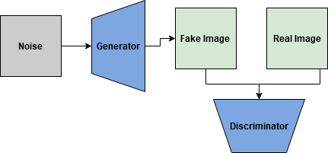
What is a GAN?
Generator
Make images from noise (“latent variables”)
Discriminator
Distinguish between generated and real images
Like a basic sigmoid classification model

